Slide 1
What industry do you want to work for?
trying to find out which industry is growing,
based on PR News
Oct 2018
Jiwon, Cha

Slide 2

PR(Public Relations)
Using the news or business press to carry positive stories about your company or your products; cultivating a good relationship with local press representatives.

Slide 3


Basic Idea
The more, The better
Growing industries publishes more PR News.
More PR News
Less PR News

Slide 4
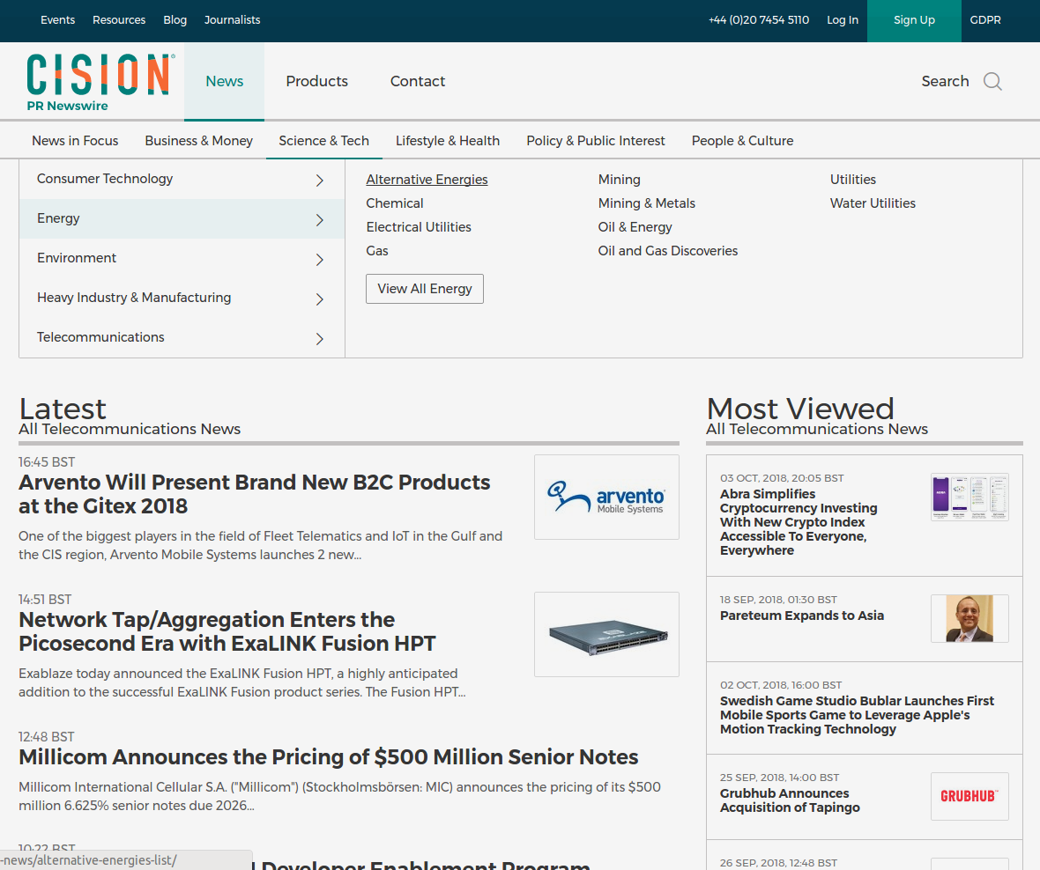
Web scraping
http://www.prnewswire.co.uk
177 Industries
95459 news
From April to October – 2018
34Mb (News Title only)
Industry | News Title | Release Date
Blockchain | Millicom Announces... | 10/11/2018 13:00:00
Chemical | ... | ...
Blockchain | ... | ...
Mining | ... | ...

Slide 5
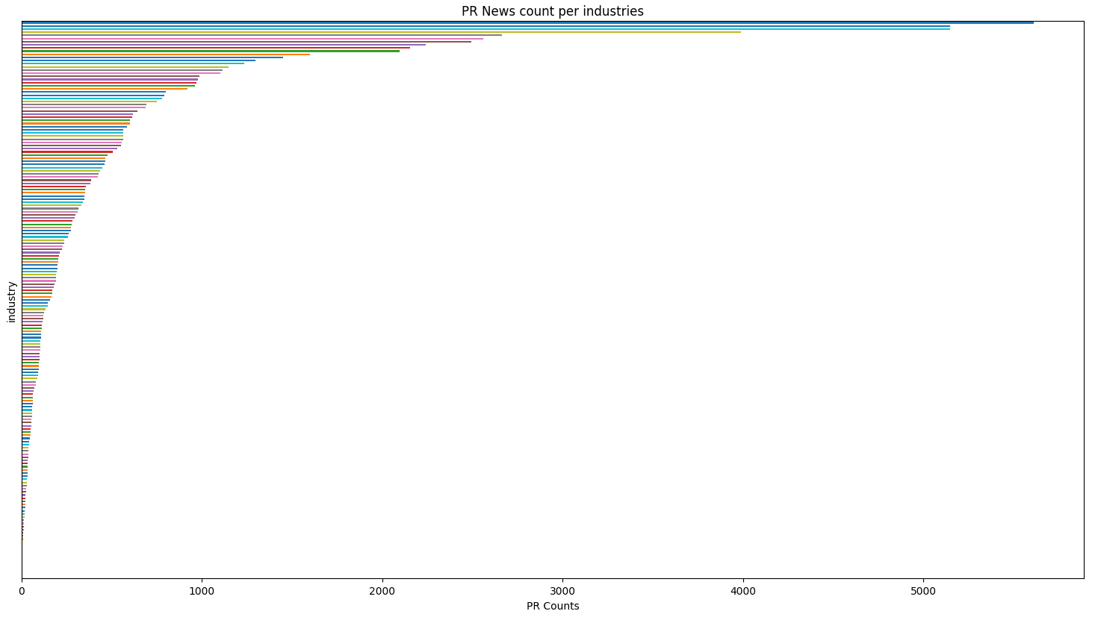
PR News Count
Industry
Number of PR

Slide 6
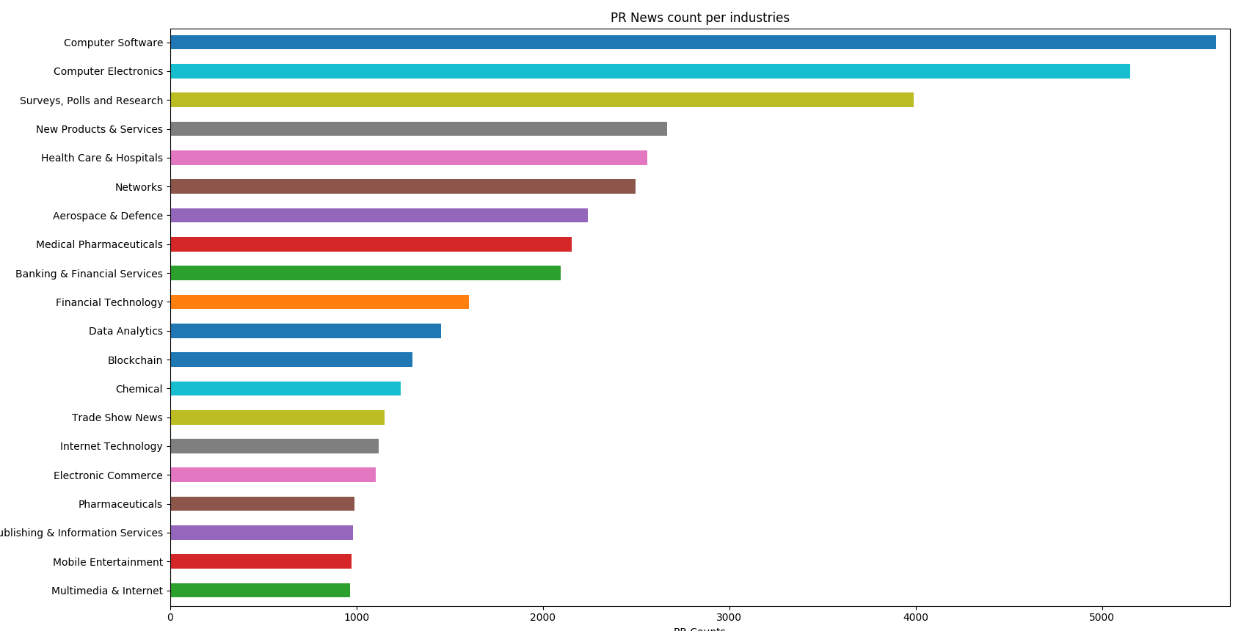
Top

Slide 7
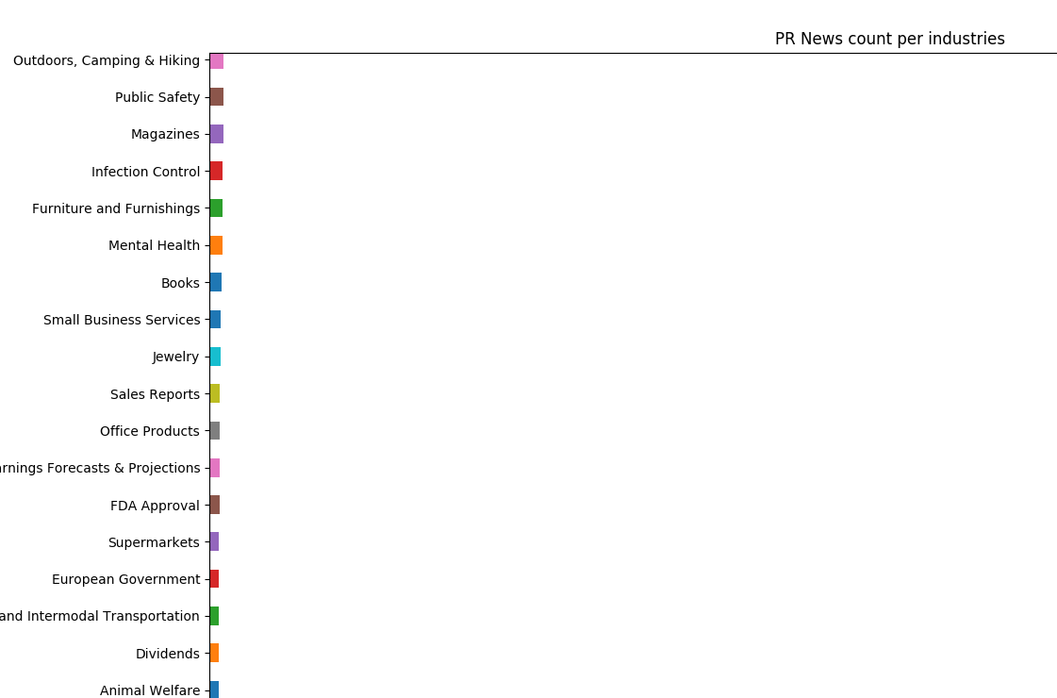
Bottom

Slide 8
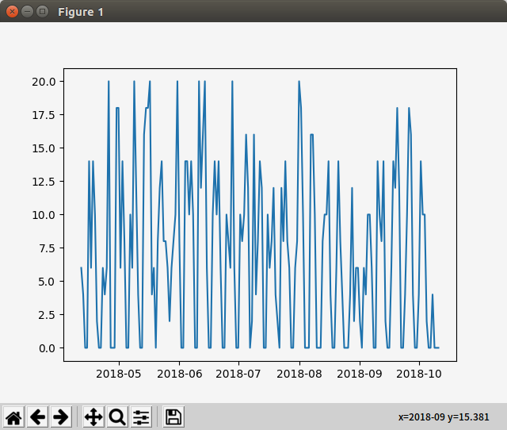
Lets find trend for each industry.
Plot for Blockchain Industry

Slide 9

Nature of PR news...
"""
day_of_week
Friday 9370
Monday 14824
Saturday 590
Sunday 711
Thursday 17890
Tuesday 18448
Wednesday 17126
"""

Slide 10

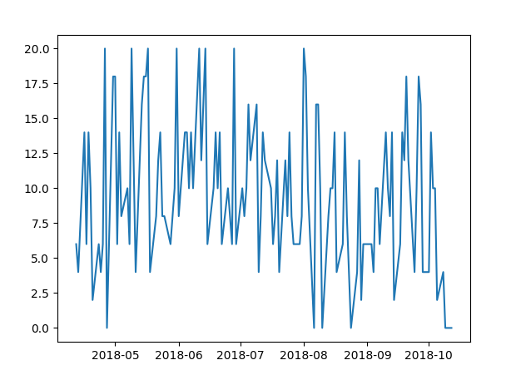

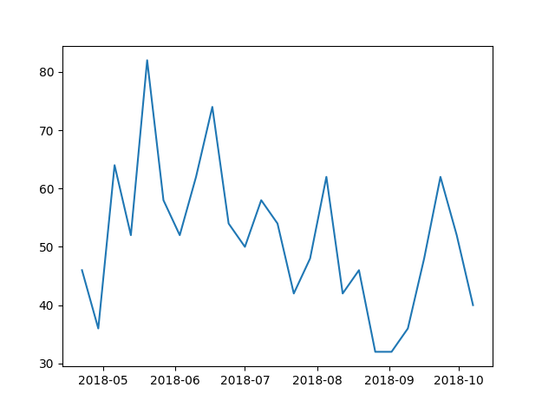

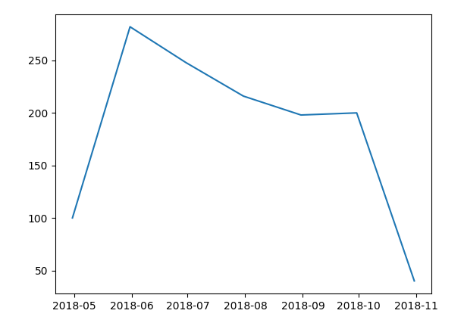
Can you see the trend?
Removed weekends
Resampled (weekly)
Resampled (Monthly)

Slide 11
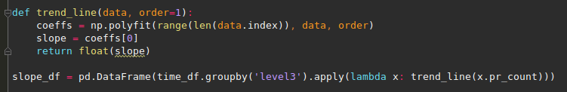
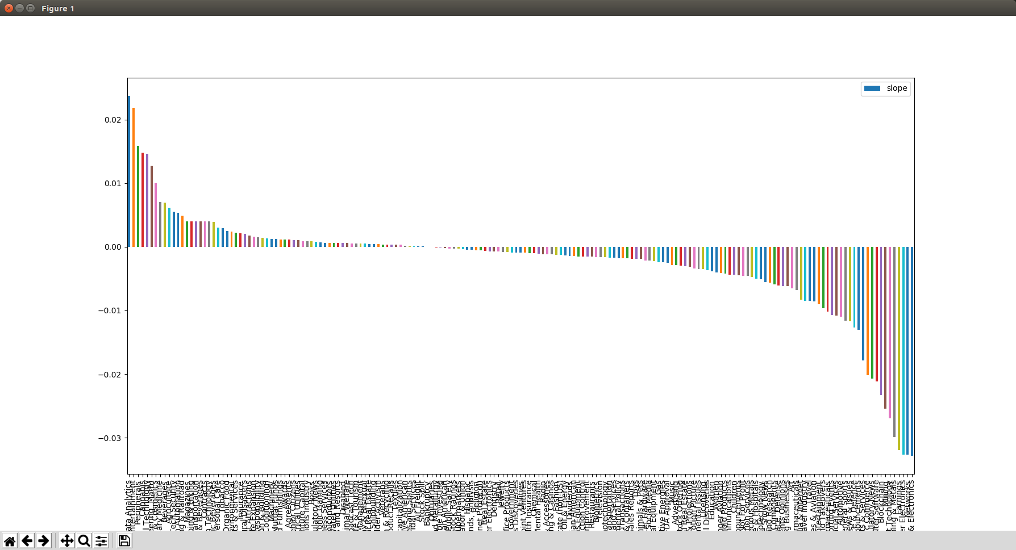
PR News count trend per industries

Slide 12
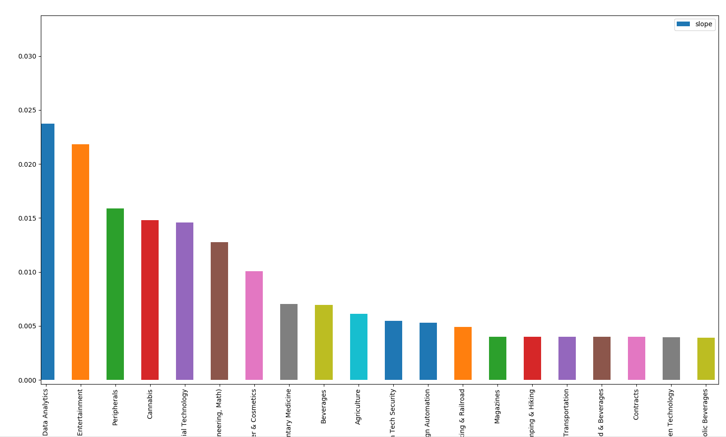
Top

Slide 13
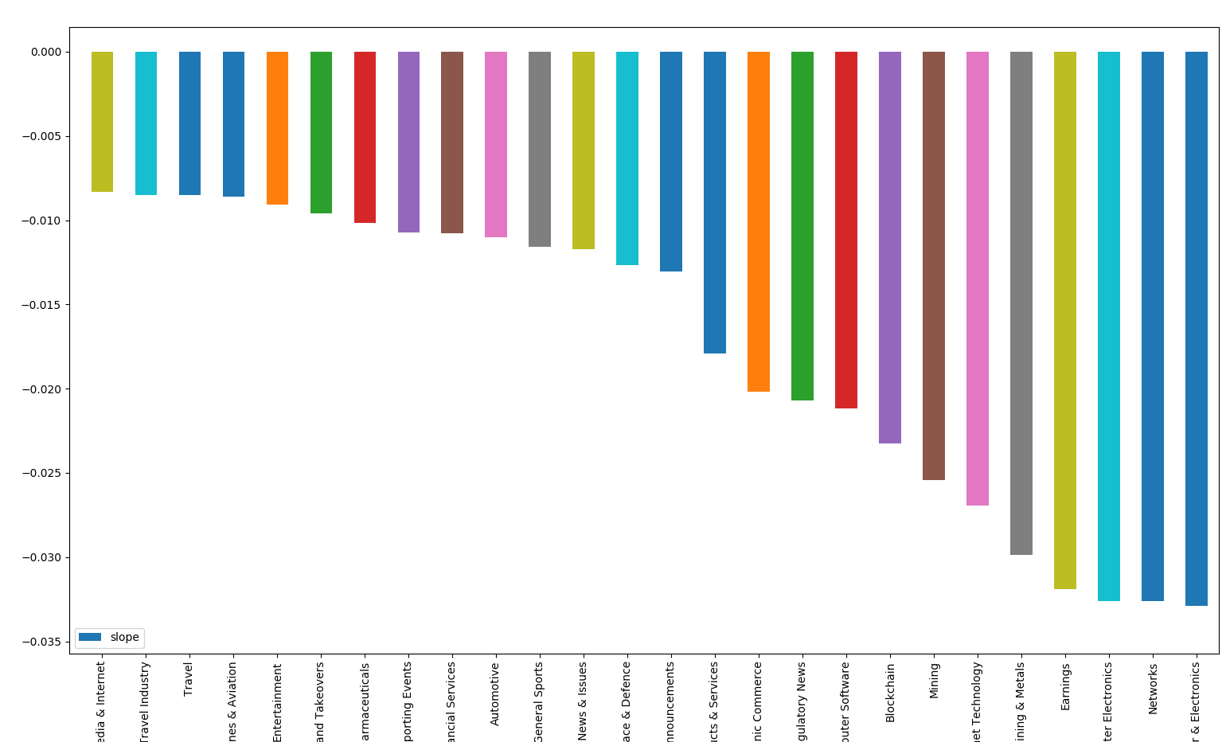
Bottom

Slide 14
We need to see 2 variables at the same time
Industry against PR Count
Industry against trend
3D Plot

Slide 15
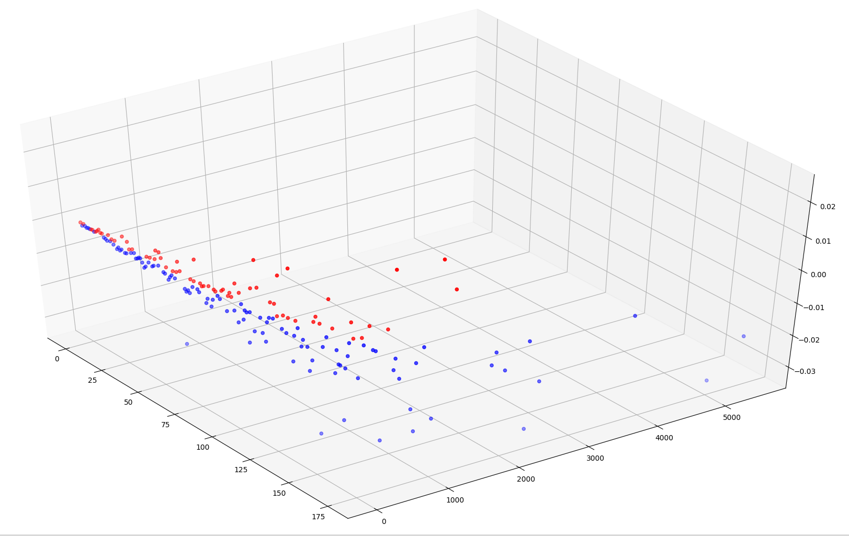
So, What industries have the most promising future?
High rank in PR_Count + Upward slope = good industry
Z: Trend
X: Industry
Y: PR Count

Slide 16
What industry do you want to work for?
High rank in PR count, Upward trend
Good!!!
Data Analytics
Financial Technology
High rank in PR count, but, Downward trend
Blockchain
Networks
Computer Electronics
Watch out!!!

Slide 17
Future Improvements
Implementing DB storage for daily batch
NLP for categorization

