Slide 1
Retail Sales & Business Performance Analysis
Power BI / DAX analysis of retail invoice data
Retail Invoice Dataset | January 2025 – August 2026
Net Sales
Profit
Invoices
Customers
40.10M
8.95M
575
364
Arbor Data Analytics | Power BI Project
Retail Sales & Business Performance Analysis | Power BI
1

Slide 2
Project Scope & Business Questions
The analysis is organized around six management questions.
01
02
03
Discount impact
Seasonality
Basket behavior
How does discounting relate to sales volume and order value?
How much uplift occurs during festive campaigns?
Do multi-item baskets create higher value?
04
05
06
Profit erosion
Regional performance
Revenue leakage
How does discounting affect profitability?
Which states and cities contribute most?
Where are returns and cancellations concentrated?
Workflow: Excel → Data Cleaning → Data Modeling → DAX → Power BI → Business Insights
Retail Sales & Business Performance Analysis | Power BI
2

Slide 3
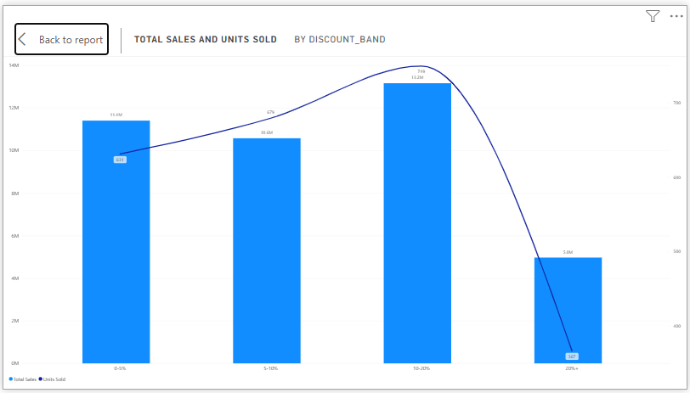
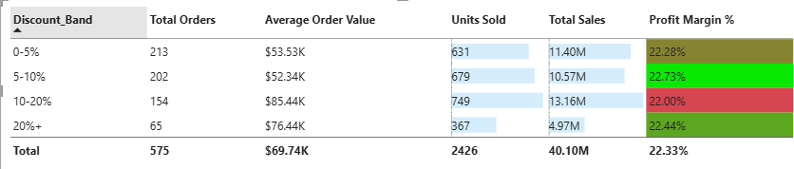
Discount Impact on Sales Volume
Power BI page: Discount Impact | Moderate discounting shows the strongest sales-volume combination.
Peak Sales Band
Peak Units
₹13.16M
749
Peak AOV
20%+ Orders
₹85.44K
65
Interpretation
• 10–20% delivers the highest sales and units.
• 20%+ discounting does not continue the upward trend.
• The relationship between discount and sales is not linear.
Retail Sales & Business Performance Analysis | Power BI
4

Slide 4
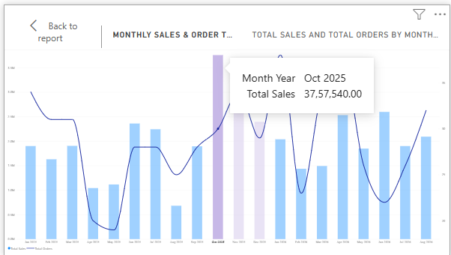
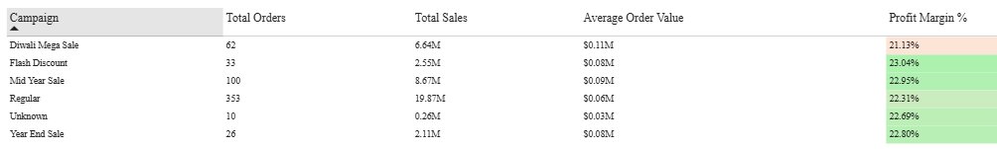
Festive & Seasonal Analysis
Peak Month
Power BI page: Seasonality | October–December 2025 shows a strong sales and order-value uplift.
Oct 2025 · ₹37.57L
Diwali Mega Sale
₹6.64M net sales
Year End Sale
₹2.11M
Retail Sales & Business Performance Analysis | Power BI
5

Slide 5
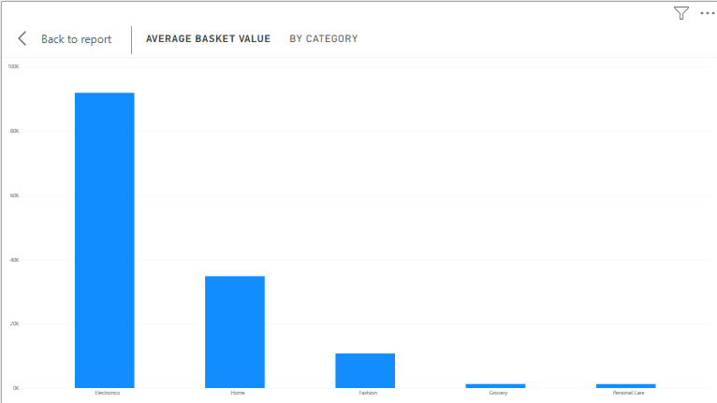
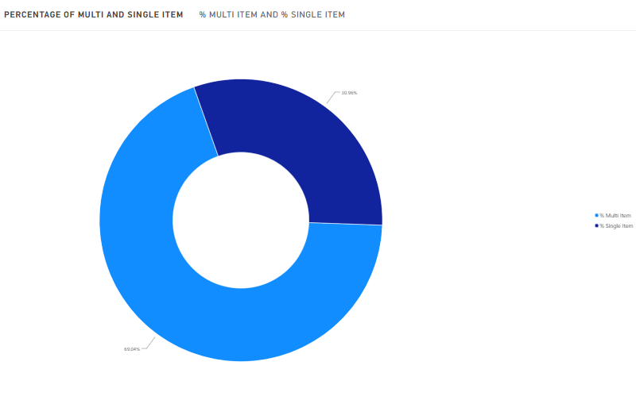
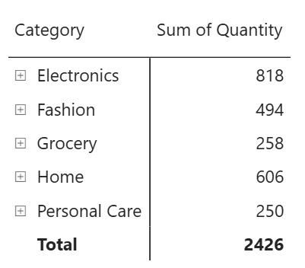
Basket Size & Combo Analysis
Power BI page: Avarage basket size + combo analysis | Multi-item baskets are the dominant value driver.
Average basket value by catagory
Single-item
Multi-item
Overall single and multi item
178 item
397 item
575 items
Average basket size
4.22
Category pairs appearing most frequently
Business implication: use high-frequency category pairs for bundling, cross-selling and personalized recommendations.
Retail Sales & Business Performance Analysis | Power BI
6

Slide 6
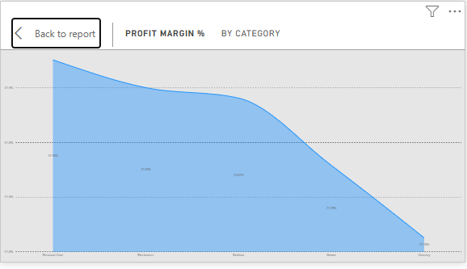
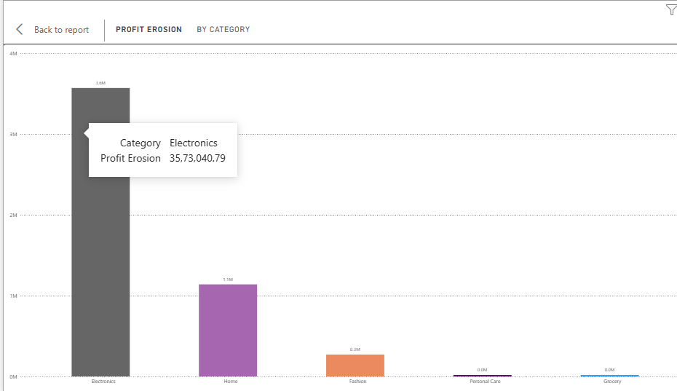
Profit Erosion & Discount Trade-off
Power BI page: Profit Erosion | The key issue is balancing incremental sales against margin.
Gross profit
Discounts%
Actual Profit
Profit Margin
₹13.97M
10.72%
8.95M
22.33%
Retail Sales & Business Performance Analysis | Power BI
7

Slide 7
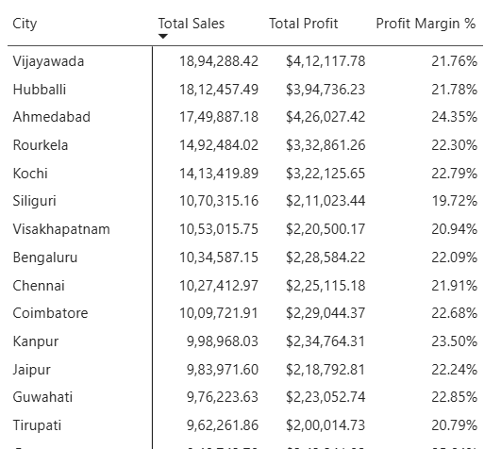
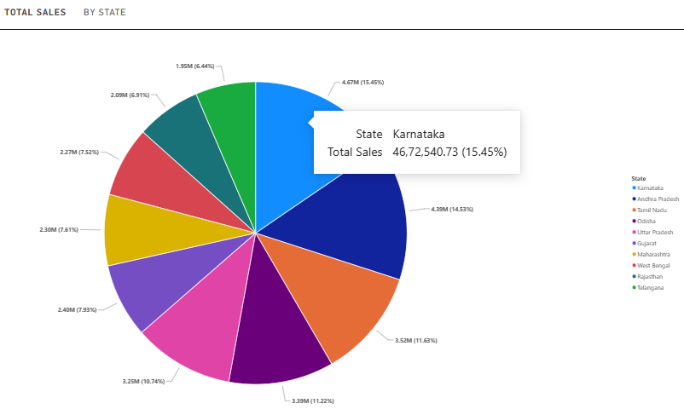
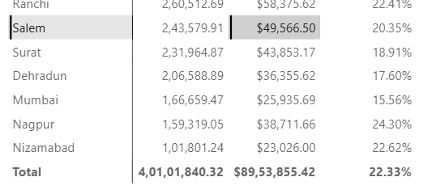
Regional Performance
Power BI page: Regional Performance | Revenue is concentrated across a set of leading states and cities.
Retail Sales & Business Performance Analysis | Power BI
8

Slide 8
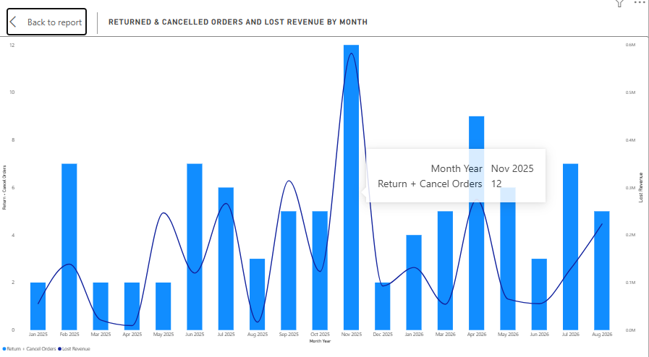
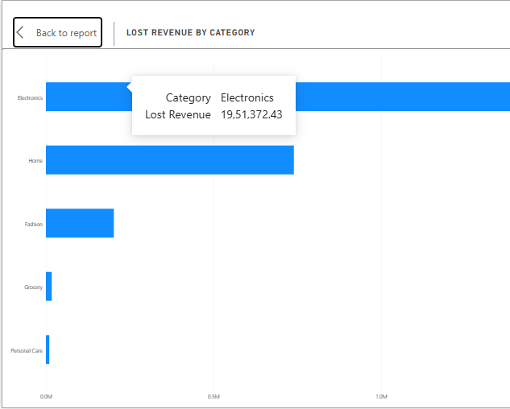
Returns, Cancellations & Revenue Leakage
Power BI page: Returns & Leakage | 46 invoices are affected by returns/cancellations.
Cancelled Orders
Returned Orders
Cancel return rate
Leakage
57
37
94
₹33.25L
Electronics contributes ≈59% of associated return/cancellation revenue; November 2025 records the largest monthly leakage at ₹5.83L.
Retail Sales & Business Performance Analysis | Power BI
9

Slide 9
Conclusion
The project converts invoice-level transactions into a management view of growth, profitability and leakage.
1
Sales
₹4.06 Cr net sales and ₹90.65L profit.
2
Product
Electronics contributes approximately 70% of sales.
3
Customer
Multi-item baskets dominate and carry much higher average value.
4
Promotion
10–20% discounts and festive campaigns are associated with strong sales performance; margin must be tracked alongside volume.
5
Leakage
≈8% of invoices are affected by returns/cancellations, with Electronics contributing the largest associated revenue.
The biggest opportunity is balancing sales growth with basket expansion, controlled discounting, regional optimization and reduction of revenue leakage.
Retail Sales & Business Performance Analysis | Power BI
13

