Slide 1
AJAX
Asynchronous JavaScript And XML
  This is technique that was coined in Feb. 2005 but that has been used (more or less) for quite a while before that
  It allows the client and the server to communicate without requiring a "hard" submit and page refresh
    In particular, the page can be updated without reloading it in its entirety
  Makes the user interface for a Web app. appear more like that of a desktop app
  See: http://en.wikipedia.org/wiki/AJAX
        http://developer.mozilla.org/en/docs/AJAX
Lecture 13_AJAX

Slide 2
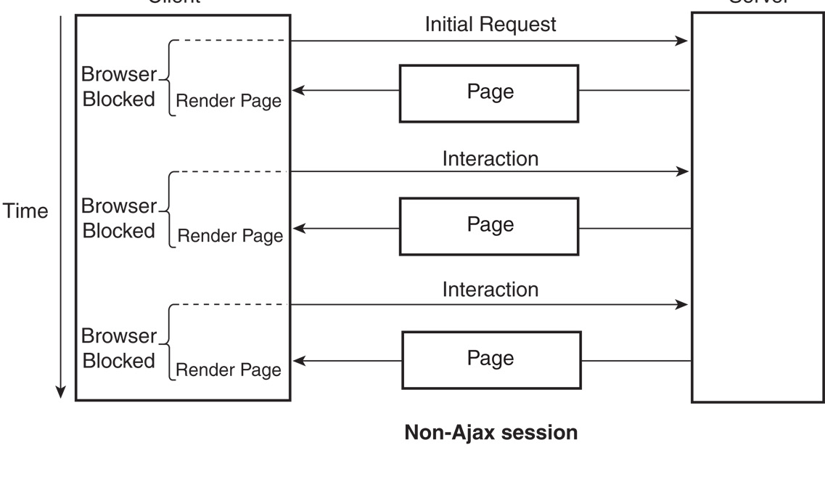
Lecture 13_AJAX

Slide 3
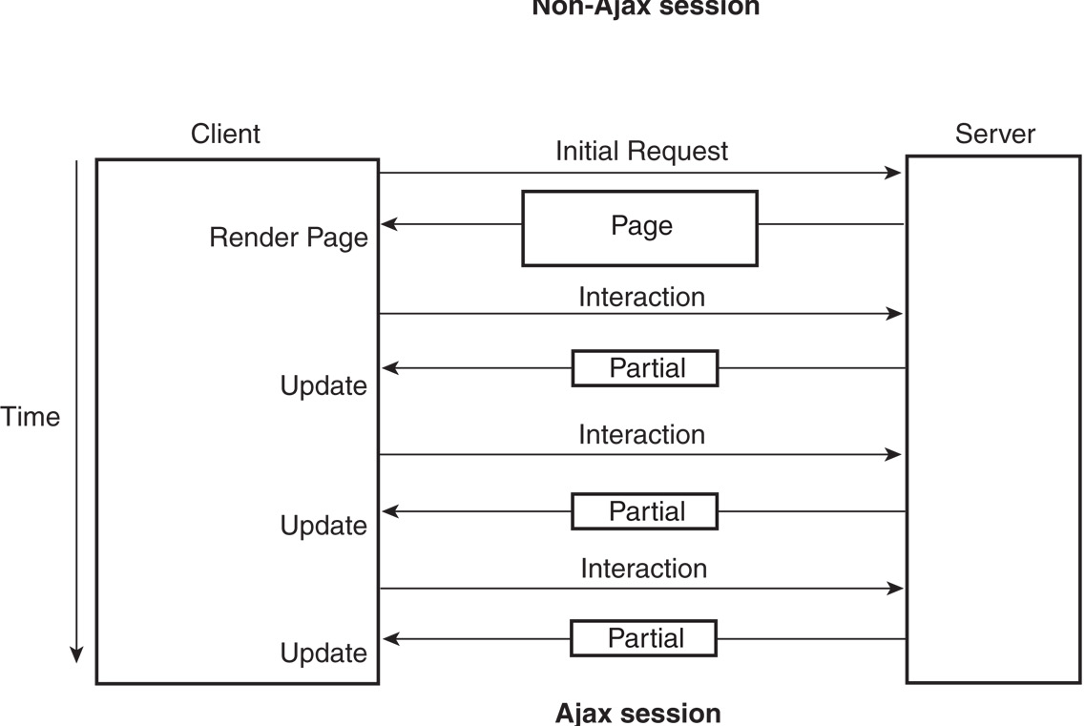
AJAX session
Lecture 13_AJAX

Slide 4
AJAX
  Let's look at a few details and some simple examples
    You may also want to research it on your own
  AJAX centers around the XMLHttpRequest object
  This object allows the client to connect to a server and to respond to the reply once it has become available
  There is a lot that can be done with this, especially in conjunction with XML and JSON – we will mention these later
Lecture 13_AJAX

Slide 5
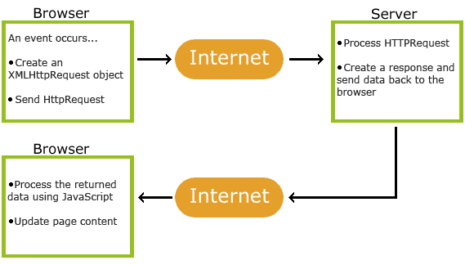
How AJAX works.
Lecture 13_AJAX

Slide 6
Ajax application
Ajax application has 4 parts:
  An HTML document to produce initial display
  A JavaScript script to produce Ajax request of server
  A Server-side program to receive request and produce requested data
  JavaScript script to receive new data from server and integrate it into original document
Lecture 13_AJAX

Slide 7
AJAX
  It is a bit tricky to use, and is not consistent across all browsers (esp. older versions)
  However, once you get the hang of it, it can be a very useful tool and it is REALLY COOL!
Basic Idea:
  Programmer creates an instance of an XMLHttpRequest object
  Several useful attributes and methods are associated with this object:
    see: http://www.w3.org/TR/XMLHttpRequest/
    Let's look at a few of them to see how they work together
Lecture 13_AJAX

Slide 8
How to make an HTTP request
To make a request:
var httpRequest;
if (window.XMLHttpRequest) { // Mozilla, Safari, IE7+ ... httpRequest = new XMLHttpRequest(); }
else if (window.ActiveXObject) { // IE 6 and older httpRequest = new ActiveXObject("Microsoft.XMLHTTP");
Actually make the request:
httpRequest.open('GET', 'http://www.example.org/some.file', true);
httpRequest.send(null);
Lecture 13_AJAX

Slide 9
Make an HTTP request
What to do after you receive the server response
httpRequest.onreadystatechange = nameOfTheFunction
httpRequest.onreadystatechange = function(){ // process the server response
Lecture 13_AJAX

Slide 10
Handling the server response
What should function do?
if (httpRequest.readyState === 4) { // everything is good, the response is received }
else { // still not ready }
Lecture 13_AJAX

Slide 11
Full list of readyState values
0 (uninitialized)
1 (loading)
2 (loaded)
3 (interactive)
4 (complete)
Lecture 13_AJAX

Slide 12
Check the response code of the HTTP server response
if (httpRequest.status === 200)
  { // perfect! }
else {
  // there was a problem with the request,
  // for example the response may contain a 404 (Not Found)
  // or 500 (Internal Server Error) response code }
Lecture 13_AJAX

Slide 13
Attributes of XMLHttpRequest object
onreadystatechange
  Attribute to which we assign an EventListener (which is a function callback)
  This will associate the function with the occurrence of the readystatechange event
    This event fires in several places, throughout the the execution (each time the state changes)
    We can check the readyState to see what, if anything, we will do in response – more on this soon
Lecture 13_AJAX

Slide 14
Attributes of XMLHttpRequest object
open(method, url, async)
    Where "method" is an HTTP method
    Where "url" is the location of the server
    Where "async" is a boolean to determine if the transfer is to be done asynchronously or not
      Method to switch the object to the open state – i.e. get ready to send data to the server
Lecture 13_AJAX

Slide 15
Attributes of XMLHttpRequest object
  send(data)
      Where "data" is a the information to be sent to the server
      Can be formatted in various ways, with different encodings
      Ex: var=value pair query string (like what you see in the URL of a form submitted via GET)
    Sends the data to the server, where (maybe) a script may run and the response is sent back
Lecture 13_AJAX

Slide 16
Attributes of XMLHttpRequest object
  readyState
      Attribute that stores the current state of the object
      Changes throughout the execution:
        0 → uninitialized
        1 → loading
        2 → loaded
        3 → interactive
        4 → complete
Lecture 13_AJAX

Slide 17
AJAX
  status
      Did everything work correctly?
        200 – yes it did
        404 – Not found
        500 – internal server error
        For more codes, see
        http://www.w3.org/Protocols/rfc2616/rfc2616-sec10.html
  responseType
      What type of data did the server send back to the client?
  response, responseText, responseXML
      Get the data that was returned
      We can parse this to utilize the data to update our page
Lecture 13_AJAX

Slide 18
AJAX
  Big Picture:
    The XMLHttpRequest object enables us to interact with the server "behind the scenes" and update our web page accordingly
    Server can still execute scripts as before (ex: PHP), but now it will send updates to the CURRENT page rather than an entirely new page
  Let's look at a simple example
    MozDemo.html – from Mozilla devel. Site
    MozDemo-1.html
    MoxDemo2.html
      Just demonstrates the basics of AJAX
Lecture 13_AJAX

Slide 19
AJAX
  Ok, that example was very simple
  In a real situation, the response from the server will require us to update our local page, possibly in a significant way
    How to do this? document.writeln()?
      Only works during initial rendering of the page
    Using DOM? Yes!
      First we will look simply at HTML
        Later we will look at XML and JSON
      See: http://www.w3schools.com/htmldom/default.asp
    Idea: If we treat our local Web page as an object, then we can modify in response to data sent back by the server
Lecture 13_AJAX

Slide 20
AJAX and DOM
  For example, consider the methods /attributes for accessing/modifying data in an HTML table:
    First we need to get the table itself
      If we assign it an "id" attribute, we can use the method getElementById()
    We may then want a particular row
      We can use the rows[] array
    We may then want a specific cell
      We can use the cells[] array from the row
    And we may want to modify that cell
      We can use the innerHTML attribute
        Not true DOM – see handout for another way
    See CDpoll.php and tabulate.php
Lecture 13_AJAX

Slide 21
AJAX and DOM
  However, what if we want to make more significant changes?
  Ex: Add a new row to a table
    Get the table again
    Insert a new row
      Use insertRow()
    Insert a new cell
      Use insertCell()
    Add the data to the cell
      Use createTextNode() for text
        More complex for the radio button – see handout
      Use appendChild()e
Lecture 13_AJAX

Slide 22
INCONSISTENCY - AJAX
  Be aware that AJAX can update data locally and can cause inconsistency with data at server
  For example, consider 2 clients both running CDpoll.php
    Client 1 then adds a new write-in choice
    Client 2 also adds a new write-in choice
    Both of these update the server DB, so any new client will show them
    However, Client 1 will not show Client 2’s new choice and vice-versa
Lecture 13_AJAX

Slide 23
INCONSISTENCY - AJAX
So we need to either
  Get updates from as well as make updates to the server with each connection
    But this may require a lot of work at each connection
    See CDpoll2.php and tabulate2.php
  Design our program in such a way that we only need to “sync” with the server occasionally
    Updates from one client do not affect another
  Use the server to read from but not to write to
    Consistency is not a problem if data does not change
Lecture 13_AJAX

Slide 24
\
CONSISTENCY
  One way to keep a page updated is to have it automatically connect to a server for new information
  We can do this with our CD poll so that even if the user does not enter a new CD, we will still see entries that other users have entered
  This can be done in a fairly simple way utilizing:
    AJAX requests
    A Javascript timer
Lecture 13_AJAX

Slide 25
\
CONSISTENCY
  When the page is loaded the timer starts
  When it “goes off” an AJAX request is triggered to check with the server for any new CD entries
    The timer is then reset for the next request
  See CDpoll-update.php and
  tabulate-update.php
    Note that we now have some consistency concerns to consider
Lecture 13_AJAX

Slide 26
\
Example
Consider the following scenario:
    Timer goes off to update the page
    Before the result is posted to the table, the user enters a new CD into the poll (generating another request)
  In this situation, both requests will send back new rows for the table, and the table will be updated twice
  Note that the DB will still be consistent
    What is not consistent is the client
  We can prevent this with some simple synchronization
    See CDpoll-update.php
Lecture 13_AJAX

Slide 27
XML
So far our AJAX examples have used responseText
Where does the XML come in?
AJAX these days also utilizes JSON objects as a response
  What are these and how are they used?
We will talk about XML now and JSON a bit later on
Lecture 13_AJAX

