Slide 1

Secure Optical V2V Communication using Lifi for Defence and Military Vehicles
Batch Number : 7 IOT ALPHA
S.Sri Mani Chandra Reddy - (2411CS050083)
B.Srikar - (2411CS050077)
Ch.Bhageerath - (2411CS050079)
T.Rakesh - (2411CS050062)
M.Sai Darshan Reddy - (2411CS050081)
A.Deepak - (2411CS050084)
M.Mani Ranga Reddy - (2411CS050027)
U.Avinash - (2411CS050087)
Year / Semester: 3/ I
Branch / Section: CSE-IOT / Alpha
Under the Esteemed Guidance of
DR. Ome Nerella ( Associate Professor,
CSE-IOT)

Slide 2
ABSTRACT:
Vehicle-to-Vehicle (V2V) communication is an important technology for developing intelligent transportation systems, where vehicles exchange information with one another to improve road safety, traffic efficiency, and driving experience.
Traditional V2V communication technologies mainly depend on radio-frequency (RF) technologies such as Wi-Fi, Dedicated Short-Range Communication (DSRC), and cellular networks.
However, these technologies can face challenges such as spectrum congestion, electromagnetic interference, limited bandwidth, and security concerns. To overcome some of these limitations, Light Fidelity (Li-Fi) can be used as an alternative communication technology for vehicle-to-vehicle communication.
Li-Fi is a high-speed wireless communication technology that uses visible light, infrared light, or other optical sources to transmit data.

Slide 3
INTRODUCTION
Vehicle-to-Vehicle (V2V) communication enables vehicles to exchange information directly with nearby vehicles using wireless communication technologies.
It allows vehicles to share speed, position, direction, braking status, and road-safety information.
The primary objective of V2V communication is to improve road safety by providing early warnings about dangerous situations.
Vehicles can notify nearby vehicles about sudden braking, collisions, obstacles, or hazardous road conditions.
V2V communication is an important component of Intelligent Transportation Systems (ITS) and connected-vehicle technology.
It supports safer, smarter, and more efficient transportation by enabling vehicles to cooperate with each other.

Slide 4
LITERATURE SURVEY
Early research focused on Vehicular Ad Hoc Networks (VANETs), where vehicles communicate dynamically without permanent network connections.
Researchers studied routing, network topology, message broadcasting, and communication reliability in highly mobile environments.
DSRC and IEEE 802.11p became important technologies for early V2V safety applications.
Research demonstrated their potential for collision warnings, emergency braking alerts, traffic information, and cooperative driving
Visible Light Communication (VLC) and Li-Fi have emerged as alternative approaches for V2V communication.
Vehicle headlights and taillights can transmit data through rapidly modulated light signals to nearby vehicles.

Slide 5
SYSTEM ANALYSIS
Existing System | Proposed Li-Fi V2V System
Uses RF/cellular/DSRC technologies | Uses visible light for communication
Can experience RF interference | Very low electromagnetic interference
May require communication infrastructure | Direct vehicle-to-vehicle communication
Network congestion can affect performance | Dedicated optical communication channel
Radio communication can have broader coverage | Directional communication with line of sight
Less dependent on vehicle headlights | Uses LED headlights/taillights as transmitters
Suitable for long-range communication | Best suited for short-range direct communication
Different hardware infrastructure may be required | Can integrate with vehicle lighting systems

Slide 6
MODULES DESCRIPTION
This module uses a high-speed LED/headlight or taillight to transmit digital information through visible light.
The LED rapidly changes its intensity according to the encoded data, which is not normally visible to the human eye.
A photodiode or light sensor receives the modulated light signal transmitted by another vehicle.
The received optical signal is converted into an electrical signal and forwarded to the microcontroller for decoding.
When an emergency message is received, the system provides an immediate visual or audio warning to the driver.
An LCD/display can show messages such as “BRAKE ALERT,” “DANGER AHEAD,” or “EMERGENCY VEHICLE.”

Slide 7
3. Architectural Design
3.1 Modules Design
Vehicle Data Sensing Module
Collects vehicle status and movement information.
Components: ESP32
    MPU6050 accelerometer
    Wheel speed sensor
Data Processing & Decision Module
The ESP32 processes the sensor information.
Functions:
Read sensor values
Determine whether normal braking or a possible collision has occurred
Create an emergency message such as:
BRAKING, ACCIDENT ALERT, OBSTACLE ALERT

Slide 8
Data Encryption Module
Protects the V2V message before optical transmission.
Recommended approach:
AES-256 encryption implemented in software on the ESP32
No separate hardware module is required for the prototype.
LiFi Transmitter Module
Converts the encrypted digital data into optical signals.
Components:
High-brightness LED
LiFi Receiver Module
Receives the optical signal from another vehicle.
Components:
Photodiode or phototransistor
LM358 op-amp

Slide 9
Alert & Display Module
Provides the received warning to the driver/operator.
Components:
LCD/OLED display
Buzzer
Power Supply Module
Provides appropriate voltages to the electronics.
Components:
Battery
buck converter
Power switch

Slide 10
3. Architectural Design
3.3 Project Architecture
Sensing Layer
The ESP32 collects speed, acceleration and orientation data using the Hall-effect sensor and MPU6050.
Processing Layer
The ESP32 detects emergency conditions and generates a V2V warning message with vehicle and event information.
Security & Communication Layer
The message is authenticated and encrypted using AES-256, then transmitted through a high-brightness LED using LiFi and received through a photodiode.
Alert Layer
The receiving ESP32 verifies and decrypts the message, then displays the warning on the LCD/OLED and activates the buzzer.

Slide 11
4. Backend Integration & Testing
4.1 Backend Integration
Hardware Integration
The ESP32 is integrated with the MPU6050, Hall-effect speed sensor, LiFi transmitter, photodiode receiver, LCD display and buzzer.
Communication Integration
The ESP32 processes vehicle data, encrypts emergency messages and transmits them through the LED. The receiving ESP32 receives and decrypts the data.
Security Integration
AES-256 encryption, vehicle identification and sequence numbers are integrated into the communication process to protect messages from unauthorized access and replay.
Application Integration
The received vehicle status and emergency alerts can be displayed locally on the LCD. For a prototype, the ESP32 acts as the main processing backend, so a separate cloud server is not mandatory.

Slide 12
4.2 Testing
Sensor Testing
The Hall-effect sensor and MPU6050 are tested under different vehicle speeds, acceleration and braking conditions to verify accurate detection.
LiFi Communication Testing
The LED transmitter and photodiode receiver are tested at different distances and alignment conditions to verify reliable optical data transmission.
Encryption Testing
Encrypted messages are checked to ensure that the original vehicle information cannot be directly interpreted without the correct key.
Authentication Testing
Invalid or modified messages are rejected by the receiving ESP32.
End-to-End Testing
An emergency condition is generated in Vehicle 1 and the complete process is tested:
Sensor → ESP32 → Encryption → LiFi → Photodiode → ESP32 → Decryption → Alert
Performance Testing
The system is evaluated for communication reliability, response time, transmission distance and alert accuracy.

Slide 13
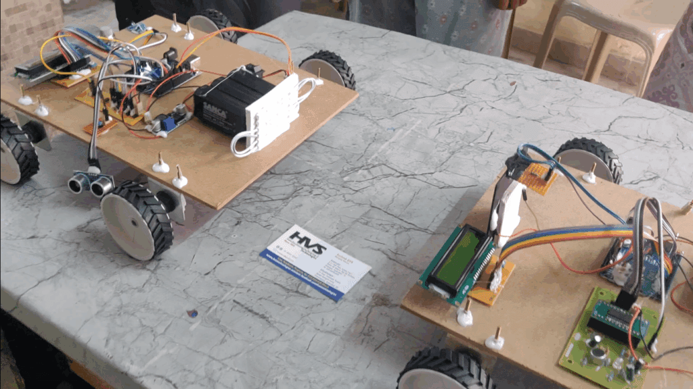
Prototype:

Slide 14
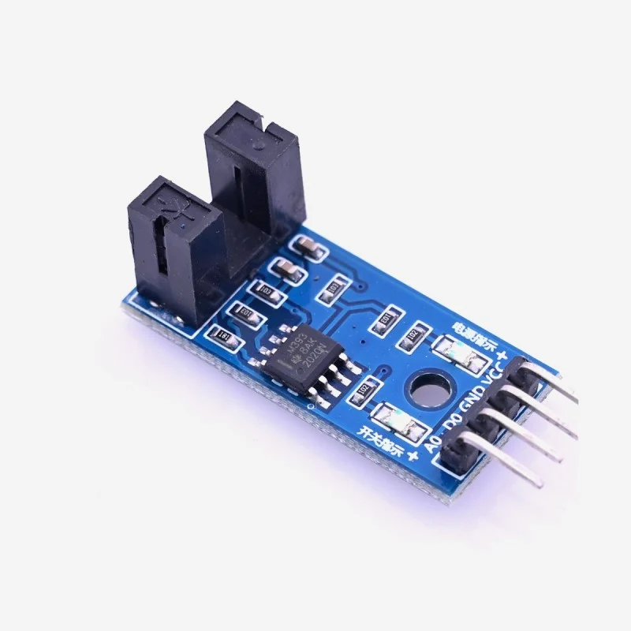
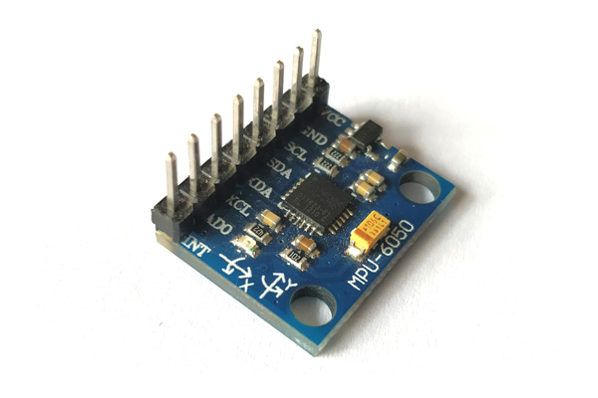
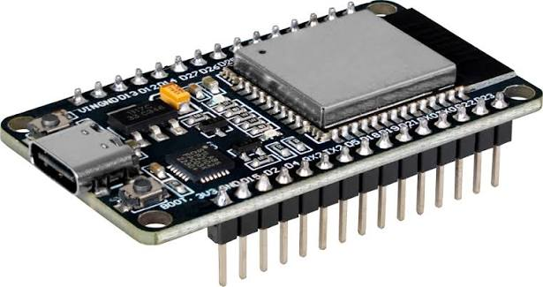
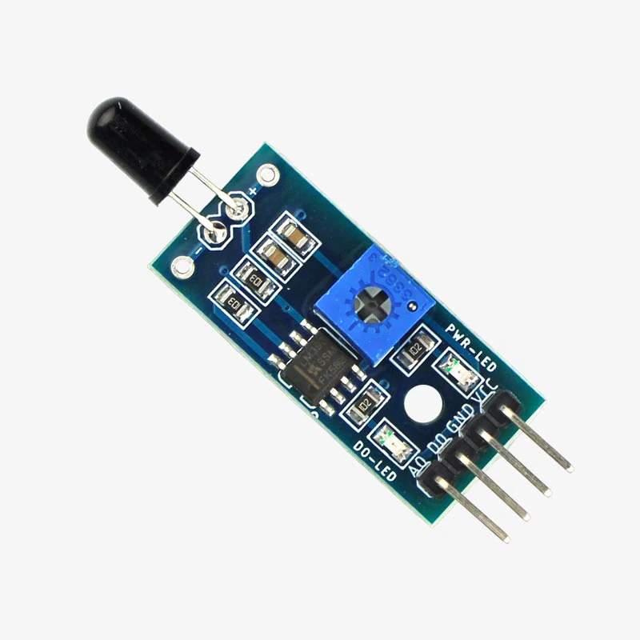
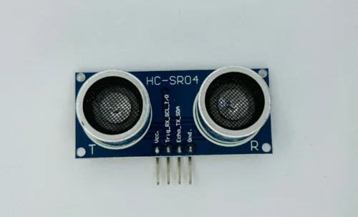
Results:
Modules

Slide 15
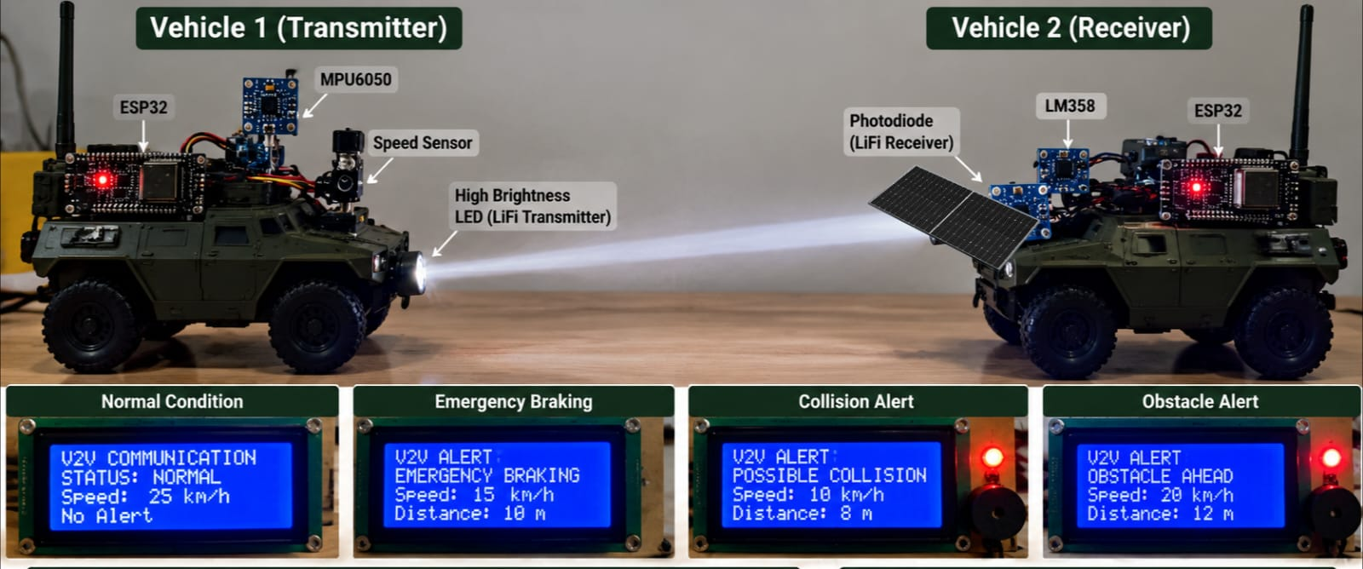
Results:

Slide 16
THANK YOU

