Slide 1
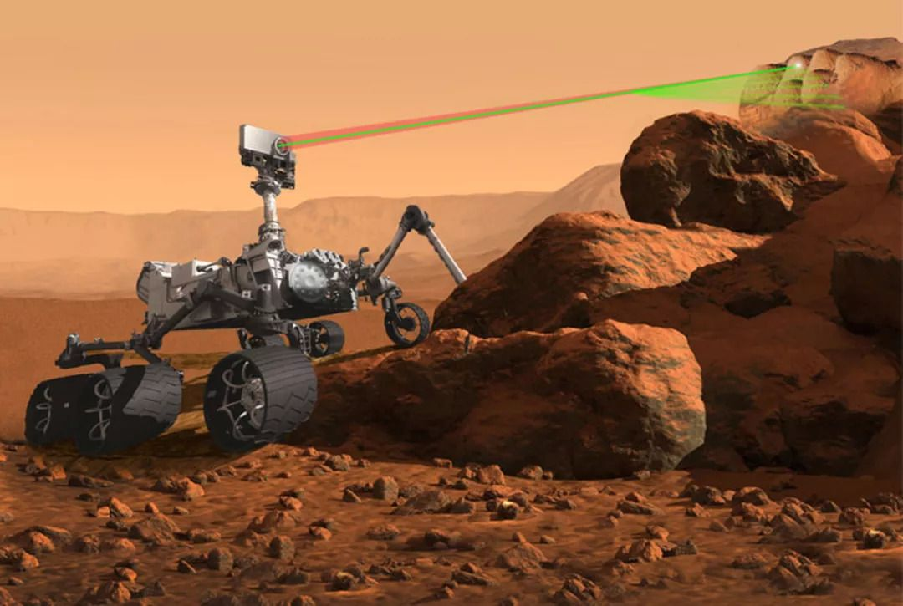
From https://m.163.com/dy/article/DPTBHSA80511ATFD.html

