Slide 1
Digital Signal Processor – TI C6748
By Saikiran Chepa

Slide 2
C6748 DSP and CPU: Different Design Goals
TI C6748: A Digital Signal Processor (DSP) optimized for
real-time numeric computation.
Normal CPU: Optimized for general-purpose computing
(OS, multitasking, user apps).
Key differences:
DSPs focus on speed and deterministic timing.
CPUs focus on flexibility and versatility.
Example: C6748 executes multiple operations per cycle
using VLIW (Very Long Instruction Word).

Slide 3
Architectural Differences
Feature | TI C6748 DSP | Normal CPU
Instruction Set | VLIW (can issue up to 8 parallel instructions) | Typically, Superscalar or Out-of-Order
Execution Units | Multiple specialized units: .L, .S, .M, .D | Few general-purpose ALUs
Pipelines | Deep pipeline with deterministic timing | Dynamic pipeline with branch prediction
Memory System | Harvard Architecture (separate program & data buses) | Von Neumann (shared program/data path)
Parallelism | Explicit parallelism (compiler scheduled) | Implicit parallelism (hardware scheduled)
Addressing | Circular & bit-reversed addressing for DSP ops | Linear addressing

Slide 4
Application and Performance Differences
DSP Strengths:
Real-time signal processing (audio, video, control loops)
Deterministic and low-latency execution
High multiply-accumulate (MAC) throughput
CPU Strengths:
Complex operating systems, multitasking
Broader instruction set and floating-point support
C6748 DSP Features:
8 functional units for parallelism
32-bit fixed + floating-point support
Hardware loops, circular buffers, zero-overhead addressing
Result: DSPs achieve more operations per cycle for signal-oriented code.

Slide 5
Introduction to Load/Store Architecture

Slide 6
Understanding Load/Store Architecture
In Load/Store architectures, arithmetic and logic operations
are performed only on registers, not directly on memory.
Load instructions bring data from memory into registers.
Store instructions move data from registers to memory.
This design simplifies the instruction pipeline and improves
parallel execution.
Used in RISC-based DSPs and processors,
including TI’s C674x core.

Slide 7
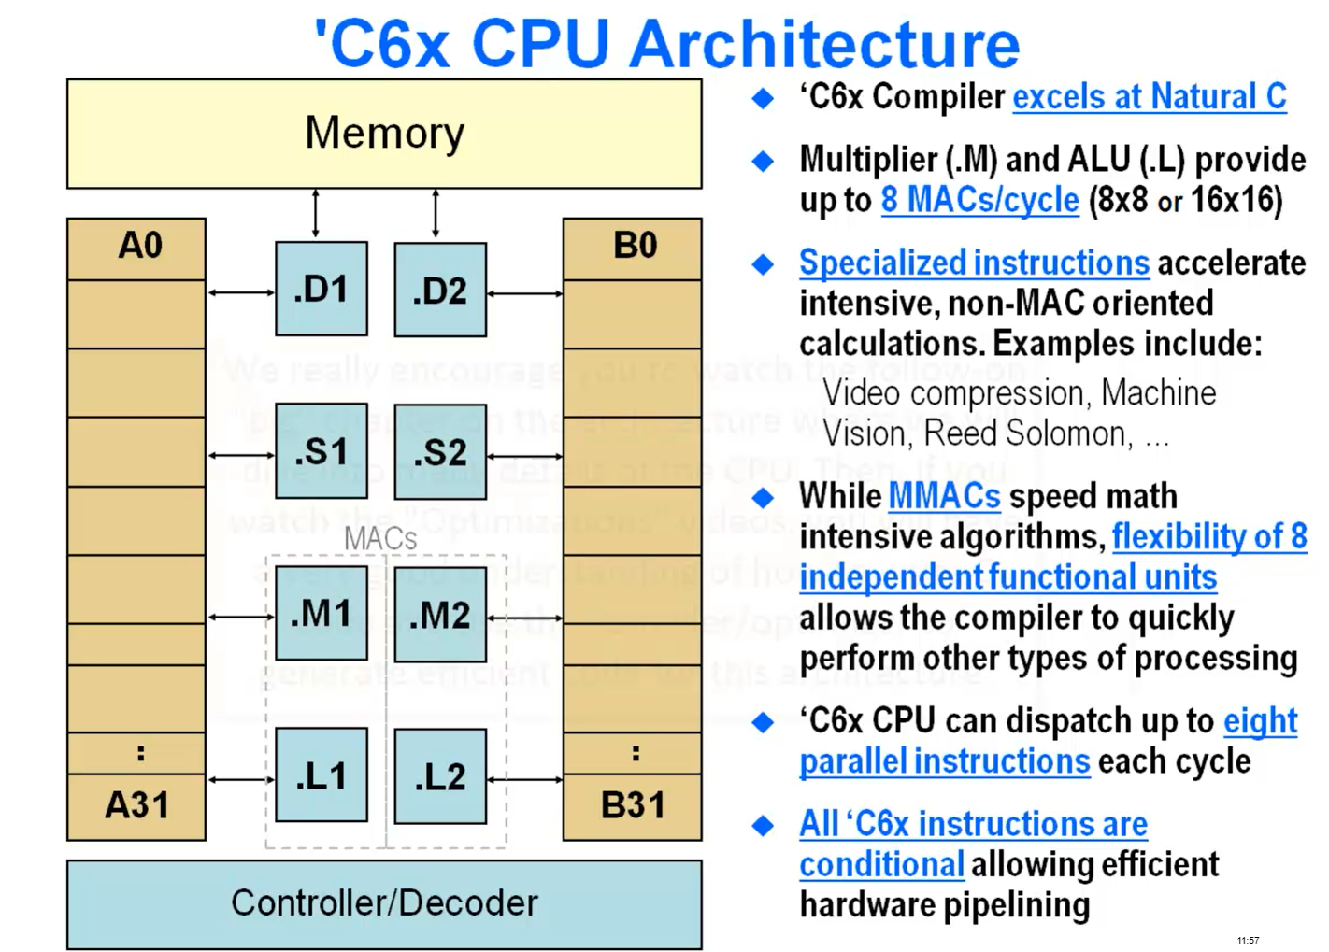
Load/Store Mechanism in C6x DSP Core

Slide 8
Why Load/Store Architecture is Efficient
Parallelism: Separate units allow concurrent execution of load/store and
arithmetic instructions.
Pipeline efficiency: Decoupling memory access avoids pipeline stalls.
Predictable timing: Each instruction performs a single, well-defined operation.
Compiler-friendly: Simplifies instruction scheduling for optimizing compilers.

Slide 9
TI C6748 Instruction Set Overview

Slide 10
Instruction Set of TI C6748 DSP
Based on C6000 VLIW (Very Long Instruction Word) architecture.
Supports both fixed-point and floating-point instructions.
Up to 8 instructions can be issued in one cycle (1 per functional unit).
Functional units:
.L → Arithmetic/Logic operations
.S → Branches, shifts, and some arithmetic
.M → Multiply and MAC (Multiply-Accumulate)
.D → Load/Store operations
Two data paths: A and B, each with its own set of units and registers
(A0–A15, B0–B15).

Slide 11
Understanding Delay Slots
A delay slot is an instruction position that executes after a branch or load
is issued but before the branch/load effect takes place.
Used to hide pipeline latency and maintain deterministic timing.
Commonly appears after:
Branch instructions (e.g., B, CALL) → 5 delay slots
Load instructions (e.g., LDW) → 4 delay slots
Compiler (or assembly programmer) must fill delay slots with useful work
(independent instructions).
If no useful instruction is available, the slot is filled with NOP (No Operation).

Slide 12
Efficient Use of Delay Slots
Compiler scheduling (TI Code Composer Studio) usually handles delay slots
automatically.
Programmers can manually optimize in hand-tuned assembly.
Key strategies:
Move independent arithmetic instructions into delay slots.
Avoid using results from loads immediately — wait for load latency to resolve.
Minimize use of NOPs → improves instruction-level parallelism (ILP).

Slide 13
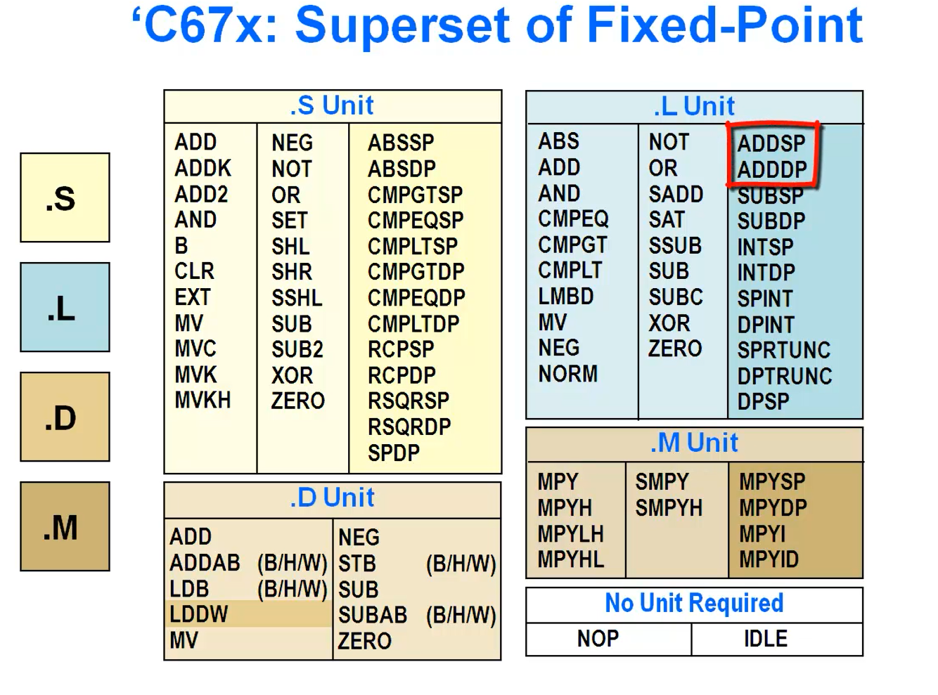
TI C67x Instruction Set

Slide 14
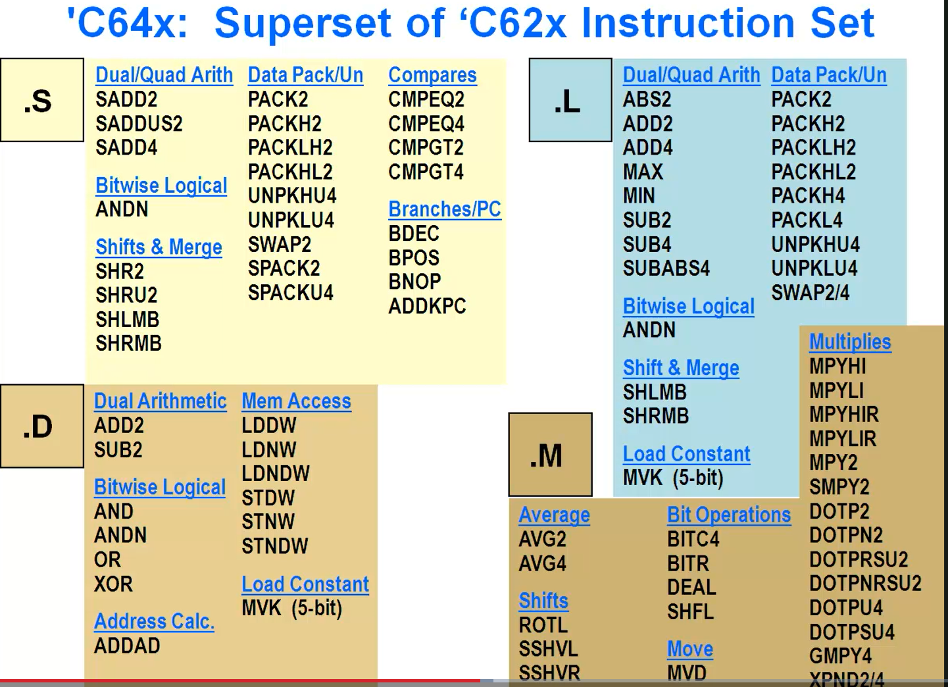
C64x Instruction Set

Slide 15
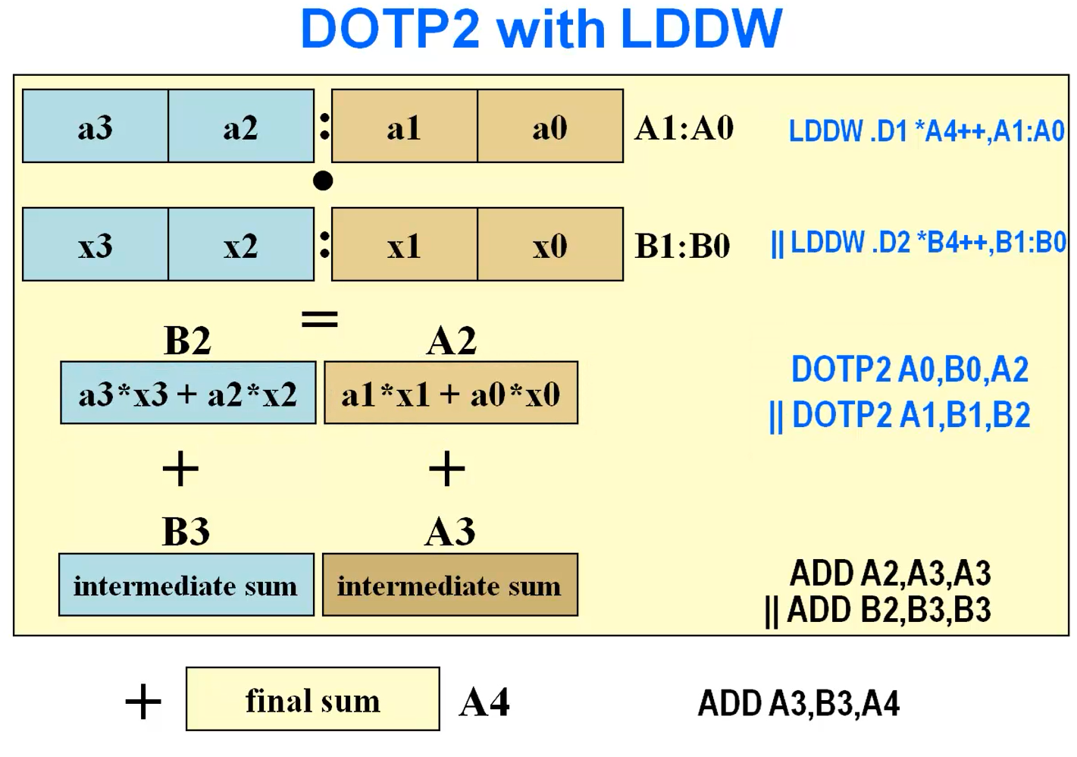

Slide 16
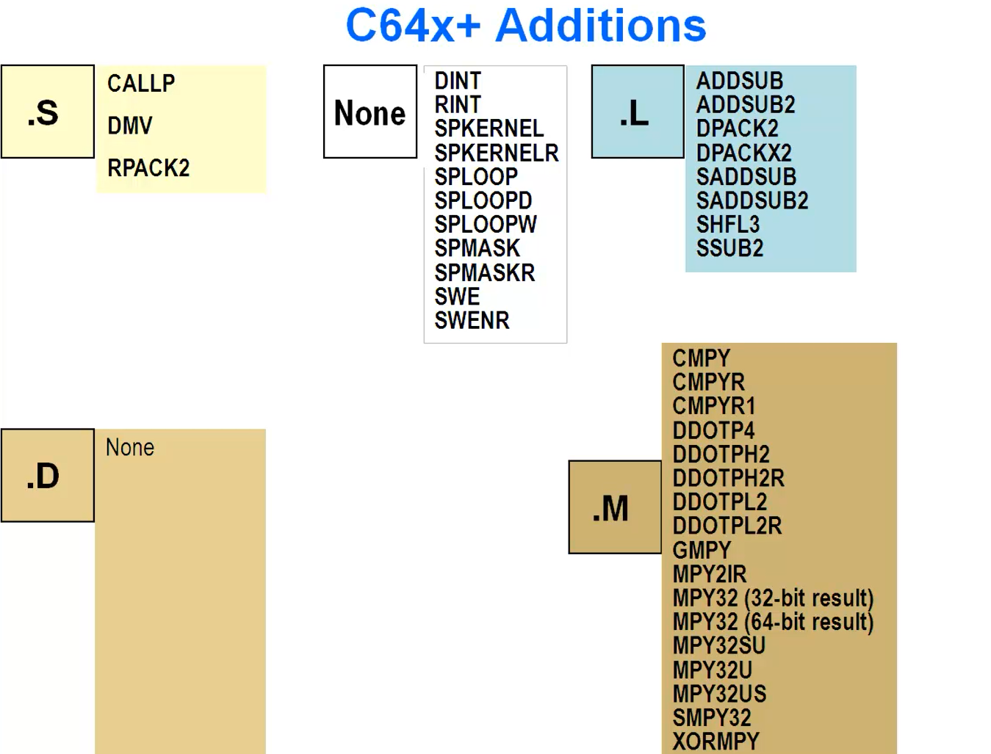
C64x+ Instruction Set

Slide 17
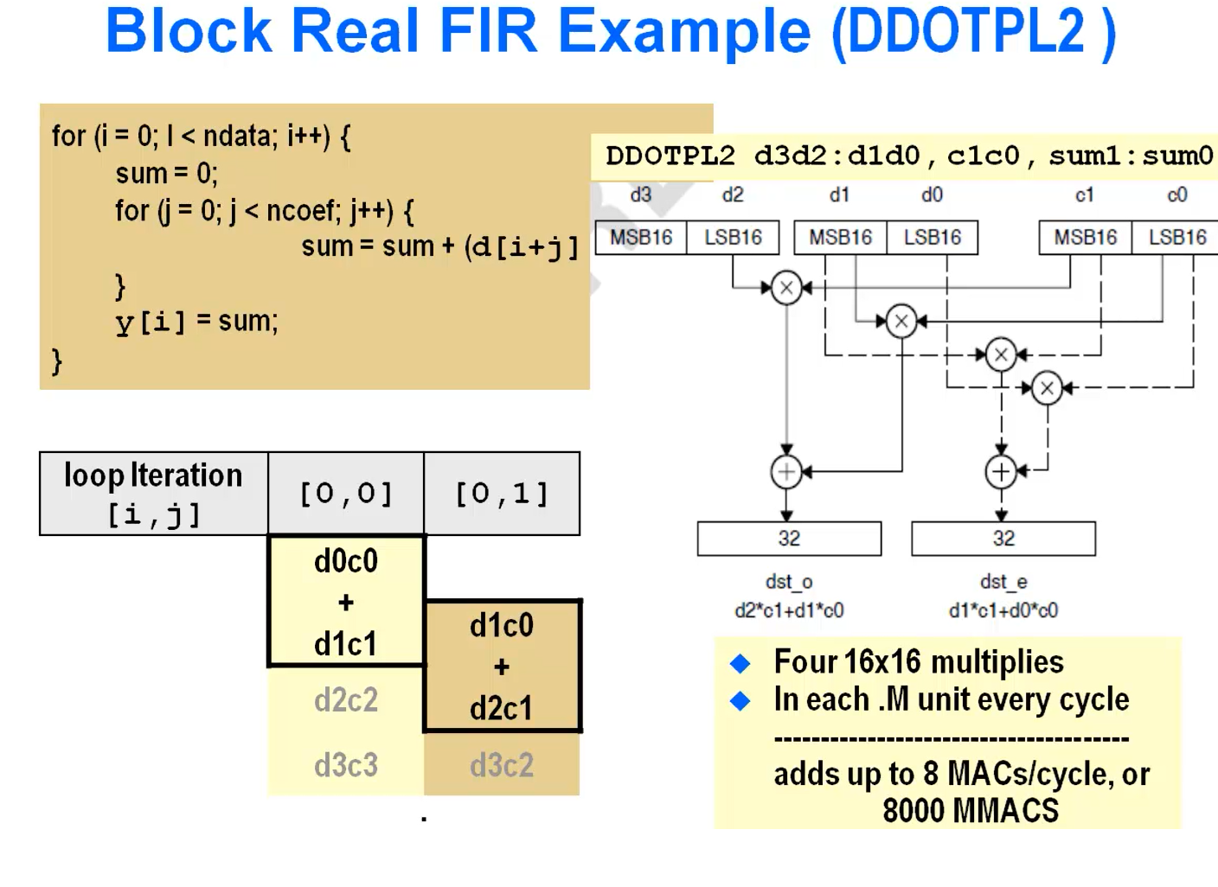

Slide 18
Introduction to Circular Addressing

Slide 19
What is Circular Addressing?
A hardware feature in TI C6000/C674x DSPs that allows automatic pointer
wrap-around in memory.
Commonly used in FIR filters, delay lines, and ring buffers.
Eliminates software checks for buffer overflow.
Supported in registers A4–A7 and B4–B7 only.

Slide 20
How Circular Mode is Controlled
AMR (Addressing Mode Register) defines which registers are circular and
the buffer size.
Each of the 8 special registers (A4–A7, B4–B7) has a 2-bit mode field:
00 → Linear
01 → Circular using BK0
10 → Circular using BK1
BK0/BK1 fields in AMR define buffer size as: Block size = 2^(N + 1) bytes.
Buffer must be power-of-two aligned.

Slide 21
How Start & End Are Determined
No explicit start/end registers exist.
Hardware derives boundaries using bit masking:
start = A4 & ~(block_size - 1)
end = start + block_size
Example:
A4 = 0x8000 0000, BK0 = 3 → block = 16 bytes
Valid range: 0x8000 0000 – 0x8000 000F
At address 0x8000 000E → *A4++ wraps back → 0x8000 0000
A4 = 0x8000 0004, BK0 = 3 → block = 16 bytes
Valid range: 0x8000 0000 – 0x8000 000F
At address 0x8000 000E → *A4++ wraps back → 0x8000 0000

Slide 22
How Circular Mode is Controlled
Bits | Field | Description
31–27 | BK1 | Block size (for mode=10)
26–22 | BK0 | Block size (for mode=01)
21–20 | B7MODE | Mode for B7
19–18 | B6MODE | Mode for B6
17–16 | B5MODE | Mode for B5
15–14 | B4MODE | Mode for B4
13–12 | A7MODE | Mode for A7
11–10 | A6MODE | Mode for A6
9–8 | A5MODE | Mode for A5
7–6 | A4MODE | Mode for A4
5–0 | Reserved | Must be 0

Slide 23
Example : Two circular buffers (A4=16B, B4=64B)
Field | Value
BK0 = 3 | (16B)
BK1 = 5 | (64B)
A4MODE = 01 | uses BK0
B4MODE = 10 | uses BK1
AMR bits = BK1(5) BK0(3) + A4mode=01 + B4mode=10 + others=00
Binary: 0010 1000 1100 0000 1000 0000 0100 0000
Hex: 0x28C08040

Slide 24
Hardware Pipelining

Slide 25
What is Pipelining in C6748 DSP?
TI C6748 uses a Very Long Instruction Word (VLIW) architecture.
Pipelining allows multiple instructions to overlap in execution
improving throughput.
The CPU executes instructions in stages, like an assembly line.
C6748 has an 8-unit functional pipeline:
2 × .L (Logic/Arithmetic)
2 × .S (Shift/Branch)
2 × .M (Multiply)
2 × .D (Data load/store)

Slide 26
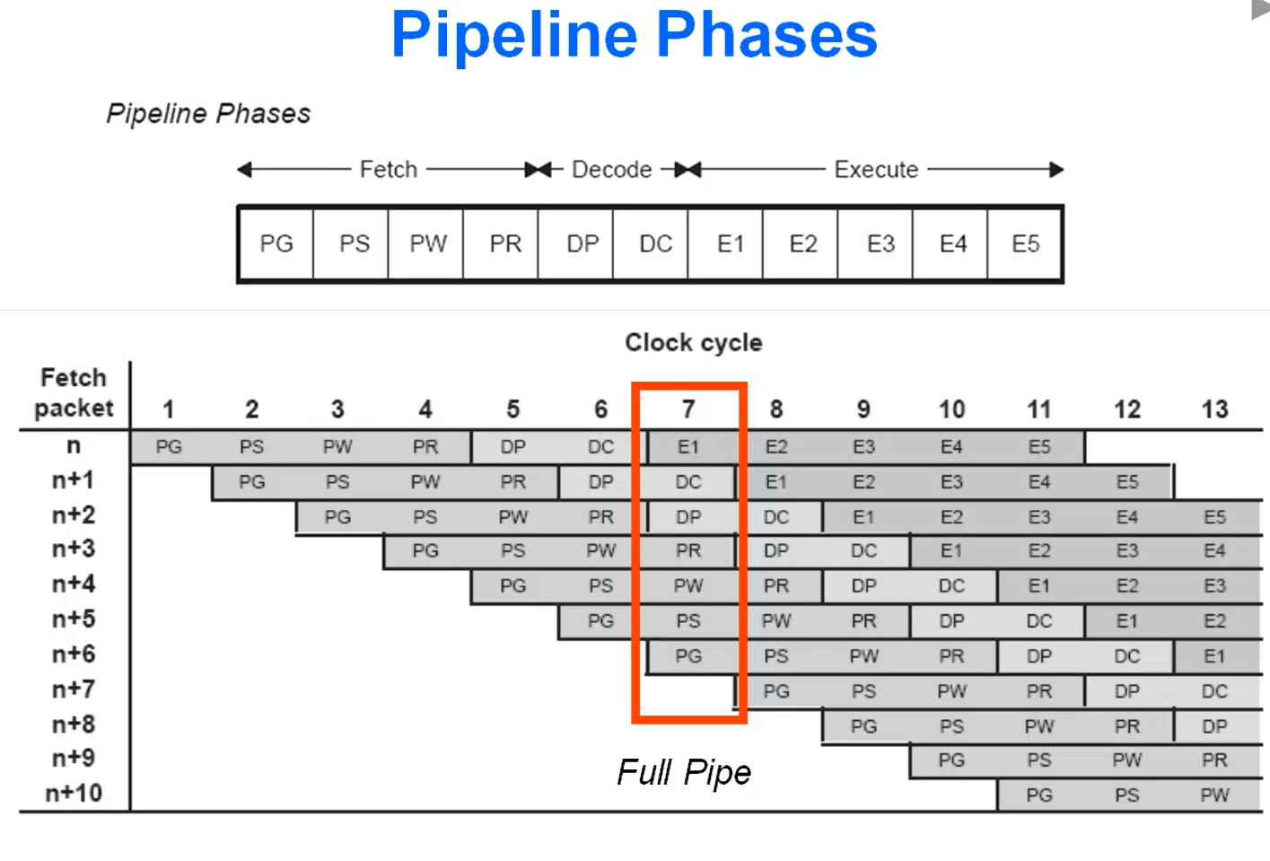

Slide 27
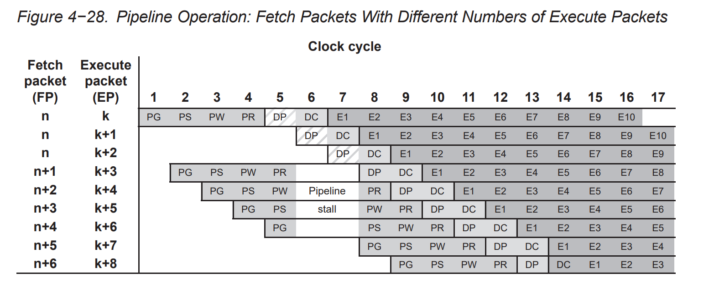

Slide 28
Hazards in Pipelining
Data Hazards: When one instruction depends on the result of another still in pipeline. → Solved using NOPs, software scheduling, or register renaming.
Structural Hazards: When multiple instructions need the same hardware unit.
Control Hazards: Occur in branch/jump instructions → mitigated by delayed branches.
C6748 has deterministic timing — no branch prediction; programmer/compiler
handles scheduling.

Slide 29
Software Pipelining

Slide 30
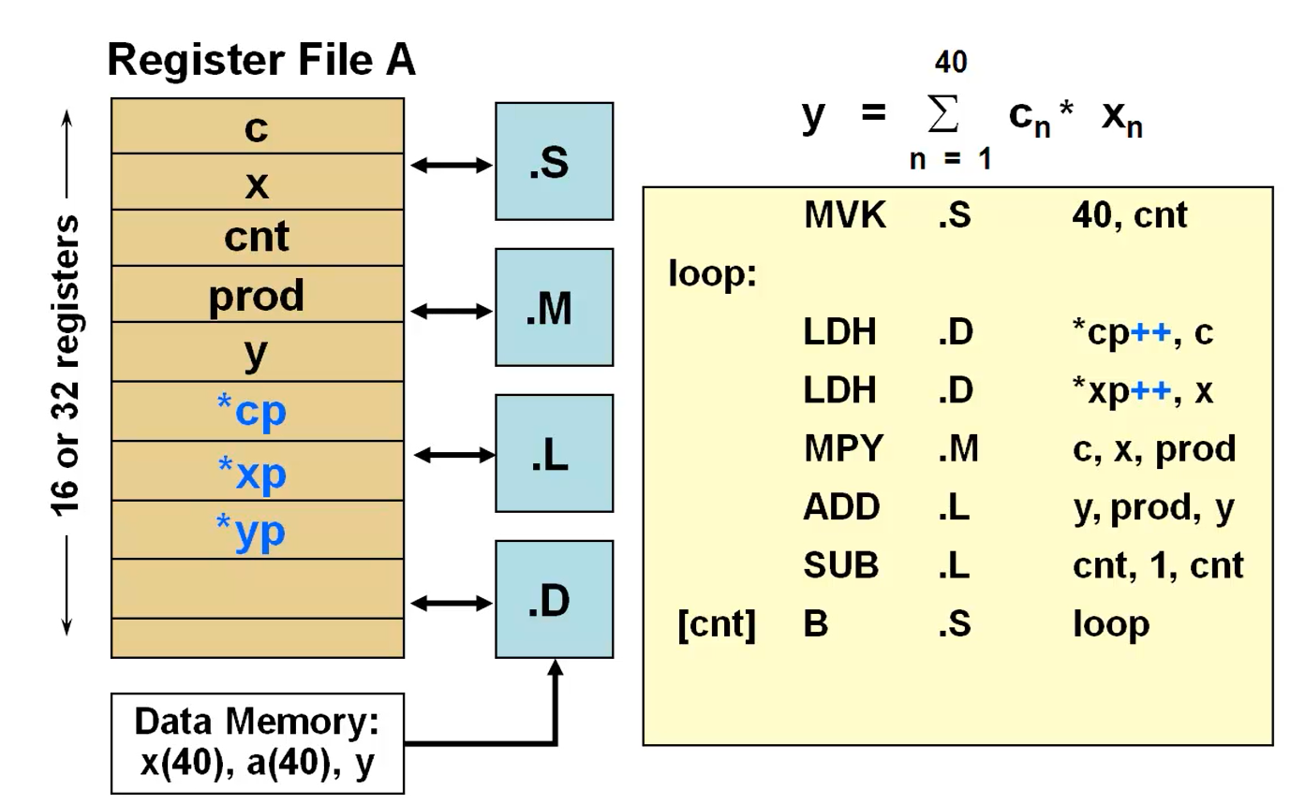

Slide 31
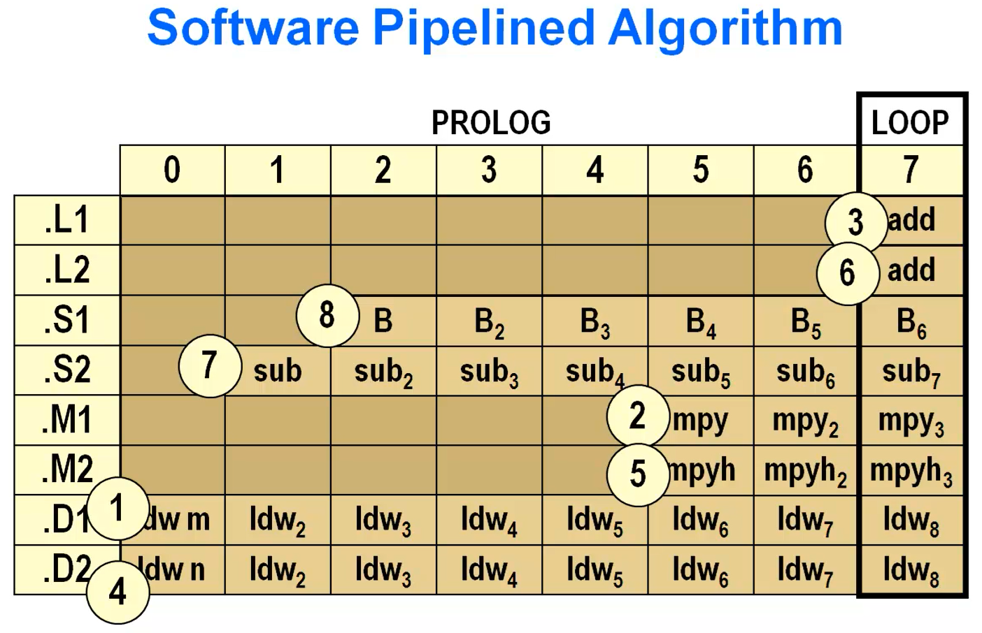

Slide 32
