Slide 1
From Theory to Code: Fixed-Point FIR Filter Design and Speech Quality Evaluation
Saikiran Chepa

Slide 2
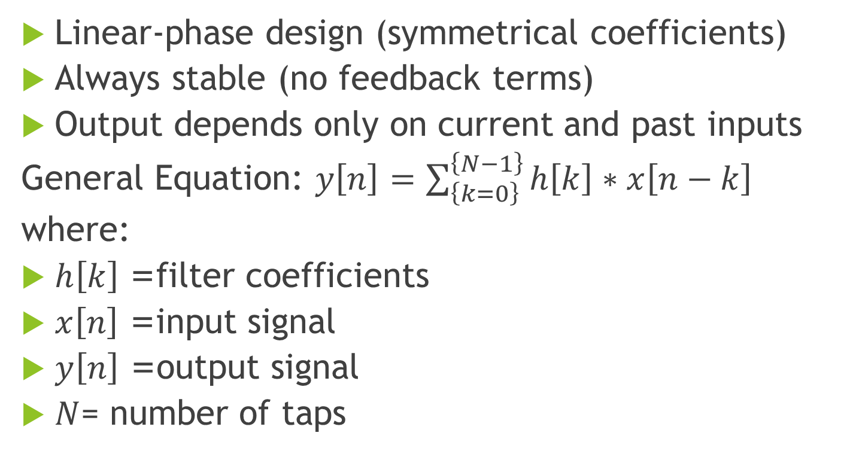
Finite Impulse Response (FIR) Filter Design
Linear-phase design (symmetrical coefficients)
Always stable (no feedback terms)
Output depends only on current and past inputs
General Equation: $y\left[n\right]=\sum_{\left\{k=0\right\}}^{\left\{N−1\right\}}{h\left[k\right]∗x\left[n−k\right]}$
where:
$h\left[k\right]$= filter coefficients
$x\left[n\right]$= input signal
$y\left[n\right]$= output signal
$N$= number of taps

Slide 3
How to do Convolution??
Direct Convolution
Multiply-accumulate (MAC) for each output sample
Complexity: O(N·M) (N = input length, M = filter length)
Simple but expensive for large filters
Overlap-Add (OLA)
Input split into blocks
Each block convolved using FFT
Results added with overlap
Efficient for long filters
Overlap-Save (OLS)
Input divided into overlapping blocks
FFT-based convolution, discarding invalid samples
Memory-efficient alternative to OLA

Slide 4
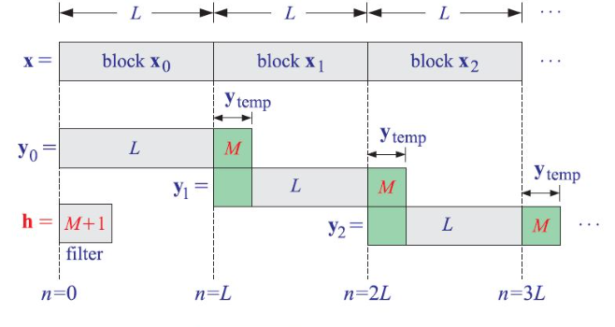
Overlap-Add(OLA)

Slide 5
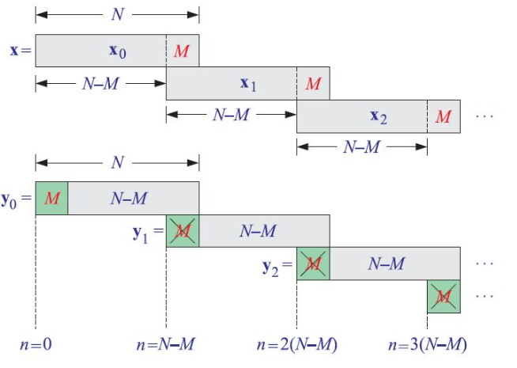
Overlap-Save(OLS)

Slide 6
Design Steps:
Specification – Define filter type (Low-pass, High-pass, Band-pass, Band-stop)
Select Parameters –
pass band frequency
stop band frequency
pass band ripple
stop band attenuation
Compute Coefficients – Using mathematical formulas (sinc + window) or tools (MATLAB/Python remez)
Implementation – Use convolution in C/Python (float or fixed-point)
Verification – Compare float vs fixed output (RMSE, PESQ for speech signals)

Slide 7
Motivation for Fixed Point
Why fixed-point?
Lower power, smaller memory footprint
Faster execution on embedded DSP/MCU
Hardware limitations (many DSPs lack floating-point units)
Typical applications: Speech/audio codecs, filters

Slide 8
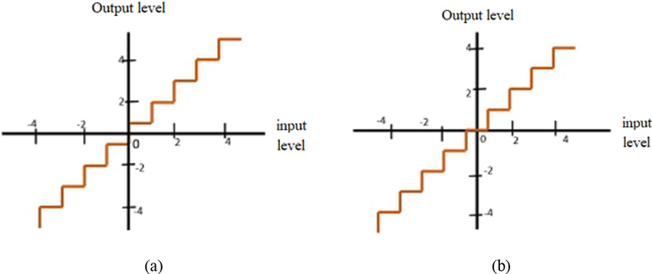
Quantizer Types: Mid-Rise and Mid-Tread

Slide 9
Floating-Point Representation (Refresher)
IEEE 754 format (32-bit float):
Sign bit (1)
Exponent (8)
Mantissa (23)
Advantages: wide dynamic range, easy for algorithm development
Limitation: not always efficient for embedded

Slide 10
Fixed-Point Representation
Represented as integers scaled by a factor
General format: Q1.m.n
1 sign bit
m = Range bits
n = fractional bits
Example: Q1.0.15 (16-bit signed fixed-point)
Range: –2⁰ to (2⁰ – 2⁻¹⁵) = -1.0 to 1 - 2⁻¹⁵
Stored as 16-bit signed integer

Slide 11
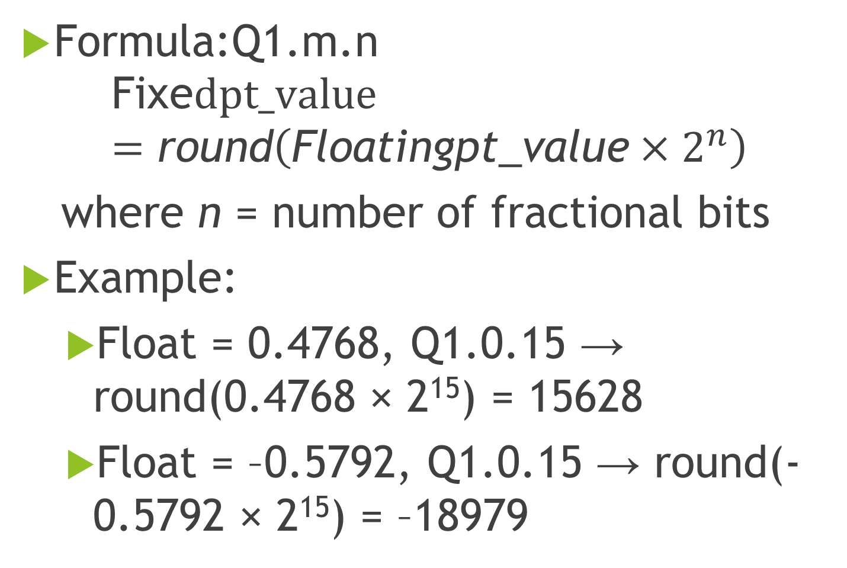
Float-to-Fixed Conversion
Formula:Q1.m.n
$$\text{Fixe}dpt_value=\text{round}\left(\text{Float}\text{ingpt}\text{_}\text{value}×2^{n}\right)$$
where n = number of fractional bits
Example:
Float = 0.4768, Q1.0.15 → round(0.4768 × 2¹⁵) = 15628
Float = –0.5792, Q1.0.15 → round(- 0.5792 × 2¹⁵) = –18979

Slide 12
Precision vs. Range Trade-off
More fractional bits → higher precision, smaller range
Q1.2.13 --> range is 2² --> -4 to 4 – 2⁻¹³ (0.0001220703125)
Q1.2.29 --> range is 2² --> -4 to 4 – 2⁻²⁹ (0.00000000186264514923095703125)
More integer bits → larger range, lower precision
Balance depends on algorithm

Slide 13
Fixed-Point Arithmetic Examples
Addition/Subtraction → straightforward, same Q format
How to add Q1.2.13 and Q1.3.12??
Multiplication → Q1.m.n × Q1.m.n = Q2.2m.2n → need to re-scale
Division → expensive, often replaced with reciprocal + multiply

Slide 14
Practical Example
Total FIR Filter Coefficients is 13
Coefficients : max 2.786655772180386
Coefficients : min -2.9153372837924336
All Coefficients absolute sum: 23.597984136187275
How will you decide Q format for Coefficients??

Slide 15
Verification
Compare float vs fixed-point FIR outputs
Metrics: RMSE, PESQ score for speech signals
PESQ score → indicates perceptual quality difference

Slide 16
Summary
Float is convenient for design, fixed-point is efficient for embedded
Conversion involves scaling, rounding, and Q-format handling
FIR filters can be effectively implemented in fixed-point
Verification tools (PESQ, RMSE) ensure correctness

Slide 17
Hands On
Fir Filter designed in Python, and coefficients and input signal dumped to binary files.
Implement floating point FIR Filter in C using the above coefficients and input signal.
Implement Fixed Point C code for FIR Filter.
Verify the outputs of Python and C Code using RMSE and PESQ.

