Slide 1
Optimization using ARM NEON Intrinsics
Ch B Sai Kiran
Capgemini Hyderabad

Slide 2
Agenda
What is Optimization
What are intrinsics
Understanding SIMD concept
Introduction NEON ISA
Some Optimization Techniques
Using the optimization techniques to implement a code

Slide 3
What is Optimization
The C Implementation of DSP algorithm is taking lot processor cycles. In order to reduce cycles we do optimization
Optimization can be C level, intrinsics level and assembly level
Each of these levels will have incremental reduction in cycles.
Up to which level to optimize depends on whether we have achieved real time implementation and also on the time duration of the project.
Optimization work starts by generating a profile sheet and identifying the most cycle consuming functions and optimizing them.

Slide 4
What are Intrinsics
In programming, intrinsics are special functions provided by compilers that allow direct access to specific processor instructions or features.
ARM NEON intrinsics are a set of functions provided by ARM compilers that enable developers to write SIMD code using C/C++ syntax.
By utilizing NEON intrinsics, developers can optimize their code for parallel processing, taking advantage of the SIMD capabilities of ARM processors.
This can result in significant performance improvements, especially in computationally intensive tasks such as image processing, audio/video encoding, and signal processing.

Slide 5
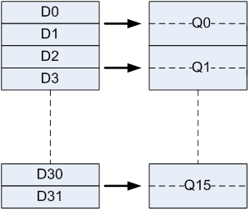
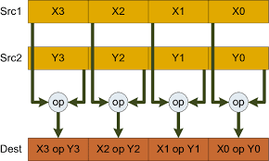
Understanding SIMD concept
Parallel Processing: SIMD is a technique used to perform parallel processing on multiple data elements using a single instruction.
D registers are 64 bit wide and Q registers are 128 bit wide.

Slide 6
Introduction NEON ISA
Data types can integer or float
Integer can 8bit, 16bit, 32bit or 64bit
SIMD operates on data in the form of vectors, where a vector represents a group of data elements (e.g., numbers, pixels, audio samples) that are processed together.
SIMD instructions enable performing operations on these vectors in a single instruction, saving time and improving performance.

Slide 7
Floating Point Intrinsics
vaddq_f32: Adds two NEON registers containing 4 single-precision floating-point values element-wise.
Example: float32x4_t result = vaddq_f32(a, b);
vmulq_f32: Multiplies two NEON registers containing 4 single-precision floating-point values element-wise.
Example: float32x4_t result = vmulq_f32(a, b);
vld1q_f32: Loads 4 single-precision floating-point values from memory into a NEON register.
Example: float32x4_t values = vld1q_f32(ptr);
vst1q_f32: Stores 4 single-precision floating-point values from a NEON register to memory.
Example: vst1q_f32(ptr, values);

Slide 8
Integer Intrinsics
vaddq_s32: Adds two NEON registers containing 4 signed 32-bit integers element-wise.
Example: int32x4_t result = vaddq_s32(a, b);
vaddq_s16: Adds two NEON registers containing 8 signed 16-bit integers element-wise.
Example: int16x8_t result = vaddq_s16(a, b);
vadd_s32: Adds two NEON registers containing 2 signed 32-bit integers element-wise.
Example: int32x2_t result = vadd_s32(a, b);
vadd_s16: Adds two NEON registers containing 4 signed 16-bit integers element-wise.
Example: int16x4_t result = vadd_s16(a, b);

Slide 9
Some Optimization Techniques
Unrolling loops
Reducing number of loads
Loading frequently accessed memory into registers
Using SIMD intrinsics

Slide 10
Here is C code we need to Optimize
for(n = 0; n < N; n++)
{
sum = 0;
for(k=0; k < M; k ++)
{
sum += x[n-k]*h[k];
}
y[n] = sum;
}

Slide 11
Lets assume M = 4
Y[0] = x[0]*h[0]
Y[1] = x[1]*h[0] + x[0]*h[1]
Y[2] = x[2]*h[0] + x[1]*h[1] + x[0]*h[2]
Y[3] = x[3]*h[0] + x[2]*h[1] + x[1]*h[2] + x[0]*h[3]
Y[4] = x[4]*h[0] + x[3]*h[1] + x[2]*h[2] + x[1]*h[3]
Y[5] = x[5]*h[0] + x[4]*h[1] + x[3]*h[2] + x[2]*h[3]
Y[6] = x[6]*h[0] + x[5]*h[1] + x[4]*h[2] + x[3]*h[3]
Y[7] = x[7]*h[0] + x[6]*h[1] + x[5]*h[2] + x[4]*h[3]
Y[8] = x[8]*h[0] + x[7]*h[1] + x[6]*h[2] + x[5]*h[3]
Y[9] = x[9]*h[0] + x[8]*h[1] + x[7]*h[2] + x[6]*h[3]
Y[10] = x[10]*h[0] + x[9]*h[1] + x[8]*h[2] + x[7]*h[3]

Slide 12
float32x4_t q_in1,q_in2,q_sum,q_temp;
float32x2_t d_taps_0,d_taps_1;
d_taps_0 = vld1_f32(&h[0]); //1 0
d_taps_1 = vld1_f32(&h[2]); //3 2
for(n = 0; n < N; n += 4) {
q_sum = 0;
q_in1 = vld1q_f32(&x[n]); //3 2 1 0
q_in2 = vld1q_f32(&x[n+4]); //7 6 5 4
q_sum = vmlaq_lane_f32(q_sum, q_in1, d_taps_1, 1);
q_temp = vextq_f32(q_in1, q_in2, 1 ); q_sum = vmlaq_lane_f32(q_sum, q_temp, d_taps_1, 0);
q_temp = vextq_f32(q_in1, q_in2, 2 ); q_sum = vmlaq_lane_f32(q_sum, q_temp, d_taps_0, 1);
q_temp = vextq_f32(q_in1, q_in2, 3); q_sum = vmlaq_lane_f32(q_sum, q_temp, d_taps_0, 0);
vst1q_f32(&y[n + 3], q_sum);
}

Slide 13
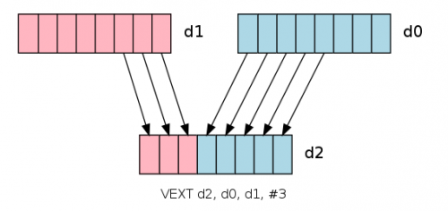

Slide 14
Thank You

