Slide 1

Want to be a Yelp Elite?
Is it possible to predict whether a user is a yelp elite from user data ?

Slide 2
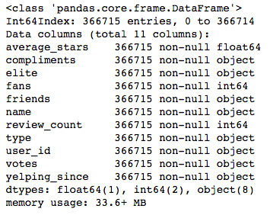
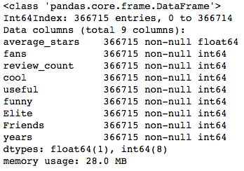
JSON file from Yelp Data Challenge
Embedded JSON dictionary
Cool, useful, funny were data embedded in the previous ‘votes’ column
Elite is the labels column—1 = Elite(has been elite) 0 = Never been elite
Friends= number of friends gained from length of ‘friends’
Years = number of years active, calculated by 2015 minus year account created
Notes:
Under sampling

Slide 3
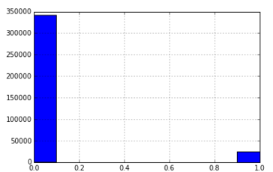
Initial trial with no cleaning
Elites vs Non-elites
Imbalanced dataset
Under-sampling & Modeling

Slide 4
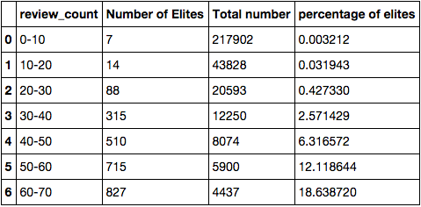
Data Cleaning- >50 reviews
Write more reviews!!!
>10% chance of becoming elite
Reduces anomalies
Eliminates ‘fake’ accounts ie, people who
have average ratings at 5 or 1

Slide 5
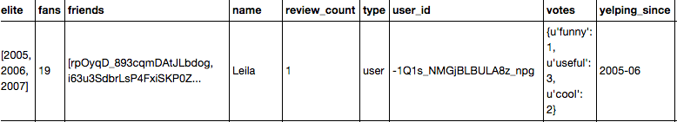
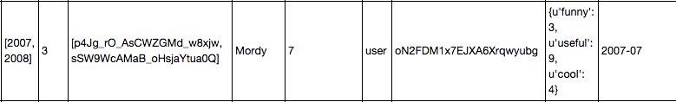
Anomalies

Slide 6
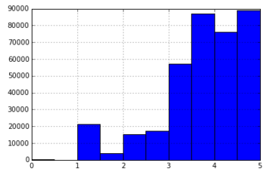
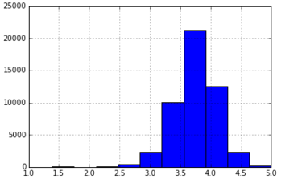
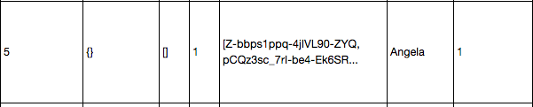
Removing ‘fake’ accounts
All Data
>50 Reviews

Slide 7
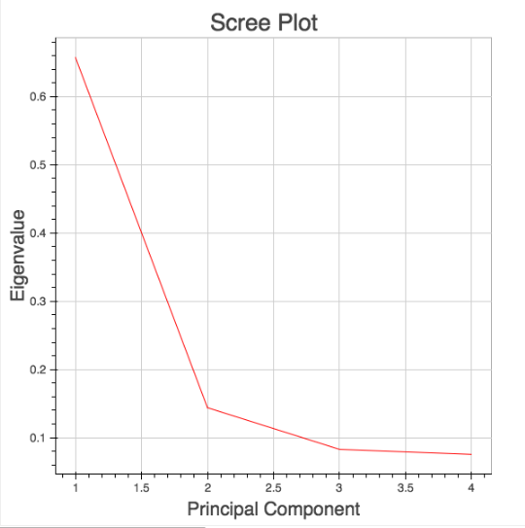
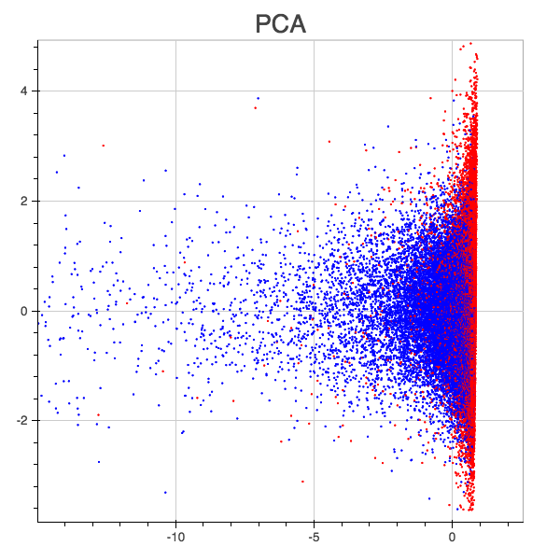
PCA
PCA using 2 components
on normalized data

Slide 8
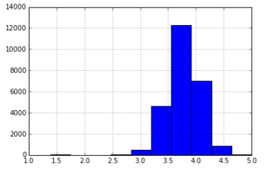
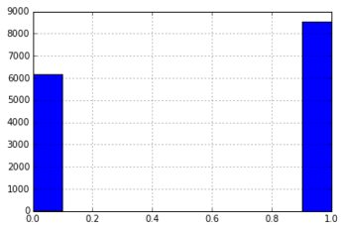
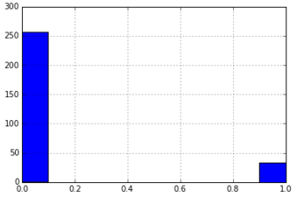
Low representation of
users with low average
ratings
Be Positive!!
Average stars > 3 stars
Review count 100-200
Average stars < 3 stars
Review count 100-200

Slide 9
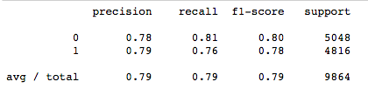
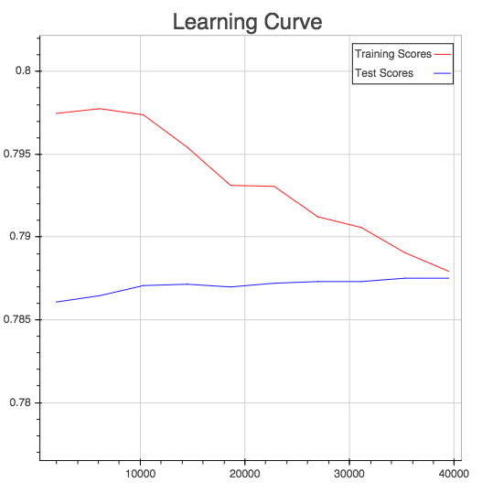
Model
Support Vector Machine
(C=1, kernel =‘rbf’)
Base Case
= 0.5117

Slide 10
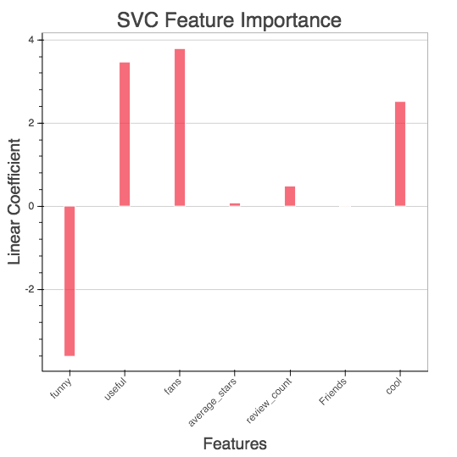
Feature importance
Feature importance
based on linear kernel
model

Slide 11
NEXT STEPS
Additional data, link databases to get check-in or geographic data
More feature engineering to allow for non-PCA model to run --- identify key features in choosing elites
In-depth analysis of friends list to link users

