Slide 1

Want to be a Yelp Elite?
Is it possible to predict whether a user is a yelp elite from user data ?

Slide 2
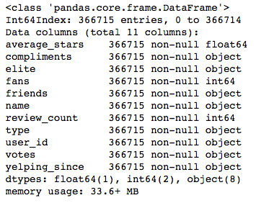
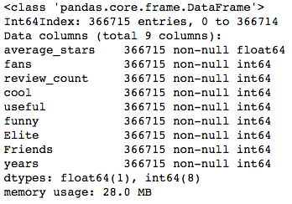
JSON file from Yelp Data Challenge
Embedded JSON dictionary
Cool, useful, funny were data embedded in the previous ‘votes’ column
Elite is the labels column—1 = Elite(has been elite) 0 = Never been elite
Friends= number of friends gained from length of ‘friends’
Years = number of years active, calculated by 2015 minus year account created

Slide 3
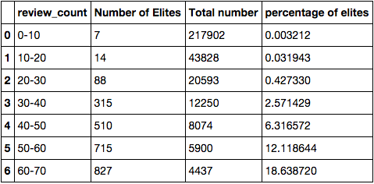
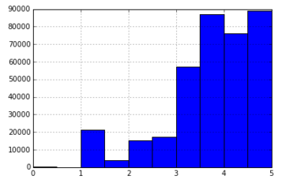
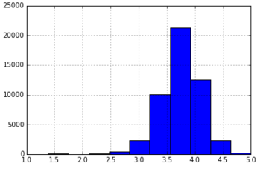
Data Cleaning
Write more reviews!!!
>10% chance of becoming elite
Reduces anomalies
Eliminates ‘fake’ accounts ie, people who
have average ratings at 5 or 1

Slide 4
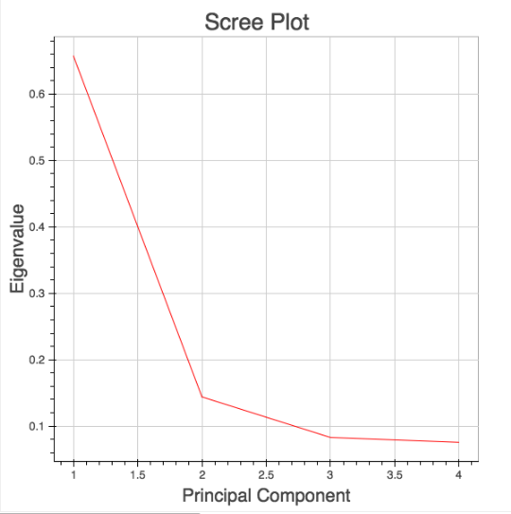
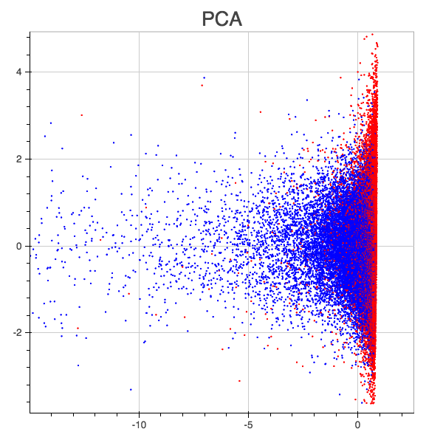
PCA
PCA using 2 components
on standardized data

Slide 5
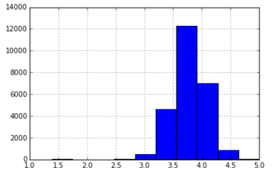
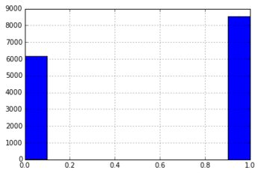
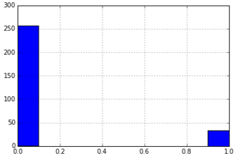
Unequal distribution of
elites based on average
star ratings
Be Positive!!
Average stars > 3 stars
Review count 100-200
Average stars < 3 stars
Review count 100-200

Slide 6
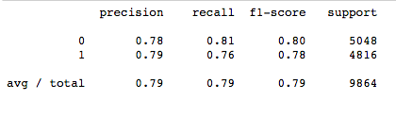
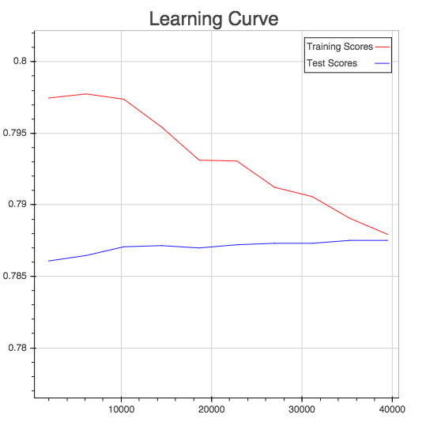
Model
Support Vector Machine
(C=1, kernel =‘rbf’)
Base Case
= 0.5117

Slide 7
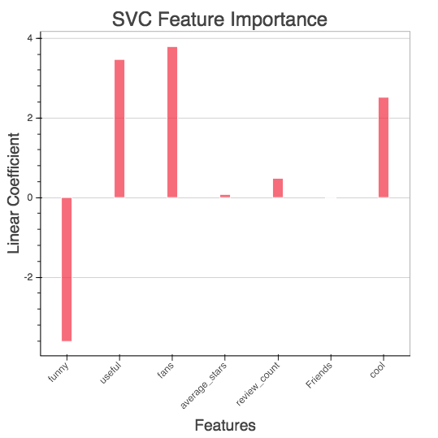
Feature importance
Feature importance
based on linear kernel
model

Slide 8
NEXT STEPS
More feature engineering to allow for non-PCA model to run
Additional data, linking databases to get check-in or geographic data

