Slide 1
Active Learning for Model Selection
Dylan Cashman
2018-12-10

Slide 2
Model Selection for Domain Scientists
What can they do?
Prediction Analysis: see how they predict for particular data instances.

Slide 3
Model Selection for Domain Scientist
What can a domain scientist really do to choose out of 100 models?
Think of computational searches…

Slide 4
Model Selection for Domain Scientist
What can a domain scientist really do to choose out of 100 models?
Think of computational searches…
Look at each model’s prediction on each data point: O(100n)
They’re smarter than that

Slide 5
Model Selection for Domain Scientist
What can a domain scientist really do to choose out of 100 models?
Think of computational searches…
Look at each one: O(100n)
They’re smarter than that
Look at all of the data at once: O(100)
Nobody’s that smart

Slide 6
binary search
Idea: If they could cut out half the models for each inference, they’d be able to very quickly narrow down candidate models
Second part: Asking them to label new data is easy, if they don’t have to do it much

Slide 7
What we need:
Generating data points that about ½ of the models disagree on

Slide 8
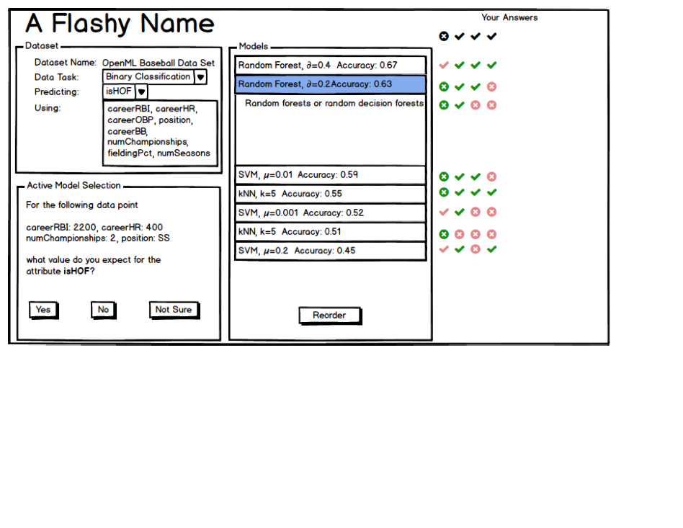

Slide 9
Computationally
We try to build a probability model of the entropy over the space
Similar to active learning, query the user for parts of the space with the most expected entropy
Gradually remove models

Slide 10
Plan
Implement (pretty sure how it will work)
Try it out on users
See how many steps it takes them to try out a model
Compare to basically tabular form, or compare to random sampling of data points
See if they get better model
Use something like Anscombe’s quartet?

Slide 11
Early Results
Built 50 models on adults dataset, using 4 numeric attributes, predicting >50k or <= 50k annual income binary classes
Calculated entropy on validation data
Trained Gaussian Process to predict entropy
Hit a snag – need to find equation for analytical gradient to find maximal entropy (will be some linear algebra

