Slide 1
Workshop 2
Angularjs and socket.io

Slide 2
Make sure these are installed
goo.gl/z6qY9C
Briefly explain AngularJS
Work through AngularJS example “app”
Briefly explain Socket.io
Work through Socket.io example
Chrome
Node.js (v5.6)
Git
Your favorite code editor, or I suggest one of these:
Atom
VSCode

Slide 3

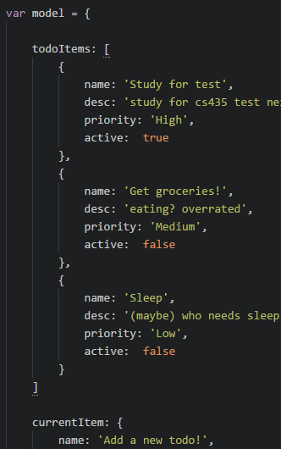
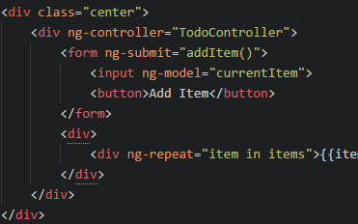
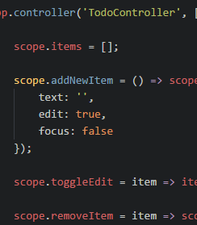
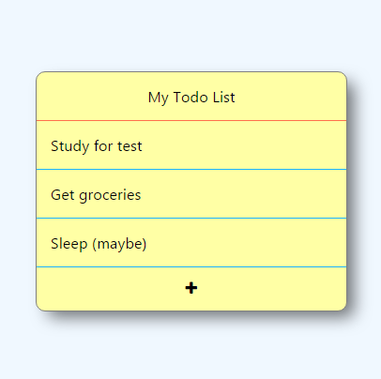
MVC
Controller’s logic modifies Model
Model
Data
binding
View
Invoke
controller
Controller
A working “model” for the view to consume
The display of the model
How the model is changed

Slide 4
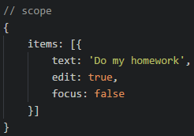
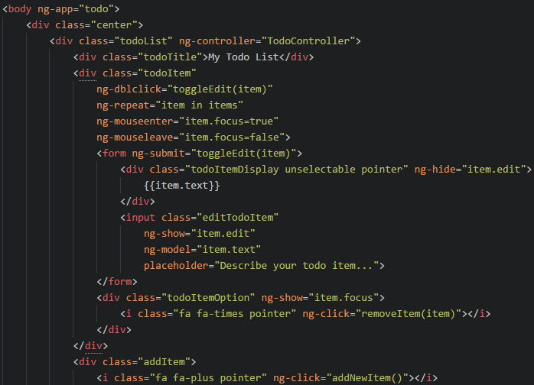
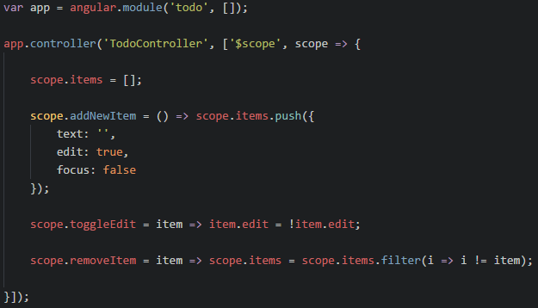
How it all fits together…
item

Slide 5
ng-
ng-click=“{{expression}}”
Evaluates the expression when the element is clicked
ng-dblclick=“{{expression}}”
Evaluates the expression when the element is double clicked
ng-repeat=“{{enumeratedValue}} in {{enumerableExpression}}”
foreach (var enumeratedValue in enumerableExpression)
Enumerates the enumerableExpression (list) into its enumeratedValues (values)
Each all elements inside the element with ng-repeat will repeat for each value in the list
The children elements will inherit a scope with the enumerateExpression value in it
ng-model=“expression”
Creates a two way binding between the view and the value in the model the expression points to
ng-show=“{{booleanExpression}}”
Shows the element when the expression is true, otherwise hides it
ng-hide=“{{booleanExpression}}”
Hides the element when the expression is true, otherwise shows it

Slide 6
Open git bash or terminal
git clone https://github.com/chcaru/workshop.git
cd workshop/workshop2
npm install
cd start
start atom .
node server

