Slide 1
Workshop 2
Angularjs and socket.io
Chris Caruso

Slide 2
Make sure these are installed
goo.gl/z6qY9C
Briefly explain AngularJS
Work through AngularJS example “app”
Briefly explain Socket.io
Work through Socket.io example
Chrome
Node.js (v5.6)
Git
Your favorite code editor, or I suggest one of these:
Atom
VSCode

Slide 3

Startup Weekend Tuscaloosa
Weekend long hackathon
Friday, April 22 - 24, 2016
Build a product prototype (web app, mobile, other…)
It’s A LOT of fun!
Looks great on resume
goo.gl/4azuLk
Sign up now for $25

Slide 4

goo.gl/mPVVPb

Slide 5
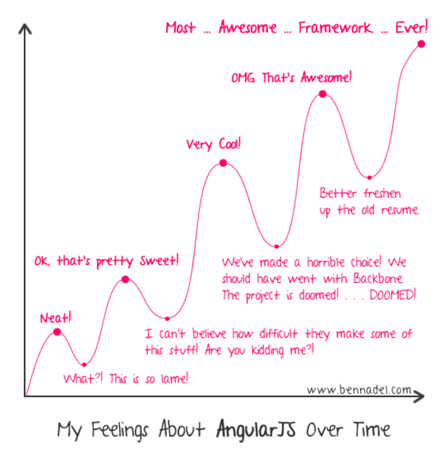
Seriously. Ask if you don’t get it!

Slide 6

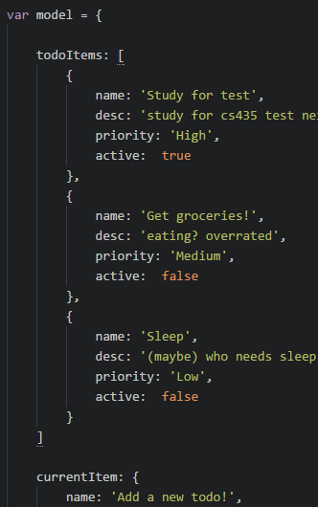
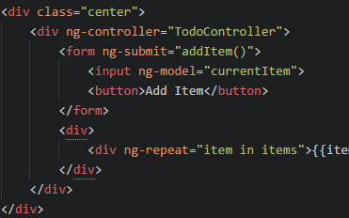
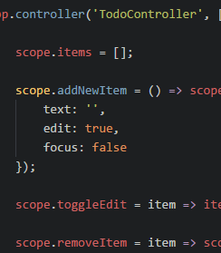
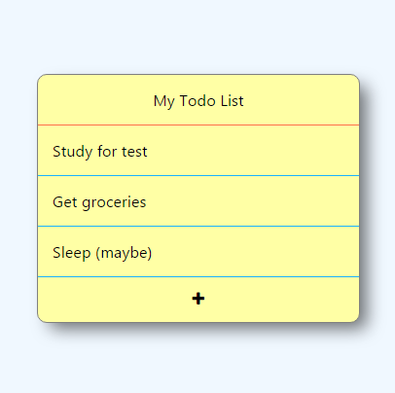
MVC
Controller’s logic modifies Model
Model
Data
binding
View
Invoke
controller
Controller
A working “model” for the view to consume
The display of the model
How the model is changed

Slide 7
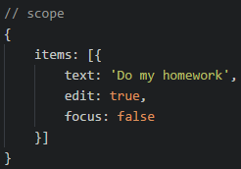
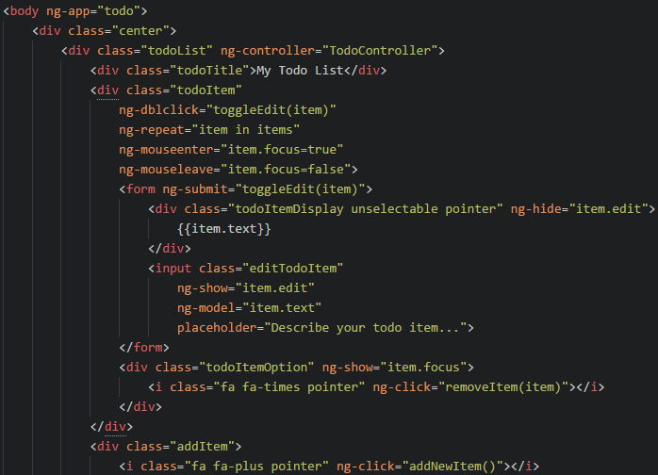
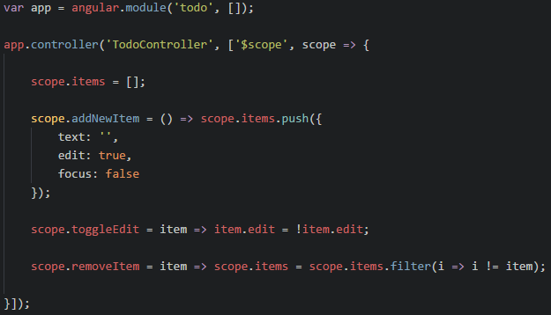
How it all fits together…
item

Slide 8
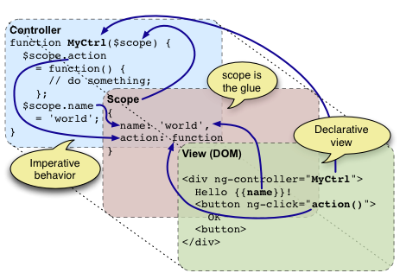

Slide 9
ng-
ng-click=“{{expression}}”
Evaluates the expression when the element is clicked
ng-dblclick=“{{expression}}”
Evaluates the expression when the element is double clicked
ng-repeat=“{{enumeratedValue}} in {{enumerableExpression}}”
foreach (var enumeratedValue in enumerableExpression)
Enumerates the enumerableExpression (list) into its enumeratedValues (values)
Each all elements inside the element with ng-repeat will repeat for each value in the list
The children elements will inherit a scope with the enumerateExpression value in it
ng-model=“expression”
Creates a two way binding between the view and the value in the model the expression points to
ng-show=“{{booleanExpression}}”
Shows the element when the expression is true, otherwise hides it
ng-hide=“{{booleanExpression}}”
Hides the element when the expression is true, otherwise shows it

Slide 10
AngularJS Dependencies and Injection
Has no dependencies
Injected
dependencies
for TodoController
Dependencies
for TodoController

Slide 11
For all your AngularJS documentation needs: docs.angularjs.org/api

Slide 12
Open git bash or terminal
git clone https://github.com/chcaru/workshop.git
cd workshop/workshop2
npm install
cd start
start atom .
node server.js
Starts node with the file server.js
We will be restarting this throughout
the workshop, so keep the window
handy, but don’t close it!

Slide 13
5 minute break If you need help, come up and ask me now Feedback: goo.gl/z6qY9C

Slide 14

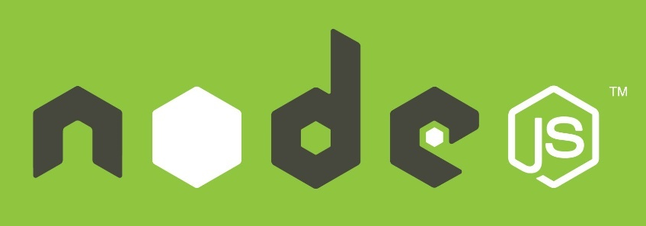


WebSockets with socket.io
WebSocket
2 way communication
channel between
the client and
the server

Slide 15


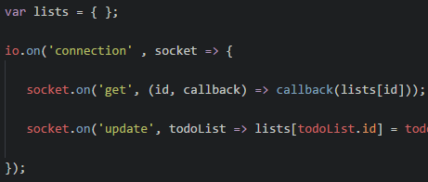
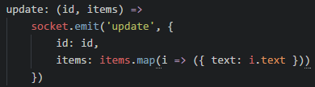

Slide 16
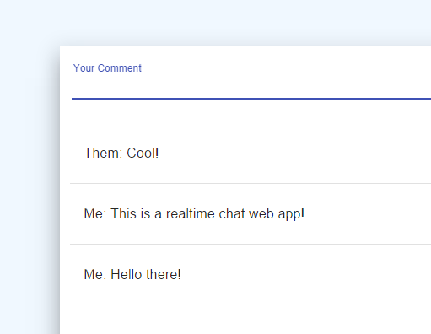
Workshop3
Tuesday 3/29 (second week after spring break)
We’ll be making this
And use Angular Material
Feedback (you can edit):
goo.gl/z6qY9C

