Slide 1
TypeScript
Scalable javascript
Chris Caruso

Slide 2
Make sure these are installed
goo.gl/
node.js (v5.10.1)
git
VSCode (recommended for TypeScript)

Slide 3

Opportunities
SDE Intern
bit.ly/1Y9KzkU
Explorer Intern
Freshman / Sophomore
Rotate between SDE / PM
bit.ly/1lbcL9L

Slide 4

Startup Weekend Tuscaloosa
Weekend long hackathon
Friday, April 22 - 24, 2016
Build a product prototype (web app, mobile, other…)
It’s A LOT of fun!
Looks great on resume
goo.gl/4azuLk
Sign up now!!

Slide 5

goo.gl/mPVVPb

Slide 6

What is ?
Superset of JavaScript
Any JavaScript is TypeScript
Has more language features than JavaScript
Compiled / Transpiled
To JavaScript
Extra features
Types!
Including generic types
Interfaces + Abstract Classes
Async / Await in ES6
Easier way to handle Promises

Slide 7
Why use ?
Types
Eliminates type errors (which are super common in JavaScript)
Allow large projects
Allow large teams
Reduces need for type documentation
Reduces need for cross developer communication
The flexibility of JavaScript with type safety
Freedom to target specific ECMAScript versions
ES3 / ES5 / ES6 / ES2016 (ES7)
Freedom to target specific module systems
CommonJS / AMD / UMD / ect…

Slide 8
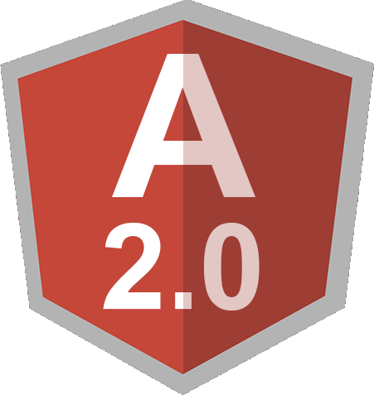

Who uses ?

Slide 9
Open git bash or terminal
git clone https://github.com/chcaru/workshop.git
cd workshop/typescript/start
npm install –g typescript
tsc –w –pretty
start code .
IF NOT USING VSCODE, USE THIS TO RUN CODE:
node bin/main.js

Slide 10
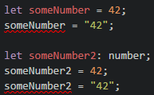
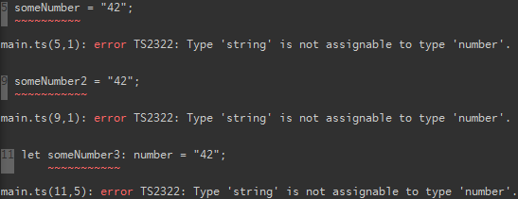
Types
Infers type of someNumber as number
VScode errors:
Compile errors:
Explicitly declare type of someNumber2 as number

Slide 11
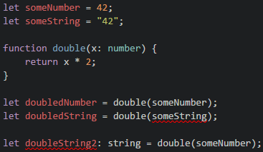
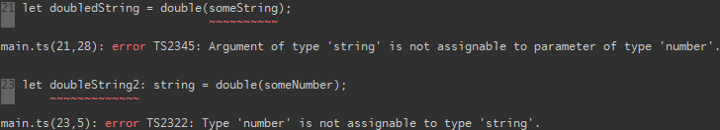
Types Cont.
Explicitly define parameter type
Infers return type as number

Slide 12


Implicit return type
Explicit return type
Explicit return type as string, produces error
because the type being returned is not correct

Slide 13
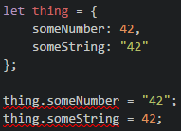

Slide 14
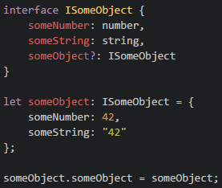
Interfaces
Interface declared type
? Means optional

Slide 15
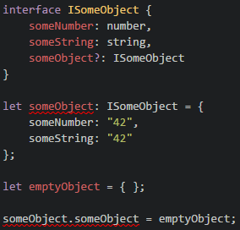
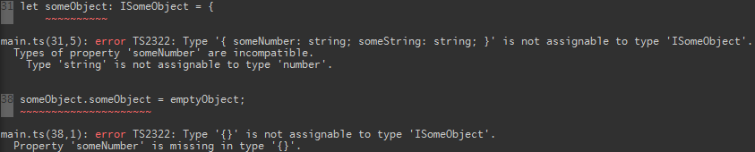

Slide 16
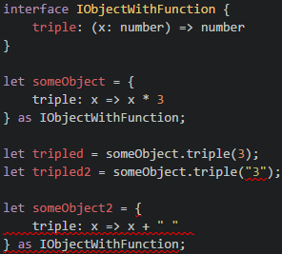
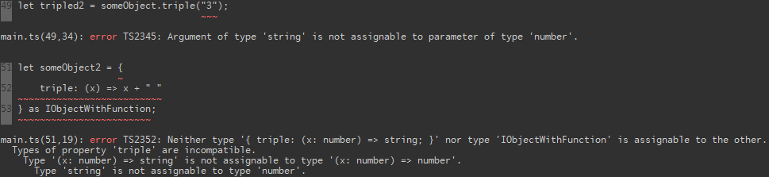

Slide 17
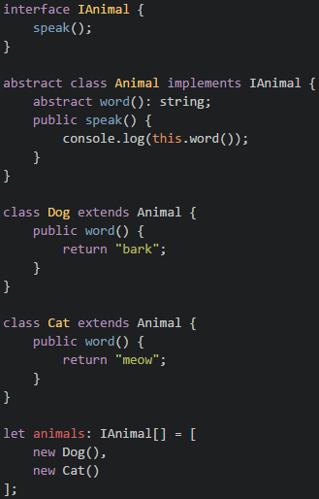

Slide 18
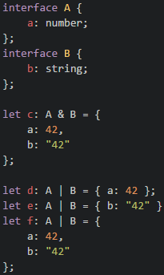

Slide 19
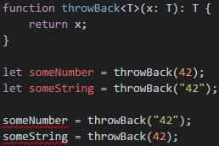
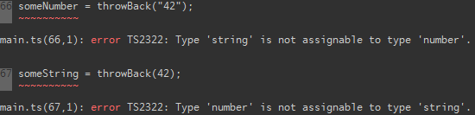
Generics

Slide 20
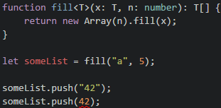

Slide 21
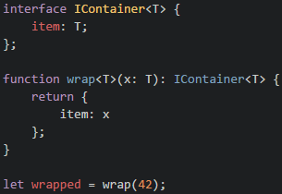
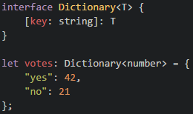
Indexer using generics:

Slide 22
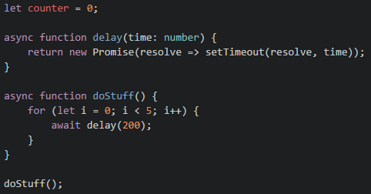

Slide 23
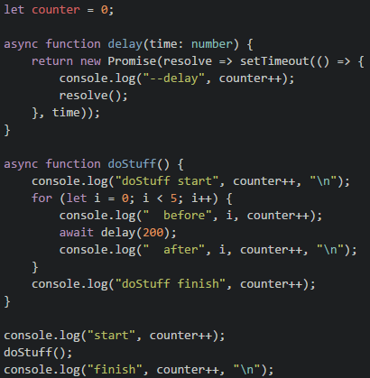

Slide 24
Startup Weekend Tuscaloosa
Weekend long hackathon
Friday, April 22 - 24, 2016
Build a product prototype (web app, mobile, other…)
It’s A LOT of fun!
Looks great on resume
goo.gl/4azuLk
Sign up now!!

Slide 25
FREE STUFF

