Slide 1
Workshop 1
Making a web app from start to finish

Slide 2
Agenda
What is a web app?
What web app will we make?
JavaScript primer
HTML primer
JavaScript with HTML
Node.js primer
Serving a simple website from Node.js

Slide 3
Make sure these are installed
Chrome
Node.js (v5.5)
Git
Your favorite code editor, or I suggest one of these:
Atom
VSCode

Slide 4
What is a Web App?
Any application that is accessed through a website
SaaS (Software as a Service)
Examples
Facebook
Google Play Music
Trello
Google Docs
Microsoft Office Online
Sometimes the difference between a “normal” website and a web app may not be clear
IMO, a web app is just a fancy and capable website
Very dynamic (compared to static content)

Slide 5
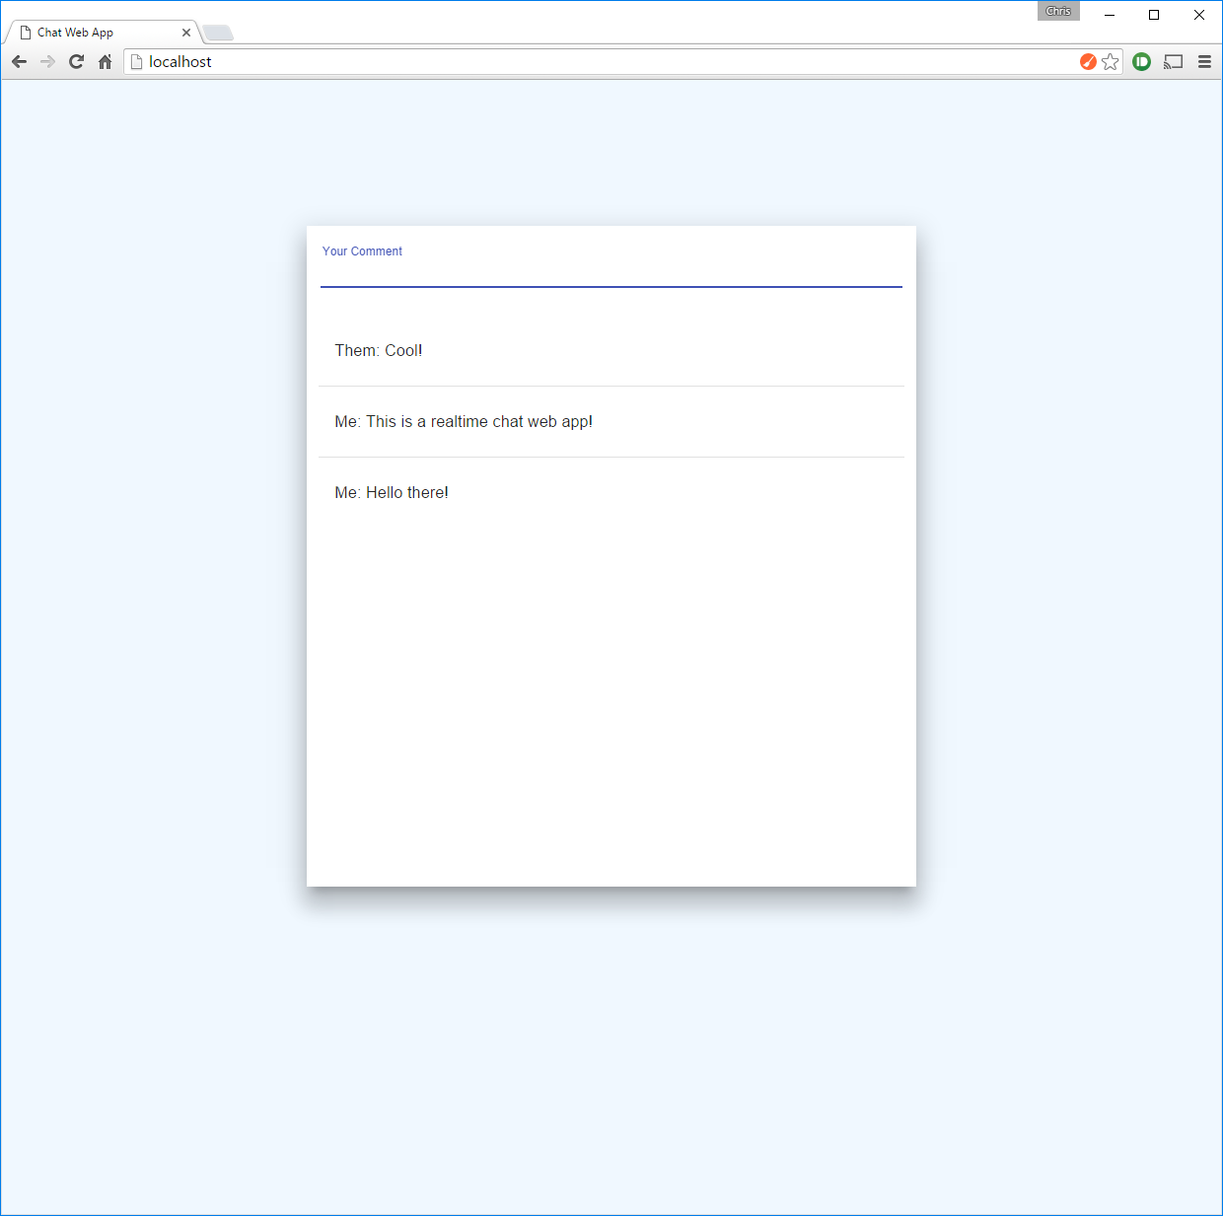
What will we build?
Real time chat web app
Like Slack

Slide 6
JavaScript
Interpreted programming language
Dynamic typing
Variables are not given a type
Used to add logic to a website
With Node.js it can be used to write a server too

Slide 7
Variable Assignment
var myVariableName = “this is a string”;
var a = 42;
var b = a;
var c = myVariableName + a;
console.log(c);

Slide 8
Conditionals
var a = 42;
if (a > 42) {
console.log(“a is more than 42”);
} else if (a < 42) {
console.log(“a is less than 42”);
} else {
console.log(“a is 42”);
}

Slide 9
Arrays (more like a list)
var a = []; // dynamic size and type, empty array
var b = [“a”, 1, “b”, 2, [“c”, 3]]; // items separated by commas
a.push(“42”); // adds item to end (stack push)
a.push(42);
console.log(a);
var c = a[0];
a[0] = 84;
var e = a.pop(); // removes and returns last item (stack pop)
var n = b.length; // number of items in array

Slide 10
Loops
var a = [“a”, “b”, “c”];
for (var i = 0; i < 5; i++) {
console.log(“index “ + i + “: ” + a[i]);
}
for (var i in a) {
console.log(“index “ + i + “: ” a[i]);
}
for (var b of a) {
console.log(b);
}

Slide 11
Objects
var a = { }; // objects are a named set of values
var b = {
a: 42, // memberName: value,
b: “chris”, // separated by commas
c: a
};
var c = b.a; // gets member a of b
b.d = “ACM”; // sets member e of b
b[“any string”] = “string indexed”;
console.log(b);
console.log(b.c);

Slide 12
More Loops
var a = { a: “12”, b: [1, 2], c: 42 };
for (var i in a) {
if (a.hasOwnProperty(i)) { // filter out unwanted members
console.log(a[i]);
}
}

Slide 13
Functions
function myFuncName(param1, param2) {
var abc = 1337 + param1 + param2;
return abc;
}
var a = myFuncName(1, -1);
var b = myFuncName;
var c = b(1, -1);

Slide 14
Lambda (anonymous functions)
var a = function(b, c) {
var d = b + c;
return d + 1337;
};
var e = a(2, -2);
var makeSum = function(b) {
return function(c) {
return b + c;
};
};
var leetSum = makeSum(1337);
leetSum(-1295);

Slide 15
More Lambdas (different syntax)
var a = (b, c) => {
return b + c + 1337;
};
a(2, -2);
var makeSum = b => c => b + c; // this is the same as the last slide!!
var leetSum = makeSum(1337);
leetSum(-1295);

Slide 16
Promises
A way to obtain a value at some point in the future
For example: I give a professor my test and he says he will return the graded test, not immediately, but at some point in the future
This contrasts how code is normally thought about
Normally, if you call a function for example, the result is returned immediately

Slide 17
More Promises
var deferred = Promise.defer();
deferred.promise.then(result => console.log(“promise result: “ + result));
deferred.resolve(1337);
var deferred2 = Promise.defer();
deferred2.resolve(1337);
deferred2.promise.then(result => console.log(“promise result: “ + result));

Slide 18
Quiz time…
What does:
new Array(6).fill(1/'z').join('')+'namtab '.split('').reverse().join('')
Evaluate to?

Slide 19
HTML Primer
<html>
<head>
<link rel="stylesheet" href="url/to/cssFile.css">
<script src="url/to/javascriptFile.js"></script>
</head>
<body>
<div class=“hoverRed">
<div class="big">This is content.</div>
<div class=“bigger">Even more content.</div>
</div>
</body>
</html>

Slide 20
CSS Primer
body {
background-color: #333;
color: #9bd7d5;
}
.big {
font-size: 16px;
}
.bigger {
font-size: 24px;
}
.hoverRed:hover {
color: red;
}

Slide 21






How it all fits together

Slide 22
Setup
git clone https://github.com/chcaru/workshop.git
cd workshop1/start

Slide 23
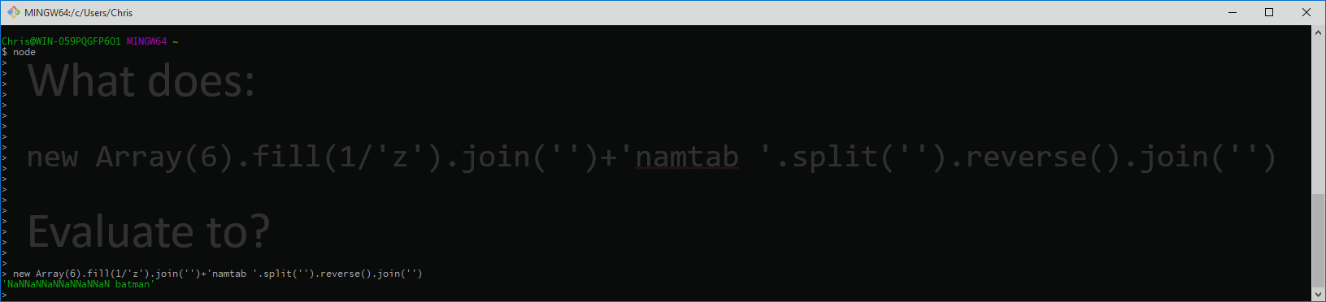
Node.js
Node.js is an asynchronous event driven framework/environment for JavaScript
Its JavaScript engine is Chrome’s V8 engine

Slide 24
What’s next?
AngularJS (1.4.9)
Socket.io
MongoDB

