Slide 1
TypeScript
Scalable javascript
Chris Caruso

Slide 2
Make sure these are installed
goo.gl/xLJ97b
node.js (v5.10.1)
git
VSCode (recommended for TypeScript)

Slide 3

Opportunities
SDE Intern
bit.ly/1Y9KzkU
Explorer Intern
Freshman / Sophomore
Rotate between SDE / PM
bit.ly/1lbcL9L
Questions? (ask now or stay after)

Slide 4

Startup Weekend Tuscaloosa
Weekend long hackathon
Friday, April 22 - 24, 2016
Build a product prototype (web app, mobile, other…)
It’s A LOT of fun!
Looks great on resume
goo.gl/4azuLk
Sign up now!!
Video

Slide 5

Prizes
1st Place
Friend level co-working space for 3 months at The Edge (Summer 2016)
Two hours of Legal consultation with Rosen Harwood
Two hours of Accounting consultation with JamisonMoneyFarmer PC (JMF)
Free .CO domain registration
$300 in credits from Google Cloud Platform to help build web and mobile apps
2nd Place
Friend level co-working space for 3 months at The Edge (Summer 2016)
One hour of Legal consulting with Rosen Harwood
One hour of Accounting consulting with JamisonMoneyFarmer PC (JMF)
Free .CO domain registration
$300 in credits from Google Cloud Platform to help build web and mobile apps
3rd Place
Free .CO domain registration
$300 in credits from Google Cloud Platform to help build web and mobile apps

Slide 6

goo.gl/mPVVPb

Slide 7
VSCode (Visual Studio Code)
Not Visual Studio
Takes about 1 minute to install
code.visualstudio.com

Slide 8

What is ?
Superset of JavaScript
Any JavaScript is TypeScript
Has more language features than JavaScript
Compiled / Transpiled
To JavaScript
Extra features
Types!
Including generic types
Interfaces + Abstract Classes
Async / Await in ES6
Easier way to handle Promises

Slide 9
Why use ?
Types
Eliminates type errors (which are super common in JavaScript)
Allow large projects
Allow large teams
Reduces need for type documentation
Reduces need for cross developer communication
The flexibility of JavaScript with type safety
Freedom to target specific ECMAScript versions
ES3 / ES5 / ES6 / ES2016 (ES7)
Freedom to target specific module systems
CommonJS / AMD / UMD / ect…

Slide 10
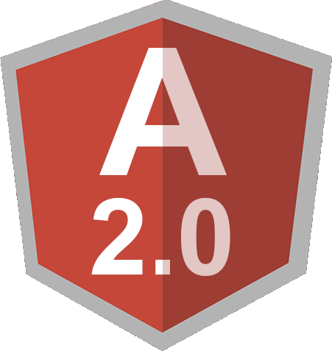

Who uses ?

Slide 11
Open git bash or terminal
git clone https://github.com/chcaru/workshop.git
cd workshop/typescript/start
npm install –g typescript
start code .
tsc –w –pretty
IF NOT USING VSCODE, USE THIS TO RUN OUR CODE:
node bin/main.js

Slide 12
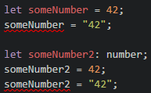
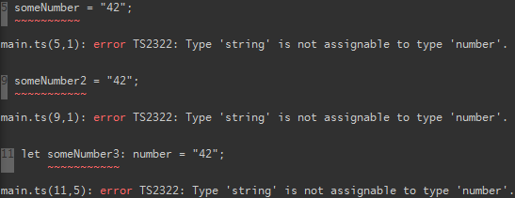
Types
Infers type of someNumber as number
VScode errors:
Compile errors:
Explicitly declare type of someNumber2 as number

Slide 13
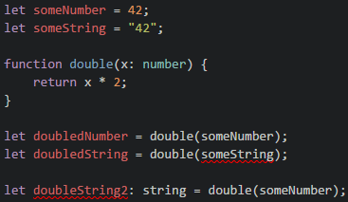
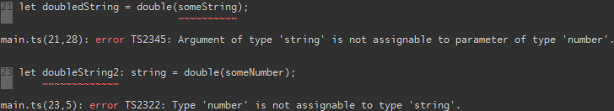
Types Cont.
Explicitly define parameter type
Infers return type as number

Slide 14


Implicit return type
Explicit return type
Explicit return type as string, produces error
because the type being returned is not correct

Slide 15
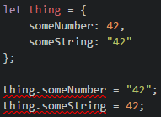

Slide 16
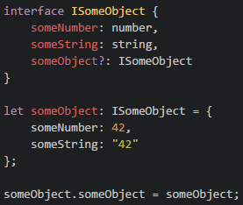
Interfaces
Interface declared type
? Means optional

Slide 17
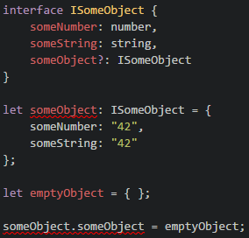
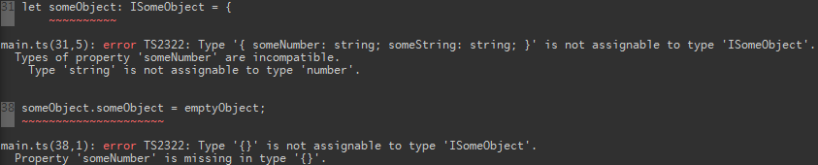

Slide 18
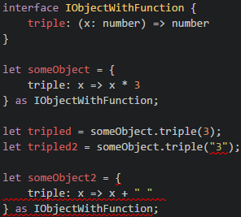
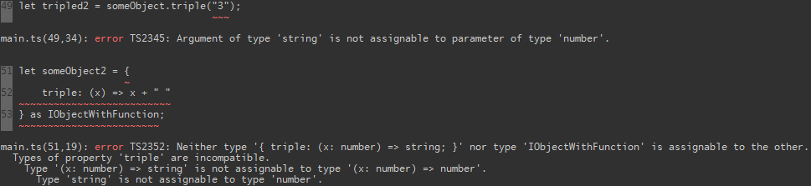

Slide 19
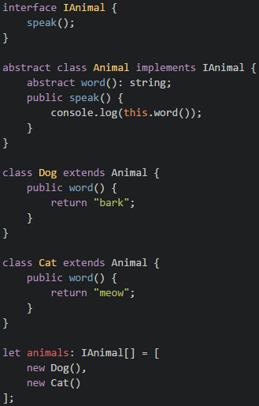

Slide 20
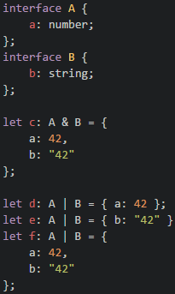

Slide 21
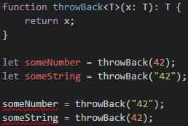
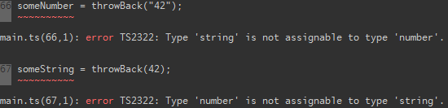
Generics

Slide 22
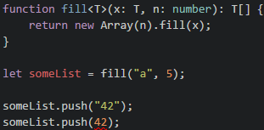

Slide 23
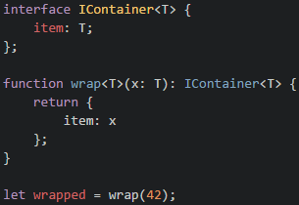
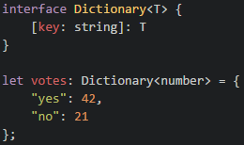
Indexer using generics:

Slide 24
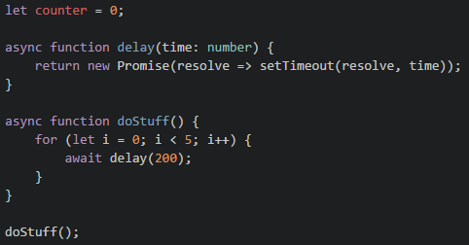

Slide 25
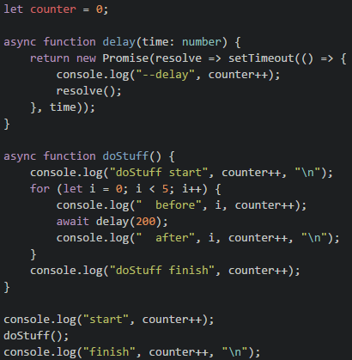

Slide 26
Startup Weekend Tuscaloosa
Weekend long hackathon
Friday, April 22 - 24, 2016
Build a product prototype (web app, mobile, other…)
goo.gl/4azuLk
Sign up now!!

Slide 27
FREE STUFF

