Slide 1
Workshop 3
Angularjs + Angular material, nodejs, and socket.io
Chris Caruso

Slide 2
Make sure these are installed
goo.gl/AMNFLQ
Chrome
Node.js (v5.6)
Git
Your favorite code editor, or I suggest one of these:
Atom
VSCode

Slide 3

Startup Weekend Tuscaloosa
Weekend long hackathon
Friday, April 22 - 24, 2016
Build a product prototype (web app, mobile, other…)
It’s A LOT of fun!
Looks great on resume
goo.gl/4azuLk
Sign up now for $25

Slide 4

goo.gl/mPVVPb

Slide 5
For all your AngularJS documentation needs: docs.angularjs.org/api

Slide 6
Open git bash or terminal
git clone https://github.com/chcaru/workshop.git
cd workshop/workshop3
npm install
cd start
atom .
node server.js
Starts node with the file server.js
We will be restarting this throughout
the workshop, so keep the window
handy, but don’t close it!

Slide 7
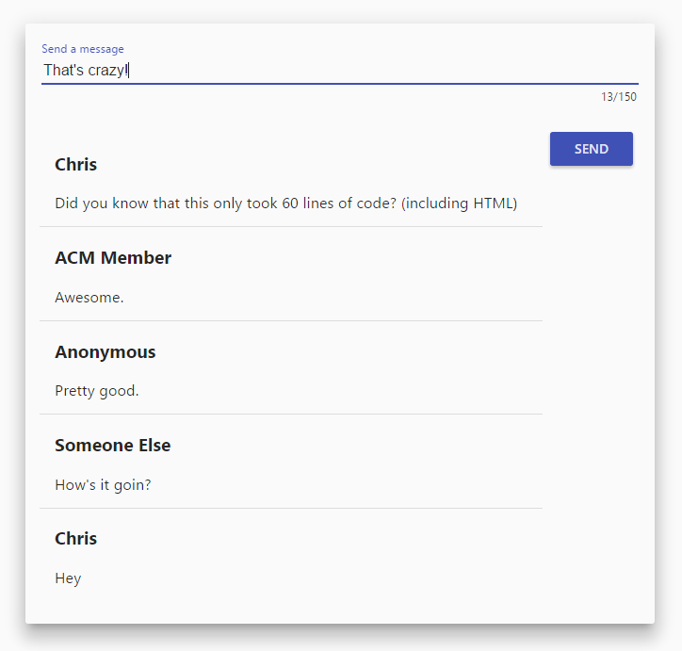

Slide 8
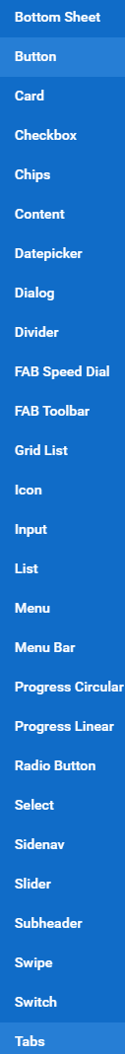
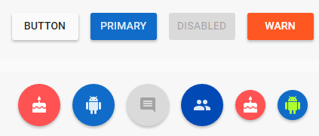
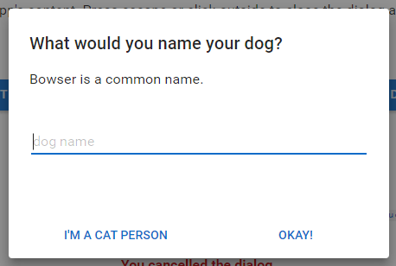


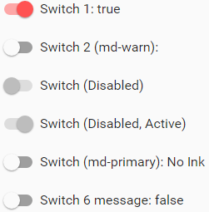
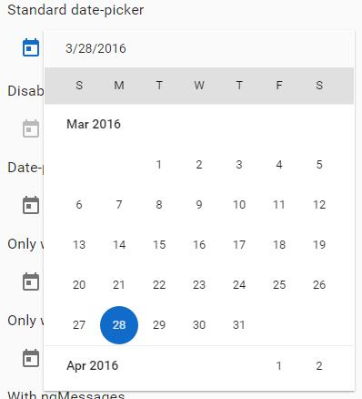


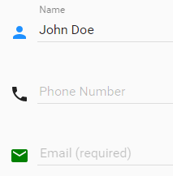
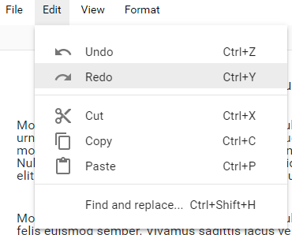

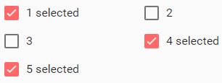
Angular Material
Prebuilt directives for AngularJS
Ready to use with AngularJS
Adhere to Material Design specs
Think of it as HTML 2.0+
Work great
Look great

Slide 9
This thing. For each message
And this thing… Between each message

Slide 10
scope.text = text in the textbox here
scope.send() = send text and name to server
scope.messages = [{
name: ‘name’,
text: ‘text’
}]
(list of messages)
scope.messages[3].name
scope.messages[4].text

Slide 11
5 minute break If you need help, ask now! Feedback: goo.gl/AMNFLQ

Slide 12


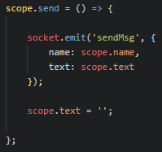

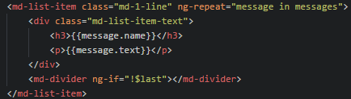
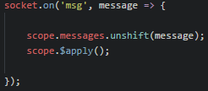
index.html
app.js
server.js

Slide 13
Send message
Receive message
Receive message
Receive message
Receive message

Slide 14
Workshop4?
Tuesday 4/12
Make sure you vote on the next workshop!
goo.gl/AMNFLQ

