Slide 1
Weekly Report 9/25
Christina Chen

Slide 2
Tasks this week
Compare each of the three fitting methods – proton only
Tune basin-hopping algorithm
Modify the objective (chi^2) function currently used to describe fitting accuracy

Slide 3
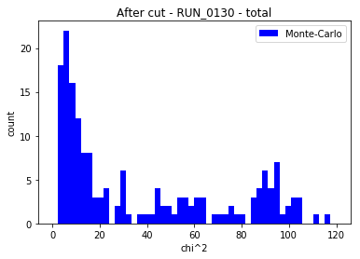
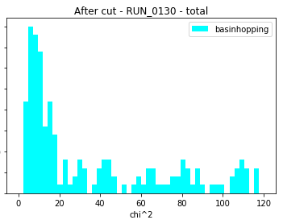
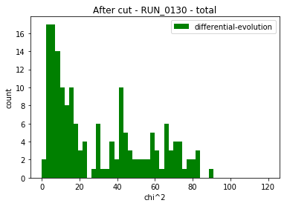
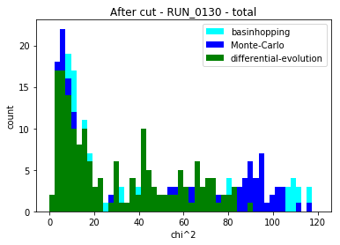
Total chi square
Used same cutting criteria as the ones in Josh’s thesis
Updated DE functional parameters to be the best ones found last week

Slide 4
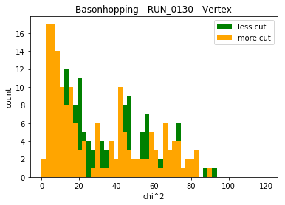
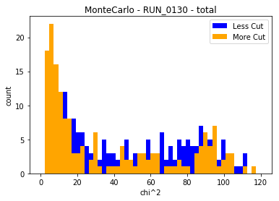
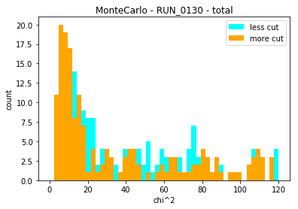
Total chi square – more vs. less cut

Slide 5
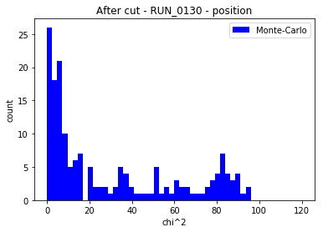
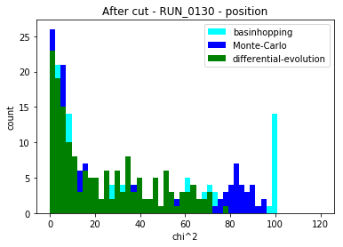
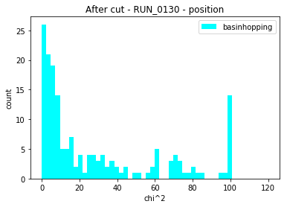
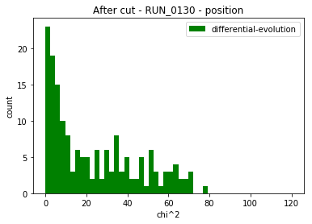
Position chi square

Slide 6
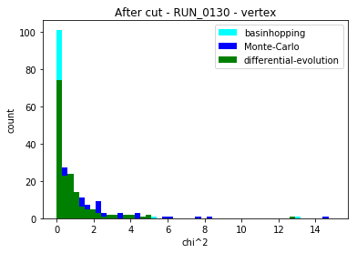
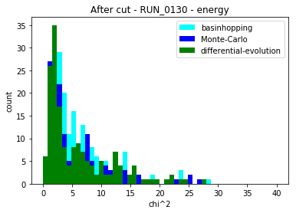
Energy and vertex chi square
The three methods do not seem to have significant differences in terms of fitting energy and vertex

Slide 7
Basin-hopping
scipy.optimize.basinhopping(f, ctr0, niter=30, T=0.01, stepsize=0.05, minimizer_kwargs={"method": method})
niter: number of iterations (“jumps”)
Stepsize: comparable to typical separation value between local minima
T: comparable to chi^2 difference between local minima
If f(new) < f(old), steps are always accepted
Otherwise, steps are accepted with probability exp[(f(old)-f(new))/T], in order to get the search space out of a local minimum

Slide 8
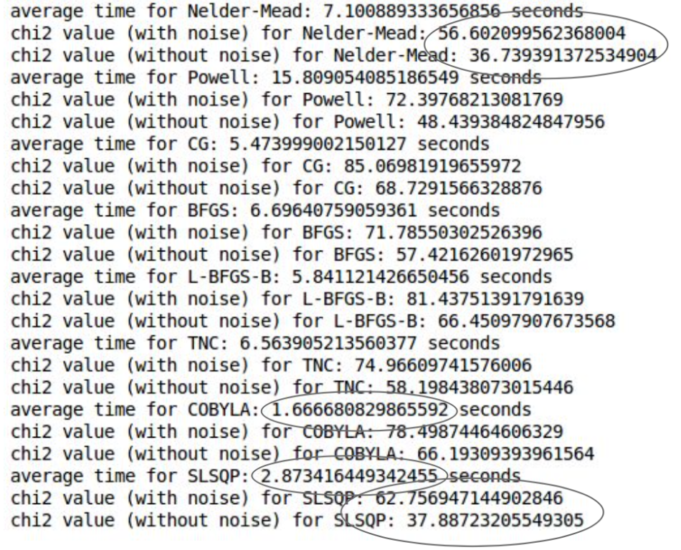
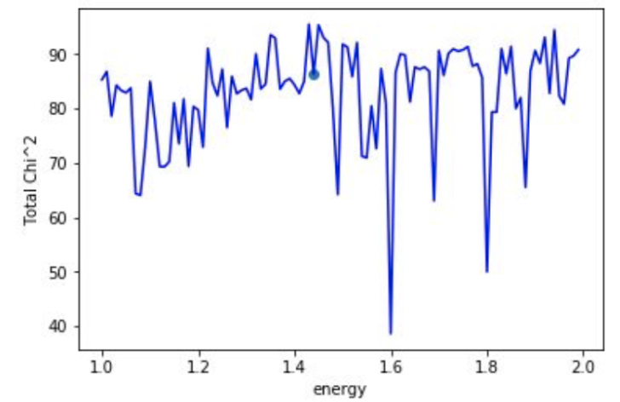
Local minimization methods
From last summer:
T=0.01
Niter = 10
Stepsize = 0.05

Slide 9
T=0.01, STEPSIZE = 0.05
N = 10: Nelder-Mead 6.77s, 46.03 SLSQP (Sequential Least Squares Programming): 1.58s, 58.89
N = 15: Nelder-Mead 7.02s, 38.59 SLSQP: 1.95s, 53.81
N = 20: Nelder-Mead 10.32s, 39.59 SLSQP: 2.8s, 52.94
N = 25: Nelder-Mead 12.46s, 37.57 SLSQP: 3.5s, 46.6
N = 30: Nelder-Mead 25.5s, 35.25 SLSQP: 3.7s, 48.39
N = 35: Nelder-Mead 30.25s, 35.31
N = 40: Nelder-Mead 20.04s, 37.3
T = 0.01, stepsize = 0.02, N = 20: chi^2 = 34.11

Slide 10
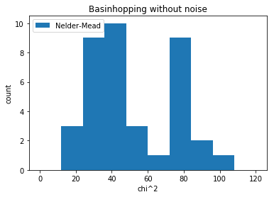
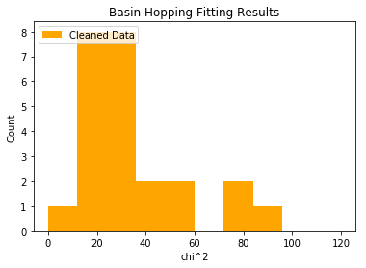
Comparing with last summer

Slide 11
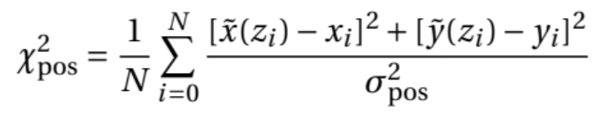
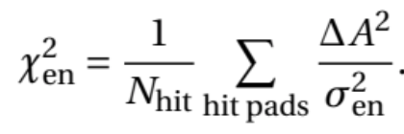
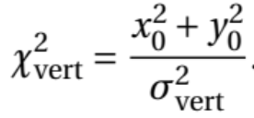
The objective function
Difference between modeled track position
and real data
Deviations between simulated track’s hit
pattern and the experimental hit pattern
To constrain the reaction vertex
to be near the z axis

Slide 12
Position chi^2
To allow position and energy chi^2 have numerically equal weights, I used scaling factors 0.25 and 0.5 on event 504 (proton-like, hard to fit) using DE and BH
Monte-Carlo’s chi^2 function is built-in and therefore more difficult to modify

Slide 13
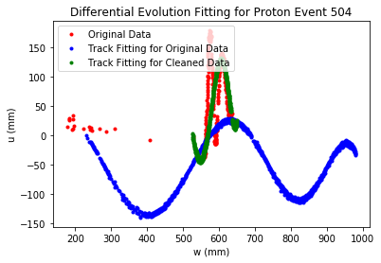
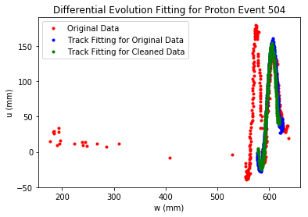
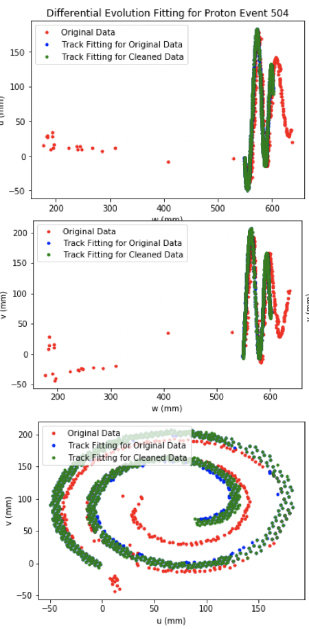
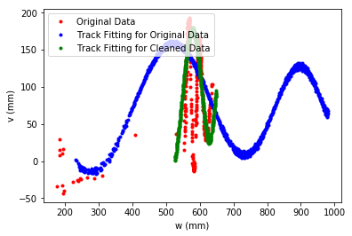
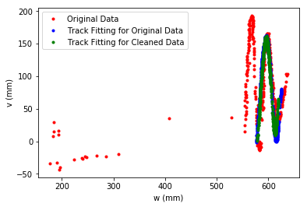
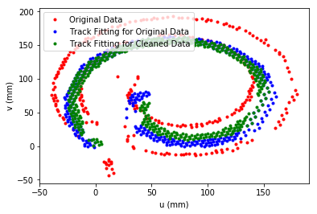
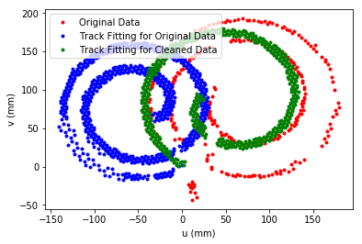
Event 504 Differential evolution
Scaling factor 0.25
Scaling factor 0.5
original
We see that DE is not robust to
decreased weight of position chi^2

Slide 14
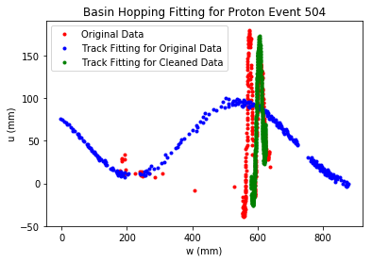
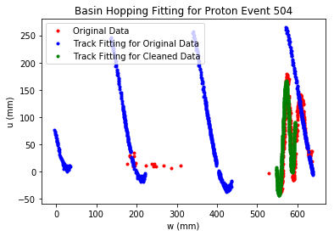
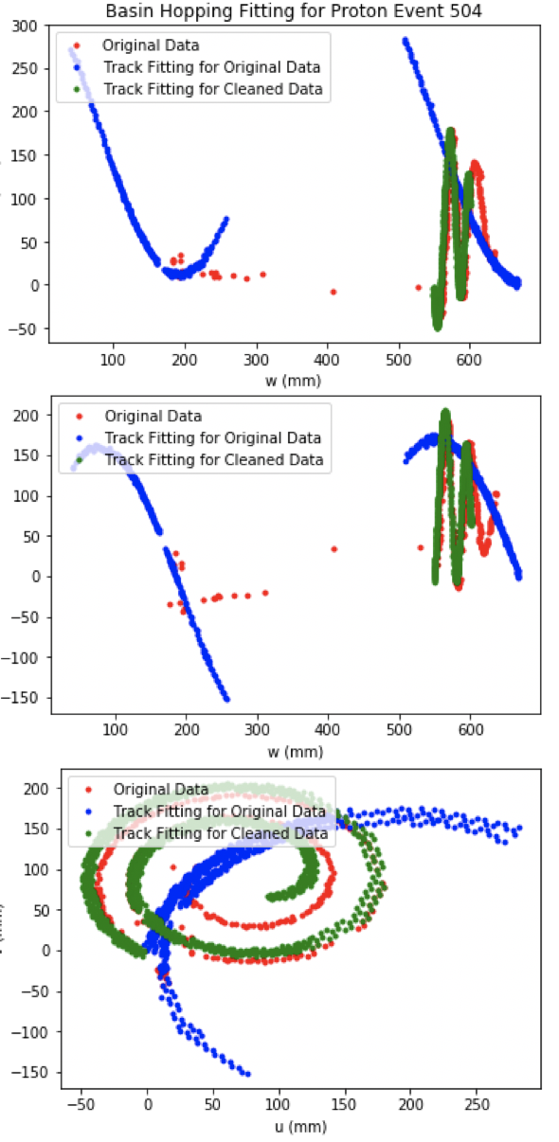
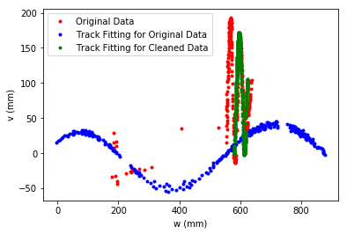
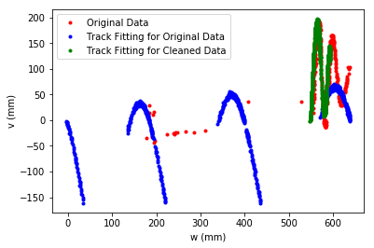
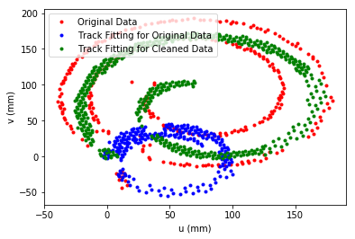
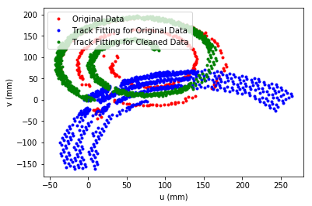
Event 504 basin- hopping
Scaling factor 0.25
Scaling factor 0.5
original
BH is more robust to decreased
weight of position chi^2; has
better fitting than DE for
modified objective function

Slide 15
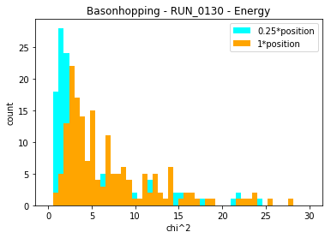
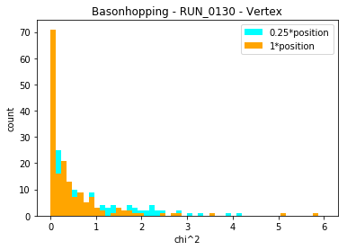
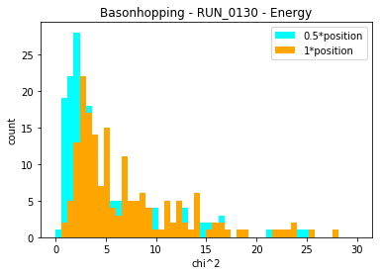
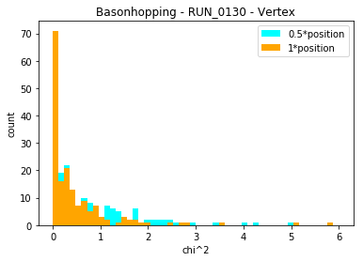
What does scaling position chi^2 do to other chi^2 components?
Improves energy chi^2

