Slide 1
Weekly report 11/13
Christina Chen

Slide 2
tasks
More bug fixing
Results of original MC algorithm
Christina’s chi^2 version 2.0

Slide 3
Random param generator
np.random.uniform
problem: some were unable to pass track simulation because they were non-physical
solution: keep generating random parameters until there are enough candidates (500) per iteration
this is faster than the previous method

Slide 4
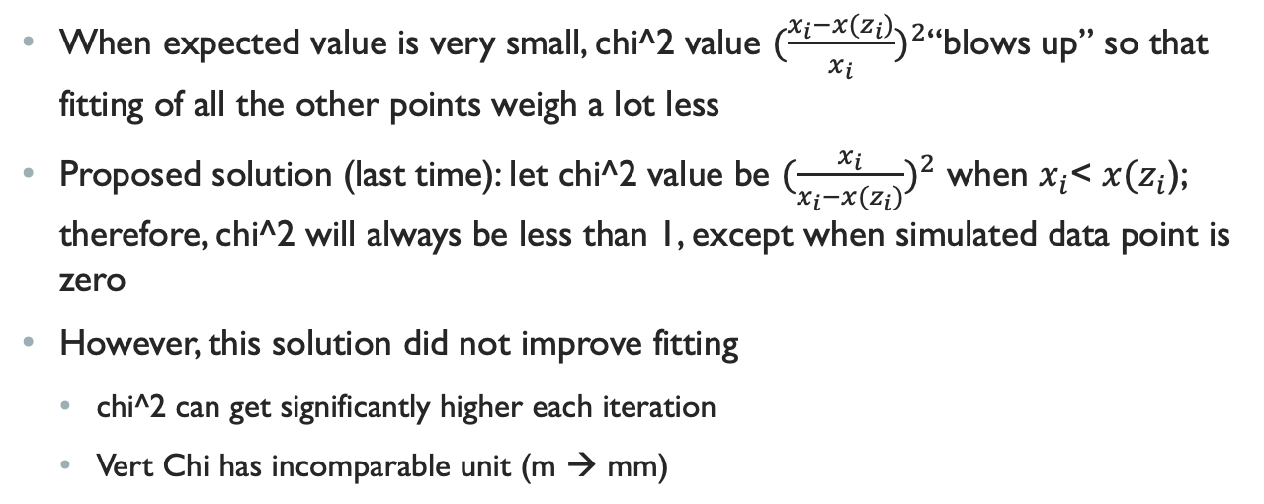
Problems from last time
When expected value is very small, chi^2 value ${(\frac{x_{i}−x(z_{i})}{x_{i}})}^{2}$“blows up” so that fitting of all the other points weigh a lot less
Proposed solution (last time): let chi^2 value be ${(\frac{x_{i}}{x_{i}−x(z_{i})})}^{2}$ when $x_{i}$< $x(z_{i}$); therefore, chi^2 will always be less than 1, except when simulated data point is zero
However, this solution did not improve fitting
chi^2 can get significantly higher each iteration
Vert Chi has incomparable unit (m → mm)

Slide 5

chi-squared test
definition: $χ^{2}=Σ\frac{({O_{i}−E_{i})}^{2}}{E_{i}}$
only applicable to observed & expected values of >5 to avoid blowing up

Slide 6
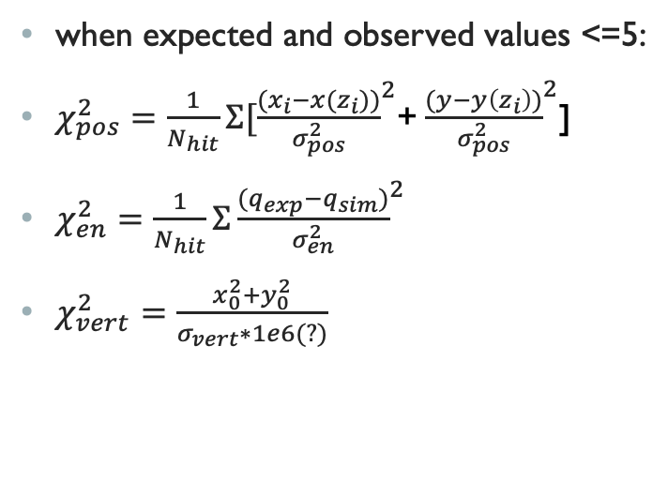
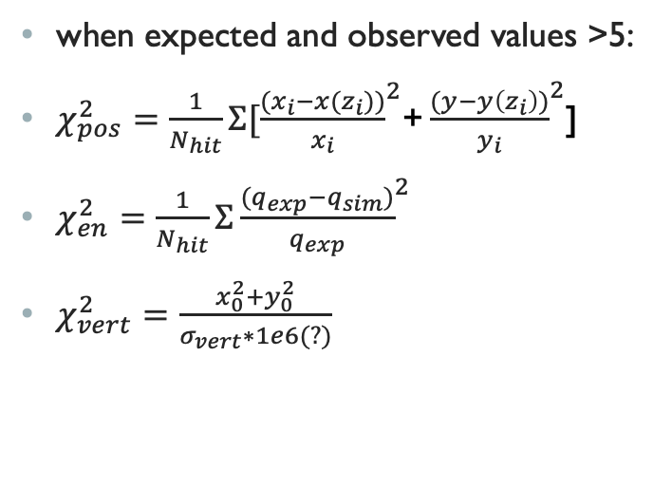
christina’s objective function 2.0
when expected and observed values >5:
$χ_{pos}^{2}=\frac{1}{N_{hit}}Σ[{\frac{{(x}_{i}−x(z_{i}))}{x_{i}}}^{2}$+ ${\frac{(y−y\left(z_{i}\right))}{y_{i}}}^{2}$]
$χ_{en}^{2}=\frac{1}{N_{hit}}Σ{\frac{{{(q}_{exp}−q}_{sim})}{q_{exp}}}^{2}$
$χ_{vert}^{2}=\frac{x_{0}^{2}+y_{0}^{2}}{σ_{vert}∗1e6(?)}$
when expected and observed values <=5:
$χ_{pos}^{2}=\frac{1}{N_{hit}}Σ[{\frac{{(x}_{i}−x(z_{i}))}{σ_{pos}^{2}}}^{2}$+ ${\frac{(y−y\left(z_{i}\right))}{σ_{pos}^{2}}}^{2}$]
$χ_{en}^{2}=\frac{1}{N_{hit}}Σ{\frac{{{(q}_{exp}−q}_{sim})}{σ_{en}^{2}}}^{2}$
$χ_{vert}^{2}=\frac{x_{0}^{2}+y_{0}^{2}}{σ_{vert}∗1e6(?)}$

Slide 7
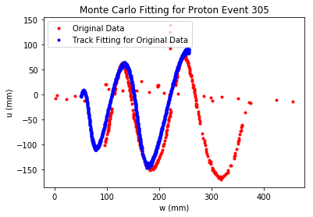
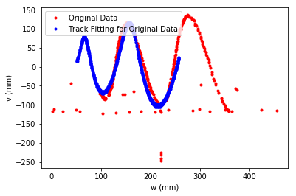
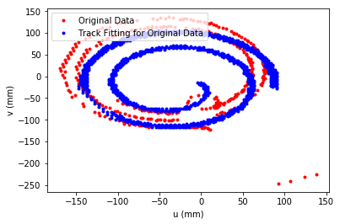
results – event 305

Slide 8
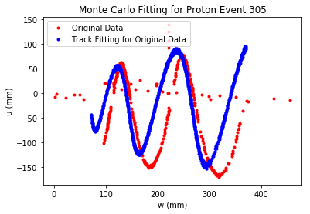
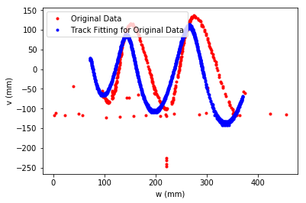
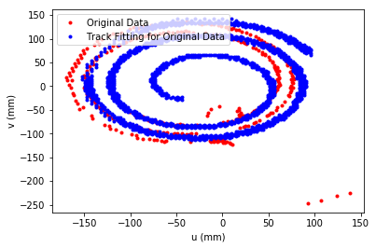
results – event 305

Slide 9
next step?
fit the new objective function with other methods
keep debugging

