Slide 1
Track Classification Applications
Christina Chen

Slide 2
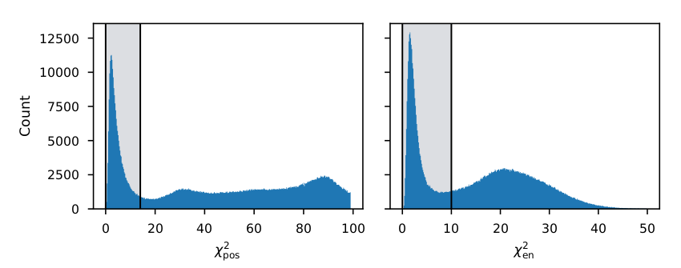
What is the next step of track classification?
Track fitting
Right now we use Monte-Carlo to classify proton events from all events
Testing Neural network models
Global optimization methods

Slide 3
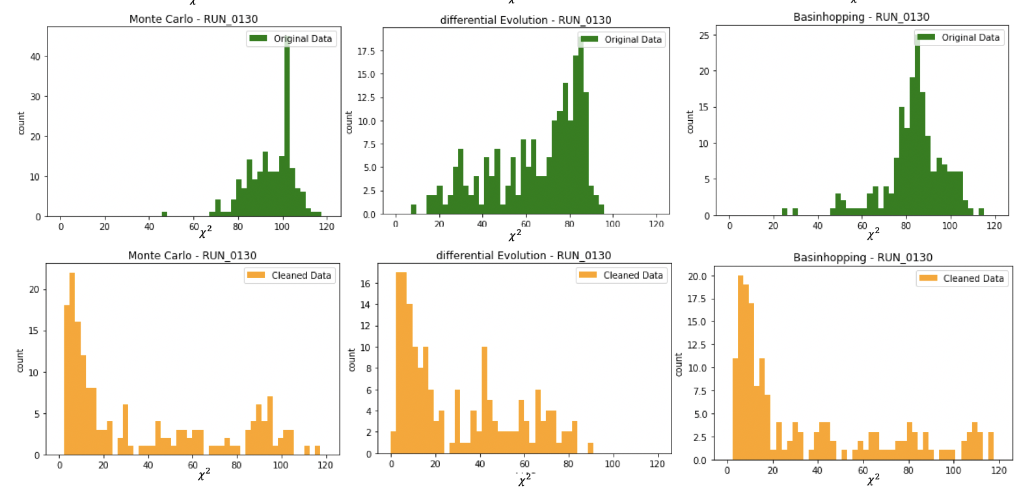
Optimization methods (~160 proton events)

Slide 4
Monte-Carlo
Six-dimensional parameter space: (x,y,z,E,φ,θ)
Random generation of uniformly distributed candidate points around the seed point
The point with lowest objective function value is updated as the new seed point
Stops when the number of iteration is reached

Slide 5
Differential Evolution
Randomly selects n points within 6-D search space (population)
Recombines each point with other candidates in the population -> there are different strategies for this
Decides whether the mutated points will be kept as the new candidate
Stops when the point with lowest objective function value is found and/or when the number of iteration has been reached

Slide 6
Basin hopping
A variation of Markov Chain Monte Carlo method, combines global stepping algorithm with local minimization algorithm
Calculates local minimum based on the starting point
Applies a random perturbation to the coordinates
Calculates candidate point (local minimum) at new location, then accepts/rejects the new candidate using Metropolis criteria.
Stops when the point with lowest objective function value is found and/or when the number of iteration has been reached

