Slide 1
Weekly report 10/2/2018
Christina Chen

Slide 2
Tasks this week
To closely examine and modify the energy component of the chi^2 function

Slide 3
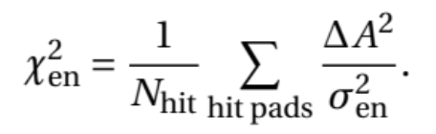
The energy objective function
A: total charge deposited in a particular pad (units: MeV/u)
Sigma: estimated energy uncertainty, ~10% of the maximum of A in the experimental track
Sums over (and divided by) all pads that were hit in the experimental track

Slide 4
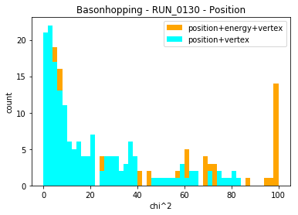
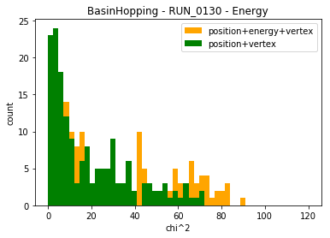
How does energy chi^2 affect position chi^2?
Performed track fitting, excluding energy chi^2, for hand-labeled proton events in run_103: we expect position chi^2 to improve it has higher weighting

Slide 5
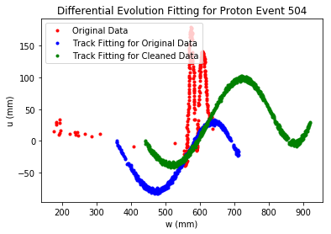
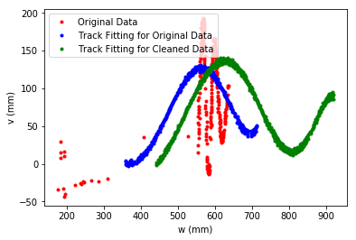
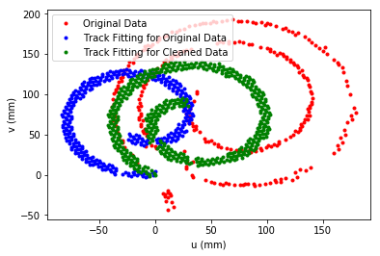
However, for certain noisy events such as event 504, we see that the position fitting got worse without energy chi^2 component
Could it be that position and energy are “helping each other” in terms of eliminating noise?

Slide 6
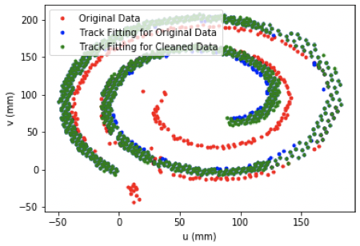
Does chi^2 energy depend on noise?
Difference in A becomes very large when a noise point causes charges to be present at places not fitted by simulated track

Slide 7
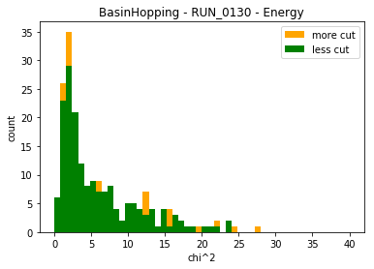
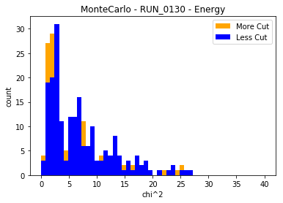
Energy histograms
Track cleaning helps reducing the energy chi^2 component

Slide 8
Another problem: is energy chi^2 unitless?
We want all the chi^2 components to be unitless so they can be added together
Right now its “unitless” is achieved by scaling the sum by 10% of A_max.
We want to minimize the effect of noise

Slide 9
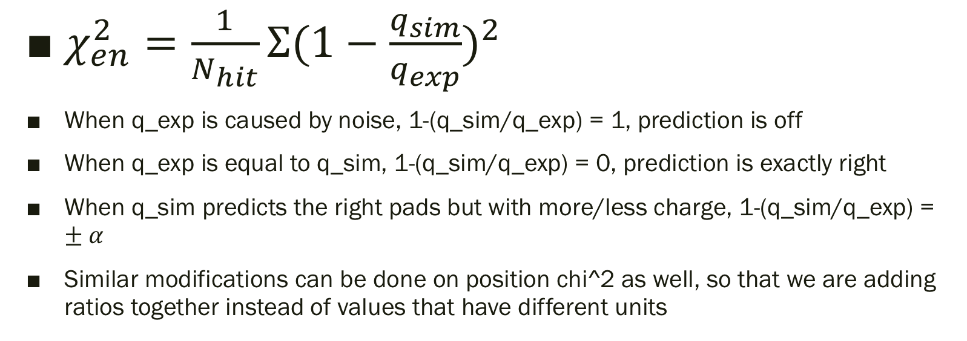
$χ_{en}^{2}=\frac{1}{N_{hit}}Σ{(1−\frac{q_{sim}}{q_{exp}})}^{2}$
When q_exp is caused by noise, 1-(q_sim/q_exp) = 1, prediction is off
When q_exp is equal to q_sim, 1-(q_sim/q_exp) = 0, prediction is exactly right
When q_sim predicts the right pads but with more/less charge, 1-(q_sim/q_exp) = $±α$
Similar modifications can be done on position chi^2 as well, so that we are adding ratios together instead of values that have different units

Slide 10
Monte Carlo Algorithm with Python - testing modified objective function
Randomly generate 500 vectors, around initial point, with certain range sigma for each parameter
For each vector, generate a simulated track
For each track, Calculate position chi^2: using interpolate 1D function to get x and y as a function of z, and take the sum of chi^2 of each x and y with real data
Calculate energy chi^2, for exp_hits not equal to 0 or NaN only
Calculate vertex chi^2
Add the three components together for total chi^2
Update the track with lowest chi^2 to be the new candidate
Generate 500 vectors within width of (sigma0)*R^I
R is the reduction factor 0.8; I is the number of iteration (goes from 1 to 20)

