Slide 1
Weekly report 11/06/2018
Christina Chen

Slide 2
tasks
Finish coding Monte-Carlo algorithms with two objective functions (pytpc vs. Christina)
Compare accuracies of the two objective functions

Slide 3
Problems to be solved…

Slide 4
1. Long time for param generation
As parameter space gets smaller, it takes a much longer time to generate 500 candidate points
Josh set # iterations to be 20; however we can only do around 10 iterations within a reasonable time

Slide 5

2. For revised objective function: penalty for nan during interpolation
Setting NaN values equal to 0.0 gives too little penalty
${(1−\frac{x(z_{i})}{x_{i}})}^{2}$ could be well above 1 (especially if there is experimental noise near x = 0); whereas NaN penalty only gives 1

Slide 6
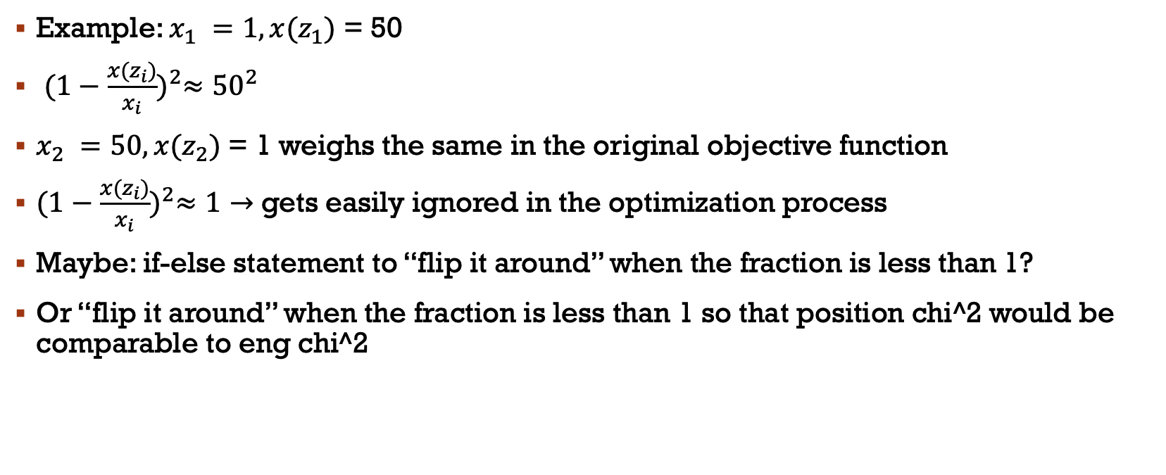
3. For revised objective function: penalty for x(z_{i}) < x_{i}
Example: $x_{1} =1, x(z_{1})$ = 50
${(1−\frac{x(z_{i})}{x_{i}})}^{2}≈{50}^{2}$
$x_{2} =50, x(z_{2})$ = 1 weighs the same in the original objective function
${(1−\frac{x(z_{i})}{x_{i}})}^{2}≈1→$ gets easily ignored in the optimization process
Maybe: if-else statement to “flip it around” when the fraction is less than 1?
Or “flip it around” when the fraction is less than 1 so that position chi^2 would be comparable to eng chi^2

Slide 7
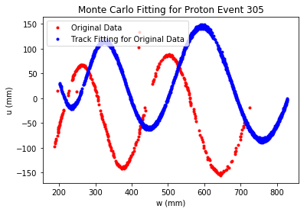
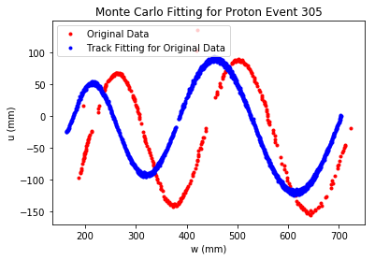
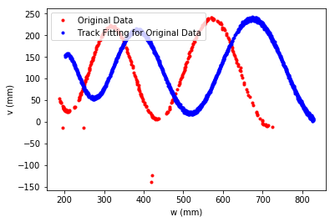
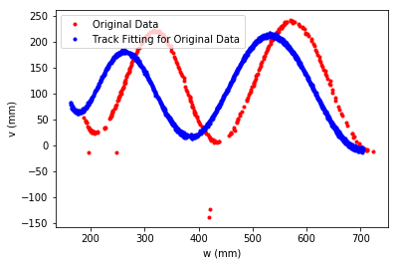
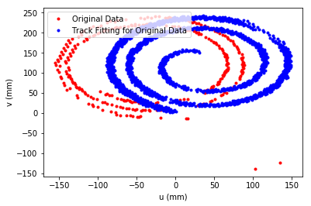
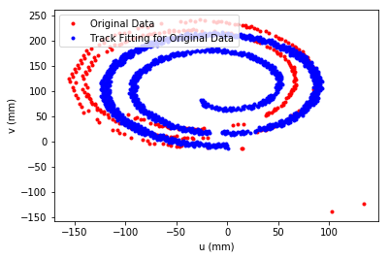
Results so far event 305
Left: original objective function
Chi values are around 160 after several iterations because there is no longer a cap on max chi2 position
Right: new objective function
This is with a penalty of 100.0 for NaN interpolation results
In progress!

Slide 8
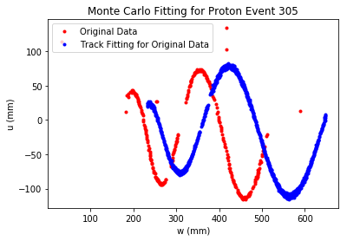
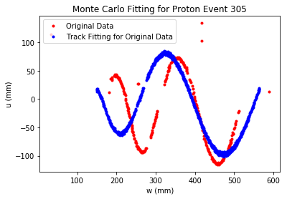
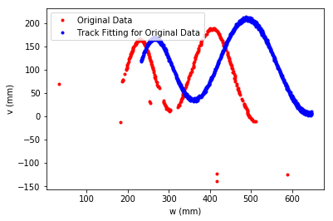
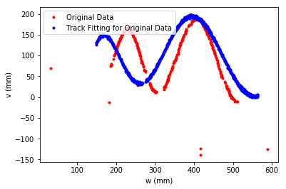
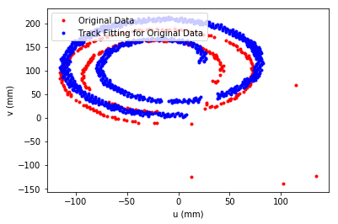
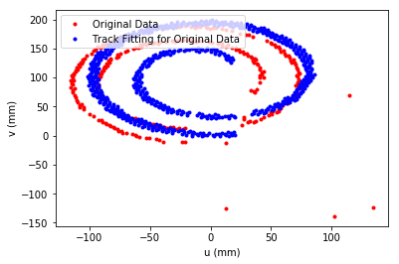
Results so far event 789
Left: original objective function
Right: new objective function

Slide 9
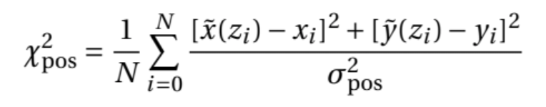
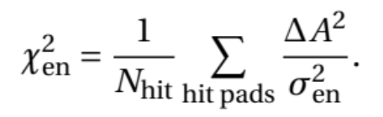
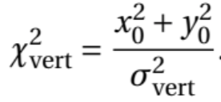

For reference
$χ_{pos}^{2}=\frac{1}{N_{hit}}Σ[{(1−\frac{x(z_{i})}{x_{i}})}^{2}$+ ${(1−\frac{y(z_{i})}{y_{i}})}^{2}$]
$=\frac{1}{N_{hit}}Σ[{(\frac{x_{i}−x(z_{i})}{x_{i}})}^{2}$+ ${(\frac{y−y(z_{i})}{y_{i}})}^{2}$]
$χ_{en}^{2}=\frac{1}{N_{hit}}Σ{(1−\frac{q_{sim}}{q_{exp}})}^{2}$
$χ_{vert}^{2}=\frac{x_{0}^{2}+y_{0}^{2}}{σ_{vert}}$

