Slide 1
Algebraic Method Engine
OAProvider and IOAProviderFactory
L₂s(2^{2s-1})
  H_2s_OAProvider
L_{t}2(t^{m}) m <= t+1, t is a prime
  Rp_OLS_p2_OAProvider
L_{t}u(t^{m}) u >= 2, m >= t+1, t is a prime
  Rp_OLS_pu_OAProvider

Slide 2
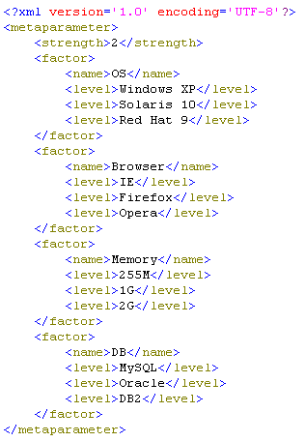
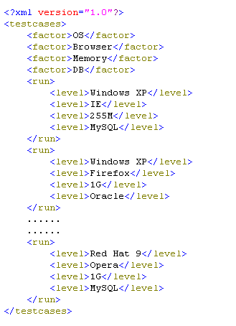
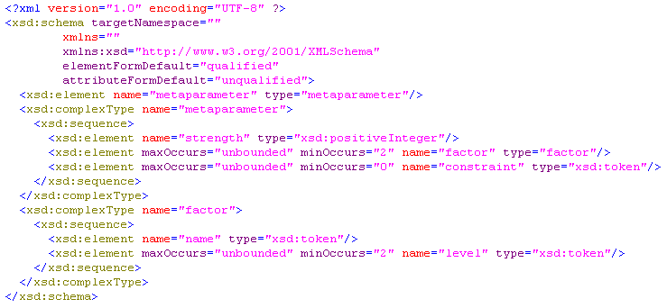
Data Transfer
MetaParameter
Test Cases

