Slide 1
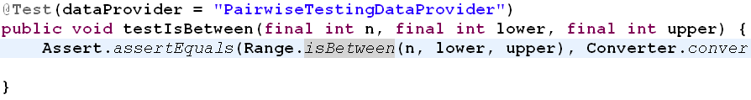
Test Case Template
Static Method
Singleton

Slide 2
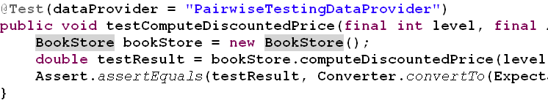
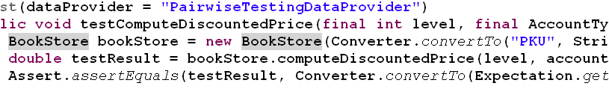
Test Case Template
Default Constructor
Constructor with arguments

Slide 3
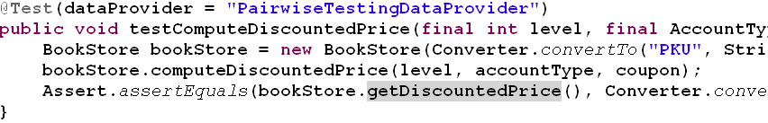
Test Case Template
Check State Method

Slide 4
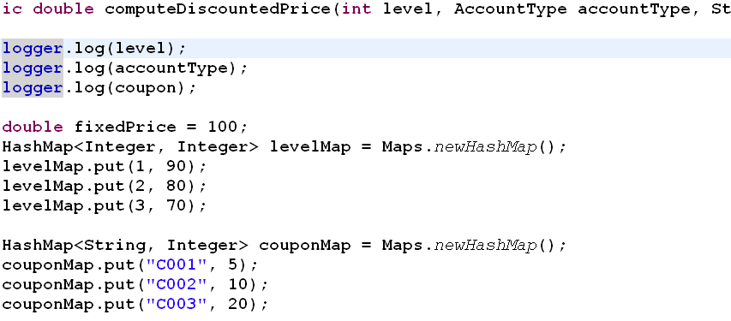
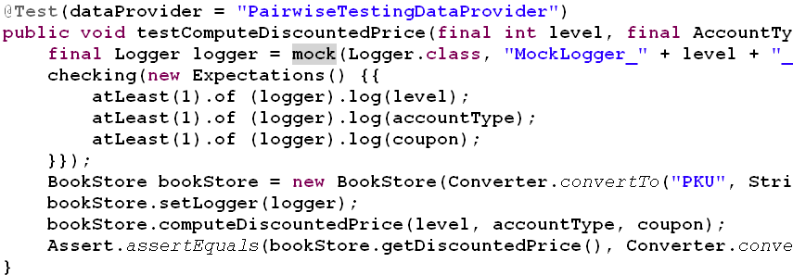
Test Case Template
Auto Mock

