Slide 1
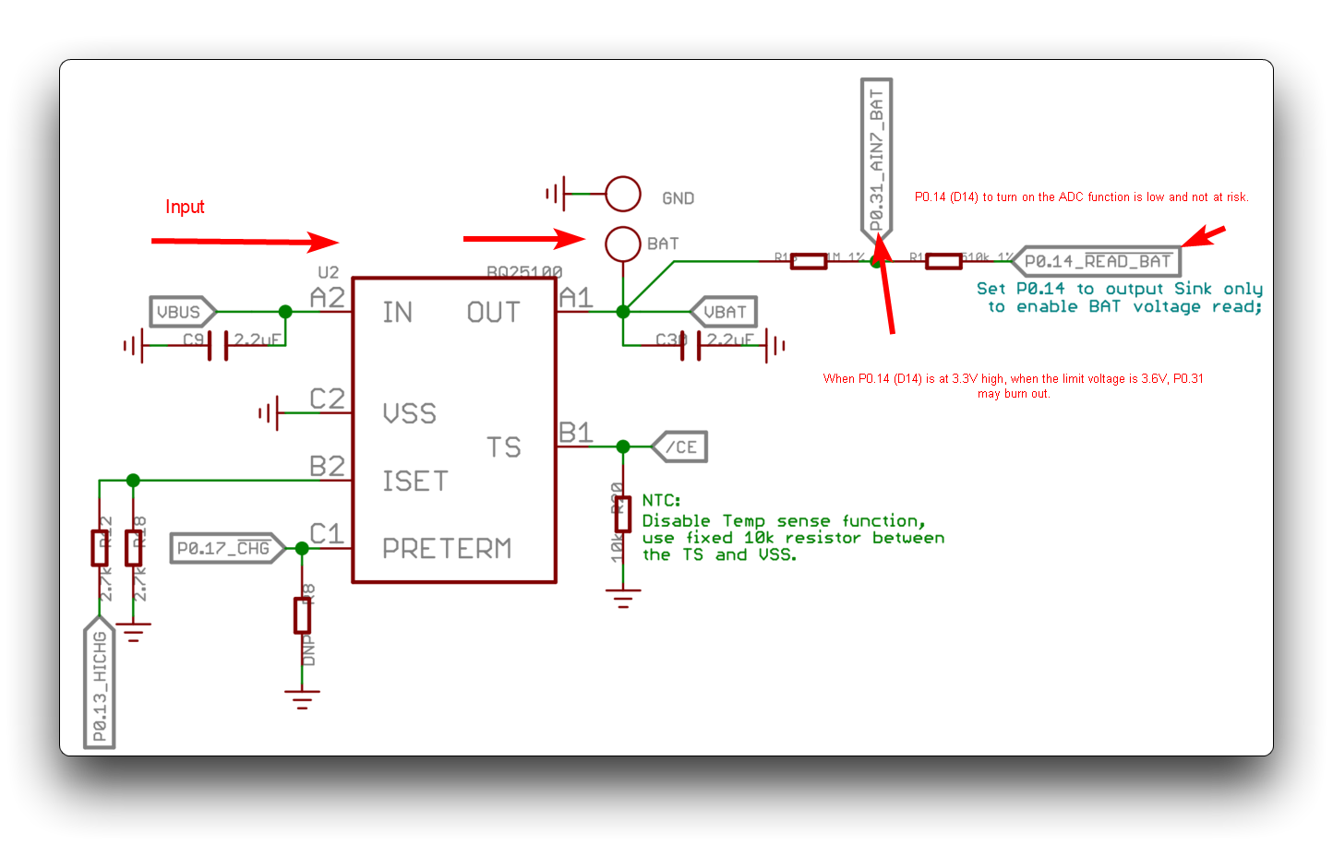
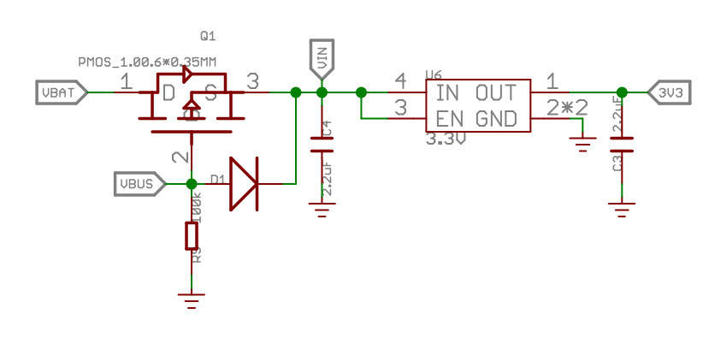
Battery management
BQ25100
Can charge 1 cell Li-Ion/LiPo battery with battery charge voltage (Max) of 4.2V
P0.14_~READ_BAT must be set low if simultaneously charging and reading voltage of battery or else analog pin could burn out
Supports 50 mA charging current (P0.13_HICHG high) or 100 mA charging current (P0.13_HICHG low)
LDO uses VBUS (USB-C) as input if connected, otherwise uses VBAT as input

Slide 2
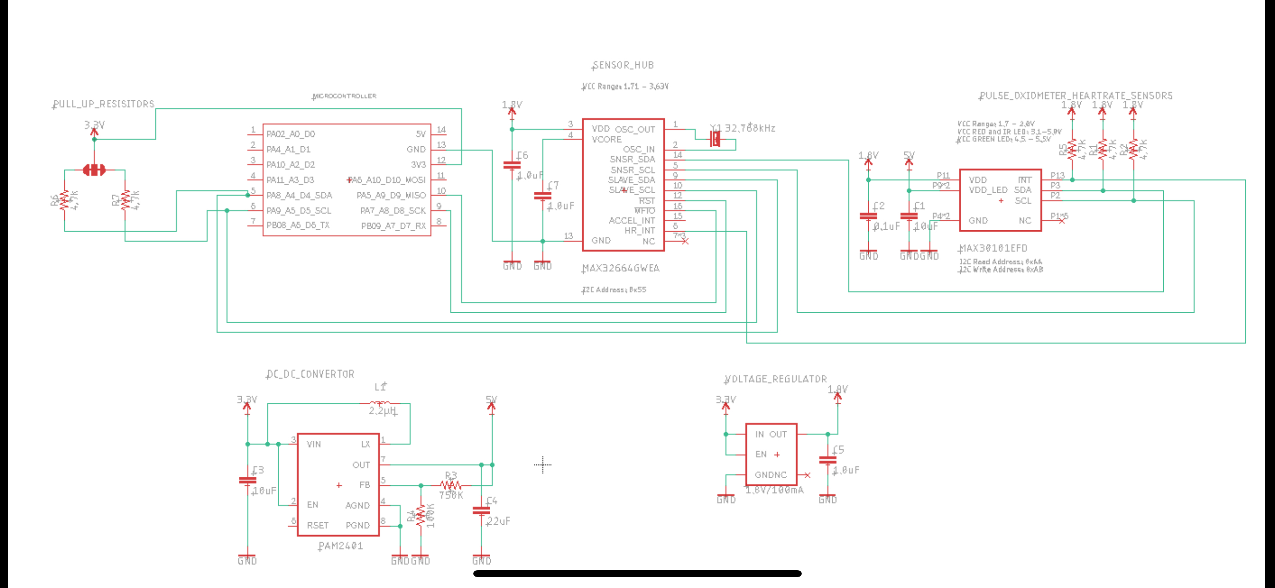
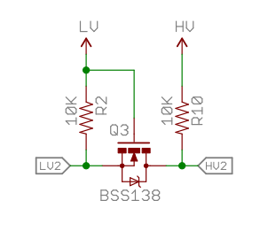





1.8V
3.3V
1.8V
3.3V
3.3V

Slide 3
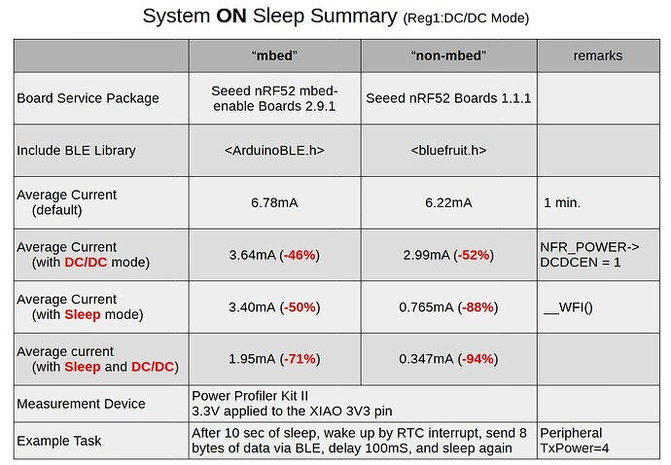
https://forum.seeedstudio.com/t/system-on-sleep-of-xiao-ble/270472/13

Slide 4
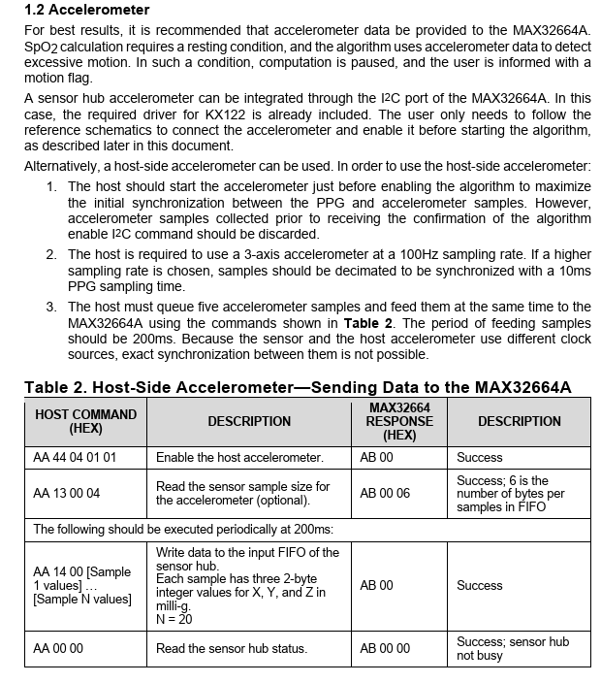
MAX 32664A User Guide:
External accelerometer needs 100 Hz sampling rate
Send 20 samples at 200 ms interval
KX122
145 ua high resolution, 10 ua low resolution (datasheet)
LSM6DS3
70 ua at 104 Hz ODR
FIFO buffer size = 4096 samples of 16 bits
Pedometer algorithm: 26 Hz ODR or greater at +/-2g sensitivity
20

Slide 5
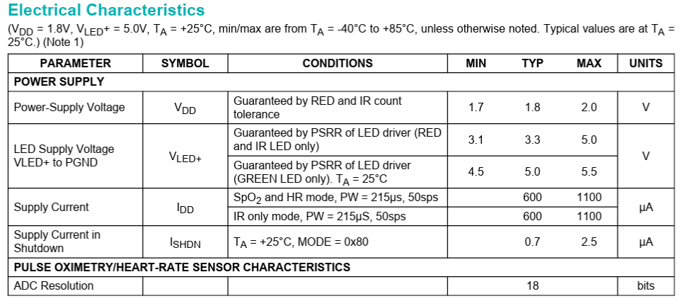
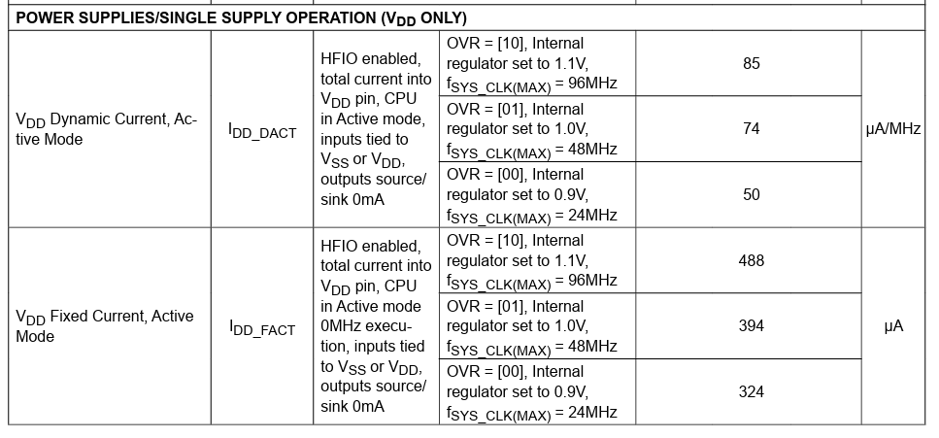
Battery Budget – PPG Sensor (MAX30101 + MAX32664)
From MAX30101 datasheet
Default values (which we currently use) are PW = 411 us, ODR = 100 Hz
600 uA * (411/215) * (100/50) = 2.3 mA
From MAX32660 datasheet
MAX32664 is MAX32660 + firmware. We are using single supply operating voltage (1.8 V into VDD, Vcore grounded – see Sparkfun sensor board schematic).
f_clk = 24 MHz to 96 MHz
24 MHz * 50 uA/MHz = 1.2 mA
96 MHz * 50 uA/MHz = 4.8 mA

Slide 6
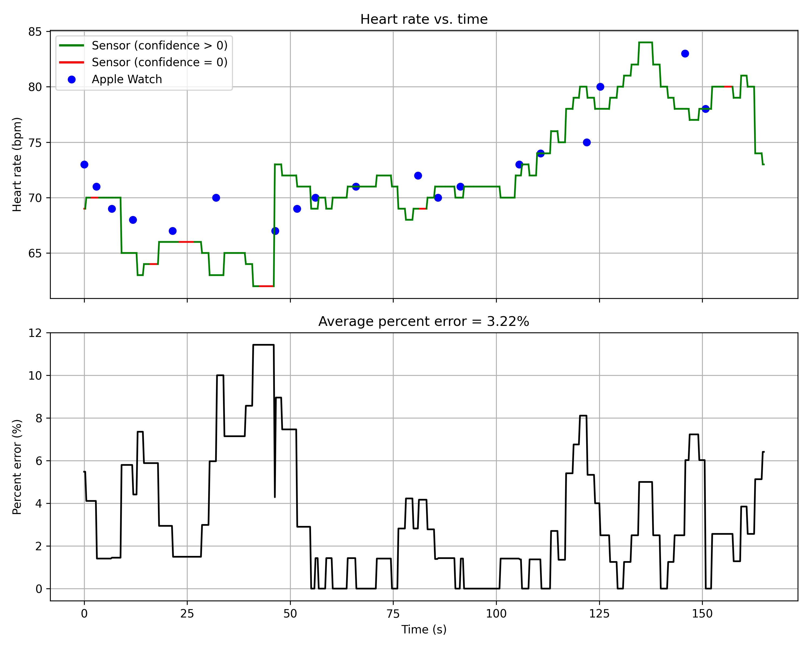
Sensor data includes “confidence” measurement that indicates how confident the proprietary algorithms of the MAX32664 are in their calculated heart rate
Methodology:
Put on glasses with sensor and adjust glasses until get nonzero confidence
Open Apple Watch app and manually enter heart rate in app
Python program records serial data from sensor with timestamp for each sample. Every time the heart rate in the Apple Watch changes, I manually enter the new heart rate into a GUI window which is also timestamped
At the same time, I am monitoring the heart rate confidence. If it drops to zero then I readjust the glasses
Recorded data for three minutes, then plotted data vs. time. For periods when sensor confidence = 0, used last nonzero sensor sample
Sensor on Temple Test
Notes:
Code to turn on all LEDs (?): https://www.reddit.com/r/ECE/comments/1i76tnu/green_led_not_working_in_max30101_sensor/

Slide 7
Component | Notes | Current
Host MCU (nRF52840) | 400 kHz I2C, 1 Mbps BLE | 1.015 mA
Sensor MCU (MAX32664) | 96 MHz clock frequency, single-supply voltage | 0.488 mA
PPG Sensor (MAX30101) | 100 Hz ODR, 411 uS pulse width | 2.3 mA
Accelerometer (LSM6DS3) | 104 Hz ODR | 70 uA
PMIC (BQ25100) | Quiescent current for device on battery power | 70 nA
I2C:
LSM6DS3 to nRF52840: 6 samples (3 accelerometer, 3 gyrometer) * 2 bytes * 20 readings + 2 bytes (pedometer) = 242 bytes
nRF52840 to MAX32664: 3 samples (3 accelerometer) * 2 bytes * 20 readings = 120 bytes
MAX32664 to nRF52840: 6 bytes of processed data (2 for heart rate, 2 for SpO2, 1 for confidence, 1 for status)
Assuming 400 kHz I2C -> 20 us / byte:
20 us * (242 + 120 + 6 + 3) bytes = 7.42 ms -> round up to 8 ms
Bluetooth:
nRF52840 to central: 2 bytes (hr) + 2 bytes (SpO2) + 2 bytes (battery) + 2 bytes (step count) + 16 bytes (overhead),
Assuming 1 Mbps -> 8 us/byte:
8 us * 24 bytes = 0.192 ms -> round up to 0.5 ms to account for TX settling and stack
Active current = 6.22 mA, System_ON_Sleep current = 0.765 mA, BLE TX current = 5.3 mA
(8 ms * 6.22 mA + 0.5 mS * 13.52 ms + 191.5 mA * 0.765 mA)/200 = 1.015

