Slide 1
Ideas on privacy vs. Authentication
Authentication by online challenges.
Charles H. Bennett
IBM Research Yorktown
January 2002
www.research.ibm.com/people/b/bennetc

Slide 2
Problem and Opportunity
Cheap pervasive sensors and cheap data storage => temptation to record everything happening in public or even private venues and save it forever, with ensuing loss of privacy.
But these recordings are sometimes good, protecting individual rights, e.g. Rodney King, war crimes evidence, polluters.
In many situations the bad guys want privacy and the good guys want publicity, with authenticity.
Societal solution: don’t prohibit data collection, but do it in a regulated and authenticated fashion, and establish a legal framework of rights and technical mechanisms for the interested parties to grant or deny access to the data, depending on circumstances and use to which the data is to be put.

Slide 3
A more specific problem:
Recordings are easily doctored, and seemingly cannot be trusted unless they have been continuously in trusted hands from the moment of generation. Those making the recordings (police, claims adjustors) often have a vested interest and may be distrusted by the public. For example, in the OJ Simpson trial, many people believed the police had falsified video recordings and other evidence
Solution:
1. Produce the recordings in a way that prevents falsification
even by the makers and operators of the recording equipment.
2. Establish the societal expectation of an authenticated
recording under certain circumstances, so its absence will
be seen as evidence that the responsible authority has destroyed it.

Slide 4
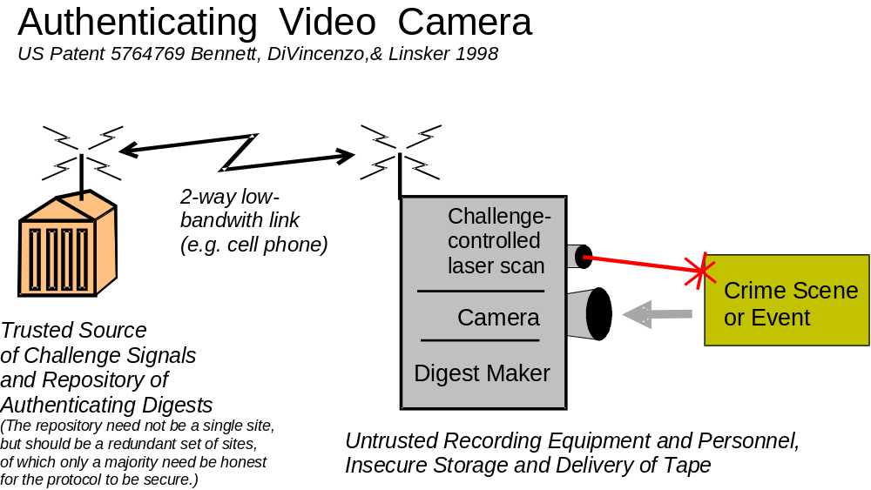
Notes:
Conventional video tape evidence must be guarded continuously from the time it is made until the time it is used, to prevent actual or alleged tampering. Using this invention, the videotape, once it was recorded, would not have to be stored in a secure manner. While the original tape is being filmed, the camera continually receives random “challenge” signals from a trusted source, which influences the scene being recorded. Meanwhile the camera sends periodic “digests” of the ongoing recording back to the trusted location. These digests are not audio or video data, but small data files serving to authenticate the much larger audio and video data stream, including the effect of the challenges. The actual audio and video is recorded on tape by the camera, and can be stored in an untrusted location. The trusted repository need not be a single trusted site, but should be a redundant set of sites, of which only a majority need be honest for the protocol to be secure.

Slide 5
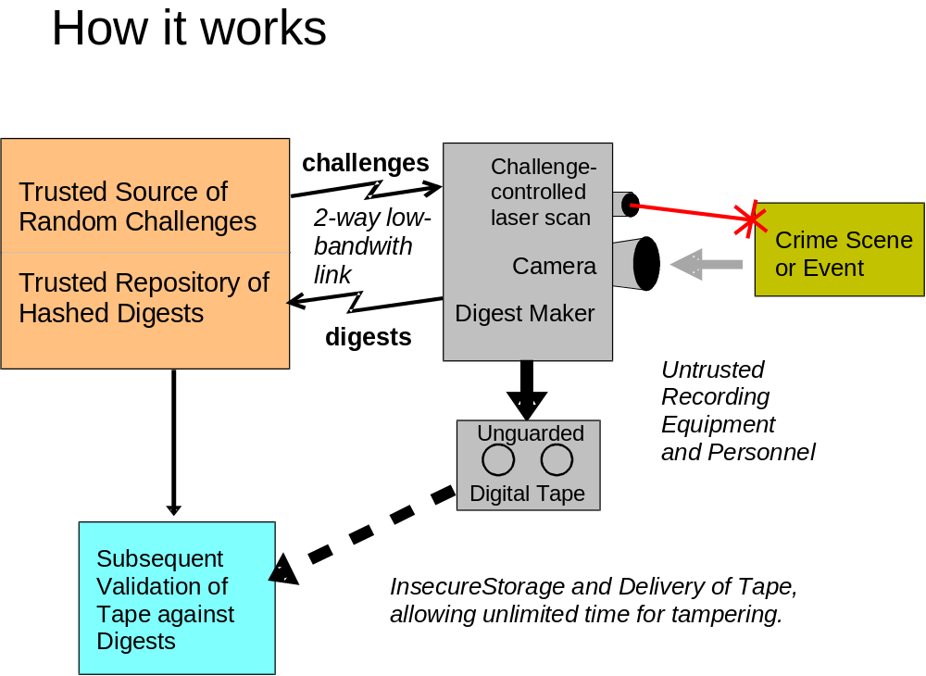
Notes:
Fuhrman buster in more detail. If anyone tried to modify the videotape after it was made, it would no longer match the digests. The digests serve to authenticate the fact that each part of the videotape (each second, say) was recorded no earlier than the time of the challenge influencing it, nor any later than transmission of the digest corresponding to that part of the tape. It also establishes that the scene corresponds to an actual event happening in front of the camera, not an electronically fabricated combination of pre-recorded material.

Slide 6
Authentication by Random Laser Scan
Challenge signal from trusted source controls aiming of a laser scanning over the scene being recorded, so as to affect the video image in a way that could not have been foreseen before arrival of the challenge signal.

Slide 7
Authentication by voluntary responses to verbal requests
Random number challenges from the trusted source are translated into verbal requests chosen from a standard menu of possible requests, e.g. “touch your nose,” and the requests conveyed to the person being filmed via a display unit or speaker attached to the camera.

Slide 8
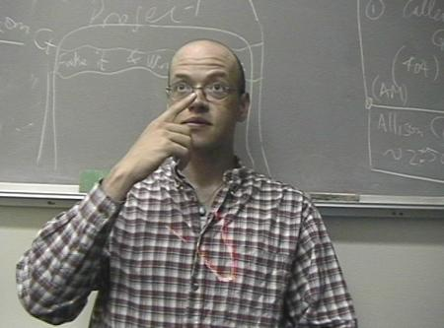
Video frame showing both laser scan and response to verbal request.

Slide 9
Wallpaper or “skin disease”
Challenge-Controlled LCD projector projects a pseudorandom texture onto scene or person being recorded.
Actions with props:
Challenge-Controlled instructions for user to perform actions involving hard-to-render props e.g. liquids, soap bubbles.

Slide 10
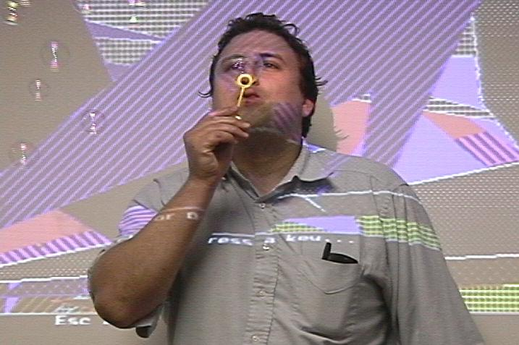

Slide 11
Besides authenticating video, it is important to
authenticate accompanying audio. This can be done by
Having the random challenge signal from the trusted source produce sounds, which then become part of the audio/video recording.
Having random challenge signal direct the subject to do something that alters the sound. Thump on your chest while speaking, or breathe some helium.
When making a video of spoken testimony, zoom in on speakers’ mouth(s). Have speaker(s) use phrases and terminology designed to be visually unambiguous, ie not substitutable by a similar-appearing phrase with a very different sound and meaning.

Slide 12
Other enhancements and variations
Low-bandwidth (eg. 56 kbaud) live video feedback to a human monitor at the trusted center, who could ask questions, suggest actions, intelligently aim camera.
Using invisible IR for challenge-controlled illumination (laser or LCD) to be less obtrusive.
Hard to render clothing and backgrounds.
Challenge-controlled shifts of camera viewpoint.
Challenge-controlled water pistol.
Non-visual interventions, eg challenge controlled dithering of control parameters in an industrial process.

