Slide 1

Quantum accuracy threshold for concatenated d-2 codes
panos aliferis
IQI,Caltech
work with
Daniel Gottesman & John Preskill
IBM,08/2005

Slide 2
Outline
+ Post-selected FTQC
- overview of the scheme
- the ancilla factory
> The threshold for postFTQC
- proving by dancing
- circuits and thresholds
? Summary/questions

Slide 3

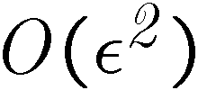
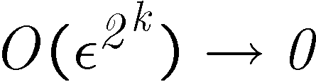

Post-selected FTQC
Overview of the scheme
> standard FTQC
Noisy operations ( )
ECC
Universal level-1 FT gadgets ( )
concatenation;
threshold theorem
Universal level-k FT gadgets
( if )

Slide 4



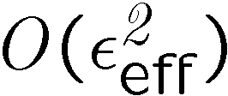
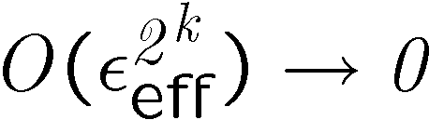
Post-selected FTQC
Overview of the scheme
> Knill’s postFTQC
Noisy operations ( )
Universal ancillas & teleportation
( even if ?)
ECC
ECC
ECC
Universal level-1 FT gadgets ( )
concatenation;
threshold theorem
Universal level-k FT gadgets
( if )

Slide 5
Post-selected FTQC
Overview of the scheme
> Knill’s postFTQC
Noisy operations ( )
Universal encoded ancillas
teleportation
ECC
decode
encode
ECC
ECC
Universal level-m post-
selected FT gadgets
Universal level-1 FT gadgets ( )
concatenation;
threshold theorem ?
concatenation;
threshold theorem
Universal level-1 post-selected
FT gadgets ( )
Universal level-k FT gadgets
( if )
EDC
Noisy operations ( )

Slide 6





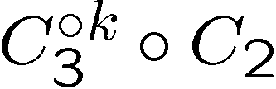
Post-selected FTQC
Overview of the scheme
> Knill’s postFTQC
Noisy operations
Universal encoded ancillas
teleportation
ECC
decode
encode
ECC
ECC
Universal level-m post-
selected FT gadgets
Universal level-1 FT gadgets
concatenation;
threshold theorem ?
concatenation;
threshold theorem
Universal level-1 post-
selected FT gadgets
Universal level-k FT gadgets
EDC
Noisy operations

Slide 7

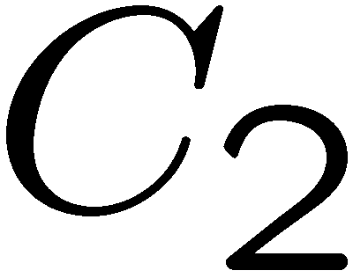


Post-selected FTQC
The ancilla factory
-
decoder
> connecting EDC and ECC
- input
EDC encoder
- output

Slide 8


Post-selected FTQC
The ancilla factory
-
decoder
> connecting EDC and ECC
- input
effective error rate, :
EDC encoder
- output
probability of encoded error
can be made arbitrarily low
below the threshold for .
local errors due to decoding

Slide 9
Outline
+ Post-selected FTQC
- overview of the scheme
- the ancilla factory
> The threshold for postFTQC
- proving by dancing
- circuits and thresholds
? Summary/questions

Slide 10





The threshold for postFTQC
Proving by dancing
> inside the factory
-
encoding
circuit

Slide 11

The threshold for postFTQC
Proving by dancing
> inside the factory
-
encoding
circuit
this idea has a problem
a single fault can lead to
an incorrect decoding.

Slide 12
The threshold for postFTQC
Proving by dancing
> inside the factory
-
encoding
circuit
want to show:
1-exRecs with sparse
faults, never lead us accept
states with encoded errors.

Slide 13

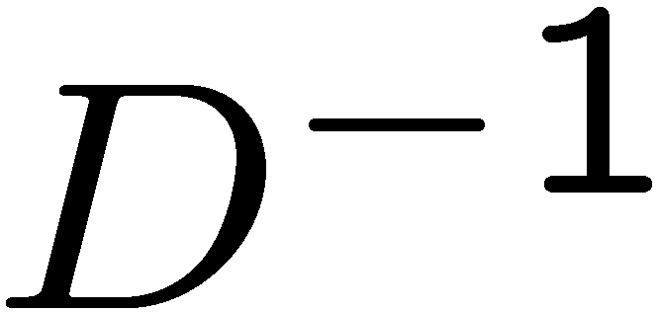


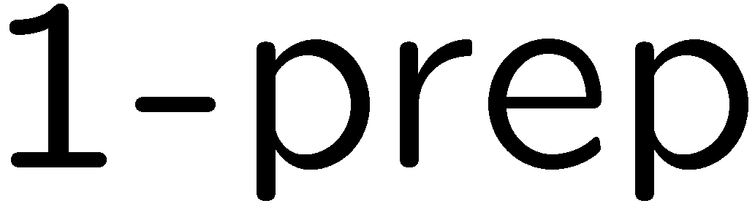
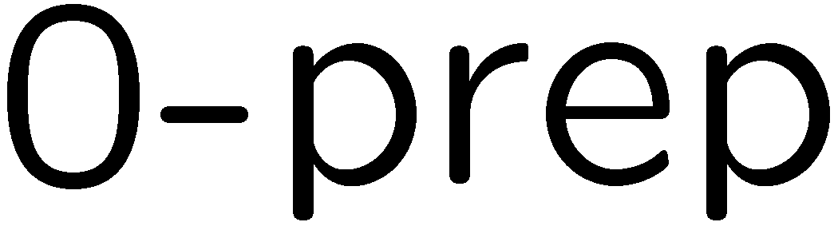
The threshold for postFTQC
Proving by dancing
> Level 1
Def: goodness
A 1-exRec is good, if it
contains at most one fault.
Def: correctness
A 1-Rec is correct, if (conditioned on detecting no errors)
,
.
and similarly for 1-meas.

Slide 14
The threshold for postFTQC
Proving by dancing
> Lemma: exRec-Cor at level 1
The 1-Rec in a good 1-exRec is correct.
proof
(a)
(b)
.
> if all 1-exRecs are good, then the 1-circuit is correct.
proof Pull ideal encoders out of state prep. 1-Recs, push them to the right
through gate 1-Recs, and annihilate them inside measurement 1-Recs.

Slide 15
The threshold for postFTQC
Proving by dancing
> transforming bad 1-exRecs to faulty 0-Gas

Slide 16
The threshold for postFTQC
Proving by dancing
> transforming bad 1-exRecs to faulty 0-Gas
> Def: correctness (revised)
A 1-Rec is correct, if (conditioned on detecting no errors)
.

Slide 17
The threshold for postFTQC
Proving by dancing
> Level k
Def: goodness
A k-exRec is bad, if it contains two independent bad (k-1)-exRecs, else it is good.
Two bad k-exRecs are independent if they don’t overlap, or if they do and the
earlier k-exRec is bad even without the shared k-ED.
example:
two non-independent
bad 1-exRecs

Slide 18



The threshold for postFTQC
Proving by dancing
> Level k
Def: goodness
A k-exRec is bad, if it contains two independent bad (k-1)-exRecs, else it is good.
Two bad k-exRecs are independent if they don’t overlap, or if they do and the
earlier k-exRec is bad even without the shared k-ED.
Def: correctness
A k-Rec is correct, if (conditioned on detecting no errors at all levels)
.

Slide 19
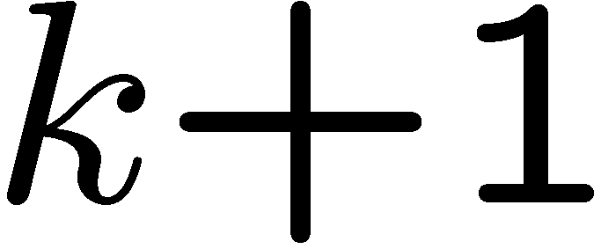


The threshold for postFTQC
Proving by dancing
> Lemma: exRec-Cor
The k-Rec in a good k-exRec is correct.
proof
good k-exRec

Slide 20
The threshold for postFTQC
Proving by dancing
> Lemma: exRec-Cor
The k-Rec in a good k-exRec is correct.
good k-exRec
proof
.

Slide 21



The threshold for postFTQC
Proving by dancing
> connecting EDC and ECC
EDC encoder
takes level-k blocks to qubits;
done separately on each output subblock
decode top-bottom:
at level k, do a level-(k-1) simulation
of the decoding circuit, etc.

Slide 22
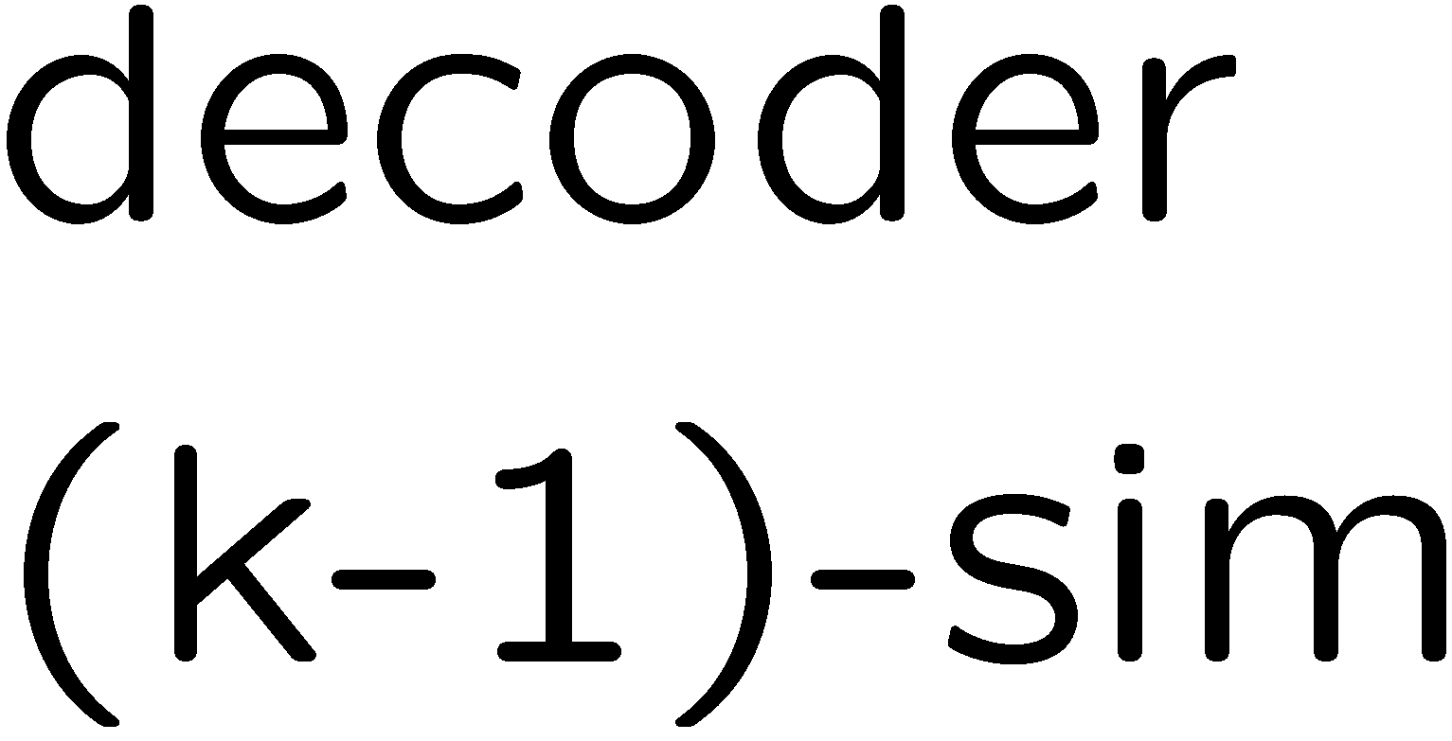
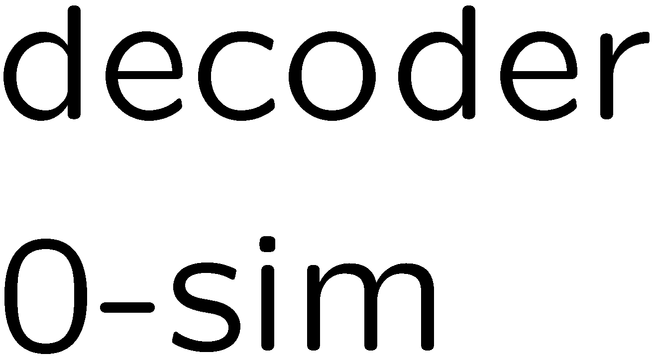

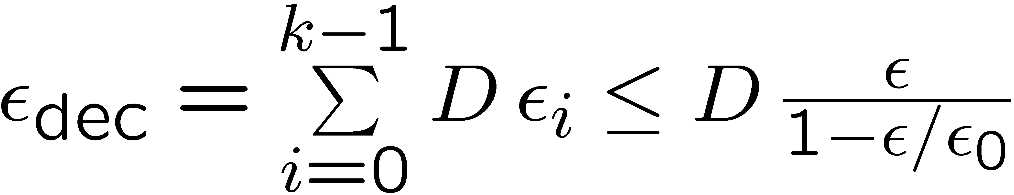
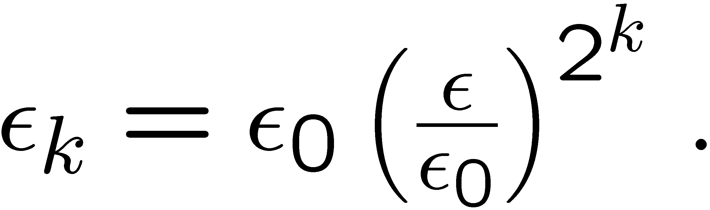
The threshold for postFTQC
Proving by dancing
> connecting EDC and ECC
EDC encoder
> eliminating the decoders sequentially
, since

Slide 23


The threshold for postFTQC
Proving by dancing
> concatenating and conditioning on detecting no errors, the probability
of encoded errors in the prepared ancillas drops doubly exponentially with level,
> we choose enough levels of concatenation for so that the logical error rate
is well below the threshold of ,
> decoding introduces local errors, which together with the Bell measurement
errors must be correctable by with probability of failure lower than the
threshold of ,
> with operations of we bootstrap the first level of ,
> the scheme is theoretically efficient, because the overhead for preparing
the ancillas is independent of the size of the computation executed using .

Slide 24
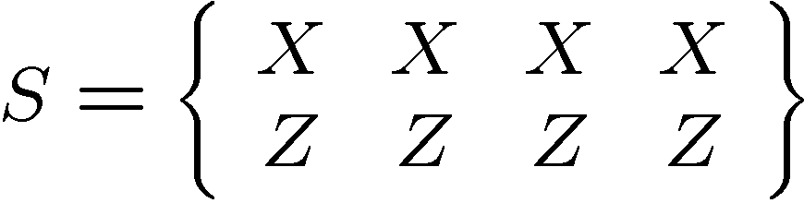
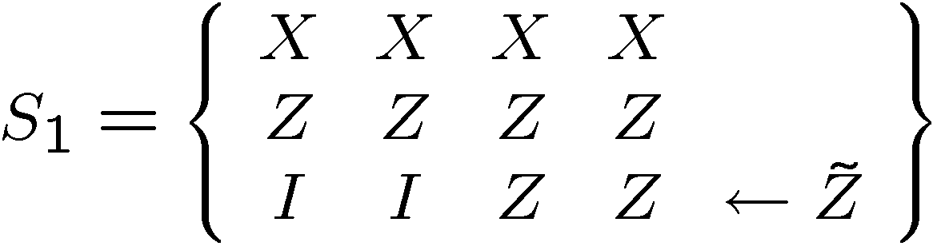
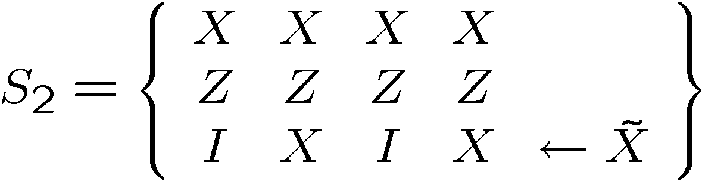
The threshold for postFTQC
Circuits and thresholds
> [[4,2,2]]
logical operations:
> adding a third stabilizer
, and
with

Slide 25
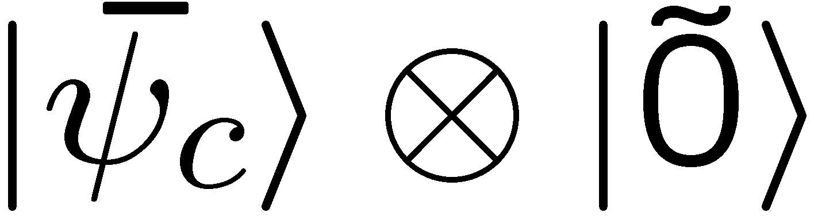
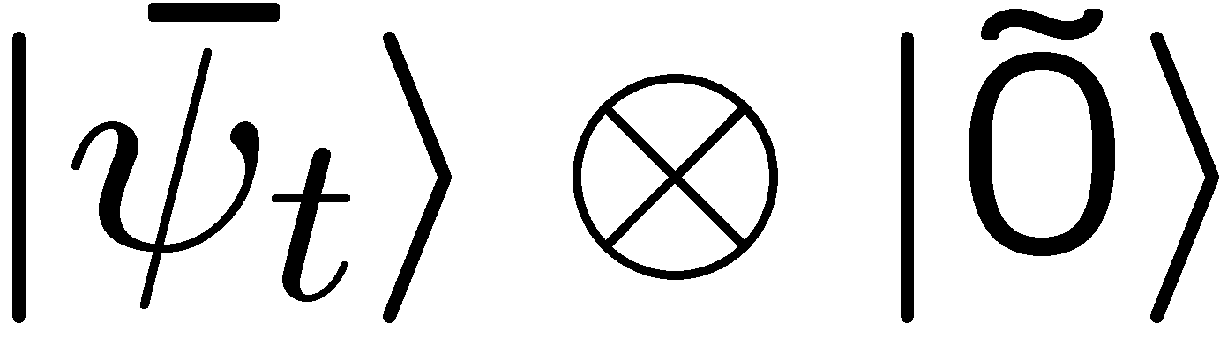
The threshold for postFTQC
Circuits and thresholds
> [[4,2,2]]: CNOT 1-exRec

Slide 26
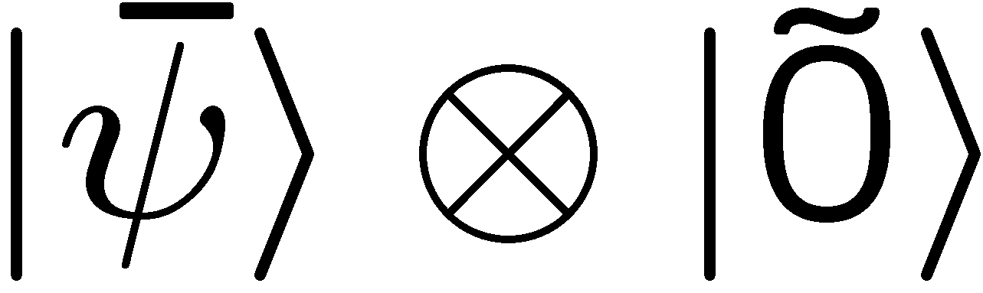
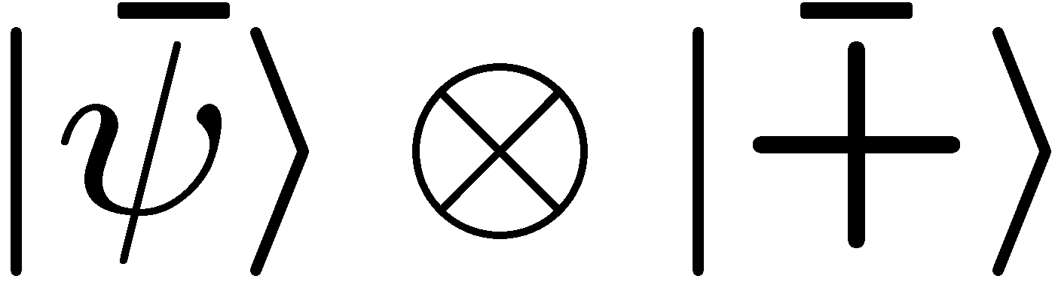
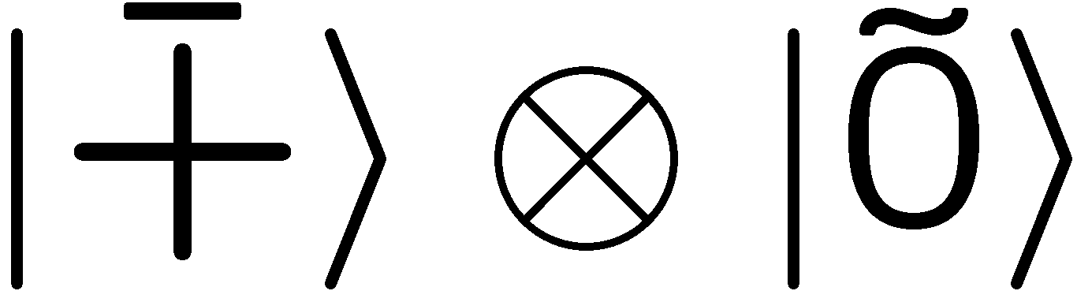


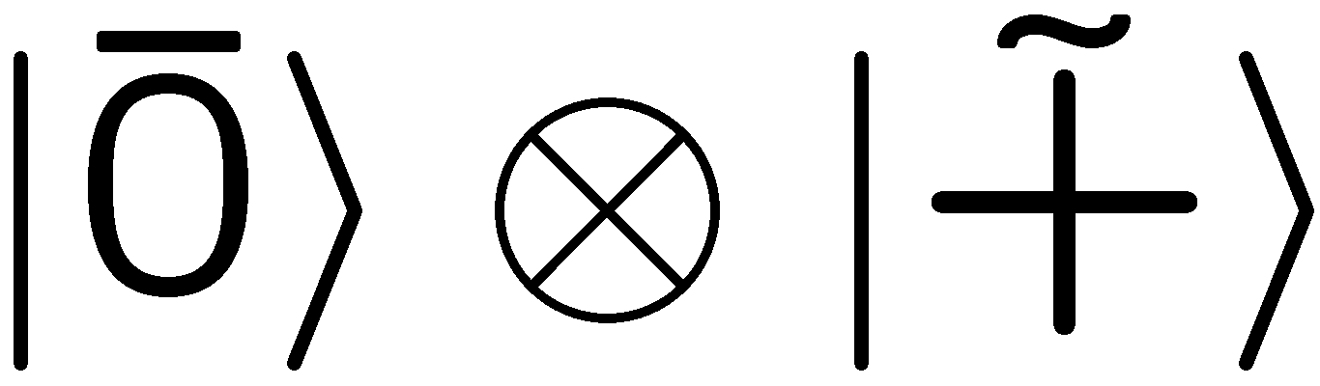

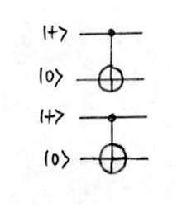
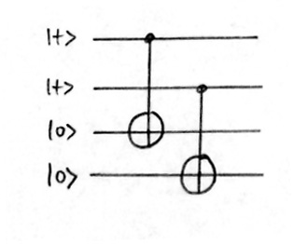
The threshold for postFTQC
Circuits and thresholds
> [[4,2,2]]: CNOT 1-exRec
> ED via
> ED via Steane

Slide 27
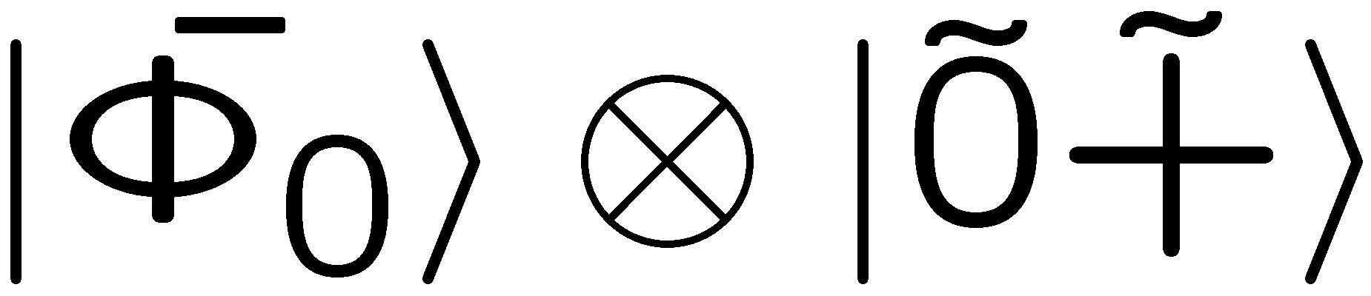
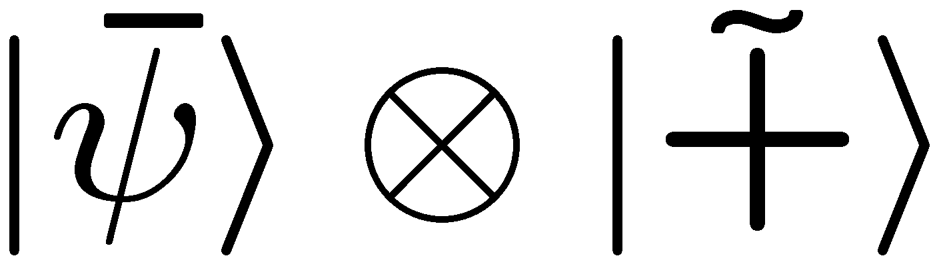
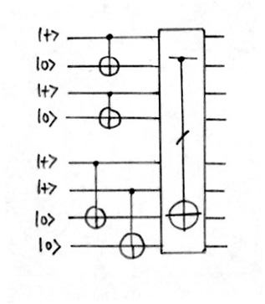
The threshold for postFTQC
Circuits and thresholds
> [[4,2,2]]: CNOT 1-exRec
> ED via
> ED via Knill

Slide 28
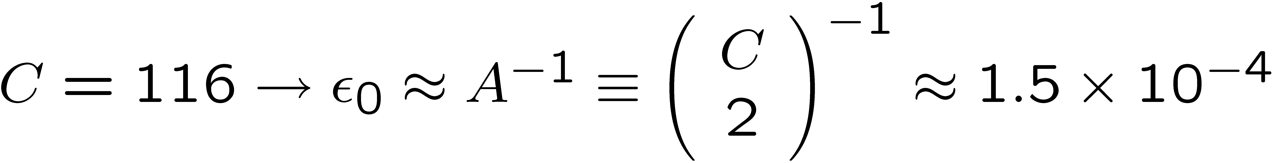
The threshold for postFTQC
Circuits and thresholds
> [[4,2,2]]: CNOT 1-exRec
> for both ED methods, the ancillas need no verification!
>
with a small correction due to
decoding and post-selection
> however, many of these fault pairs will lead to detected errors… and so we
can again only count the malignant pairs to get a better bound.

Slide 29
Outline
+ Post-selected FTQC
- overview of the scheme
- the ancilla factory
> The threshold for postFTQC
- proving by dancing in reverse
- circuits and thresholds
? Summary/questions

Slide 30
Summary
The postFTQC paradigm ?
> fault-tolerance can be reduced to ancilla preparation and teleportation;
Knill’s scheme shows how the ancilla preparation part, while determining
the threshold, can be cleanly separated from the rest,
> the ancillas needed are known and can be prepared in various ways;
post-selection (as in entanglement purification) is a method that yields
high fidelity copies at the expense of low efficiency.
Open issues in our analysis
> extend the proof to define goodness in terms of malignant sets
of locations.
> investigate the efficiency of this scheme, and compare with standard FT.

Slide 31

references
- postFTQC
E. Knill, quant-ph/{0312190, 0402171, 0404104,0410199}
- the threshold dance
PA, D. Gottesman, J. Preskill, quant-ph/0504218
art by Henry Matisse.

