Slide 1
Accuracy Threshold and Architecture for Trapped-Ion Quantum Computing
Andrew Cross, Tzvetan Metodiev, and
Isaac Chuang
August 30, 2005

Slide 2
Our Problem
How do we lay out a fault-tolerant ion-trap quantum computer using the concatenated [[7,1,3]] code?
What bound can we achieve on the accuracy threshold?
What is the clock speed of the computer?
What is the area of a logical qubit?

Slide 3
Outline
Elements of a trapped-ion computer
Ballistic transport as a “move” gate
Tile microarchitecture and associated microcode subroutines
Parameter choices for our calculation
Number of locations in the replacements
Results: threshold, clock speed, area

Slide 4
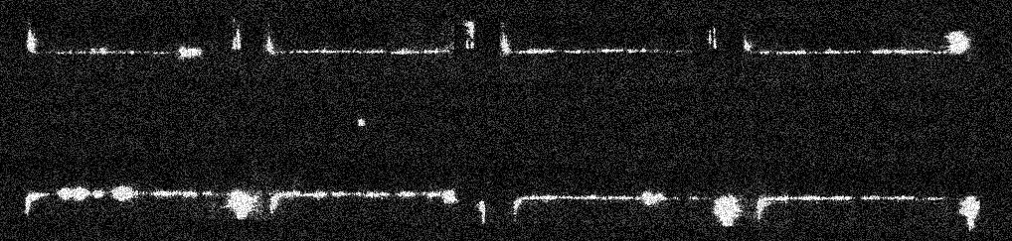

Ions
Qubit – Energy levels of an ion in column one or two of the periodic table.
Electromagnetically trapped and laser cooled.
A “physical qubit” or p-bit could be three ions; one encoded pair and a sympathetic cooling ion [Steane,quant-ph/0412165].
http://monroelab2.physics.lsa.umich.edu/

Slide 5
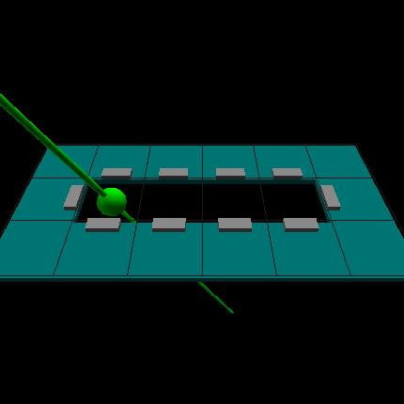
Gates
Lasers pulses apply gates and measurements.
The Coulomb interaction couples ions in the same trap, enabling two qubit gates.
  1 μs for a single qubit gate
  10 μs pulse sequence implements a two qubit gate
  [Wineland, J. Res. NIST 103 1998]
There are no more than six ions in a trap simultaneously, three for each logical qubit.
Lasers perform gates and measurements.

Slide 6
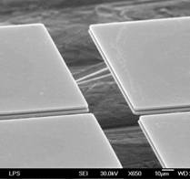
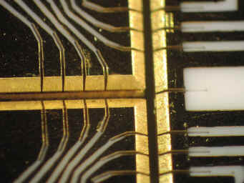
Traps
Linear segmented traps and T junctions. X junctions can be thought of as offset Ts.
[Hensinger,quant-ph/0508097]
Segmented traps allow ion chains to be “split” apart and to re-“join” during two qubit gates
[Rowe,quant-ph/0205094]
Cooling pulses control the vibrational mode heating during these operations
[Barrett, quant-ph/0307088]
Segmented traps enable ballistic transport between trapping regions.
[Wineland; Blatt Nature v429]
http://monroelab2.physics.lsa.umich.edu/

Slide 7
Outline
Elements of a trapped-ion computer
Ballistic transport as a “move” gate
Tile microarchitecture and associated microcode subroutines
Parameter choices for our calculation
Number of locations in the replacements
Results: threshold, clock speed, area

Slide 8
Ballistic Transport Model

Slide 9
Ballistic Transport Model
Define one “Move” gate
(equate the 6 possible operations)

Slide 10
Outline
Elements of a trapped-ion computer
Ballistic transport as a “move” gate
Tile microarchitecture and associated microcode subroutines
Parameter choices for our calculation
Number of locations in the replacements
Results: threshold, clock speed, area

Slide 11
Tile Microarchitecture
data
ancilla
“blob”
[Svore, Terhal, DiVincenzo, 0410047]

Slide 12
Tile Microarchitecture
data
Transport channels
ancilla
“blob”
[Svore, Terhal, DiVincenzo]
Four logical qubits

Slide 13
Tile Microarchitecture
data
Transport channels
ancilla
“blob”
[Svore, Terhal, DiVincenzo]
Ancilla
Four logical qubits

Slide 14
Microcode Subroutines
2
1
verification qubits
|0⟩ and |+ ⟩
ancilla
5
3
move
|cat⟩ ancilla
4
extraction
6
transversal CX

Slide 15
|0⟩ and |+⟩ ancilla preparation
|0⟩ and |+ ⟩
ancilla
*

Slide 16
Ancilla Preparation: |0⟩ and |+⟩
*
*
90°
1
5
3
7
4
2
6
(1)
(2)
(3)
*
*
*
9 controlled-NOT gates

Slide 17
Ancilla Preparation: |0⟩ and |+⟩
*
1
1
5
2
3
4
3
7
4
5
6
7
2
6
move: 0
c-x: 0
prepare: 0
wait: 0
wait: 0

Slide 18
Ancilla Preparation: |0⟩ and |+⟩
1
2
3
5
1
4
5
3
6
7
4
7
2
6
2
move: 0
c-x: 0
prepare: 6
wait: 0
wait: 0

Slide 19
Ancilla Preparation: |0⟩ and |+⟩
1
2
3
5
1
4
5
3
6
7
4
7
2
6
2
3
move: 0
c-x: 3
prepare: 6
wait: 0
wait: 0

Slide 20
Ancilla Preparation: |0⟩ and |+⟩
1
2
3
5
1
4
5
3
6
7
4
7
2
6
2
3
4
move: 5
c-x: 3
prepare: 7
wait: 1
wait: 0

Slide 21
Ancilla Preparation: |0⟩ and |+⟩
1
2
3
1
5
4
4
5
7
6
7
3
6
2
2
3
4
5
move: 5
c-x: 4
prepare: 7
wait: 1
wait: 5

Slide 22
Ancilla Preparation: |0⟩ and |+⟩
1
2
3
1
5
4
4
5
7
6
6
7
3
2
2
3
4
5
6
move: 9
c-x: 4
prepare: 7
wait: 4
wait: 5

Slide 23
Ancilla Preparation: |0⟩ and |+⟩
1
2
3
1
5
4
4
5
7
6
6
7
2
3
2
3
4
5
6
7
move: 9
c-x: 6
prepare: 7
wait: 4
wait: 8

Slide 24
Ancilla Preparation: |0⟩ and |+⟩
1
2
3
1
5
4
4
5
7
6
6
7
2
3
2
3
4
5
6
7
8
move: 13
c-x: 6
prepare: 7
wait: 7
wait: 8

Slide 25
Ancilla Preparation: |0⟩ and |+⟩
1
2
3
5
4
1
4
5
7
6
7
3
6
9
2
2
3
4
5
6
7
8
move: 16
c-x: 6
prepare: 7
wait: 11
wait: 8

Slide 26
Ancilla Preparation: |0⟩ and |+⟩
1
2
3
1
5
4
5
7
4
6
3
7
6
2
2
3
4
5
6
7
8
9
10
move: 16
c-x: 9
prepare: 7
wait: 11
wait: 9

Slide 27
Ancilla Preparation: |0⟩ and |+⟩
1
2
3
1
5
4
5
7
4
6
3
7
6
2
2
3
4
5
6
7
8
9
10
11/12
12 timesteps; 66 locations
move: 22
c-x: 9
prepare: 7
wait: 19
wait: 9

Slide 28
Ancilla Verification
verification qubits
*

Slide 29
Ancilla Verification: |0⟩ and |+⟩
(move verifier, not ancilla)
*
A
1
5
1’
5’
V
3
7
4
3’
7’
4’
2
6
2’
6’
ancilla
verifier
move: 7
c-x: 0
measure: 0
wait: 7
wait: 0
wait: 0

Slide 30
Ancilla Verification: |0⟩ and |+⟩
A
1
5
V
1’
5’
3
7
4
3’
7’
4’
2
6
2’
6’
move: 14
c-x: 0
measure: 0
wait: 14
wait: 0
wait: 0

Slide 31
Ancilla Verification: |0⟩ and |+⟩
A
1
5
V
1’
5’
3
7
4
3’
7’
4’
2
6
2’
6’
move: 21
c-x: 0
measure: 0
wait: 21
wait: 0
wait: 0

Slide 32
Ancilla Verification: |0⟩ and |+⟩
A
1
5
V
1’
5’
3
7
4
3’
7’
4’
2
6
2’
6’
move: 28
c-x: 0
measure: 0
wait: 28
wait: 0
wait: 0

Slide 33
Ancilla Verification: |0⟩ and |+⟩
1
5
A
1’
5’
V
3
7
4
3’
7’
4’
2
6
2’
6’
move: 28
c-x: 7
measure: 0
wait: 28
wait: 0
wait: 0

Slide 34
Ancilla Verification: |0⟩ and |+⟩
1
5
A
1’
5’
V
3
7
4
3’
7’
4’
2
6
2’
6’
move: 35
c-x: 7
measure: 0
wait: 35
wait: 0
wait: 0

Slide 35
Ancilla Verification: |0⟩ and |+⟩
1
5
A
V
1’
5’
3
7
4
3’
7’
4’
2
6
2’
6’
move: 35
c-x: 7
measure: 7
wait: 35
wait: 0
wait: 7

Slide 36
Ancilla Verification: |0⟩ and |+⟩
A
1
5
V
1’
5’
3
7
4
3’
7’
4’
2
6
2’
6’
move: 35
c-x: 7
measure: 7
wait: 42
wait: 0
wait: 7

Slide 37
Ancilla Verification: |0⟩ and |+⟩
A
1
5
V
1’
5’
3
7
4
3’
7’
4’
2
6
2’
6’
move: 35
c-x: 7
measure: 7
wait: 49
wait: 0
wait: 7

Slide 38
Ancilla Verification: |0⟩ and |+⟩
(ancilla enters channel)
A
1
5
V
1’
5’
3
7
4
3’
7’
4’
2
6
2’
6’
9 timesteps; 105 locations
move: 35
c-x: 7
measure: 7
wait: 49
wait: 0
wait: 7

Slide 39
Cat state preparation
|cat⟩ ancilla

Slide 40
Ancilla Preparation: |cat⟩
(borrowed verifier, and relabeled bits)
1
5
6
2
3
4
4
3
7
V
5
6
7
2
1
V
move: 0
c-x: 0
prepare: 0
wait: 0/0/0
measure: 0

Slide 41
Ancilla Preparation: |cat⟩
1
2
3
5
6
7
4
4
V
5
3
2
1
6
7
V
move: 0
c-x: 0
prepare: 0
wait: 0/0/0
measure: 0

Slide 42
Ancilla Preparation: |cat⟩
1
2
3
4
5
6
7
4
3
V
5
2
1
6
7
V
3
move: 0
c-x: 0
prepare: 2
wait: 0/0/0
measure: 0

Slide 43
Ancilla Preparation: |cat⟩
1
2
3
4
5
6
7
4
3
V
5
2
1
6
7
V
3
4
move: 0
c-x: 1
prepare: 2
wait: 0/0/0
measure: 0

Slide 44
Ancilla Preparation: |cat⟩
1
2
3
4
5
6
7
4
3
V
5
2
1
6
7
V
3
4
5
move: 2
c-x: 1
prepare: 4
wait: 0/0/0
measure: 0

Slide 45
Ancilla Preparation: |cat⟩
1
2
3
5
6
7
4
4
V
5
3
6
2
1
7
V
3
4
5
6
move: 2
c-x: 3
prepare: 4
wait: 0/0/0
measure: 0

Slide 46
Ancilla Preparation: |cat⟩
1
2
3
5
6
7
4
4
V
5
3
6
2
1
7
V
3
4
5
6
7
move: 5
c-x: 3
prepare: 6
wait: 1/0/0
measure: 0

Slide 47
Ancilla Preparation: |cat⟩
1
2
3
5
6
7
4
4
V
5
3
2
1
6
7
V
3
4
5
6
7
8
move: 5
c-x: 5
prepare: 6
wait: 1/2/0
measure: 0

Slide 48
Ancilla Preparation: |cat⟩
1
2
3
5
6
7
4
4
V
5
3
2
1
6
7
V
3
4
5
6
7
8
9
move: 9
c-x: 5
prepare: 8
wait: 3/2/0
measure: 0

Slide 49
Ancilla Preparation: |cat⟩
1
5
2
3
6
4
4
7
5
V
6
3
2
1
7
V
3
4
5
6
7
8
9
10
move: 9
c-x: 7
prepare: 8
wait: 3/6/0
measure: 0

Slide 50
Ancilla Preparation: |cat⟩
1
5
2
3
6
4
4
7
5
V
6
3
2
1
7
V
3
4
5
6
7
8
9
10
11
move: 15
c-x: 7
prepare: 8
wait: 5/6/0
measure: 0

Slide 51
Ancilla Preparation: |cat⟩
1
5
6
2
3
7
4
4
3
5
1
V
6
7
2
V
3
4
5
6
7
8
9
10
11
12
move: 15
c-x: 8
prepare: 8
wait: 5/12/0
measure: 0

Slide 52
Ancilla Preparation: |cat⟩
1
5
6
2
3
7
4
4
3
5
1
V
6
7
2
V
3
4
5
6
7
8
9
10
11
12
13
move: 17
c-x: 8
prepare: 8
wait: 11/12/0
measure: 0

Slide 53
Ancilla Preparation: |cat⟩
1
5
6
2
3
4
4
3
7
5
V
6
7
2
1
V
3
4
5
6
7
8
9
10
11
12
13
14
move: 17
c-x: 8
prepare: 8
wait: 11/12/7
measure: 1

Slide 54
Ancilla Preparation: |cat⟩
(ancilla enters channel)
1
5
6
2
3
4
4
3
7
5
V
6
7
2
1
V
3
4
5
6
7
8
9
10
11
12
13
14
15
14 timesteps; 64 locations
move: 17
c-x: 8
prepare: 8
wait: 11/12/7
measure: 1

Slide 55
Syndrome Extraction
extraction

Slide 56
Syndrome extraction (d=2,3)
d=2:
D
D
A
A
D
A
D
D
D
A
A
A
D
D
A
A
D
d=2
A
A
A
(s)
A
A
A
Data shifts UR to the black circle at step (s)
A
A

Slide 57
Movement
move

Slide 58
Corners
3
1
1
2
7
5
2
3
4
5
6
4
6
7
6
2
4
7
3
5
1

Slide 59
Movement subroutines

Slide 60
Local Transversal CX
transversal CX

Slide 61
Local Transversal CX
1
2
3
6’
2’
1
5
4
5
6
7
4’
7’
3’
3
7
4
1’
2’
3’
5’
1’
2
6
4’
5’
6’
7’
1

Slide 62
Local Transversal CX
1
5
2
3
6’
2’
1
4
5
4’
7’
3’
4
6
7
5’
1’
3
7
1’
2
6
2’
3’
4’
5’
6’
7’
1
2

Slide 63
Local Transversal CX
1
5
2
*
3
2’
1
4
5
4’
7’
4
6
3’
7
6’
5’
1’
3
7
1’
2
6
2’
3’
4’
5’
6’
7’
1
2
3

Slide 64
Local Transversal CX
1
*
2
3
5
1
4
5
5’
4’
7’
4
6
3’
7
2’
1’
3
7
1’
6’
2
6
2’
3’
4’
5’
6’
7’
1
2
3
4

Slide 65
Local Transversal CX
1
2
3
5
4
5’
5
1
4’
4
6
3’
7’
7
2’
1’
3
7
1’
2
2’
6’
6
3’
4’
5’
6’
7’
1
2
3
4
5

Slide 66
Local Transversal CX
1
2
3
5
4
5’
5
1’
1
4’
4
6
3’
7’
7
2’
3
7
1’
2
2’
6’
6
3’
4’
5’
6’
7’
1
2
3
4
5
6

Slide 67
Summary: Durations and Locations
Routine | Duration | mv | w_{mv} | cx | w_{cx} | p | w_{p} | m | w_{m} | #
|0,+⟩ Gen. | [12] 7m+p+4g₂ | 22 | 19 | 9 | 9 | 7 | 0 | 0 | 0 | 66
|0,+⟩ Ver. | [9] 7m+g₂+r | 35 | 49 | 7 | 0 | 0 | 0 | 7 | 7 | 105
|cat⟩ | [14] 7m+p+5g₂+r | 17 | 11 | 8 | 12 | 8 | 0 | 1 | 7 | 64
Syn. (d cells) | [4+6d] (6d+2)m+g₂+r | 21d+29 | 42d | 7 | 0 | 0 | 0 | 7 | 7 | 63d+ 49
Trans. g₂ | [11] 10m+g₂ | 66 | 74 | 7 | 0 | 0 | 0 | 0 | 0 | 147
Turn | [9] 9m | 49 | 14 | 0 | 0 | 0 | 0 | 0 | 0 | 63
Cell mv | [3] 3m | 21 | 0 | 0 | 0 | 0 | 0 | 0 | 0 | 21
Prep. | - | - | - | - | - | - | - | - | - | -
Trans. m | [1] r | 0 | 0 | 0 | 0 | 0 | 0 | 7 | 0 | 7

Slide 68
Summary: Durations and Locations
Routine | Duration | mv | w_{mv} | cx | w_{cx} | p | w_{p} | m | w_{m} | #
M₁₁ (s side) | (3s+21)m | 21s+ 119 | 28 | 0 | 0 | 0 | 0 | 0 | 0 | 21s+ 147
M₁₂ (s side) | (3s+6)m | 21s+ 41 | 0 | 0 | 0 | 0 | 0 | 0 | 0 | 21s+ 41
M₂₁=M₆₁ (s side) | (3s+15)m | 21s+ 91 | 14 | 0 | 0 | 0 | 0 | 0 | 0 | 21s+ 105
M₂₂ (s side) | (3s+6)m | 21s+ 28 | 14 | 0 | 0 | 0 | 0 | 0 | 0 | 21s+ 42
M₆₂ (s side) | (3s+12)m | 21s+ 70 | 14 | 0 | 0 | 0 | 0 | 0 | 0 | 21s+ 84
T meas. (k cells) | [8d+4] 2g_{T}+(8d)m+g₂+r | 28d+7 | 56d | 7 | 0 | 0 | 0 | 7 | 7 | 84d+28+ 14 [T] + 7 [w_{T}]

Slide 69
Outline
Elements of a trapped-ion computer
Ballistic transport as a “move” gate
Tile microarchitecture and associated microcode subroutines
Parameter choices for our calculation
Number of locations in the replacements
Results: threshold, clock speed, area

Slide 70
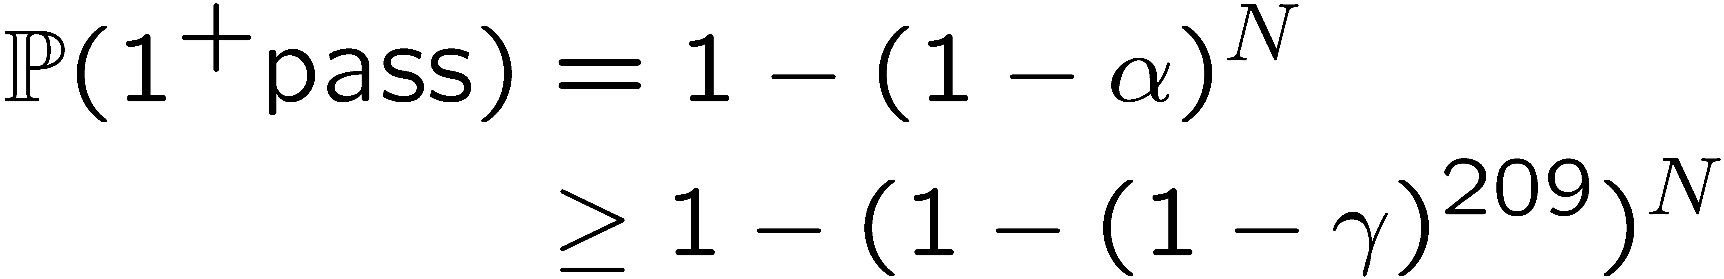
How many |0⟩ (or |+⟩) ancilla?
N | γ =10⁻² | γ =10⁻³ | γ =10⁻⁴
1 | 0.122 | 0.811 | 0.97
2 | 0.229 | 0.964 | 0.9995
3 | 0.324 | 0.993 | 0.999991
4 | 0.406 | 0.998 | >0.99999

Slide 71
How many |cat⟩ ancilla?
N | γ =10⁻² | γ =10⁻³ | γ =10⁻⁴
1 | 0.525 | 0.937 | 0.993
2 | 0.774 | 0.996 | 0.99995
3 | 0.893 | 0.9997 | >0.99999
4 | 0.949 | 0.99998 | >0.99999

Slide 72
Tile parameters
d=4
S=13

Slide 73
Outline
Elements of a trapped-ion computer
Ballistic transport as a “move” gate
Tile microarchitecture and associated microcode subroutines
Parameter choices for our calculation
Number of locations in the replacements
Results: threshold, clock speed, area

Slide 74
Locations in each replacement
We have synchronized X(Z) ancilla preparation with Z(X) syndrome extraction

Slide 75
Outline
Elements of a trapped-ion computer
Ballistic transport as a “move” gate
Tile microarchitecture and associated microcode subroutines
Parameter choices for our calculation
Number of locations in the replacements
Results: clock speed, area, threshold

Slide 76
Clock speed
Limits [Steane]:
L=1, CX: ~50 kHz
L=1, move: ~40 kHz
Experiments:
L=1, CX: ~800 Hz
L=1, move: ~440 Hz

Slide 77
Area per cell
Very simple:
If each trap is 20μm by 20μm and each cell is 10 traps long, then
  Level 1 area is about 60 mm²
  Level 2 area is about 100 cm²

Slide 78
Accuracy Threshold: Method
Applied method of Aliferis, Gottesman, and Preskill [0504218]
Implemented as general software tools (C++, lex, yacc)
~ 80kb “quantum assembly language” file
# local fault-tolerant controlled-NOT gate
#SIM NO_STABILIZER END
#SIM CONFIGURATION_SIZE 2 END
qubit cq1, cq2, cq3, cq4, cq5, cq6, cq7; # control
qubit tq1, tq2, tq3, tq4, tq5, tq6, tq7; # target
...
#SIM FAULTS_OFF END
(s1,s2,s3) = syndrome(s1,s2,s3,s4,s5,s6,s7);
@(s1==0,s2==0,s3==1) z cq1;
@(s1==0,s2==1,s3==0) z cq2;
@(s1==0,s2==1,s3==1) z cq3;
@(s1==1,s2==0,s3==0) z cq4;
...

Slide 79
Accuracy Threshold:
Malignant Pairs
4731 locations in a CNOT (11,188,815 pairs)
~60 hours simulation running time
3,132,443 malignant pairs (∼3.2e-7)

Slide 80
Concluding points
We can soon have rigorous bounds on the accuracy threshold, clock speed, and area required for a functioning ion-trap quantum computer
These will be worst-case results:
  Maximum distances used
  Movement locations dominate, so if movement is substantially better than other operations, the threshold will greatly improve
Future work could study different codes, average and worst-case behavior, and apply software schedulers to reduce the number of locations

