Slide 1
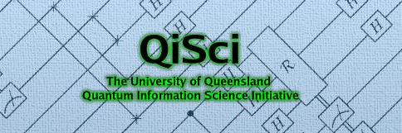
Noise thresholds for optical quantum computers
30 August 2005
Christopher Dawson
Henry Haselgrove
Michael Nielsen
Notes:
=

Slide 2
Introduction: our aim
To numerically find the noise threshold for cluster-state linear optical quantum computing (LOQC)
  Thereby, help judge feasibility of implementing LOQC.
Our final result will be a noise threshold curve.
  We imagine that each optical element is subject to depolarization noise and photon loss noise.
  We determine the range of these noise strengths for which fault tolerant error correction can reduce the error rate to zero:
(above the threshold)
Depolarization rate (per optical element)
(below the threshold)
The threshold
Photon loss rate (per optical element)

Slide 3
Background
Linear-optical quantum computing (LOQC)
  Qubit: encoded in polarization of a single photon
  Resources: Single-photon sources, passive linear optics (beam splitters, phase delays, wave plates), photon-counting photodetectors.
  Major advantage: photons can be isolated from environment
  Major disadvantage: photon-photon interactions difficult
Knill, Laflamme, & Milburn:
  Devised the nondeterministic controlled phase (CPHASE) gate
  Fundamentally nondeterministic (not due to “noise”)
control
|vi
|vi
target
Prob. Success ¼ 1/20

Slide 4
Improvements to KLM
Difficulty of KLM
  CPHASE becomes extremely complex (1000s of optical elements) when probability of success is made high
Examples of improved LOQC schemes
  Nielsen:
    Computation is performed in the cluster-state model.
    The cluster state can be built efficiently using the low-success-probability (i.e. simple) version of KLM CPHASE gate.
    Overall optical circuit is simplified as a result
  Browne and Rudolf:
    Also uses cluster-state model, using even simpler fusion gate as alternative to CSIGN.
    Results in further simplification to the optical circuit
The scheme we simulate :
  Takes elements of Nielsen, and Browne and Rudolf
  Plus further modifications

Slide 5
Related threshold results
A range of threshold estimates (numerical and analytical) have been performed before.
  For example, Steane’s comprehensive numerical threshold simulations (Circuit model, and simple depolarization noise)
Such results don’t directly apply to the situation we consider
  Our protocol operates in the cluster-state model, not the circuit model
  Our noise model is necessarily more complicated (two noise types, having very different effects)
Analytical results for cluster state model:
  Nielsen and Dawson showed that a threshold exists in the cluster-state model
  Simplified argument by Aliferis & Leung
  These proofs give a bound on the threshold, but not a precise value

Slide 6
Physical setting
Resources:
  Source of Bell pairs (simple two-node cluster state)
    Perhaps generated using parametric downconversion
  Photon-number discriminating photodetectors
  Passive linear optics
  Quantum memory
Qubits, and operations on qubits
  Dual-rail qubits: α|0i + β|1i ! α |Hi + β |Vi
  Single-qubit measurements and gates very simple combinations of above resources
  The fusion gate (to build cluster states, described later)
Error model:
  Each qubit operation (fusion, memory, Bell preparation, measurement) has a possibility of introducing depolarisation and/or photon loss.
  Nondeterminism of fusion gates: they “fail” with probability 1/2.
  For convenience, no dark counts (false positive photon counts)

Slide 7
Remainder of the talk
A little more background:
  Cluster state model
  Fusion gate
  Building cluster states optically with fusion gate
Our cluster-based error-correction protocol
The simulation, and final threshold results

Slide 8
Cluster state computing
Raussendorf and Briegel:
  Measuring each qubit of a cluster state is universal for quantum computing.
  That is, any quantum circuit can be simulated by first creating, then measuring, a cluster state.
Cluster states:
  most general notion, often called graph state
  For every graph, there is a corresponding cluster state. For example:
1
2
1
|+i
)
2
|+i
3
|+i
3
4
4
|+i

Slide 9
Cluster state computing
Converting a quantum circuit to a cluster state computation:
  Write the circuit in terms of the universal set:
    Controlled phase two-qubit gate
    He^{-iαZ} == HZ_{α} (family of single qubit gates)
  Replace each HZ_{α} in the circuit as follows:
x
HZ_{α}
HZ_{α}
|+i
X

Slide 10
Example conversion
x
|+i
HZ_{α}
|+i
HZ_{α}
|+i
X
|+i
X
|+i
HZ_{β}
x
|+i
HZ_{β}
x
|+i
HZ_{α}
|+i
|+i
x
|+i
HZ_{β}
Classical feed-forward
Cluster creation
Measurement

Slide 11
The fusion gate
The fusion “gate” has two inputs and one output
(Polarization-discriminating photodetector)
45°
input qubit 1
output qubit
input qubit 2
Behaviour of the gate depends on how many photons are detected:
“Success”:
  Defined to be when the photodetector counts exactly one photon.
  Then, output relates to the input by the operator |0ih00| + |1ih11|
“Failure”:
  Defined to be when the photodetector counts zero or two photons.
  Then, computational basis measurement is performed on input qubits |01i and |10i. No qubit is output.

Slide 12
Building cluster states optically
In our protocol, fusion gates build clusters from Bell pairs. The cluster
is equivalent to a Bell pair .
Effect of a fusion gate on a cluster state depends on the success or failure of the gate
Successful fusion gate: combines two nodes of a cluster
)
(50%
probability)
Failed fusion gate: removes nodes from cluster
)
(50%
probability)

Slide 13
Fusion with higher probability of success
How do you build up clusters efficiently with fusion gates that fail 50% of the time?
First build a supply of microclusters by fusing Bell states
Use microclusters as building blocks. To join with many parallel attempts at fusion
Chance of join succeeding can be made arbitrarily high
(creating a k-leaf microcluster takes on average k² Bell pairs)

Slide 14
Clusterized error correction protocol
For comparison, traditional fault-tolerant QEC:
data
A
A
A
A
F.T. ancilla creation
X syndrome extractions
Z syndrome extractions
Similar elements present, in a disguised form, in the cluster-state protocol.

Slide 15
Clusterized protocol
data, plus “dangling nodes”
A
A
A
A
Cluster for data-ancilla interaction
ancilla cluster
(equivalent circuit)
data
X synd.
Z synd.
Z synd.
X synd.
A
A
A
A

Slide 16
Ancilla creation
0
1
2
3
4
5
6
7
8
0
j+i
1
j+i
2
j+i
3
j+i
4
j+i
H
5
j+i
H
6
j+i
H
7
j+i
H
8
j+i
9
j+i
10
j+i

Slide 17
1
2
3
4
5
6
7
8
0
1
2
3
4
5
6
7
8
9
10
0
1
2
3
4
5
6
7
8
0
j+i
1
j+i
2
j+i
3
j+i
4
j+i
H
5
j+i
H
6
j+i
H
7
j+i
H
8
j+i
9
j+i
10
j+i

Slide 18
1
2
3
4
5
6
7
8
0
1
2
3
4
5
6
7
8
9
10
The above cluster is created by fusing microclusters
Then all qubits in columns 1 to 7 are measured, to “run” the cluster
  (leaves column 8 so we can join main cluster)
Verification bits (output of first four rows) are checked
Additional verification check: no lost photons

Slide 19
input data cluster
A
A
A
A
“telecorrector” cluster
Verified ancillas are joined to form the “telecorrector” cluster (this cluster both teleports and corrects the data)
Pre-running the telecorrector:
Even before we interact (join) the telecorrector with the data, we do the following:
  Measure all the dark-coloured qubits, to pre-run part of the cluster
  (This pre-running commutes with the process of joining the telecorrector to the data)

Slide 20
A
A
A
A
Advantages of pre-running the telecorrector qubits:
We can check for a range of different types of errors on the telecorrector, and throw it away if necessary:
  Disagreeing syndromes.
    Normally, disagreeing syndromes cause a QEC round to be wasted, just adding more noise to data.
    We can throw away telecorrectors with disagreeing syndromes. Effect will be to improve threshold.
  Lost photons.
    When the telecorrector is pre-measured, lost photons are easily detected. Thus, lost photons on these qubits don’t add noise to data
  Nondeterminism of fusion gates.
    We only use a telecorrector when we know the construction of it has succeeded.

Slide 21
When we have a verified telecorrector, we attach it to data, and measure data to finish running the cluster.
Many fusion-gate attempts per row needed.
A
A
A
A
Error-corrected data
Multiple fusion gate attempts, followed by measurement
Photon loss and nondeterminism at this stage:
  effects output data, but we know which row.
    These are located errors.
    Decoding routine takes advantage of this knowledge
  Don’t need to replace a lost photon: qubit being teleported onto almost certainly still has a photon.

Slide 22
How we simulate the protocol
We perform a many-trial Monte Carlo simulation
  Stochastically introduce errors according to noise model
  Track errors as they propagate through the circuit
Measure the resulting rate of Pauli errors on the encoded qubit, that is crashes
Two very different types of crashes:
  Located crashes: - The experimenter knows that the encoded state has suffered depolarization. Triggered when many qubits in the code experience located errors, e.g. photon loss.
  Unlocated crashes: - Crashes not known to the experimenter. Mainly caused by combinations of depolarization errors.
Input parameters ! Output statistics
(photon loss rate, depolarization rate) ! (loc. crash rate, unloc. crash rate)

Slide 23
Our simulator: a redundancy code of sorts
How do you know when a simulation of a fault-tolerant computation is working bug-free? Can results be verified?
Our approach: Write two versions of the same simulator independently, and compare results!
Look for bugs until simulators agree completely.

Slide 24
Thresholds and concatenation
Noise levels are below the threshold when repeated concatenation of error-correction protocols reduce the effective error rate to zero
Level 1 (cluster protocol)
Level 2 (circuit-based protocol)
Photon loss rate
Loc. crash rate = loc. error rate
Loc. crash rate…
Depolarization rate
unloc. crash rate = unloc. error rate
unloc. crash rate
Level 3 (circuit-based protocol)
…= loc. error rate
…etc.
…= unloc. error rate

Slide 25
Deterministic (circuit-based) protocol
Used for second and higher levels of concatenation
Inspired by cluster model, this protocol also uses a “telecorrector”
  (Syndromes are extracted before any interaction with data)
Schematic showing the order of syndrome extractions in our circuit-based telecorrection protocol:
Data
j+i^{­n}
Legend (measurement types):
teleportation
Z syndrome extraction
X syndrome extraction
j0i
j0i
j+i^{­n}
j0i
j0i
(telecorrector creation)
Noise model: unlocated and located errors.

Slide 26
Circuit-model results: flow diagram
x 10
-3
12
10
8
unlocated error rate, p
6
(using 23-qubit Golay code)
4
2
0
0
0.05
0.1
0.15
0.2
0.25
0.3
located error rate, q

Slide 27
Polynomial fitting. Deterministic threshold
x 10
-3
12
10
8
unlocated error rate, p
6
(using 23-qubit Golay code)
4
2
0
0
0.05
0.1
0.15
0.2
0.25
0.3
located error rate, q

Slide 28
Final threshold results
We fit polynomials to the map (input noise rates)  (crash rates) for both protocols
  1. Optical protocol
  2. Circuit-based protocol
Can then test any value for the physical noise rates, very quickly, by applying map 1 once and map 2 many times
Result: high-resolution threshold curve with respect to the physical noise rates
Carried out whole procedure for two code types:
  7-qubit Steane code
  23-qubit Golay code

Slide 29
Final threshold results
x 10
-4
7-qubit code, memory noise disabled
x 10
-3
23-qubit code, memory noise disabled
1
ε
4
ε
0.8
3
0.6
Depolarization parameter,
Depolarization parameter,
2
0.4
1
0.2
0
0
0.002
0.004
0.006
0.008
0.01
0.012
0
0
0.005
0.01
0.015
0.02
Photon loss rate,
γ
Photon loss rate,
γ
7-qubit code, all noise types enabled
23-qubit code, all noise types enabled
x 10
-5
x 10
-4
3
ε
8
ε
6
2
Depolarization parameter,
Depolarization parameter,
4
1
2
0
0
0.5
1
1.5
2
2.5
3
3.5
4
0
Photon loss rate,
γ
-3
0
1
2
3
4
5
6
x 10
Photon loss rate,
γ
x 10
-3

Slide 30
Final threshold results
x 10
-4
7-qubit code, memory noise disabled
x 10
-3
23-qubit code, memory noise disabled
1
ε
4
ε
0.8
3
0.6
Depolarization parameter,
Depolarization parameter,
2
0.4
1
0.2
0
0
0.002
0.004
0.006
0.008
0.01
0.012
0
0
0.005
0.01
0.015
0.02
Photon loss rate,
γ
Photon loss rate,
γ
7-qubit code, all noise types enabled
23-qubit code, all noise types enabled
x 10
-5
x 10
-4
3
ε
8
ε
6
2
Depolarization parameter,
Depolarization parameter,
4
1
2
0
0
0.5
1
1.5
2
2.5
3
3.5
4
0
Photon loss rate,
γ
-3
0
1
2
3
4
5
6
x 10
Photon loss rate,
γ
x 10
-3

Slide 31
Conclusions
In principle, reliable LOQC can be performed with combined error rates, per physical operation, of:
  photon loss rate 10⁻³
  Pauli error rate 2 £ 10⁻⁴.
Threshold is worse than circuit-model threshold (as it should be: nondeterministic gates). Not too much worse though.
Using the cluster state model in linear optics quantum has several advantages
  Use of the simple fusion gate as building block
  Advantages associated with the teleported nature of cluster state computing
    Post-selection for pre-agreeing syndromes
    Post-selection against located noise types

Slide 33
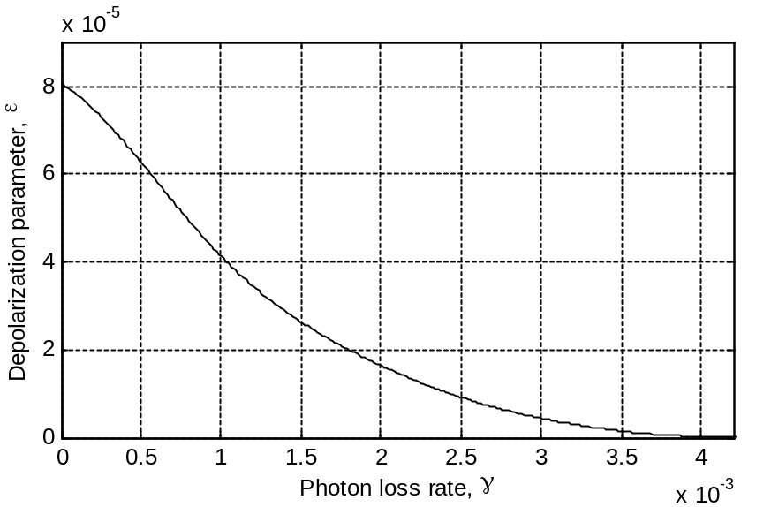
Example of rough resource-usage calculation
(using this noise rate)
*
Level | # Bell pairs per EC round | Unloc. crash rate | Loc. crash rate
1 | 1 × 10⁸ | 2 × 10⁻⁴ | 5 × 10⁻³
2 | 4 × 10¹⁰ | 6 × 10⁻⁵ | 8 × 10⁻⁴
3 | 2 × 10¹³ | 3 × 10⁻⁶ | 3 × 10⁻⁵
4 | 7 × 10¹⁵ | 7 × 10⁻⁹ | 6 × 10⁻⁸
5 | 3 × 10¹⁸ | 3 × 10⁻¹⁴ | 3 × 10⁻¹³

Slide 34
Polynomial fitting. Deterministic threshold
(note: protocol performs better with small amounts of located noise!)
x 10
-3
4
3.5
3
(using 23-qubit Golay code)
2.5
Unlocated error rate, p
2
1.5
1
0.5
0
0
0.05
0.1
0.15
0.2
0.25
Located error rate, q

Slide 35
1
2
3
4
5
6
7
8
0
1
2
3
4
5
6
7
8
9
10
0
1
2
3
4
5
6
7
8
0
j+i
1
j+i
2
j+i
3
j+i
4
j+i
H
5
j+i
H
6
j+i
H
7
j+i
H
8
j+i
9
j+i
10
j+i

Slide 36
1
2
3
4
5
6
7
8
0
1
2
3
4
5
6
7
8
9
10
0
1
2
3
4
5
6
7
8
0
j+i
1
j+i
2
j+i
3
j+i
4
j+i
H
5
j+i
H
6
j+i
H
7
j+i
H
8
j+i
9
j+i
10
j+i

Slide 37
1
2
3
4
5
6
7
8
0
1
2
3
4
5
6
7
8
9
10
0
1
2
3
4
5
6
7
8
0
j+i
1
j+i
2
j+i
3
j+i
4
j+i
H
5
j+i
H
6
j+i
H
7
j+i
H
8
j+i
9
j+i
10
j+i

Slide 38
1
2
3
4
5
6
7
8
0
1
2
3
4
5
6
7
8
9
10
0
1
2
3
4
5
6
7
8
0
j+i
1
j+i
2
j+i
3
j+i
4
j+i
H
5
j+i
H
6
j+i
H
7
j+i
H
8
j+i
9
j+i
10
j+i

Slide 39
1
2
3
4
5
6
7
8
0
1
2
3
4
5
6
7
8
9
10
0
1
2
3
4
5
6
7
8
0
j+i
1
j+i
2
j+i
3
j+i
4
j+i
H
5
j+i
H
6
j+i
H
7
j+i
H
8
j+i
9
j+i
10
j+i

Slide 40
1
2
3
4
5
6
7
8
0
1
2
3
4
5
6
7
8
9
10
0
1
2
3
4
5
6
7
8
0
j+i
1
j+i
2
j+i
3
j+i
4
j+i
H
5
j+i
H
6
j+i
H
7
j+i
H
8
j+i
9
j+i
10
j+i

