Slide 1
Hamiltonian Approach to Fault Tolerant Quantum Error Correction:
Are the standard FT-QEC assumptions internally consistent?
Daniel Lidar
Departments of Chemistry and Electrical Engineering
University of Southern California
With Robert Alicki and Paolo Zanardi [quant-ph/0506201]

Slide 2
We’re Counting on Fault Tolerant Quantum Error Correction (QEC)
Fault tolerance threshold (~10⁻⁴) often used as design criterion for quantum computers
FT-QEC is viewed as backbone of scalability of quantum computing and communication
Most Markovian-threshold work relies on phenomenological models, in particular effective error maps, and not “bottom-up” from Hamiltonian.
Interesting to re-examine the basic assumptions in light of rigorous conditions for existence of quantum Markovian limit.

Slide 3

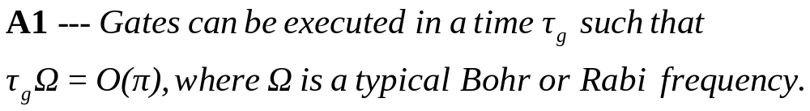
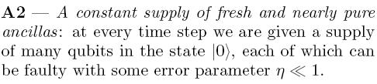

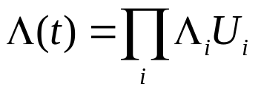
Minimal Assumptions of FT-QEC
Fast (non-adiabatic) gates:
Entropy sink:
Markovian bath:
Notes:
Λi are (CP) maps, which exhibit exponentially decaying correlations in both space and time.
Ui are ideal unitary superoperators (corresponding to quantum logic gates)

Slide 4
Two Rigorous Paths to Quantum Markov Dynamics, Consistent with Thermodynamics
“Singular Coupling Limit” (SCL):
High temperature bath ➔
fast gates ok, but cannot have pure ancillas
“Weak Coupling Limit” (WCL):
Slow (adiabatic) gates ➔
pure ancillas ok, but cannot have fast gates

Slide 5

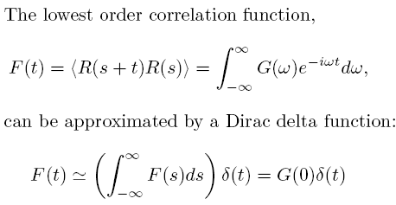
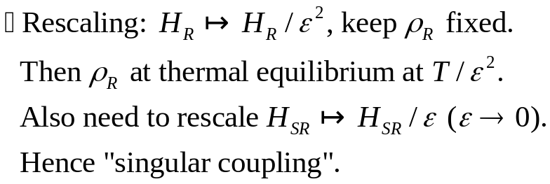
Singular Coupling Limit (SCL)
Assumptions:
Notes:
R(t) is interaction picture version of R wrt H_R

Slide 6


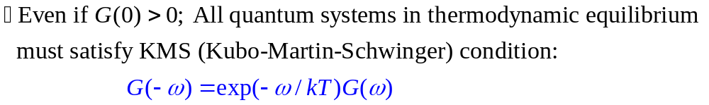
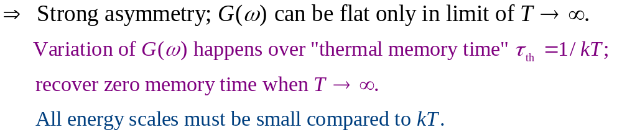
SCL Domain of Applicability
When does “white noise” limit hold?
For the important case of linear coupling to a bosonic field we have G(0)=0 so F(t) cannot be well approximated by a delta function
bath
QC
anc.
Notes:
The G(0)=0 case shouldn’t be over-dramatized, since we don’t need F(t) to be a strict delta function.

Slide 7




Weak Coupling Limit (WCL)
E.B. Davies, Commun. Math. Phys. 39, 91 (1974)
Assumptions:
Let
Then:
Notes:
E_k are Bohr energies (eigenvalues of H_S)

Slide 8
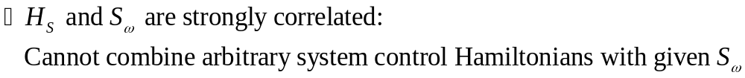
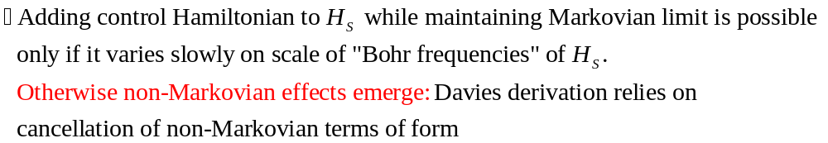

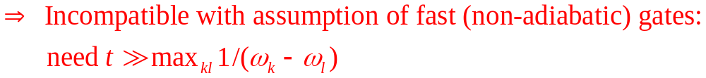
WCL Domain of Applicability
Implications of
Note: discrete spectrum essential! Adding fast control makes spectrum (quasi-)continuous
Notes:
The Markov approximation is, equivalently, a long-time limit (compared to maxωkl 1/ωkl – the system’s Bohr frequencies), and one cannot expect this approximation to be valid at short times. However, FT-QEC assumes operations on a time-scale that is short on the scale set by maxωkl 1/ωkl.

Slide 9

Consequences
Fast gates:
or Rabi
Entropy sink:
SCL
Markovian bath:

Slide 10
Consequences
Fast gates:
or Rabi
Entropy sink:
WCL
Markovian bath:

Slide 11
Implications
Markovian FT-QEC theory should be revisited. The threshold results are valid within a phenomenological theory of Markovian FT-QEC, but this theory may not be “microscopically” consistent.
We haven’t been specific about nature of non-Markovian errors in WCL. It’s possible they can be corrected in a more advanced FT-QEC theory.
However, one must be careful about importing Markovian assumptions (esp. in context of ancillas). Namely, the error-operator form E_{QC} ⊗ I_{ancilla} requires the SCL, if system and ancillas are coupled.
Notes:
SCL arises in point 2 in that product error form needs the assumption of delta function correlation functions between system-bath and ancillas-bath. Otherwise don’t get Lindblad operators of the simple sum form that gives rise to the product error operator form.

Slide 12
Open Questions and Future Research Directions
Can one devise a fully consistent, fully “Hamiltonian-up” approach to FT-QEC?
Fault-tolerance in the adiabatic QC paradigm? [It is automatically consistent with the WCL]
Fault-tolerant dynamical decoupling?
[see K. Khodjasteh, D.L., quant-ph/0408128]

Slide 13
Some extra details on the next few slides

Slide 14
Three level systems, Raman transitions, and all that
Common objection: “In trapped ions one applies Raman transitions between nearly degenerate levels. Then the SCL-type contradiction doesn’t apply since effective energy scale vanishes and hence T is infinite.”
But in Raman transition effective energy scale is:
Only holonomic approach to QC uses truly degenerate qubits (and is adiabatic)

Slide 15



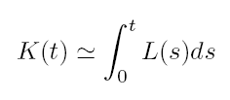
WCL Domain of Applicability – Detailed
Markov:
instead of prop. to t²

Slide 16
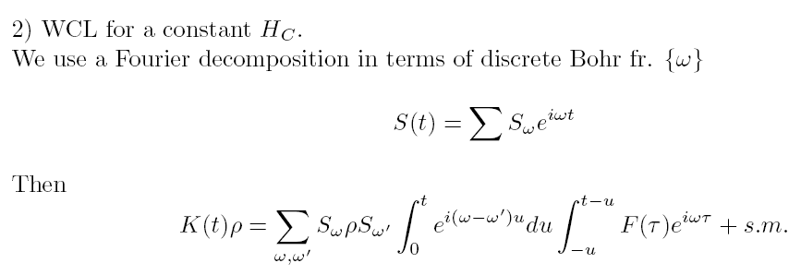


(of Floquet unitary)
Conditions for Markovianity:

Slide 17
Note on ancillas in recent non-Markovian FT-QEC work
Non-Markovian FT-QEC recent papers by Terhal & Burkard and Aliferis, Gottesman & Preskill import some of the usual phenomenology of Markovian FT-QEC, in particular, assumption of decoupled and (nearly) pure ancillas – a Markovian SCL-type assumption:
Assume that the QC and ancillas are coupled to independent reservoirs. If there exists a nontrivial interaction between the QC and the ancillas, then a first-principles derivation of the error map (or Lindblad generator) generally yields, to lowest order, a form that differs from I + F_{QC} + F_{ancilla}, which is the one that corresponds to the product structure E_{QC} ⊗ I_{ancilla}.
The exception is when one explicitly assumes Dirac delta functions for the autocorrelation functions of the reservoirs that the QC and ancillas are coupled to. However, this is possible only for an SCL-type approach to the Markov approximation.
Note that if one tries to use the WCL in this case, one obtains a joint (Lindblad) generator that depends on the Hamiltonian H_{QC+ancilla}, and which does not yield a product structure E_{QC} ⊗ I_{ancilla}. In other words, after introducing the ancillas, one should expect that instead of the product type errors E_{QC} ⊗ I_{ancilla} (which can appear only in the SCL Markovian approximation), one will have “entangled errors” of the form E_{QC+ancilla}

