Slide 1

Fault Tolerance with
Nearest-Neighbour Interactions
Vwani Roychowdhury
Joint work with
Thomas Szkopek, P. Oscar Boykin , Heng Fan,
Eli Yablonovitch, and
HRL Team
UCLA
U. Florida Gainesville

Slide 2
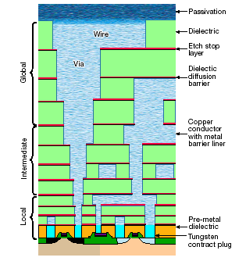
Physical Architecture: 1-D Topology
Fabrication yield limits processing to ~10 metallization layers, and thus ≤20 qubit wide stripes
gate electrodes
electron qubits
substrate
qubit stripe (cross-section)
serpentine
intersecting
projected 35nm CMOS node (2015)
qubit stripe (top view)

Slide 3
Nearest Neighbour Penalties
Penalty in gate count of ~13X
305 → 3873
Penalty in error threshold of ~160X
2.1x10⁻⁵ → 1.3x10⁻⁷
Penalty in voltage pulse amplitude / timing of ~13X
0.52° → 0.041°
Free Nearest Neighbour
Communication Communication

Slide 4
Physical Layout
The worst possible case for communication is the 1-D topology of a linear array
That is:
We consider a topology comprising L lines of qubits. L grows only as loglog(T), where T is the total number of logical gates. Hence three or five linear arrays will be sufficinent.

Slide 5
Fault Tolerance
data qubits
logic + errors
error detection
+ error recovery
+ errors
ancillary qubits

Slide 6

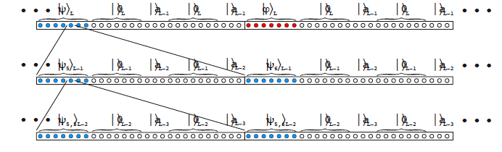
Concatenated Codes
7-qubit CSS code:
Concatenation: apply the code recursively
L=4
L-1=3
L-2=2
L-3=1
L-4=0

Slide 7
Concatenated Gates
Apply operation U_{L} then apply error correction E_{L} for all L
N_{U} gates U’_{L-1}
N_{E} gates U’_{L-1}
N_{U} gates U’_{L-2}
N_{E} gates U’_{L-2}
N_{U} gates U’_{L-2}
N_{E} gates U’_{L-2}

Slide 8
Error Threshold
For independent errors, the probability of a gate error at level L is:
where N is the total number of L-1 gates between error correction cycles at level L
Errors are suppressed super-exponentially below a threshold
Error threshold determined by gate count N

Slide 9
Logical Gate Circuits
Apply operation U_{L} then apply error correction E_{L}
Several operations U_{L} can be performed qubit-wise at level L-1: X, Z^{1/2}, H (Hadamard), SWAP, CNOT
Universal computation requires a “non-trivial” gate needing extra resources: CCNOT (Fredkin-Toffoli), Z^{1/4} → ignore these for the moment

Slide 10
Logical Gate Circuits
“internal” communication for 2 qubit gates
Level L
Level L-1: 7 non-local operations
Level L-1: 7² local operations
space
space
space
time
time
time
Free Communication
Nearest-Neighbour Communication

Slide 11
Layout Issue: Why L linear chains?
If this circuit is implemented in a single chain of qubits then it might introduce two errors if only one of the swap gets develops an error. To avoid this problem, we use a second linear chain of qubits to route the the bits to be swapped. Using concatenation, this will lead to the use of L linear chains of qubits if one uses L levels of concatenation.

Slide 12
Internal Communication
Level L
1 operation
Level L-1
7²=49 operations
Level L-2
7⁴=2401 operations

Slide 13
Error Correction Circuit
After each U_{L}, perform error correction E_{L}
50% of the fault tolerant circuit E_{L} (phase correction only):

Slide 14
Error Correction Circuit
Prepare 3 logical 0’s

Slide 15
Error Correction Circuit
Prepare 3 logical 0’s
Compare 0’s for bit-flips

Slide 16
Error Correction Circuit
Prepare 3 logical 0’s
Compare 0’s for bit-flip
Decode error (classically), and correct bit-flip

Slide 17
Error Correction Circuit
Prepare 3 logical 0’s
Compare 0’s for bit-flip
Decode error (classically), and correct bit-flip
Copy qubit phase error to logical 0

Slide 18
Error Correction Circuit
Prepare 3 logical 0’s
Compare 0’s for bit-flip
Decode error (classically), and correct bit-flip
Copy qubit phase error to logical 0
Repeat 1-4

Slide 19
Error Correction Circuit
Prepare 3 logical 0’s
Compare 0’s for bit-flip
Decode error (classically), and correct bit-flip
Copy qubit phase error to logical 0
Repeat 1-4
Rotate phase flips into bit flips

Slide 20
Error Correction Circuit
Prepare 3 logical 0’s
Compare 0’s for bit-flip
Decode error (classically), and correct bit-flip
Copy qubit phase error to logical 0
Repeat 1-4
Rotate phase flips into bit flips
Decode error (classically) and correct phase flip

Slide 21

Free Communication Count
Without Zero Preparation:
With Zero State Preparation:

Slide 22
Remote-CNOT
What if EPR pairs are available?
 | Gate Count N | Error Threshold P_{th}=2/N² | Gate Accuracy Threshold Φ_{th}=2(2/N²)^{1/2}
Free Communication | 305 | 2.1x10^{‑5} | 0.52°
reCNOT Communication | 35+1090= 1125 | 1.6x10⁻⁶ | 0.14°
Nearest Neighbour Communication | 3873 | 1.3x10⁻⁷ | 0.041°

Slide 23
Physical Tolerances
What is the threshold tolerance on gate amplitude and timing?
z
error probability
ε=sin²(φ/2)~(φ/2)²
rotation error
φ
φ
x
Bloch sphere

Slide 24
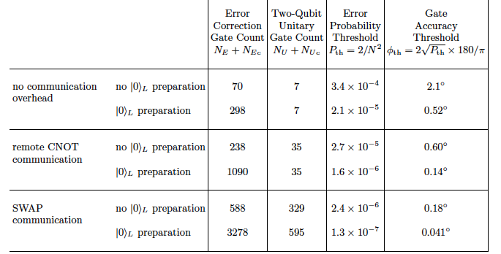
Summary of Results
In context: 1/30th of a degree corresponds to 1ps accuracy
in a 10ns pulse

Slide 25


Some Numbers
T=10^{14}; P_{th}=10^{-6};
\epsilon= 10^{-7}; then L=3 suffices.
So the overhead in terms of qubits is at least (21)^3= 9261.

Slide 26
Complexity of Shor’s Algorithm
Space Time Tradeoff:
O(L^3) qubits in time O(Log^2 L)
O(L^2) qubits in time O(L*Log L)
O(L) qubits in time O(L^2)
If L=10^3, then
10^9 qubits; time depending on embedding in the physical space ……………..
The numbers are too depressing. :-)

Slide 27
Parallel Communication on a Qubit Array
L qubits
information
L qubits
ancilla
qubit cell

Slide 28
Entanglement Swapping Circuit
measurement*
control
spin
H
charge
to classical bus
H
unitary gate*
charge (from bus)
target
spin
entangle (phase I)
entangle (phase II)
measurement + classical communication (phase III)
* = qubit operations at even/odd locations differ by one Hadamard rotation

Slide 29
Entanglement Swapping for Qubit Distribution
control
measurement + classical communication (phase III)
see next slide
entangle (phase I)
entangle (phase II)
target
binary distribution tree
time

Slide 30
log(L) Depth Classical Processing (Phase III)
time
measurement = spin to electric charge
unitary gate = electric charge to spin
compute parity (X2)
compute parity (X4)
compute parity (X8)
compute parity (X16)

Slide 31
log(L) Depth Qubit Distribution
control
target
entangle (phase I)
measurement + classical communication (phase III)
entangle (phase II)
control
target
binary distribution tree
time

Slide 32
Gate Accuracy Threshold Summary
 | Gate Count N | Error Threshold P_{th}=2/N² | Gate Accuracy Threshold Φ_{th}=2(2/N²)^{1/2}
Free Communication | 305 | 2.1x10^{‑5} | 0.52°
Nearest Neighbour Communication | 3873 | 1.3x10⁻⁷ | 0.041°
Penalty for nearest-neighbor communication is an ~13X reduction in pulse amplitude or timing.
In context: 1/30th of a degree corresponds to 1ps accuracy in a 10ns pulse

Slide 33
Questions?
Can we optimize the error correction circuits for fewer gates?
Is there a better way to suppress error than concatenated encoding?
Is 0.041° accuracy achievable? With solid state qubits?

Slide 34
Acknowledgements
P. Oscar Boykin, UF Gainesville
Geoffery Simms, Mark Gyure, Bryan Fong, HRL Laboratories
Thomas Szkopek, Heng Fan, Eli Yablonovitch, UCLA
Financial support from DARPA, CNID, MARCO-MSD

