Slide 1
Local Fault-tolerant Quantum Computation
Krysta Svore
Columbia University
FTQC
29 August 2005
Collaborators: Barbara Terhal and David DiVincenzo, IBM
quant-ph/0410047

Slide 2
Our Problem
Every quantum technology will use fault-tolerant components to achieve scalability
Many technologies require qubits to be adjacent (local) to undergo a multi-qubit operation
Threshold studies have only been done in detail in the nonlocal setting
  Steane: 3 x 10⁻³, AGP: 2.73 x 10⁻⁵,
  Knill: 3 x 10⁻²

Slide 3
Our Goal
Determine the effects of locality on the fault-tolerance threshold for quantum computation
  We perform a first assessment of how exactly locality influences the threshold
Perform an analytical analysis to estimate local and nonlocal thresholds for the [[7,1,3]] CSS code
Discussion point: Distinguish between the true threshold and pseudothresholds
Notes:
Mention what the [[7,1,3]] CSS code is and why we chose it.

Slide 4
Outline
Introduction
A local architecture
Local threshold estimate and results
2D lattice architecture
Discussion point: Thresholds vs. pseudothresholds

Slide 5
Fault-tolerant Computation
Operations are replaced by encoded procedures
A procedure is fault-tolerant if its failing components do not spread more errors in the output encoded block of qubits than the code can correct

Slide 6
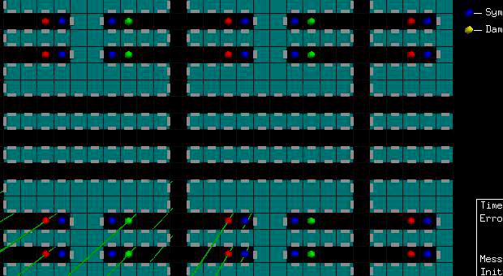
Computation Settings
Local: two qubits must be spatially adjacent to undergo a two-qubit gate
Nonlocal: no restriction on distance between qubits to perform a multi-qubit gate
[ITSIM: Cross, Metodiev]

Slide 7
Local Architecture
All operations must be nearest-neighbor
The most frequent operations should be the most local
The circuitry that replaces the nonlocal circuitry, such as an error correction routine or an encoded gate operation, must be fault-tolerant
Notes:
Explain what nonlocal circuitry means.

Slide 8
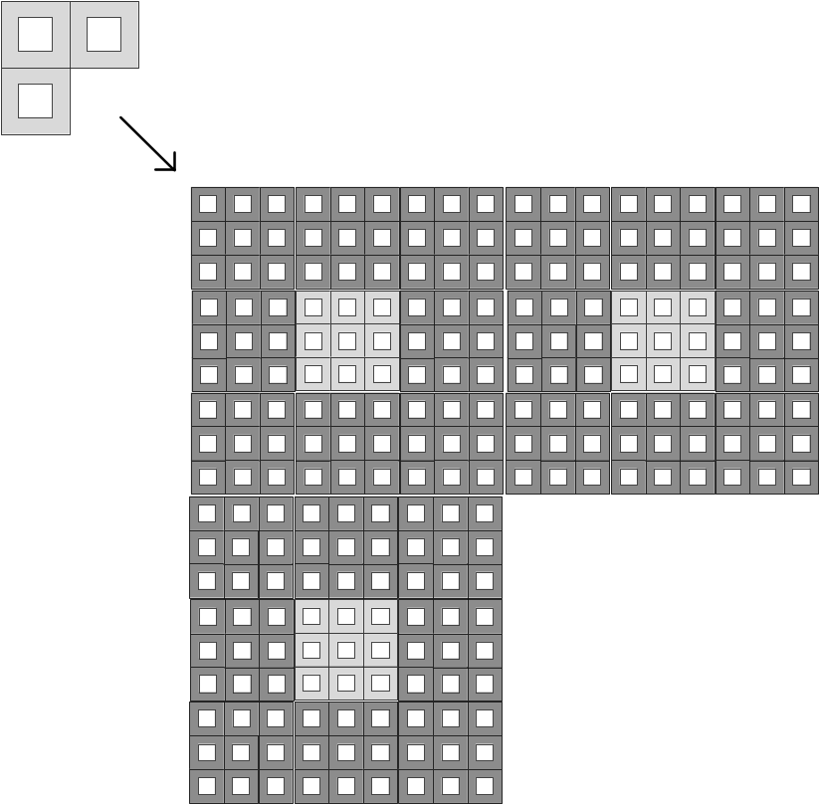
Local Spatial Layout
Original data qubits
  Move distance r
  Surround ‘stationary’ level 0 ancillas
When concatenated, data qubits must move r²
Grayness of the area indicates amount of moving qubits need to do
Error correction must be done in transit
Original circuit concatenated once
Original circuit concatenated twice
Notes:
Relate to picture of the H-tree. Layout is different in this case, but both cases require movement. Point out that in transit implies that you must have intermediate error correction.

Slide 9
Fault-tolerant Replacement Rules
A quantum circuit consists of locations: one-qubit gates, two-qubit gates, or identity operations
Each location in the original circuit M₀ is replaced by error correction and the fault-tolerant implementation of the original location to obtain M₁
M₀ is concatenated recursively L times to obtain M_{L}
Notes:
Also mention the definition of a 1-rectangle

Slide 10
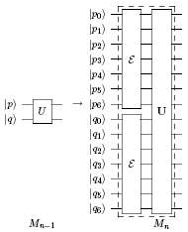
Nonlocal Two-qubit Replacement
Replace U by
  error correction
  fault-tolerant implementation of U
  dashed box is called a
  1-rectangle

Slide 11
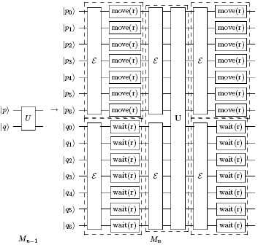
Local Two-qubit Replacement
Replace U by
  “move” (transport) operations
  “wait” (identity) operations
  error correction
  fault-tolerant implementation of U

Slide 12
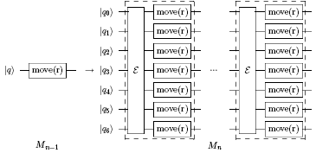
Local “Move” Replacement
Replace move(r) by r move(r) operations with error correction
If movement fails often, set r=τd and error-correct after each of the τ move(d) operations
Notes:
Define a composite rectangle for the local case.

Slide 13
Outline
Introduction
A local architecture
Local threshold estimate and results
2D lattice architecture
Discussion point: Thresholds vs. pseudothresholds

Slide 14
Local Threshold Estimate
Failure rate of composite 1-rectangle must be smaller than the error rate of the original location
  γ₀´ γ(0) ¸ 1 – (1 - γ(1))^{r} ¼ γ(1) r
A 1-rectangle fails if more than 2 of the A locations are faulty
  γ(1) ¼ C(A,2) γ(0)²
Threshold condition
  γ_{0crit} = 1/ (r C(A,2))
Notes:
We assume a move(r) replacement is the worst, since it takes r 1-rectangles.
This means that the g_o_crit has to be the initial failure probability of the components in order for the next level to have a smaller error probability than the original location.

Slide 15
Threshold Analysis
Start with a vector of failure probabilities of the locations, γ(0)
  Locations include one-,two-qubit gates, memory, etc.
Map γ(0) onto γ(1), repeat
γ(0) is below the threshold if γ(L) 0 for large enough L
Approximate failure probability function γ_{l}(L) = F_{l}(γ(L - 1))

Slide 16
Failure Probabilities
Nonlocal
  γ₁: one-qubit gate
  γ₂: two-qubit gate
  γ_{w}: wait location
  γ_{m}: measurement
  γ_{p}: preparation
Local
  γ₁: one-qubit gate
  γ₂: two-qubit gate
  γ_{w1}: wait in parallel with a one-qubit gate
  γ_{w2}: wait in parallel with a two-qubit gate
  γ_{wd}: wait(d) gate
  γ_{md}: move(d) gate
  γ_{m}: measurement
  γ_{p}: preparation

Slide 17
Nonlocal Analysis
Recent threshold estimates are overly optimistic
  Claim thresholds > 10⁻³
  More realistic estimate is order of magnitude lower
Find a threshold value of 4 x 10⁻⁴
Probability map has multiple parameters
  L=1 simulation does not characterize the threshold

Slide 18
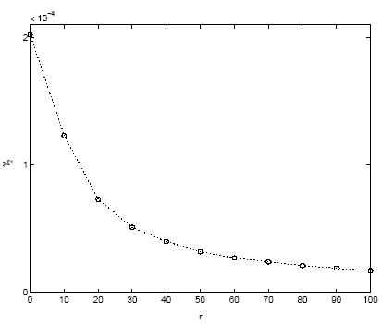
Local gate error rate vs. scale parameter r
γ₁=γ₂=γ_{m}=γ_{p}, γ_{w}=0.1 x γ₂, γ_{wd}=0.1 x γ_{md}, γ_{md}=r/τ x γ₂
Notes:
Gate error rate threshold versus the scale parameter r.
We take γ1 = γ2 = γm = γp , γw = 0.1 x γ2, γwd = 0.1 x γmd, and γmd = r /τ x γ2, where w is wait, wd is wait d steps, and md is move d steps. τ, the frequency with which a transported qubit is error-corrected, is optimized in every case.
It is always near τ = r /10.
The threshold follows very close to a 1/r dependence.

Slide 19
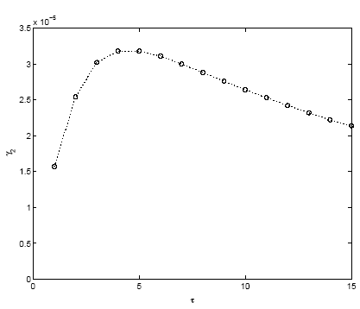
Gate error rate threshold γ₂ vs. frequency of error correction τ
r=50, γ₁=γ₂=γ_{m}=γ_{p}, γ_{w}=0.1 x γ₂, γ_{wd}=0.1 x γ_{md}, γ_{md}=r/τ x γ₂
Notes:
Gate error rate threshold versus τ, the frequency of error correction of a transported qubit.
We take the same settings as above.
While not very strongly τ dependent, the optimal threshold occurs at τ= r /10 = 5.

Slide 20
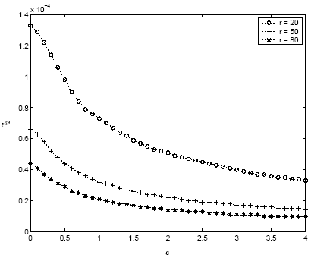
Gate error threshold γ₂ vs. relative noise rate per unit distance ε
γ₁=γ₂=γ_{m}=γ_{p}, γ_{w}=0.1 x γ₂, γ_{wd}=0.1 x r/τ x γ2, γ_{md}=εr/τ x γ₂
Notes:
Gate error threshold versus ε, a parameter that measures the relative noise rate per unit distance for a qubit being moved.
We take the same settings, except with γwd = 0.1 x r /τ x γ2, and γmd = ε r /τ x γ2.
Scale parameter r equals 20, 50, and 80 are studied.
At every point, τ is re-optimized.
The dependence on ε is very slow, evidently slower than 1/ε.

Slide 21
Local Analysis Conclusions
Threshold scales as Θ(1/r)
Threshold is 7.5 x 10⁻⁵
Threshold does not depend very strongly on the noise levels during transportation
Infrequent error correction may have some benefits while qubits are in the “transportation channel”

Slide 22
Outline
Introduction
A local architecture
Local threshold estimate and results
2D lattice architecture
Discussion point: Thresholds vs. pseudothresholds

Slide 23
Further Extensions: 2D Lattice
Local error-correction routine
2D lattice layout
  Surround ancillas by data
    Most frequent operations most local
  Maintain fault-tolerant properties
  Assume SWAP used for qubit transport

Slide 24
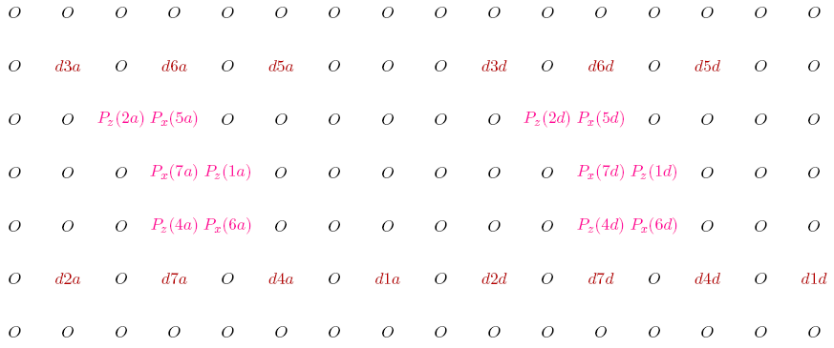
2D Lattice Layout

Slide 25
2D Lattice Layout
6 x 8 lattice of qubits per data qubit
Efficient deterministic local error correction
  X,Z error correction in same space region
34 timesteps to perform CNOT
  [[7,1,3]] error correction
  Move via SWAP (with dummy qubits)
  At next level, error correct after every SWAP

Slide 26
Outline
Introduction
A local architecture
Local threshold estimate and results
2D lattice architecture
Discussion point: Thresholds vs. pseudothresholds

Slide 27
Fault-Tolerance Thresholds Today
10⁻⁷
10⁻⁶
Aharonov & Ben-Or
Knill et al
10⁻⁵
Steane
Gottesman
Aliferis et al
Threshold
SvTD(2D)
10⁻⁴
SvTD;
SvCChA
Gottesman & Preskill
10⁻³
Zalka
Steane
10⁻²
Analytical
Numerical
Other
Silva
Reichardt
Knill
‘96
‘97
‘98
‘99
‘00
‘01
‘02
‘03
‘04
‘05
Year
Notes:
Write out each type of analysis and the exact method. Spend about 5 minutes on this slide.
Bring up fact that not always concatenate to high levels. Not always use different location types. These lead to pseudothresholds.

Slide 28
What is a Pseudothreshold?
γ_{i}^{L} is a level-L pseudothreshold for location type i if
  γ_{i}^{L} < γ_{i}^{L-1}
May or may not indicate the real threshold
Can be more than an order of magnitude different than the real threshold
Collaborators: Andrew Cross, Isaac Chuang, MIT, Al Aho, Columbia
quant-ph/0508176

Slide 29
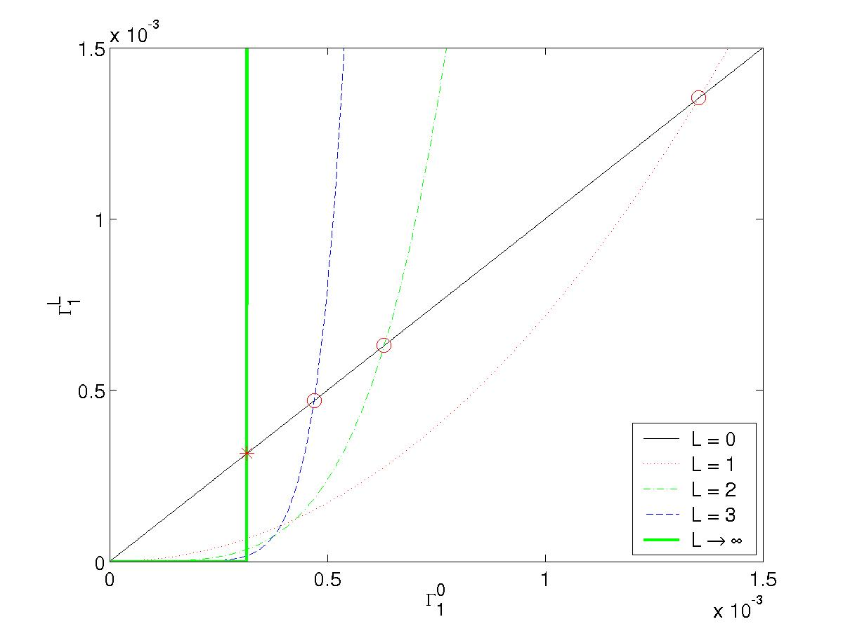
1-Qubit Gate Pseudothreshold
There are many different types of locations:
  Not a 1-parameter map
  Number of location types increases as system model becomes more realistic
More than one level of simulation is required to converge to the threshold

Slide 30
Can we determine the threshold from the pseudothreshold?
Set every initial failure probability to 0, except for location of interest
Conjecture: Level-1 pseudothreshold in this setting upper bounds the actual threshold
Supported by numerical evaluation of threshold set of [[7,1,3]] code
  Bounded above by 1.1 x 10⁻⁴
Notes:
Wait location pseudothreshold. Threshold is 8.8 x 10^-5. Look at every axis. Confirmed by numerical evaluation of threshold set for this code.

Slide 31
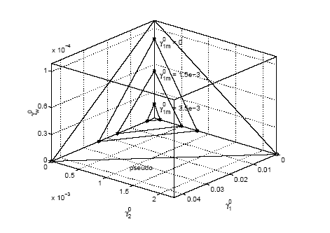
Threshold Set

