Slide 1
Application Backend Database (MySQL)
Christian Dean
1

Slide 2

Database Creation
Database created with “Sea Quail” database diagramming tool
MySQL create script generated from “Sea Quail” diagram

Slide 3
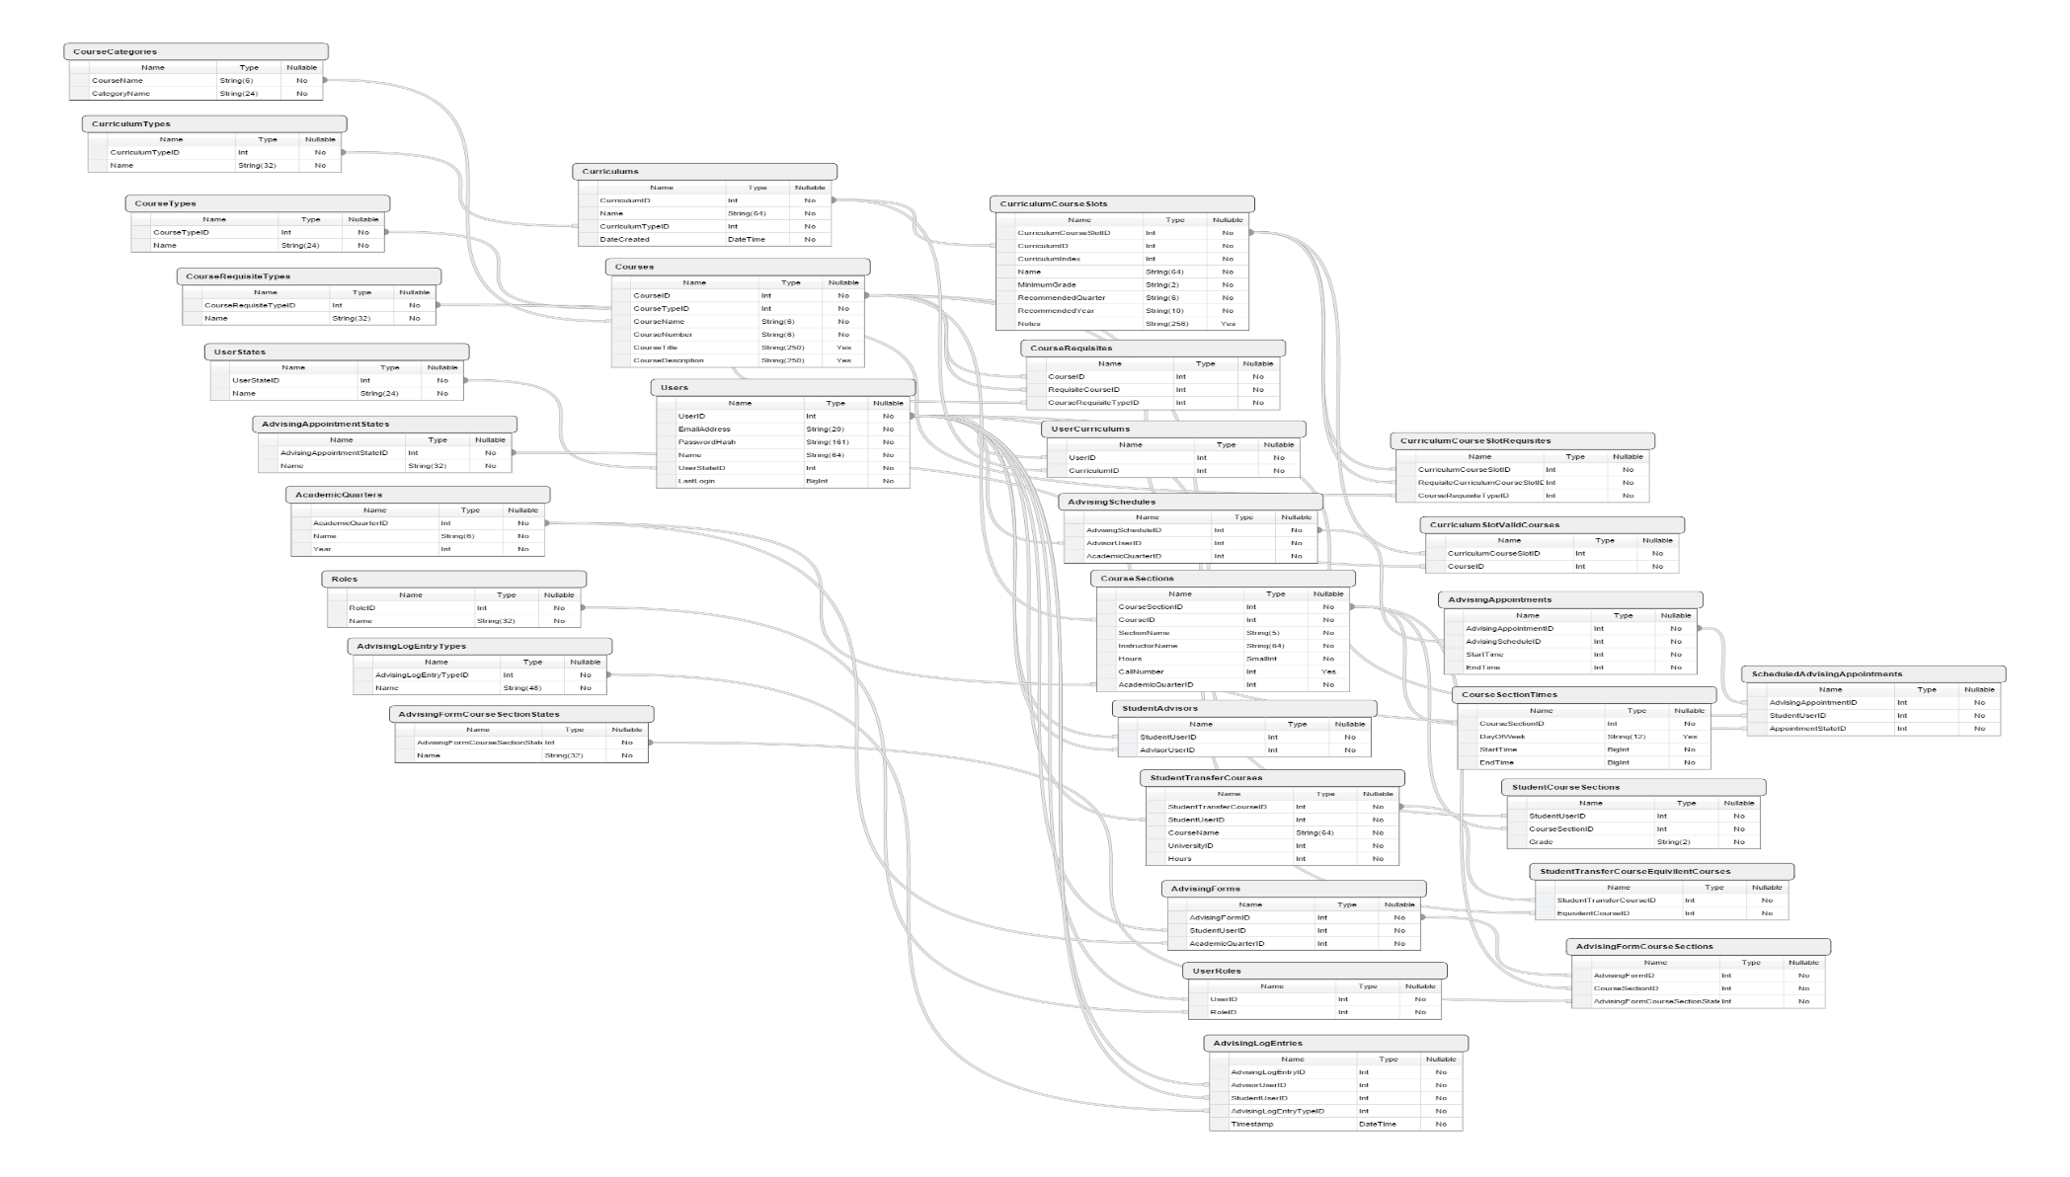
CS Advising App Database
31 Tables
High modularity
Extensible
Min. redundancy

Slide 4
Database Structure Breakdown
6 “collections” of tables:
Tables related to courses
Tables related to users
Tables related to advising appointment scheduling
Tables related to curricula
Tables related to advising forms
Tables related to data logging
Notes:
Tell em what you’re gonna tell em
Kind of dry material
Just going to cover the table functions and how they relate
Not going to cover the individual columns though

Slide 5
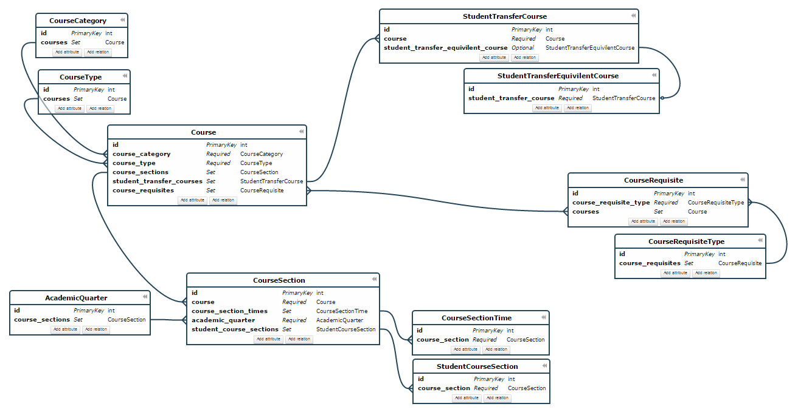
Tables Related to Courses

Slide 6
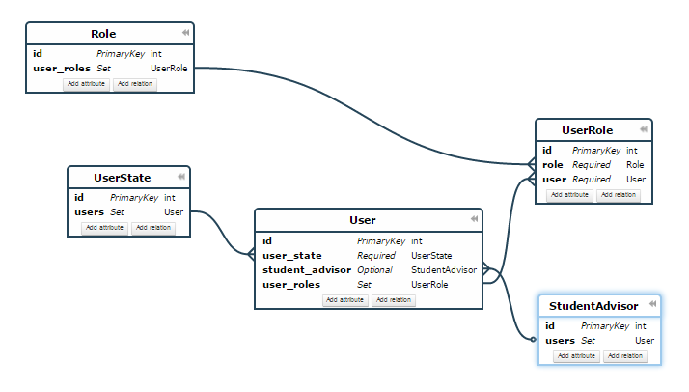
Tables Related to Users

Slide 7
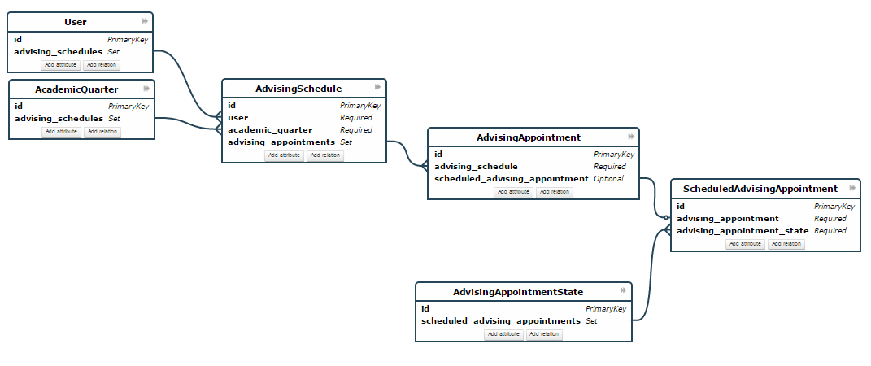
Tables Related to Advising Appointments

Slide 8
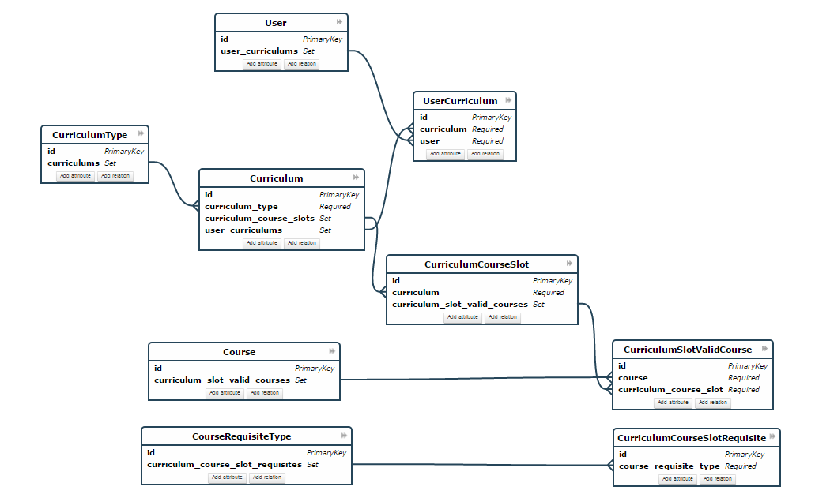
Tables Related to Curricula

Slide 9
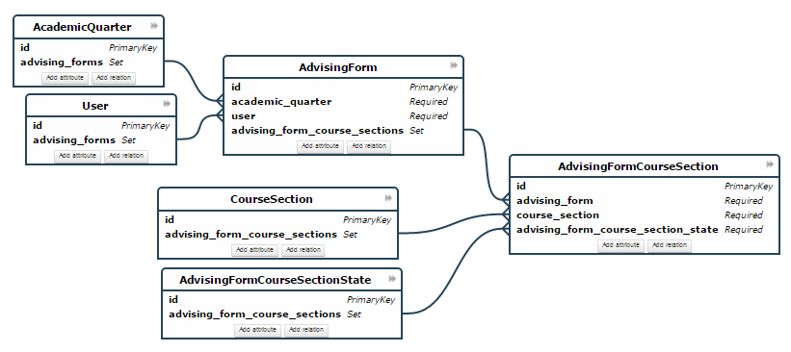
Tables Related to Advising Forms

Slide 10
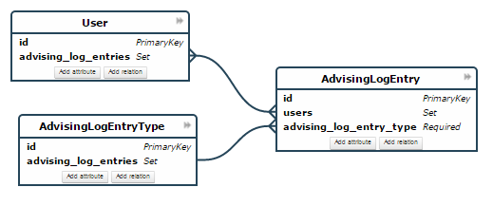
Tables Related to Data Logging

Slide 11
“Extra” informational slides follow
(Ryan: put these after final conclusion slide?)

Slide 12
Tables Related to Courses
CourseCategories
CourseTypes
Courses
CourseSections
CourseSectionTimes
StudentCourseSections
AcademicQuarters
CourseRequisiteTypes
CourseRequisites
StudentTransferCourses
StudentTransferCourseEquivilentCourses
Courses
Creation
Structure
Tables
Courses
Users
Advising Appt.
Curricula
Logging
Sections
Requisites
Transfers
Statically defined table

Slide 13
Tables Related to Users
UserStates
Roles
Users
StudentAdvisors
UserRoles
Creation
Structure
Tables
Courses
Users
Advising Appt.
Curricula
Logging
Statically defined table

Slide 14
Tables Related to Advising Appointments
AdvisingAppointmentStates
AdvisingSchedules
AdvisingAppointments
ScheduledAdvisingAppointments
Creation
Structure
Tables
Courses
Users
Advising Appt.
Curricula
Logging
Statically defined table

Slide 15
Tables Related to Curricula
CurriculumTypes
Curriculums
CurriculumCourseSlots
UserCurriculums
CurriculumCourseSlotRequisites
CurriculumSlotValidCourses
Creation
Structure
Tables
Courses
Users
Advising Appt.
Curricula
Logging
Statically defined table

Slide 16
Tables Related to Data Logging
AdvisingLogEntryTypes
AdvisingLogEntries
Creation
Structure
Tables
Courses
Users
Advising Appt.
Curricula
Logging
Statically defined table

