Slide 1
PROJECT TITLE
CAPSTONE PROJECT
Presented By:
1. Abhijeet Singh-Graphic Era University-Btech CSE

Slide 2
OUTLINE
Problem Statement (Should not include solution)
Proposed System/Solution
System Development Approach (Technology Used)
Algorithm & Deployment
Result (Output Image)
Conclusion
Future Scope
References

Slide 3
Problem Statement
With the rapid growth of digital communication and interconnected systems, securing network infrastructure against cyber-attacks has become a critical priority. Modern networks are frequently targeted by various forms of malicious activities such as Denial of Service (DoS), Probing, Remote to Local (R2L), and User to Root (U2R) attacks, which can compromise data integrity, availability, and confidentiality.
Traditional intrusion detection systems often rely on manual rules or outdated signatures, making them ineffective against new or evolving threats. Therefore, there is an urgent need for an intelligent and automated solution.
The system will leverage the Kaggle dataset and be deployed on IBM Cloud Lite to provide scalable, early detection and protection against potential threats in communication networks.

Slide 4
Proposed Solution
The proposed solution is to develop a machine learning-based Network Intrusion Detection System (NIDS) that can accurately detect and classify various types of cyber-attacks such as DoS, Probe, R2L, and U2R. Using the Kaggle intrusion detection dataset, the model will be trained to analyze network traffic patterns and distinguish between normal and malicious activity. The system will be deployed on IBM Cloud Lite for scalability and accessibility, providing real-time alerts and early threat detection to help secure communication networks.
Data Collection: Use the Kaggle Network Intrusion Detection dataset
Data Preprocessing: Handle missing values, duplicates, and normalize numerical features.
Machine Learning Algorithm: Train a classification model (e.g. Decision Tree, Random Forest or SVM)
Evaluation: Evaluate model performance using accuracy, precission, recall, and confusion Matrix

Slide 5
System Approach
The "System Approach" section outlines the overall strategy and methodology for developing and implementing the rental bike prediction system. Here's a suggested structure for this section:
System requirements:
IBM Cloud (mandatory)
IBM Watson Studio for model development and training
IBM Cloud Object Storage for dataset handling

Slide 6
Algorithm & Deployment
Algorithm Selection:
Snap Decision Tree Classifier (or Decision Tree based on performance)
Data Input:
The input data includes network traffic patterns .
Training Process:
Supervised learning using labelled scheme types
Prediction Process:
Model deployed on IBM Watson Studio with API endpoint for real-time predictions

Slide 7
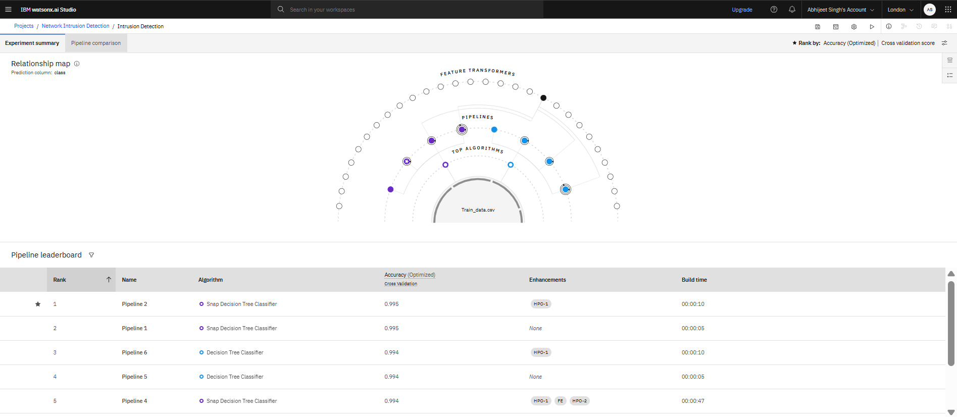
Result

Slide 8
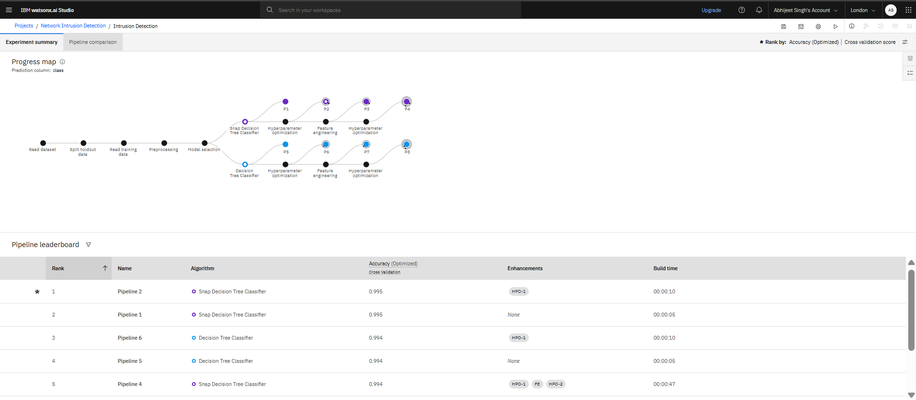
Result

Slide 9
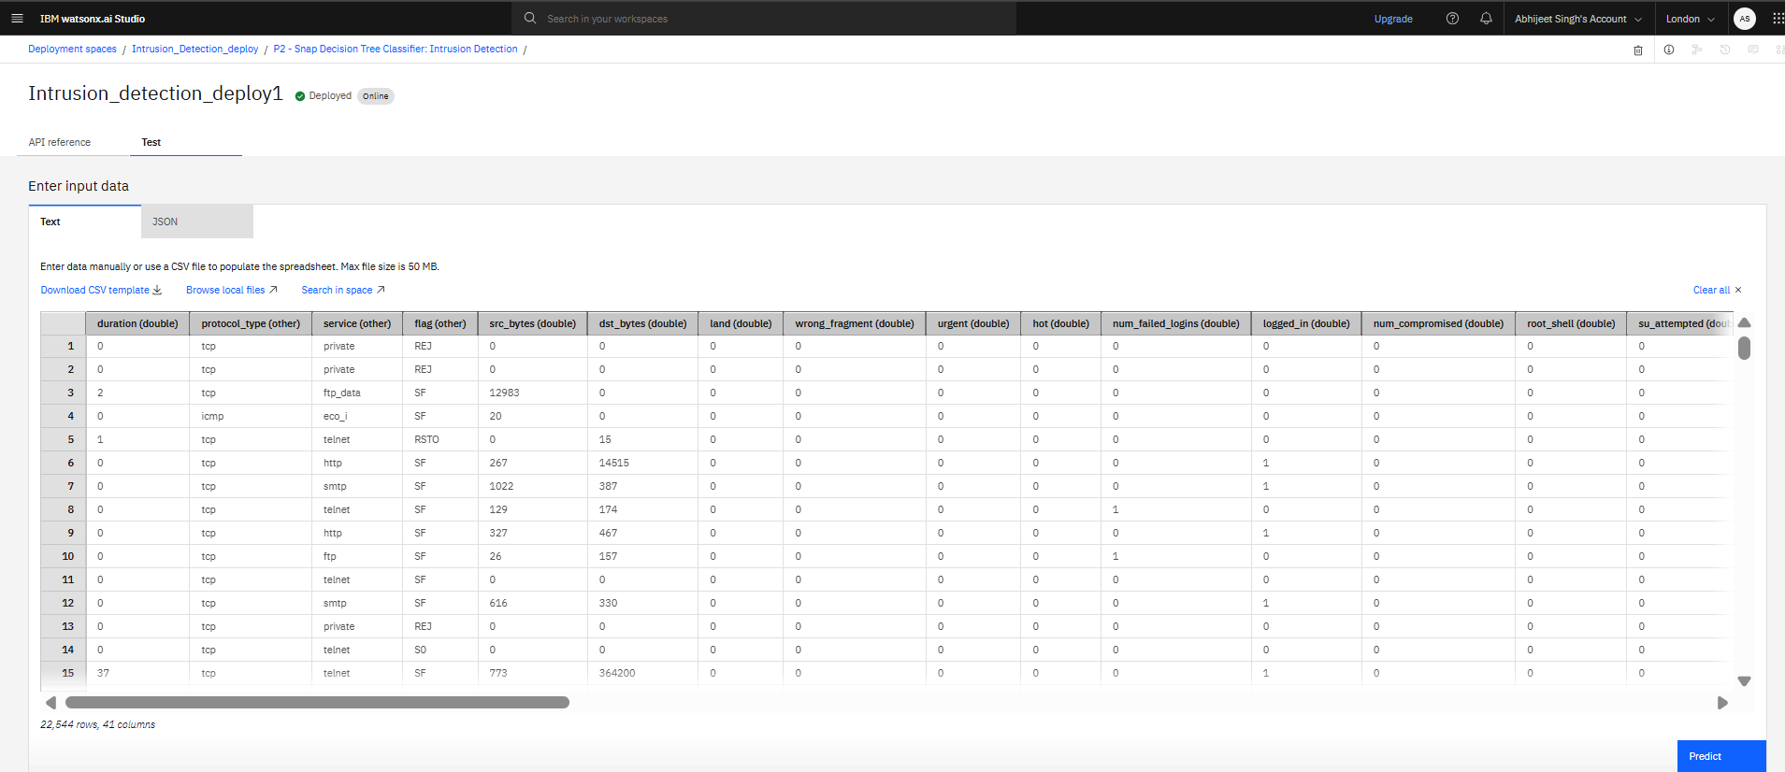
Result

Slide 10
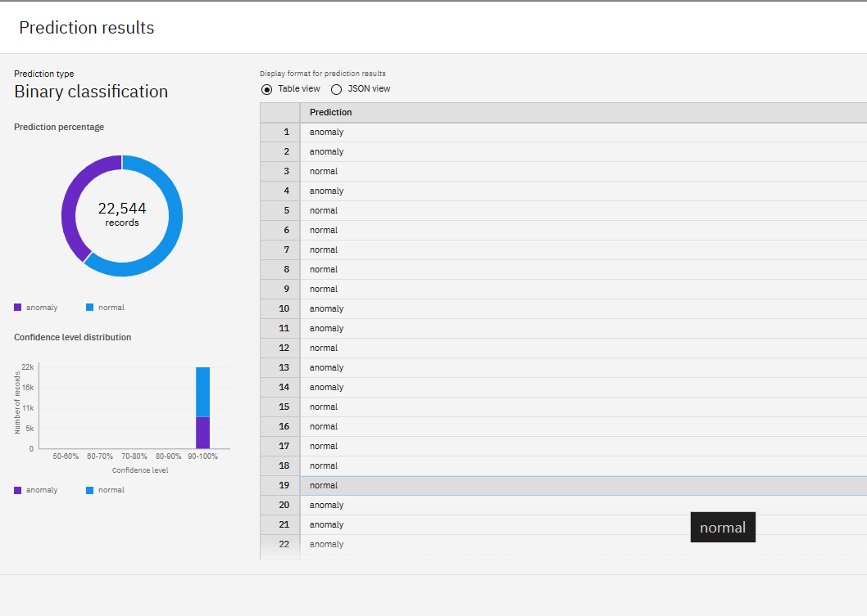
Result

Slide 11
Conclusion
This project successfully demonstrates the use of machine learning to build an intelligent Network Intrusion Detection System (NIDS) capable of identifying and classifying various types of cyber-attacks. By leveraging the Kaggle intrusion detection dataset and deploying the model on IBM Cloud Lite, the system provides an efficient and scalable solution for real-time network security. It enhances the ability to detect evolving threats early, reduces reliance on manual rule-based systems, and contributes to strengthening the overall cybersecurity infrastructure of modern communication networks.

Slide 12
Future scope
Real-Time Monitoring with IBM Watson IoT: Integrate IBM Watson IoT to stream live network data and detect intrusions in real-time using the deployed model.Adaptive Learning: Implement self-learning mechanisms where the system updates itself based on new attack patterns without manual retraining.
Scalable Deployment with IBM Kubernetes Service: Use IBM Kubernetes on IBM Cloud to scale the intrusion detection system across multiple servers for enterprise-level security.
Advanced Threat Analysis with IBM QRadar: Extend the system by integrating with IBM QRadar SIEM for deeper threat intelligence, incident correlation, and automated response.
Cloud Object Storage for Big Data: Store vast amounts of live and historical network traffic in IBM Cloud Object Storage for continuous analysis and auditing.

Slide 13
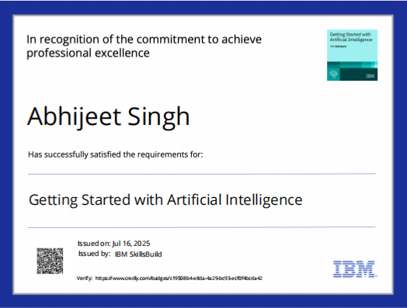
IBM Certifications

Slide 14
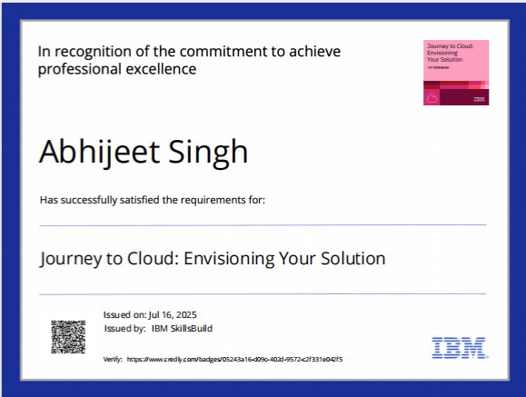
IBM Certifications

Slide 15
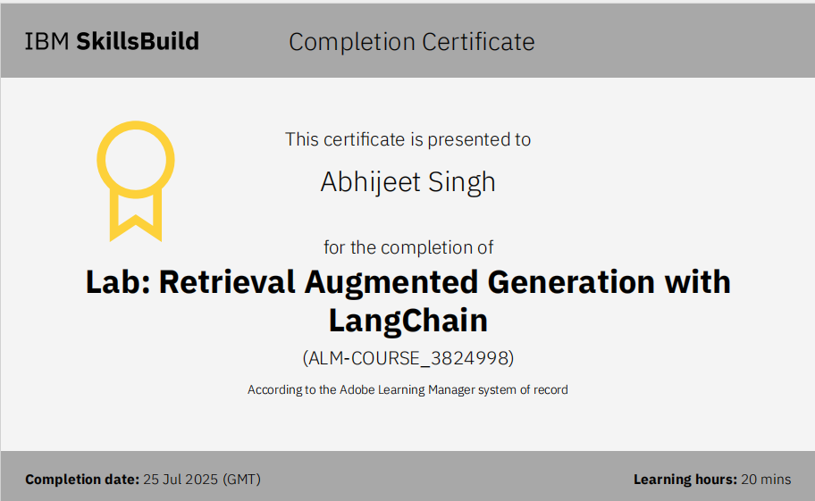
IBM Certifications

Slide 16
THANK YOU

