Slide 1

2016
Wifi
chf-conference-center
Pw: 0102030405

Slide 2


Slide 3

Sponsored in part by Our Partners

Slide 4

Sponsored in part by Our Besties
Wifi
chf-conference-center
Pw: 0102030405

Slide 5
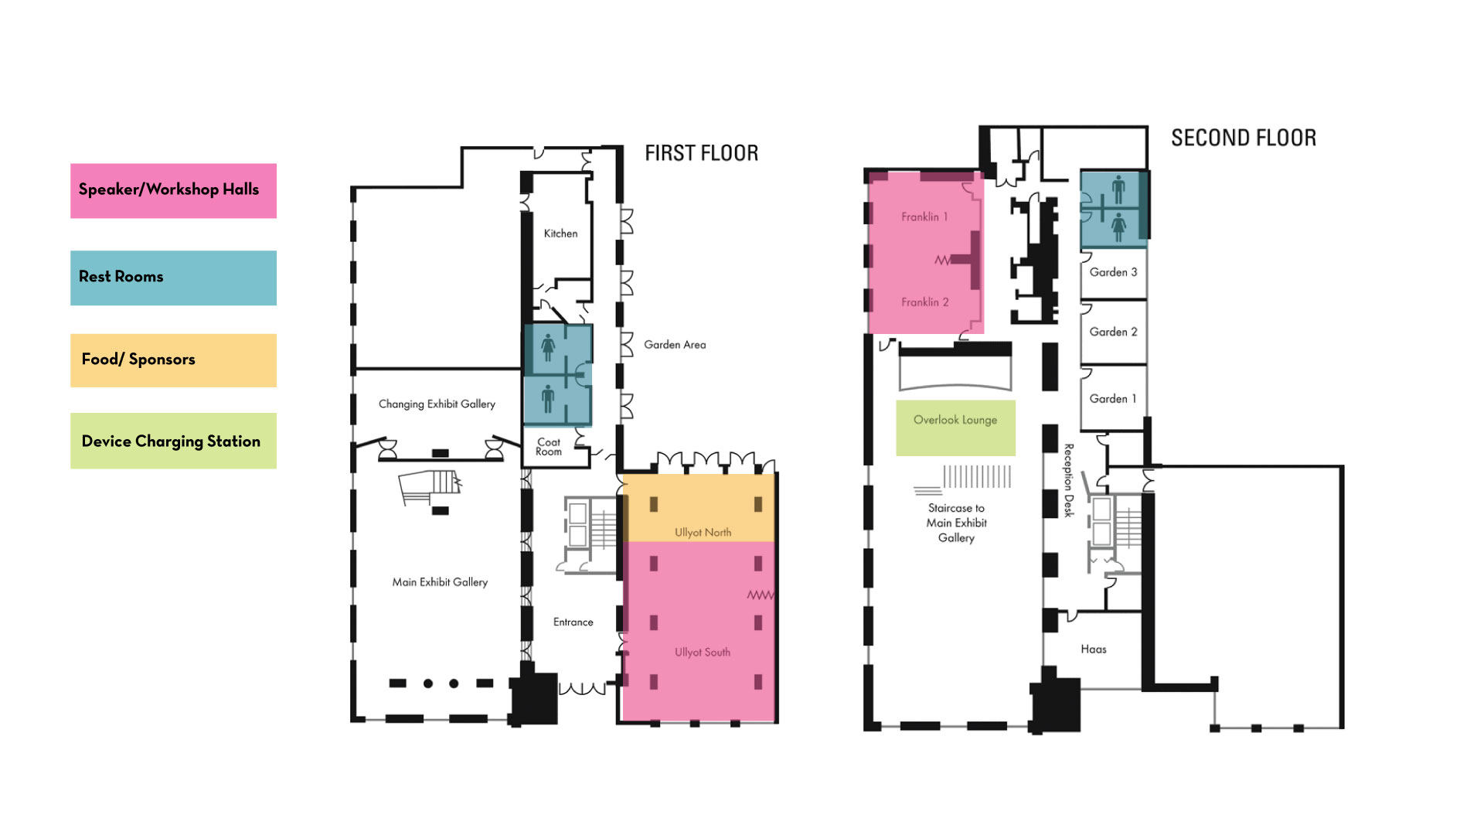

Slide 6

Sponsored in part by Our Friends and Colleagues
Wifi
chf-conference-center
Pw: 0102030405

