Slide 1

CHEA Makara
Introduction to Probability

Slide 2
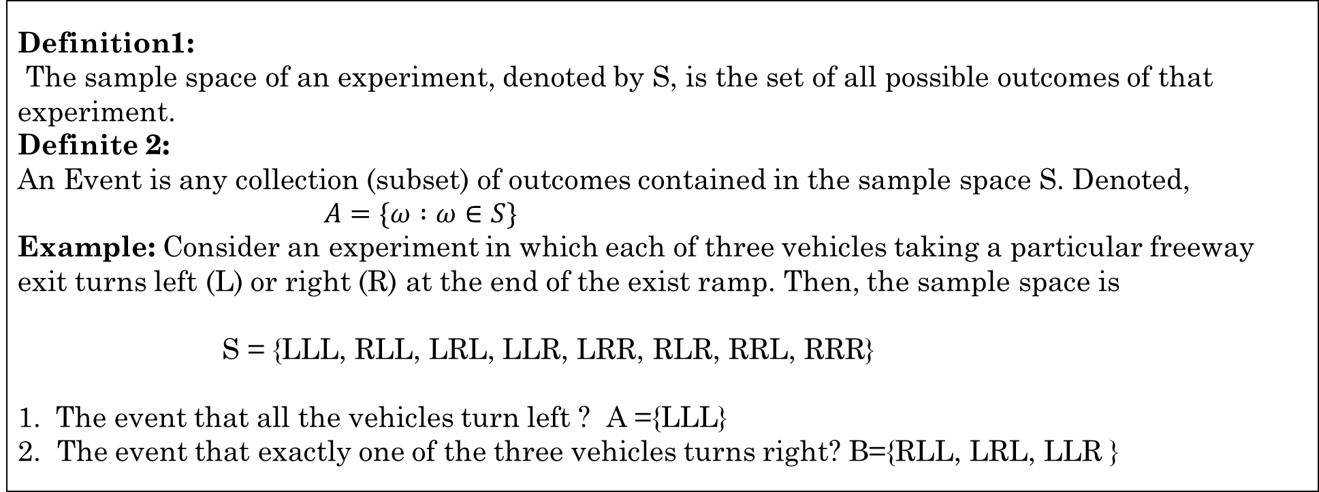
Sample Space of an Experiment
Definition1:
The sample space of an experiment, denoted by S, is the set of all possible outcomes of that experiment.
Definite 2:
An Event is any collection (subset) of outcomes contained in the sample space S. Denoted,
$A=\{ω :ω∈S\}$
Example: Consider an experiment in which each of three vehicles taking a particular freeway exit turns left (L) or right (R) at the end of the exist ramp. Then, the sample space is
S = {LLL, RLL, LRL, LLR, LRR, RLR, RRL, RRR}
The event that all the vehicles turn left ? A ={LLL}
2. The event that exactly one of the three vehicles turns right? B={RLL, LRL, LLR }

Slide 3
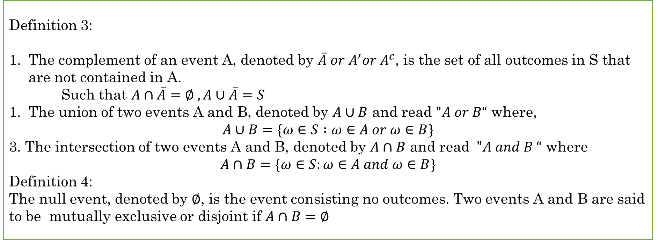
Definition 3:
The complement of an event A, denoted by $\overline{A} or A^{′}or A^{c}$, is the set of all outcomes in S that are not contained in A.
Such that $A∩\overline{A}=∅ , A∪\overline{A}=S$
The union of two events A and B, denoted by $A∪B$ and read $"A or B“$ where,
$$A∪B=\{ω∈S :ω∈A or ω∈B\}$$
3. The intersection of two events A and B, denoted by $A∩B$ and read $"A and B “$ where
$$A∩B=\{ω∈S:ω∈A and ω∈B\}$$
Definition 4:
The null event, denoted by $∅$, is the event consisting no outcomes. Two events A and B are said to be mutually exclusive or disjoint if $A∩B=∅$

Slide 4
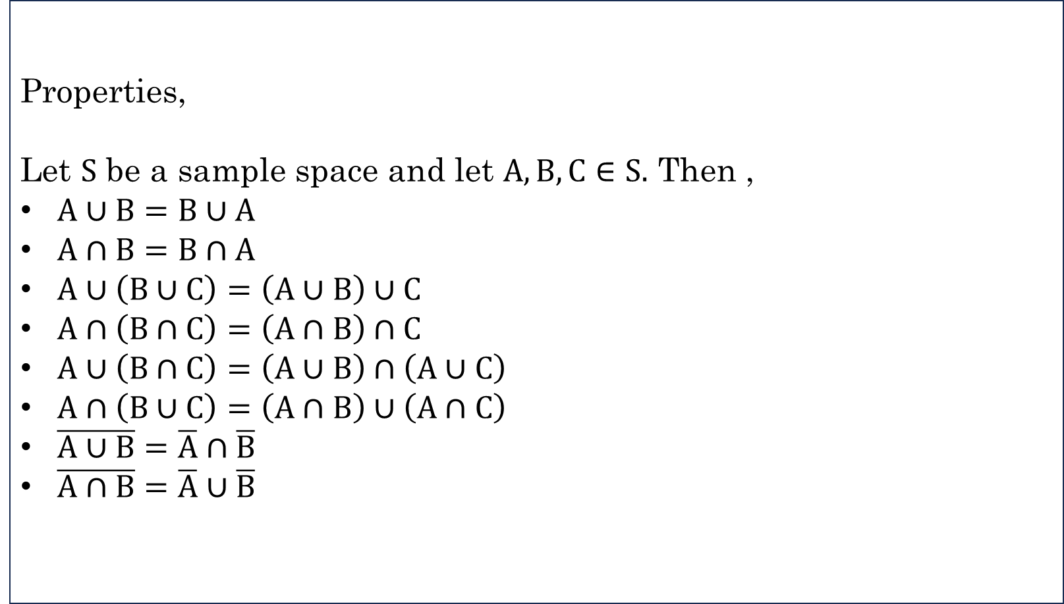
Properties,
Let $S$ be a sample space and let $A,B,C∈S.$ Then ,
$A∪B=B∪A$
$A∩B=B∩A$
$A∪\left(B∪C\right)=\left(A∪B\right)∪C$
$A∩\left(B∩C\right)=\left(A∩B\right)∩C$
$A∪\left(B∩C\right)=\left(A∪B\right)∩\left(A∪C\right)$
$A∩\left(B∪C\right)=\left(A∩B\right)∪\left(A∩C\right)$
$\overline{A∪B}=\overline{A}∩\overline{B}$
$\overline{A∩B}=\overline{A}∪\overline{B}$

Slide 5
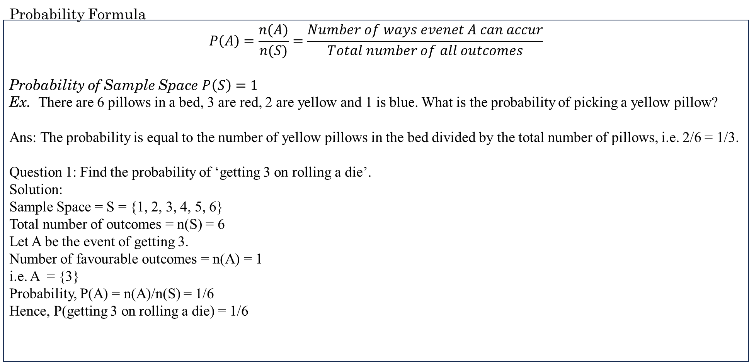
Probability Formula
$$P\left(A\right)=\frac{n(A)}{n(S)}=\frac{Number of ways evenet A can accur}{Total number of all outcomes}$$
Probability of Sample Space $P\left(S\right)=1$
Ex. There are 6 pillows in a bed, 3 are red, 2 are yellow and 1 is blue. What is the probability of picking a yellow pillow?
Ans: The probability is equal to the number of yellow pillows in the bed divided by the total number of pillows, i.e. 2/6 = 1/3.
Question 1: Find the probability of ‘getting 3 on rolling a die’.
Solution:
Sample Space = S = {1, 2, 3, 4, 5, 6}
Total number of outcomes = n(S) = 6
Let A be the event of getting 3.
Number of favourable outcomes = n(A) = 1
i.e. A = {3}
Probability, P(A) = n(A)/n(S) = 1/6
Hence, P(getting 3 on rolling a die) = 1/6

Slide 6
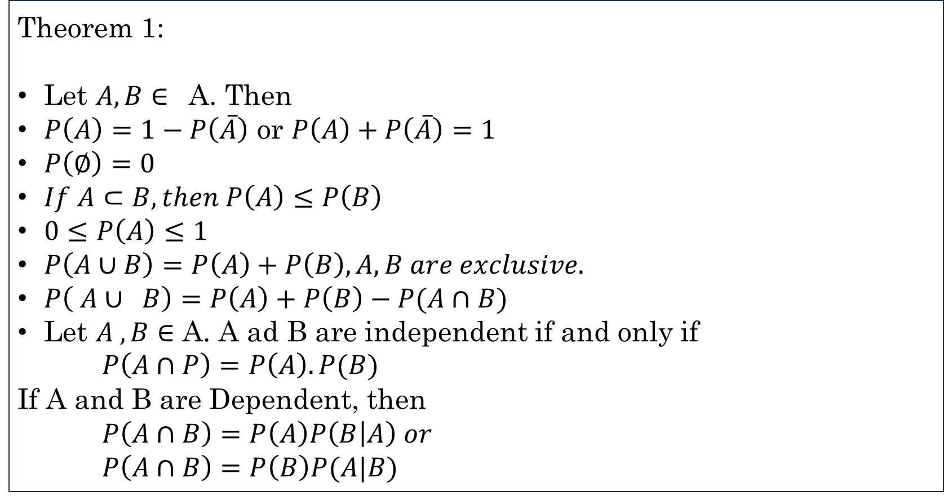
Theorem 1:
Let $A,B∈$ A. Then
$P\left(A\right)=1−P\left(\overline{A}\right)$ or $P\left(A\right)+P\left(\overline{A}\right)=1$
$P\left(∅\right)=0$
$If A⊂B, then P\left(A\right)≤P\left(B\right)$
$0≤P\left(A\right)≤1$
$P\left(A∪B\right)=P\left(A\right)+P\left(B\right), A,B are exclusive.$
$P\left( A∪ B\right)=P\left(A\right)+P\left(B\right)−P(A∩B)$
Let $A , B∈$ A. A ad B are independent if and only if
$P\left(A∩P\right)=P\left(A\right).P(B)$
If A and B are Dependent, then
$P\left(A∩B\right)=P\left(A\right)P\left(B | A\right) or$
$P\left(A∩B\right)=P\left(B\right)P(A|B)$

Slide 7
Question 2: Draw a random card from a pack of cards. What is the probability that the card drawn is a face card?
Solution:
A standard deck has 52 cards.
Total number of outcomes = n(S) = 52
Let E be the event of drawing a face card.
Number of favourable events = n(E) = 4 x 3 = 12 (considered Jack, Queen and King only)
Probability, P = Number of Favourable Outcomes/Total Number of Outcomes
P(E) = n(E)/n(S)
= 12/52
= 3/13
P(the card drawn is a face card) = 3/13

Slide 8
Problems on Probability with solutions:
Example 1: A coin is thrown 3 times .what is the probability that atleast one head is obtained? Sol: Sample space = [HHH, HHT, HTH, THH, TTH, THT, HTT, TTT] Total number of ways = 2 × 2 × 2 = 8. Fav. Cases = 7 P (A) = 7/8 OR P (of getting at least one head) = 1 – P (no head)⇒ 1 – (1/8) = 7/8
Example 2: Find the probability of getting a numbered card when a card is drawn from the pack of 52 cards. Sol: Total Cards = 52. Numbered Cards = (2, 3, 4, 5, 6, 7, 8, 9, 10) 9 from each suit 4 × 9 = 36 P (E) = 36/52 = 9/13
Example 3: There are 5 green 7 red balls. Two balls are selected one by one without replacement. Find the probability that first is green and second is red. Sol: P (G) × P (R) = (5/12) x (7/11) = 35/132

Slide 9
Example 4: What is the probability of getting a sum of 7 when two dice are thrown? Sol: Probability math - Total number of ways = 6 × 6 = 36 ways. Favorable cases = (1, 6) (6, 1) (2, 5) (5, 2) (3, 4) (4, 3) --- 6 ways. P (A) = 6/36 = 1/6
Example 5: 1 card is drawn at random from the pack of 52 cards. (i) Find the Probability that it is an honor card. (ii) It is a face card. Sol: (i) honor cards = (A, J, Q, K) 4 cards from each suits = 4 × 4 = 16 P (honor card) = 16/52 = 4/13 (ii) face cards = (J,Q,K) 3 cards from each suit = 3 × 4 = 12 Cards. P (face Card) = 12/52 = 3/13
Example 6: Two cards are drawn from the pack of 52 cards. Find the probability that both are diamonds or both are kings. Sol: Total no. of ways = 52C2 Case I: Both are diamonds = 13C2 Case II: Both are kings = 4C2 P (both are diamonds or both are kings) = (13C2 + 4C2 ) / 52C2

