Slide 1
OLIST MARKETPLACE · DATA ANALYTICS REVIEW
From Data to Decisions:
Delivery, Retention & Growth Opportunities
Executive Summary & Business Value — three data-driven questions,
answered from a validated single source of truth.
NTU DSAI · Group 5 Project

Slide 2
EXECUTIVE SUMMARY · 1 OF 3
The Problem: Three Questions, One Marketplace
Olist connects ~3,100 sellers to ~96,000 customers across Brazil. Three questions decide where the platform should invest next:
1. Delivery & reviews
2. Retention
3. Geography
Does a late delivery drag down customer reviews — and does that cost revenue?
97% of customers buy exactly once. Why, and is it fixable?
Where does revenue actually come from, and how should growth spend follow it?
Dataset at a glance (Section 0)
99.4K
R$13.5M
4.09 / 5
3.1%
orders · 96.1K customers
product revenue, 24 months
avg. review score (bimodal)
of customers ever repeat
Olist marketplace analysis · olist_marts (BigQuery) · 99,441 orders, Sep 2016 – Oct 2018
2

Slide 3
EXECUTIVE SUMMARY · 2 OF 3
Our Approach: One Validated Source of Truth
› Validated the warehouse first. Checked the dbt star schema (4 facts, 4 shared dimensions) against the raw source tables — every fact's row count matches (e.g. fct_order_items: 112,650 = 112,650). No structural errors.
› Analysis reads governed data only. All three deep-dives query the olist_marts layer via SQL — never raw or staging — so every analyst who re-runs this gets the same numbers.
› Cost-aware by design. Heavy grouping and joins run inside BigQuery; the notebook only pulls back small, aggregated results. No SELECT * on a fact table.
› Diagnose, then prescribe. Each of the three sections pairs a data-backed diagnosis with a costed, actionable recommendation — not just a chart.
THE FOUNDATION
olist_marts star schema
4 fact tables
orders, items, payments, reviews
4 shared dimensions
customer, product, seller, date
Grain verified
fact row counts match raw, exactly
Query surface
BigQuery, aggregated pulls only
Olist marketplace analysis · olist_marts (BigQuery) · 99,441 orders, Sep 2016 – Oct 2018
3

Slide 4
EXECUTIVE SUMMARY · 3 OF 3
What We Found — And Why It Matters
Delivery → Reviews
Retention
Geography
A delivery only 4–7 days late already turns 68% of buyers into dissatisfied customers (1–2★). R$1.16M of revenue (8.8%) rides on late orders.
96.9% of customers order once. Repeat buyers are worth 1.8× more — the clearest margin lever the data shows.
3 states (SP, RJ, MG) generate 63% of all revenue. Growth spend should defend that core and target the long tail by region, not by city.
Bottom line: the three problems share one fix pattern — fix what's measurable and controllable (delivery ops, first-30-day retention, regional targeting) and the business follows.
Olist marketplace analysis · olist_marts (BigQuery) · 99,441 orders, Sep 2016 – Oct 2018
4

Slide 5
BUSINESS VALUE · OVERVIEW
Where This Analysis Creates Value
Four levers, each traced back to a specific number in the data:
Value driver | What we found | Current value | How to capture it
Delivery reliability | 8% of delivered orders are late; 4–7 days late flips 68% of buyers to dissatisfied | R$1.16M revenue exposed on late orders | Service recovery + peak-season carrier capacity
Customer retention | 96.9% of customers buy once; repeat buyers are worth 1.8×+ more | 3.1% repeat rate today | Lifecycle nudge (day 20–25), cross-sell, win-back ~68K lapsed
Geographic focus | SP / RJ / MG = 63% of revenue; long tail = 4,200+ small cities | 63% revenue in 3 states | Defend the 3-state core; target the tail by region, not city
Data foundation | Star schema grain-checked vs. raw source; zero mismatches found | 79 automated data tests | Standardize reporting on the olist_marts layer
Olist marketplace analysis · olist_marts (BigQuery) · 99,441 orders, Sep 2016 – Oct 2018
5

Slide 6
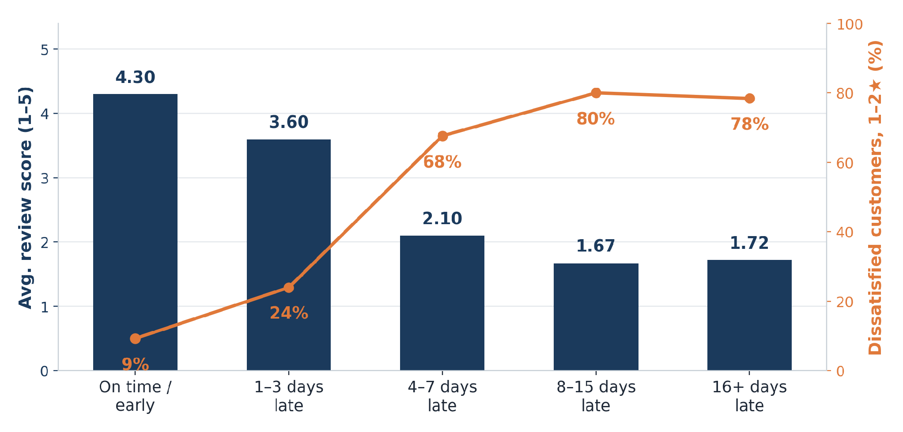
BUSINESS VALUE · DRIVER 1 OF 3
Delivery Reliability Protects Reviews & Revenue
› Reviews collapse fast. 4–7 days late is enough to flip 68% of buyers into dissatisfied customers (1–2★); beyond ~8 days the score simply floors near 1.7 — no worse.
› Revenue is already exposed. R$1.16M of realized product revenue (8.8%) passed through a late delivery.
› It's a peak-season problem. Baseline late rate is 4–6%; it spikes to 14–21% in Nov, Feb and Mar — a capacity issue, not a random one.
› The fix is operational. Padded delivery promises and pre-booked carrier capacity at peak, plus a service-recovery credit within 24–48h of any late delivery.
Avg. review score & dissatisfied-customer rate, by how late the delivery ran
Olist marketplace analysis · olist_marts (BigQuery) · 99,441 orders, Sep 2016 – Oct 2018
6

Slide 7
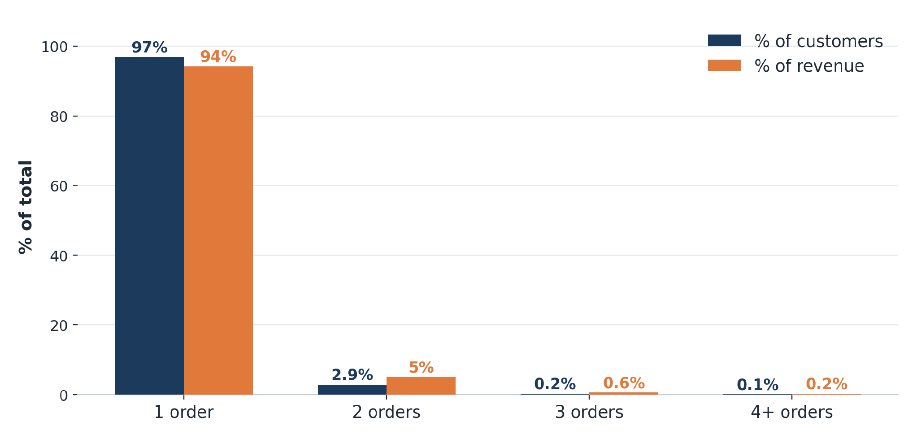
BUSINESS VALUE · DRIVER 2 OF 3
Turning One-Time Buyers Into Repeat Customers
› 96.9% of customers order once. Only 3.1% place a second order — yet a repeat buyer is worth 1.8×+ more (R$288 vs R$159).
› The window is the first month. Median gap to a 2nd order is 28 days; 51% of all repeats happen within 30 days.
› Category predicts loyalty. Home appliances (8.9%) and fashion accessories (6.5%) repeat; electronics (1.8%) and consoles (1.9%) are one-and-done.
› The fix is low-cost. A day 20–25 lifecycle nudge, category cross-sell, and a win-back offer to the ~68K-customer lapsed pool — all through channels the platform already owns.
Share of customers vs. share of revenue, by number of orders placed
Olist marketplace analysis · olist_marts (BigQuery) · 99,441 orders, Sep 2016 – Oct 2018
7

Slide 8
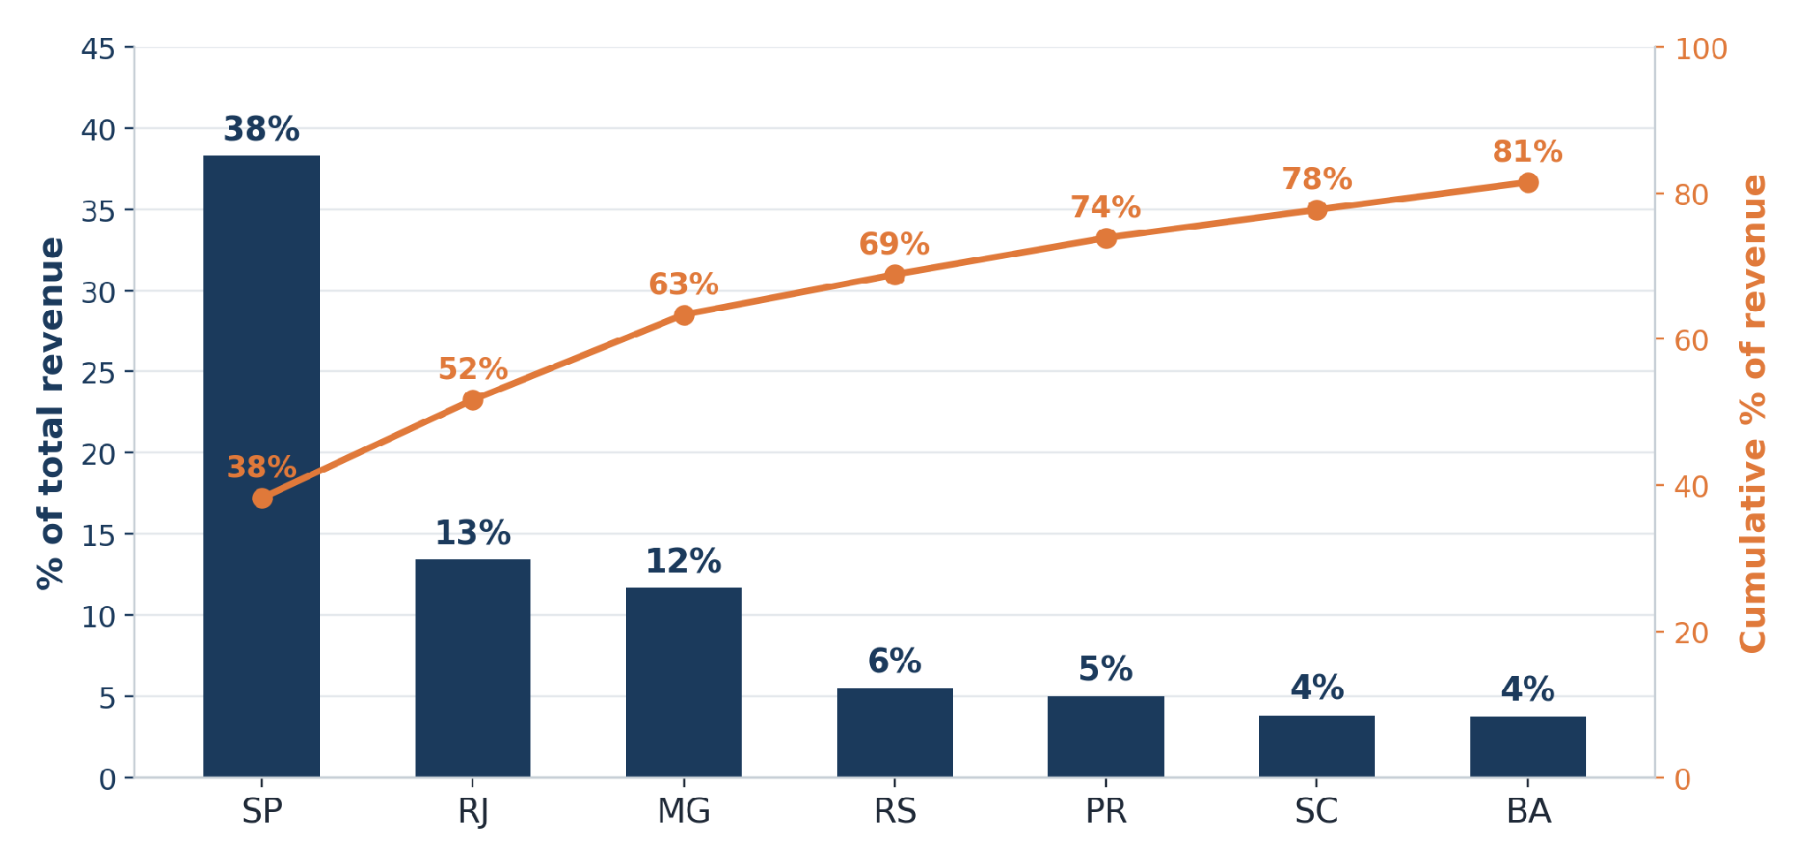
BUSINESS VALUE · DRIVER 3 OF 3
Revenue Is Concentrated — Growth Spend Should Follow
› Three states, most of the revenue. São Paulo alone is 38%; SP + RJ + MG together are 63%; the top 7 states reach 82%.
› The long tail is real but thin. ~4,200 smaller cities share the remaining ~39%; 2,905 of them have ≤5 orders each — only ~7% of revenue combined.
› Distance changes behaviour, not loyalty. Northeast customers (CE, PE, BA) order less often but bigger — avg. order value R$150–171 vs R$126 in SP.
› The fix is targeting, not spend. Defend the SP/RJ/MG core on service levels, and grow the tail at region level instead of chasing 4,200 individual cities.
% of total revenue and cumulative share, top 7 states
Olist marketplace analysis · olist_marts (BigQuery) · 99,441 orders, Sep 2016 – Oct 2018
8

Slide 9
BUSINESS VALUE · DRIVER 3 OF 3
Zooming Out: Revenue by Region
Same demand geography as the state view, rolled up to the 5 official IBGE regions (mapping on the next slide) — pandas group-by on the state-level pull, zero extra BigQuery scan.
Region | Revenue (R$) | % of revenue | Cumulative % | Avg. order value (R$)
Southeast | 8.82M | 65.4% | 65.4% | 131.04
South | 1.94M | 14.4% | 79.7% | 138.38
Northeast | 1.54M | 11.4% | 91.1% | 165.30
Central-West | 0.86M | 6.4% | 97.5% | 150.49
North | 0.33M | 2.5% | 100.0% | 181.98
› The Southeast alone is 65.4% of revenue (SP, RJ, MG, ES) — slightly more than the top-3-states view (63%), because it also folds in Espirito Santo.
› Top 2 regions = 80% of revenue. Southeast + South together leave only 20% spread across the Northeast, Central-West and North.
› AOV rises as revenue share falls: R$131 in the Southeast core vs. R$182 in the North — the same far-customers-order-bigger pattern seen at state and city level.
Olist marketplace analysis · olist_marts (BigQuery) · 99,441 orders, Sep 2016 – Oct 2018
9

Slide 10
BUSINESS VALUE · APPENDIX
Brazilian States, by Region
All 27 Brazilian states (26 states plus the Federal District), mapped to their official IBGE region — the same regions used in Section 3's Northeast-vs-core comparisons.
State | Full name | Region
AC | Acre | North
AP | Amapá | North
AM | Amazonas | North
PA | Pará | North
RO | Rondônia | North
RR | Roraima | North
TO | Tocantins | North
AL | Alagoas | Northeast
BA | Bahia | Northeast
CE | Ceará | Northeast
MA | Maranhão | Northeast
PB | Paraíba | Northeast
PE | Pernambuco | Northeast
State | Full name | Region
PI | Piauí | Northeast
RN | Rio Grande do Norte | Northeast
SE | Sergipe | Northeast
DF | Distrito Federal | Central-West
GO | Goiás | Central-West
MT | Mato Grosso | Central-West
MS | Mato Grosso do Sul | Central-West
ES | Espírito Santo | Southeast
MG | Minas Gerais | Southeast
RJ | Rio de Janeiro | Southeast
SP | São Paulo | Southeast
PR | Paraná | South
RS | Rio Grande do Sul | South
SC | Santa Catarina | South
Source: IBGE — Divisoes Regionais do Brasil (ibge.gov.br/geociencias/organizacao-do-territorio/divisao-regional/15778-divisoes-regionais-do-brasil.html), the Brazilian federal statistics agency responsible for the official state-to-region division.
Olist marketplace analysis · olist_marts (BigQuery) · 99,441 orders, Sep 2016 – Oct 2018
10

Slide 11
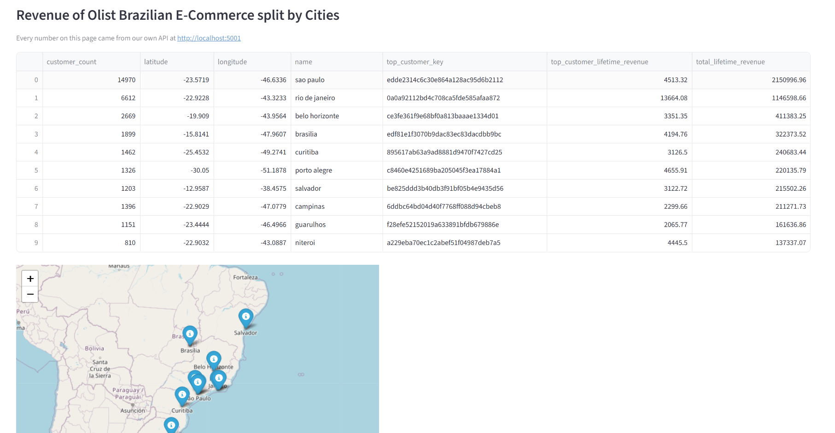
BUSINESS VALUE · APPENDIX
Brazilian States, by Regions with Top 10 revenue
We use Streamlit to provide a visualisation of the regions that have generated the top 10 revenue. PowerBI has limitation to provide this data.
Source: IBGE — Divisoes Regionais do Brasil (ibge.gov.br/geociencias/organizacao-do-territorio/divisao-regional/15778-divisoes-regionais-do-brasil.html), the Brazilian federal statistics agency responsible for the official state-to-region division.
Olist marketplace analysis · olist_marts (BigQuery) · 99,441 orders, Sep 2016 – Oct 2018
11

Slide 12
BUSINESS VALUE · KPI SUMMARY
KPIs by Use Case
Use case | KPI | Current value
Delivery & Reviews | Late-delivery rate | 8.11% of delivered orders
 | Dissatisfied rate, 4–7 days late | 67.6%
 | Revenue via late orders | R$1.16M (8.8% of product revenue)
 | Repeat-rate gap, on-time vs. late | 3.41% vs. 2.78% (0.63pp)
Retention | Repeat-purchase rate | 3.1% (2,997 of 96,096 customers)
 | Repeat-customer value multiplier | 1.8× a one-time buyer (R$288 vs. R$159)
 | Median days to 2nd order | 28 days (51% within 30 days)
 | Lapsed win-back pool | ~68,000 customers (181–540 days)
Geography | Revenue concentration, top 3 states | 63% (SP 38%, RJ 13%, MG 12%)
 | Revenue concentration, top 10 cities | 34%
 | Long-tail revenue share | ~7% (2,905 cities, ≤5 orders each)
 | AOV, Northeast vs. core | R$152–171 (CE/PE/BA) vs. R$126 (SP)
Olist marketplace analysis · olist_marts (BigQuery) · 99,441 orders, Sep 2016 – Oct 2018
12

Slide 13
BUSINESS VALUE · ROADMAP
Recommended Roadmap & How We'll Measure It
0–30 DAYS
30–90 DAYS
ONGOING
Quick wins
Next quarter
Sustained
› Service-recovery credit on every late order, within 24–48h
› Lifecycle nudge + voucher at day 20–25 post-purchase
› Pad delivery promises & pre-book carrier capacity for Nov / Feb–Mar
› Category cross-sell for one-time buyers in low-repeat categories
› Quarterly win-back offers to the ~68K-customer lapsed pool
› Regional (not city-level) targeting for growth spend
KPIs to track
MEASURED AGAINST
› Repeat rate at 30 / 60 / 90 days, vs. a holdout group
› Dissatisfied-customer rate on late orders (Section 1 guardrail)
The KPI Summary on the previous slide — repeat rate, late-delivery rate, and revenue concentration — not a one-time estimate.
Olist marketplace analysis · olist_marts (BigQuery) · 99,441 orders, Sep 2016 – Oct 2018
13

Slide 14
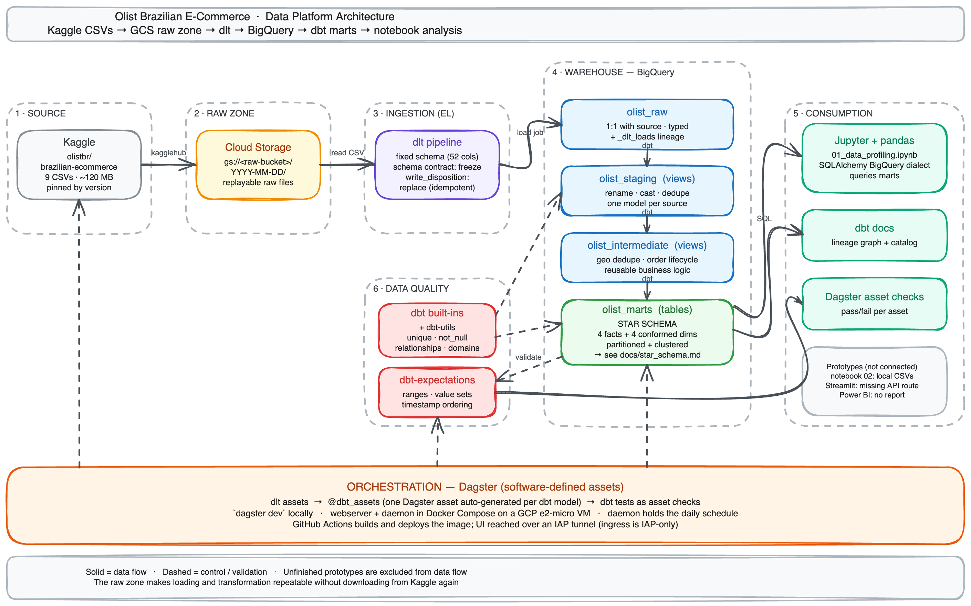
TECHNICAL FOUNDATION · 1 OF 8
High-Level Architecture
Six zones, one flow. Solid arrows are data moving; dashed arrows are control and validation.
Everything inside runs as one Dagster asset graph — the contracts each layer keeps are on the next slide.
Generated from code: docs/diagrams/generate_diagrams.py, so the picture cannot drift from the pipeline.
Olist marketplace analysis · olist_marts (BigQuery) · 99,441 orders, Sep 2016 – Oct 2018
14
Notes:
This is the map; the next slide is the contract. Walk it left to right in about forty seconds — source, raw zone, load, warehouse, consumption — then point out zone 6, data quality, validating staging and marts, and the orange band underneath holding it all together. Two things worth saying out loud: the grey box on the right lists what is deliberately NOT connected, and the whole diagram regenerates from Python, so it is current by construction.

Slide 15
TECHNICAL FOUNDATION · 2 OF 8
What Each Layer Promises, and What Sets It Running
The diagram shows the shape of the platform. These are the rules that keep it trustworthy when it runs unattended.
THE CONTRACT EACH LAYER KEEPS
ORCHESTRATION · TWO SIGNALS, ONE GRAPH
1 · SOURCE — Kaggle
Dataset version and all 52 columns pinned in config; a missing file or an unexpected column fails the run.
08:00 SGT · daily_refresh schedule
a clock, because Kaggle announces nothing
2 · RAW ZONE — Cloud Storage
The exact extracted files stay under a dated prefix, so any prefix replays downstream without re-downloading.
Kaggle → GCS → olist_raw
the ingestion group only
3 · LOAD — dlt
Schema frozen: a new or retyped column fails the load. Loads replace, so a rerun never duplicates rows.
automation-condition sensor, every 60s
an event: raw materialized successfully
4 · WAREHOUSE — BigQuery + dbt
Each cleaning rule lives in the earliest layer with enough context — and only there.
21 dbt models + their asset checks
marts rebuilt, tests run in the same pass
5 · CONSUMPTION — notebooks, Streamlit, dbt Docs
Consumers read marts, never raw or staging.
Why two signals and not one cron. Kaggle publishes no event, so ingestion is polled. A successful raw load is an event inside the platform, so transforms react to it — and failed ingestion never rebuilds the marts over stale data.
Olist marketplace analysis · olist_marts (BigQuery) · 99,441 orders, Sep 2016 – Oct 2018
15
Notes:
The left column is the answer to 'how do you know the data is right?' — each contract turns a class of silent corruption into a failed run. The right column is the answer to 'who runs it?' — nobody; a clock starts ingestion and an event starts the transforms.

Slide 16
TECHNICAL FOUNDATION · 3 OF 8
Why These Tools — and What We Turned Down
Five decisions carry the platform. Each was made against a named alternative:
Concern | Our choice | Why it wins here | What we turned down
Warehouse | BigQuery | Managed columnar storage with elastic compute, and transformation logic that runs next to the data it reads | Postgres is tuned for transactions; DuckDB is excellent locally but would not exercise a cloud architecture
Ingestion | dlt | Declared column types, a schema contract that freezes drift, replace loads, and per-table lineage in Dagster | Hand-written loaders mean owning retry, schema and lineage code; Meltano adds a Singer layer without removing the Kaggle step
Transformation | dbt Core | Dependency graph, tests and documentation in one tool — and every model appears individually in the asset graph | Raw SQL carries no dependency or test metadata; dbt Cloud would add a second scheduler and hide model-level lineage
Orchestration | Dagster | The pipeline is naturally an asset graph, not a task list, and it integrates directly with both dlt and dbt | Airflow would restate dbt's dependencies by hand; cron gives no lineage and no conditional downstream execution
Quality | dbt tests + utils + expectations | 79 structural and business checks run in the same build command and surface as asset checks | A separate assertion service would split ownership and reporting away from the models being tested
Olist marketplace analysis · olist_marts (BigQuery) · 99,441 orders, Sep 2016 – Oct 2018
16
Notes:
If a CTO pushes on any row, the answer is in the right-hand column — we know what we declined and why. The dbt Core vs dbt Cloud line is the one most likely to be challenged: the deciding factor was model-level lineage, not licence cost.

Slide 17
TECHNICAL FOUNDATION · 4 OF 8
Warehouse Design: A Star That Cannot Double-Count
The marts are a fact constellation — four facts at their own natural grains, sharing four conformed dimensions.
CONFORMED DIMENSIONS · JOINED ON *_key
WHY THIS SHAPE, AND NOT ONE WIDE TABLE
dim_customer
dim_product
dim_seller
dim_date
› One order has many items and many payments. Flatten both into a single fact and every payment repeats on every line — revenue inflates silently, and nothing errors.
› fct_orders is the hub. Delivery lateness, review linkage and reconciled payment-vs-item totals all sit at order grain, so the headline revenue measure is safe to sum.
› dim_customer is keyed on customer_unique_id. The raw customer_id is a per-order surrogate; keying on it would make every repeat customer look like a new person.
› Measures are additive only where the grain allows it. Payments sum across payment rows, price and freight across item rows; review scores are analysed, never summed.
› Physical layout is declared for scale. Facts partition on their date and cluster on the keys they are filtered by — design intent today, measurable speedup at volume.
FACTS · EACH KEPT AT ITS OWN GRAIN
fct_orders
one row per order
fct_order_items
order_id +
order_item_id
fct_payments
order_id +
payment_sequential
fct_reviews
one deduplicated
review
ORDER-GRAIN HUB
The rule that protects revenue: never join fct_payments straight to fct_order_items and sum payment_value. Facts meet only through order_id, and only after each is aggregated to order grain. Tests assert both composite grains on every build.
Olist marketplace analysis · olist_marts (BigQuery) · 99,441 orders, Sep 2016 – Oct 2018
17
Notes:
This is the schema-design justification. The one thing to land with a business audience: the orange box. Getting this wrong is how a marketplace reports revenue that does not exist — and the design makes that mistake structurally impossible rather than a rule people have to remember.

Slide 18
TECHNICAL FOUNDATION · 5 OF 8
How the Numbers Stay Correct Without Anyone Watching
79 tests run inside every build — not as a separate job someone has to remember to start.
THE 79 CHECKS, BY FAMILY
WHAT HAPPENS WHEN ONE FAILS
unique, not_null
declared grains and required join keys
Most failures block the build.
A missing key, a broken relationship, a duplicated grain or an out-of-domain value stops the run before anything downstream rebuilds on it.
relationships
order, customer, product, seller, payment and review links
Two lifecycle checks warn instead.
The source holds plausible historical anomalies. They stay visible in the run without blocking models that have nothing to do with them.
accepted_values
order status and payment type domains
dbt_utils
composite keys, non-negative amounts, customer grain
Nothing is ever repaired silently.
Tests verify data; they do not mutate it. A bad row is surfaced and left in place, so the fix happens in a model that everyone can review.
dbt_expectations
row-count bands, date ranges, timestamp ordering
Declared beside the models they guard in _sources.yml and each layer's schema.yml — so a new model without tests is visible in review, not discovered in production.
Results land on the assets themselves.
Dagster maps each test onto the asset it guards, so a failure names the model at fault rather than a generic failed job.
Olist marketplace analysis · olist_marts (BigQuery) · 99,441 orders, Sep 2016 – Oct 2018
18
Notes:
The left column is coverage, the right column is behaviour — the second matters more. The line that lands with executives: nothing is repaired silently. A test that quietly fixed a bad row would give you a clean dashboard over a broken pipeline.

Slide 19
TECHNICAL FOUNDATION · 6 OF 8
Risks — and How Each One Is Contained
Six things could go wrong. Five are already contained by design; one is an open gap we are naming rather than hiding.
Source schema drift
Single-VM deployment
Misreading the incomplete tail
Kaggle republishes the dataset with a new, renamed or retyped column.
CONTAINED BY
The dlt contract freezes the schema, so the load fails loudly instead of quietly changing the marts. The last good dated prefix still replays.
One e2-micro runs the webserver and daemon, with SQLite run history.
CONTAINED BY
History is bind-mounted and survives restarts; images are SHA-pinned and redeployable. Residual: history is durable but not replicated.
The extract stops during 2018, so the final month looks like a collapse.
CONTAINED BY
dim_date.is_complete_month marks it, and every trend in this deck filters on it rather than relying on the reader to remember.
Using the wrong customer key
Payment reconciliation not enforced
Warehouse cost drift
customer_id is a per-order surrogate; keying on it hides every repeat buyer.
CONTAINED BY
dim_customer is keyed on customer_unique_id, and a test asserts it has fewer rows than fct_orders — the mistake fails the build.
Reconciliation flags exist in the marts, but no test blocks on a tolerance.
OPEN GAP
Documented as an open gap rather than a silent one. Next: a blocking test at a tolerance finance agrees.
Unbounded scans on facts as history and query volume grow.
CONTAINED BY
Aggregation happens inside BigQuery and only small results are pulled back; facts are partitioned by date and clustered on their join keys.
Olist marketplace analysis · olist_marts (BigQuery) · 99,441 orders, Sep 2016 – Oct 2018
19
Notes:
Lead with the orange card if asked what keeps us up at night. Naming an uncovered gap is deliberate: the reconciliation flag exists and is queryable, but no test blocks on it, so we will not claim coverage we do not have.

Slide 20
TECHNICAL FOUNDATION · 7 OF 8
What Holds at 100× Volume — and What We Would Change
Scalability is a claim worth being specific about. Here is what survives growth untouched, and what we would rebuild.
HOLDS AS-IS
WOULD CHANGE
› ELT with a durable raw zone. A transformation defect is fixed in SQL and rebuilt — no re-extraction.
› The star-schema grains. Items and payments stay separate facts at any volume; that is what keeps revenue additive.
› Tests as asset checks. 79 checks already run inside the build, not as a second system to maintain.
› The asset graph. New models join the lineage without rewiring the orchestrator.
› Partitioning and clustering. Already declared on the facts, waiting for the volume to make them matter.
› Incremental models. Marts rebuild in full today; at volume they become incremental on the partition column.
› Deployment topology. One VM with SQLite becomes Postgres-backed Dagster, a separate code server, per-run containers.
› Ingestion pattern. A static snapshot is polled; a live source moves to CDC or event-driven arrival.
› Cost controls. Slot reservations, byte-scanned budgets and per-consumer quotas once scans stop being trivial.
› Serving layer. Notebooks and the console suffice today; a BI semantic layer follows the user count.
Honest caveat: at ~120 MB, partitioning and clustering express the intended access pattern — they are not a measured speedup on this sample. We present them as scale-aware design, not as a performance result.
Olist marketplace analysis · olist_marts (BigQuery) · 99,441 orders, Sep 2016 – Oct 2018
20
Notes:
The caveat at the bottom is the credibility line. Claiming a performance win at 120 MB would be the easiest thing in this deck to disprove, so we say plainly that the layout is intent rather than result.

Slide 21
TECHNICAL FOUNDATION · 8 OF 8
Why the Architecture Is Part of the Business Value
Delivery → Reviews
Retention
Geography
Order timestamps are typed and frozen at ingestion, and payments are kept in their own fact table instead of being joined to order lines. That discipline is what keeps the R$13.5M revenue and R$1.16M late-delivery figures accurate instead of inflated.
dim_customer is keyed on customer_unique_id, not the per-order customer_id every raw table uses. Get that key wrong and Olist looks like it has zero repeat customers — this one modeling decision is what makes the 3.1% repeat rate visible at all.
int_geolocation_deduped collapses ~1M raw coordinate rows to one reliable point per zip code before it reaches dim_customer. Skip that step and city/state revenue totals double-count, and the 3-state concentration finding becomes noise.
Bottom line: the marts rebuild themselves the moment new data lands, 79 tests guard them on every build, and non-engineers can already query them directly — this stays a live, self-serve capability, not a one-off report.
Olist marketplace analysis · olist_marts (BigQuery) · 99,441 orders, Sep 2016 – Oct 2018
21

