Slide 1
Cheap and FAIR: Building a Serverless Research Data Repository
Identifiers & Landing Pages
Andrea Zonca & Rick Wagner zonca@sdsc.edu & rick@sdsc.edu SDSC
Gateways 2024, September 30, 2024, Online

Slide 2
Identifiers…hoo boy
Identifiers can be a contentious topic
It’s all about namespaces and resolvers
Identifiers don’t need to be semantically meaningful
Datasets can have multiple identifiers
E.g., You can start with a local identifier and then add a DOI
URLs are challenging
Using a URL for an identifiers means the identifier “owns” a URL

Slide 3
Identifiers: Some Reasonable Terms
identifier: a chain of characters used to refer to an entity
locally unique identifier: an identifier which is unique to a given context but which may clash if moved out of this specific context
globally unique identifier: an identifier which is produced such that the probability of the exact same string is extremely low (but not null), hence global—AKA a universally unique identifier (UUID)
persistent identifier: an identifier which provides a long-lasting reference to a digital resource—needs a resolution service (e.g., DOI)
identifier resolution service: software infrastructure that can return a URL (i.e., a landing page) for an identifier (e.g., DataCite)
https://nih-cfde.github.io/the-fair-cookbook/content/recipes/Identification/identifiers.html

Slide 4
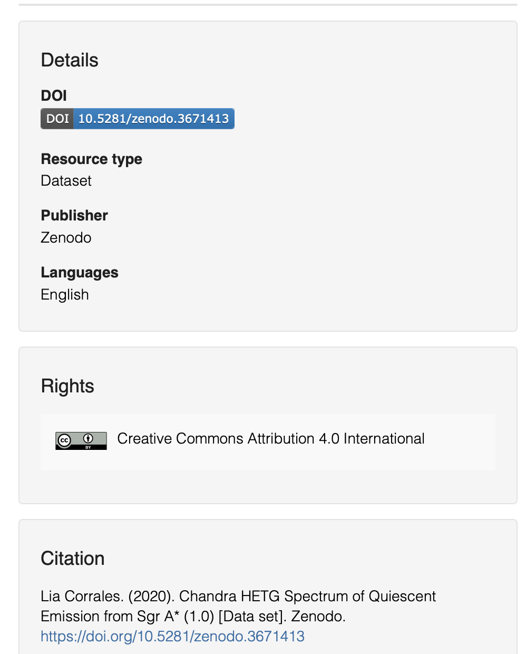
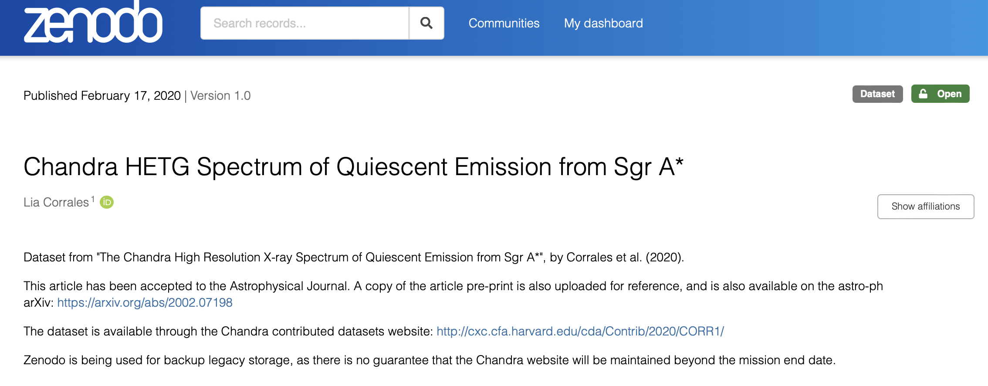
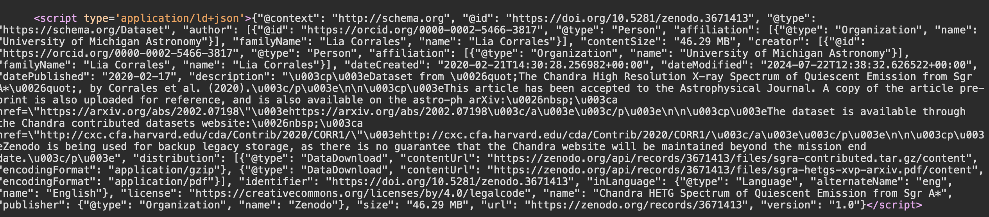
Landing Pages
A landing page is the web page that describes a dataset.
It provides the metadata about the dataset in
human & machine-readable
formats.

Slide 5
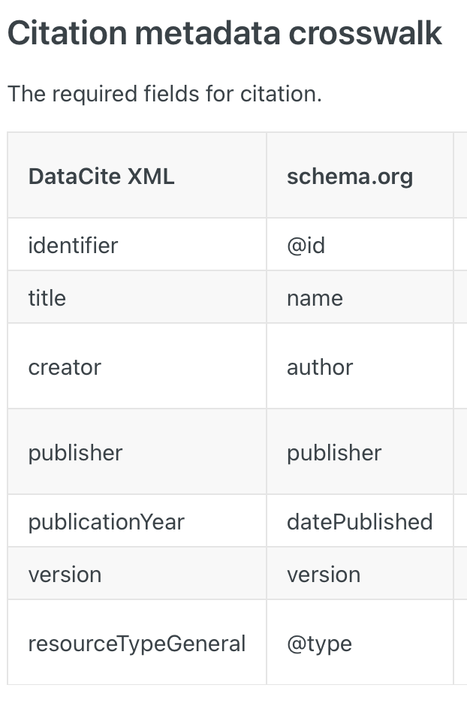
Two Metadata Standards to Know
DataCite
Used for DOIs
Schema.org
Used for Google Dataset Search
Use clearest terms on your landing pages (human-readable)
Use Schema.org to generate JSON-LD embedded in your landing pages (machine-readable)

Slide 6
Recommended Practices
Assign every dataset an identifier unique to your repository
Use this identifier in your metadata
Ensure that every dataset landing page
has the minimum DataCite and Schema.org fields
in both JSON-LD and human-readable formats
Landing pages are public even when the data is not
Use a Creative Commons or OSI license if possible
If you assign a DOI to your dataset, be diligent about maintaining the landing page
Landing pages need to stay even if the data is gone

