Slide 1
Cheap and FAIR: Building a Serverless Research Data Repository
What is FAIR Data?
Andrea Zonca & Rick Wagner zonca@sdsc.edu & rick@sdsc.edu SDSC
Gateways 2024, September 30, 2024, Online

Slide 2
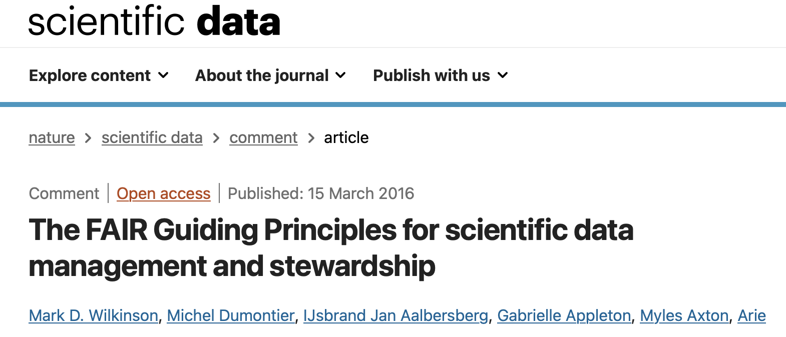
The FAIR Principles
15 guidelines to promote the Findability, Accessibility, Interoperability, and Reuse (FAIR) of research datasets.
The principles are labeled as F1 or A1.2 to refer to a particular guideline.
https://doi.org/10.1038/sdata.2016.18
https://www.go-fair.org/fair-principles/

Slide 3
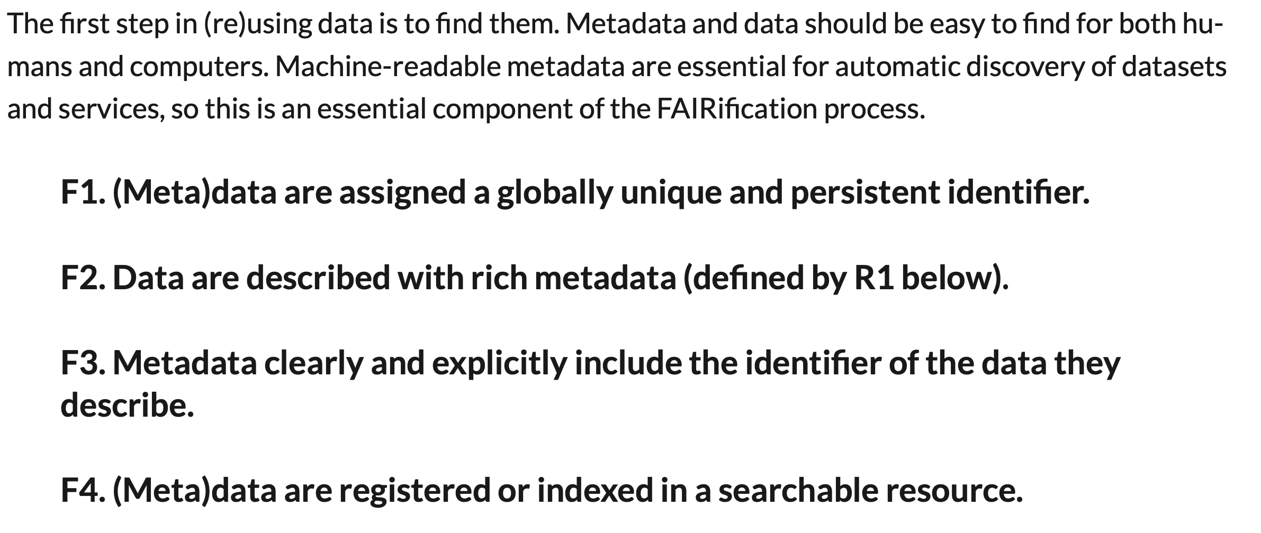
Findable

Slide 4
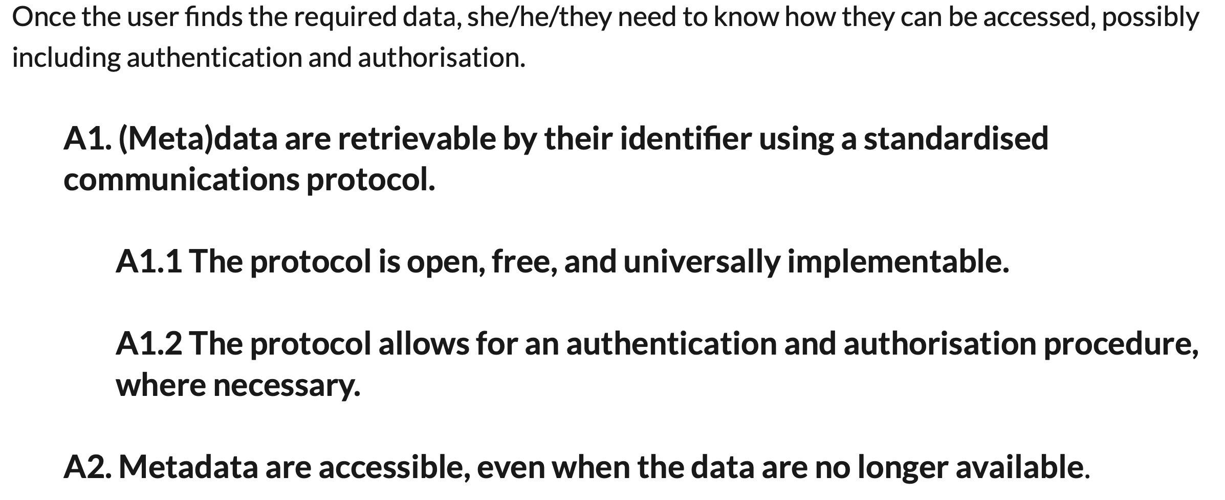
Accessible

Slide 5
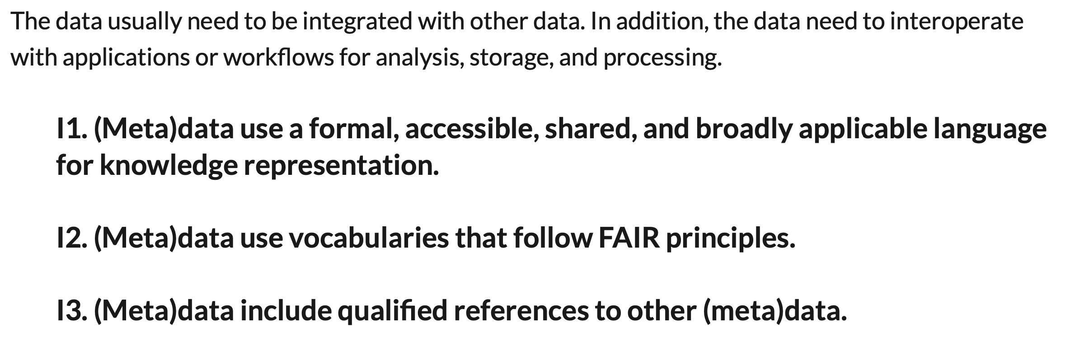
Interoperable

Slide 6
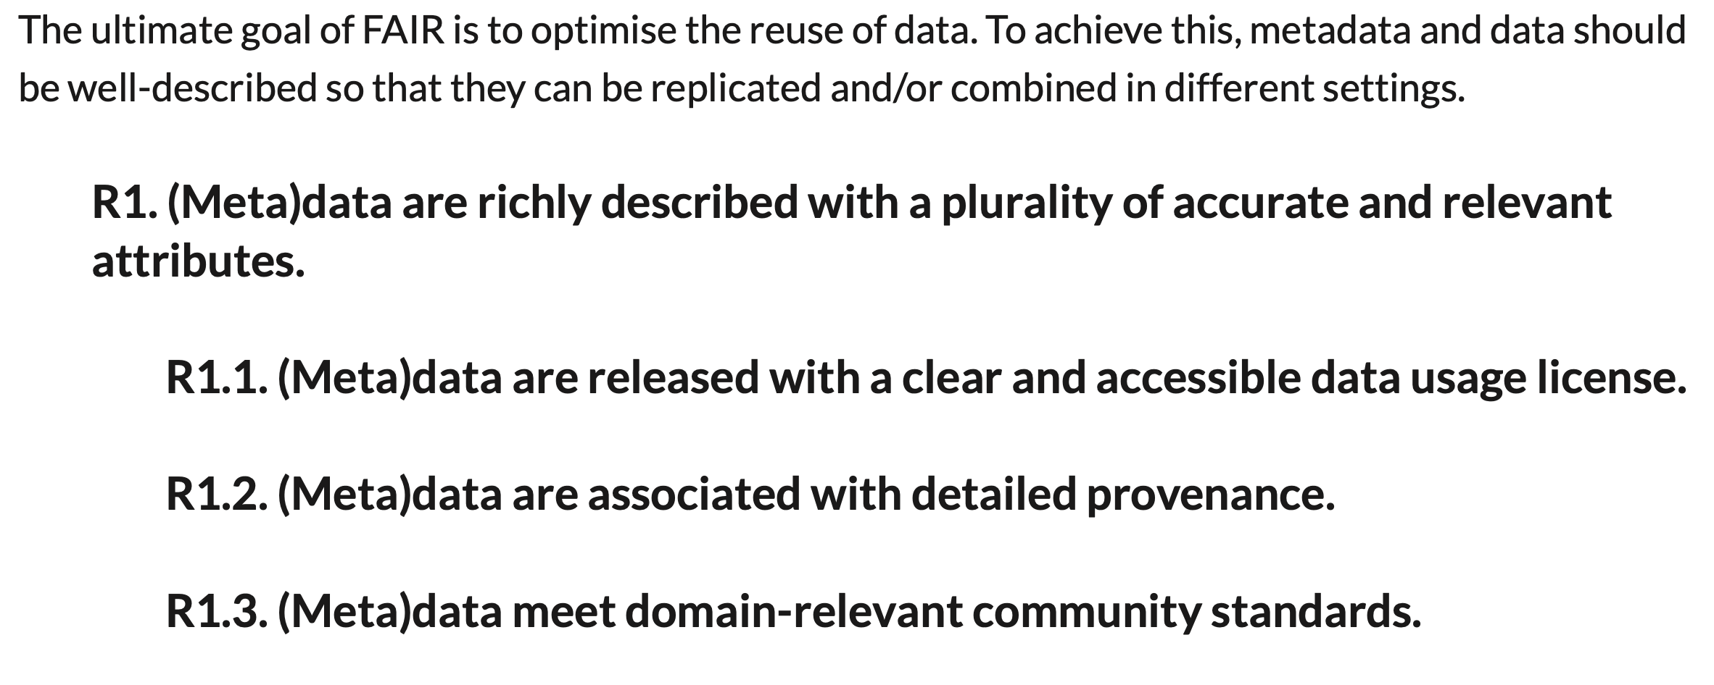
Reusable

Slide 7
How is the SRDR FAIR?
Findable
Human & machine-readable metadata
Datasets listed in catalog
Unique dataset identifiers
Interoperable
Metadata based on Schema.org & DataCite
Metadata in JSON-LD
Accessible
Data & landing pages via HTTPS
Access control using OAuth/OIDC
Persistent landing pages
Reusable
Data files in widely-used formats
Usage guidelines defined

