Slide 1
Cheap and FAIR: Building a Serverless Research Data Repository
Introduction
Andrea Zonca & Rick Wagner zonca@sdsc.edu & rick@sdsc.edu SDSC
Gateways 2024, September 30, 2024, Online

Slide 2
Outline
Introduction & Setup
NB 1: GitHub Pages & JupyterHub
What is FAIR Data?
NB 2: Working with Globus Collections
Identifiers and Landing Pages
NB 3: Creating a Data Repository Catalog
15 Minute Break
NB 4: Validating the Catalog & Programmatic Data Access
NB 5: Enhancing the Catalog
Making the SRDR Interactive
NB 6: Public Data
NB 7: Restricted Data
Presentation
Hands-on
Break

Slide 3


Initial Technical Requirements
Internet connection
If you’re listening to this, you probably have one
Web browser
For communication, use whatever suits you
Chat
Raise hand, voice, etc.
Rick & Andrea will alternate helping attendees
Turn your camera on if you’re comfortable
As we proceed, we’ll ask if you’ve completed a step. Please use the yes and no reactions in Zoom.

Slide 4
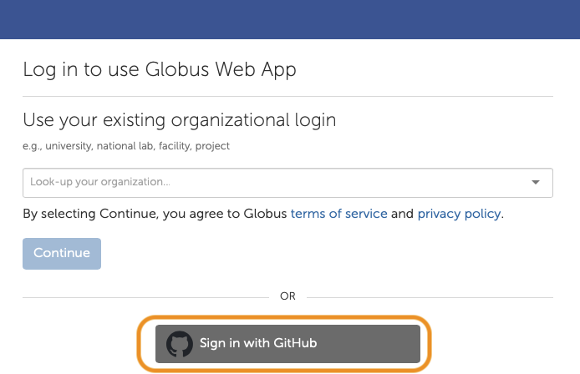
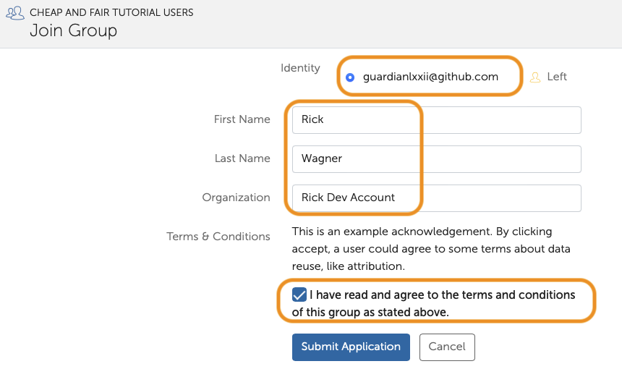
Setup Steps
Link to setup steps below
Join GitHub if needed
Globus:
Join with GitHub
Or Link GitHub identity
Join Group to access resources
Look in chat
https://github.com/cheapandfair/cheapandfair-gateways-2024

Slide 5
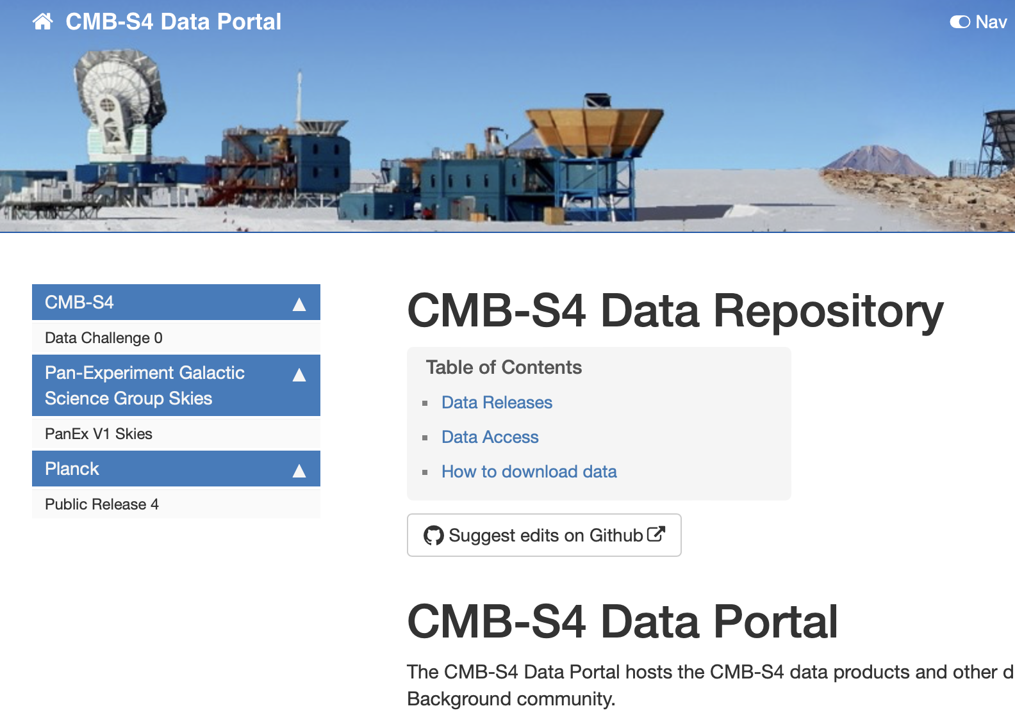
Motivation: CMB S4 Data Repository
Public & restricted data
Ease of access
Large (TBs) and small (MBs) datasets
Future curation & publication
Minimal operational overhead
https://data.cmb-s4.org
Notes:
CMB-S4 is an international collaboration of over 500 scientists de- veloping data pipelines to support future telescopes at the South Pole and Chile. During this development phase and during future op- erations, datasets go through several phases of distribution within the Collaboration followed by potential publication to the wider As- trophysics scientific community.

Slide 6
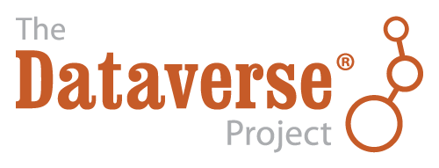
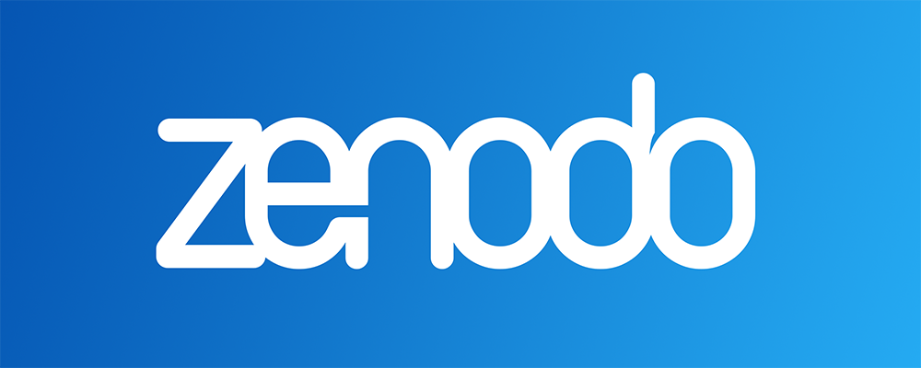


A “Missing Middle” (a little hyperbolic)
Researcher projects currently have two data repository options
Self-hosted & “on prem”
Lot of features & extensible
Requires significant operational support
Institutional scale solutions
Public or shared repositories
Zero management, free/“pre-paid”
Fixed features (e.g., metadata schema)
Largely open data solutions
Generalist Repository Comparison Chart
https://doi.org/10.5281/zenodo.7946938
Notes:
There are two common solutions for this: self-hosted repository frameworks like Dataverse, DSpace, or iRODS; or public or shared repositories such as Zenodo, figshare, or Dryad. The self-hosted frameworks have the advantage of be- ing highly extensible and customizable. Their drawbacks include a significant effort to deploy, configure, and operate, which make them more appropriate as an institutional solution. The public or shared repositories are free or available to researchers at supporting institutions and have wide adoption. However, they offer limited extensibility and may not support managed access or restricted data [13].

Slide 7




A Data Repository Is…
a set of datasets
described by and discoverable in a catalog
organized in and accessible from a collection
managed by one or more policies
A data repository’s quality is based its policies and how well they are implemented.
Premise:

Slide 8
SRDR* Components
datasetA/
file1.csv
file2.png
manifest.json
metadata.json
folderB/
file3.fits
file4.dat
Datasets: One or more files in a single folder and its subfolders.
Collection: Datasets organized in Globus Guest Collection
Provides HTTPS URLs and per-datasets access control.
collection/
datarelease1/
datasetA/
datasetB/ datarelease2/
datasetC/
datasetD/
*SRDR: Serverless Research Data Repository

Slide 9
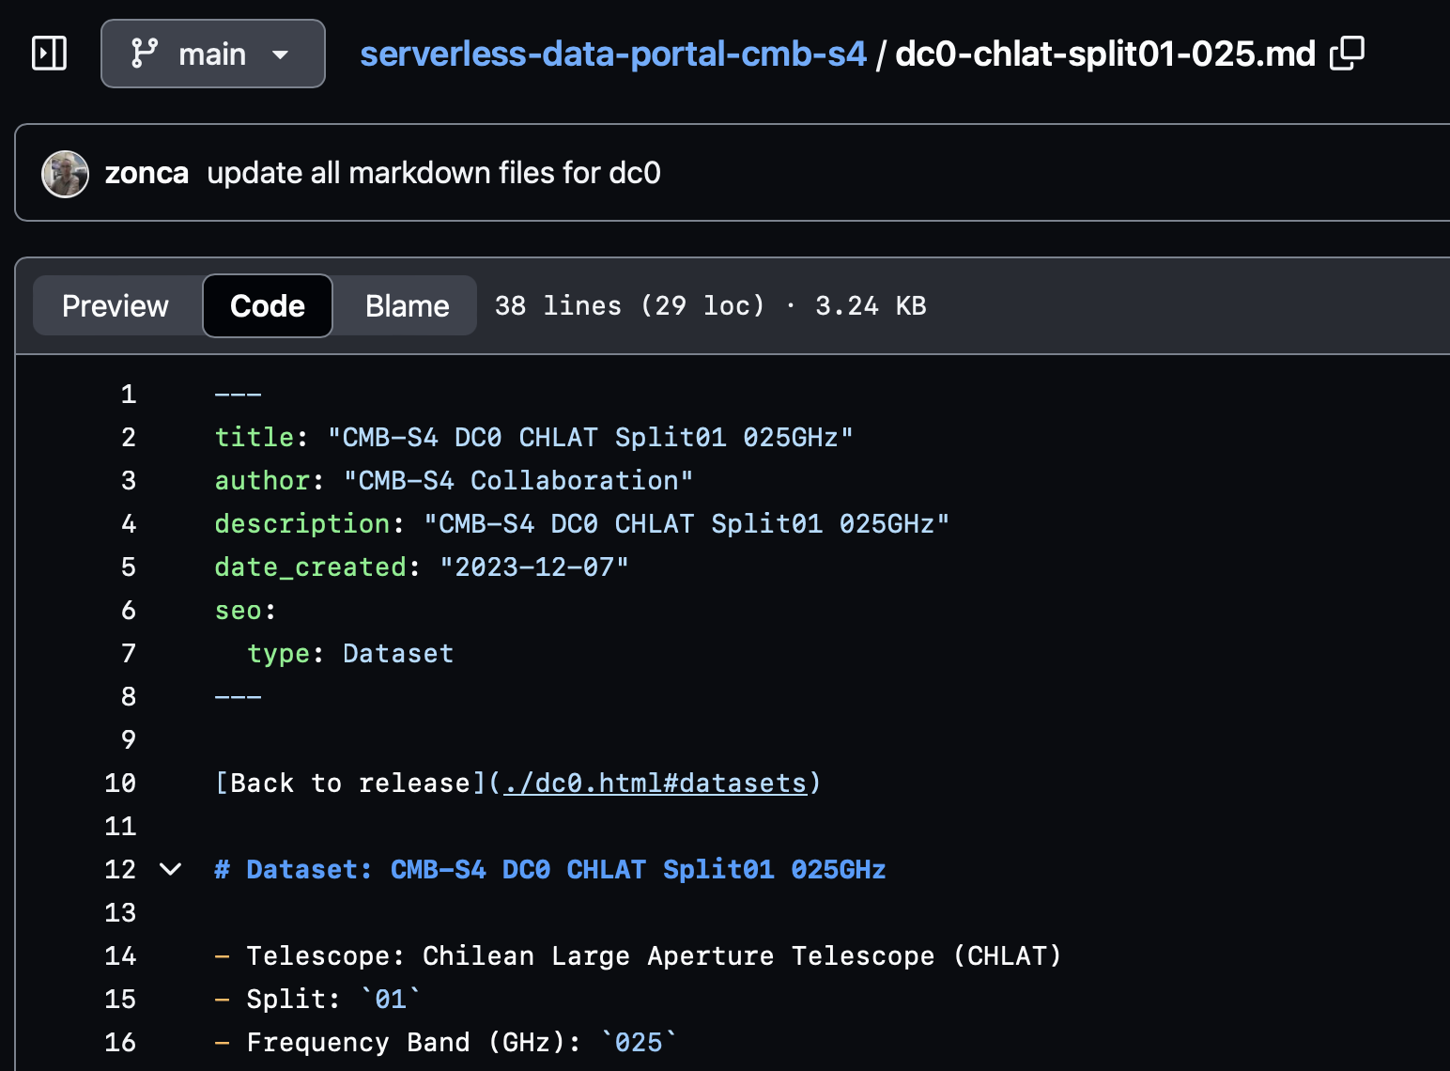
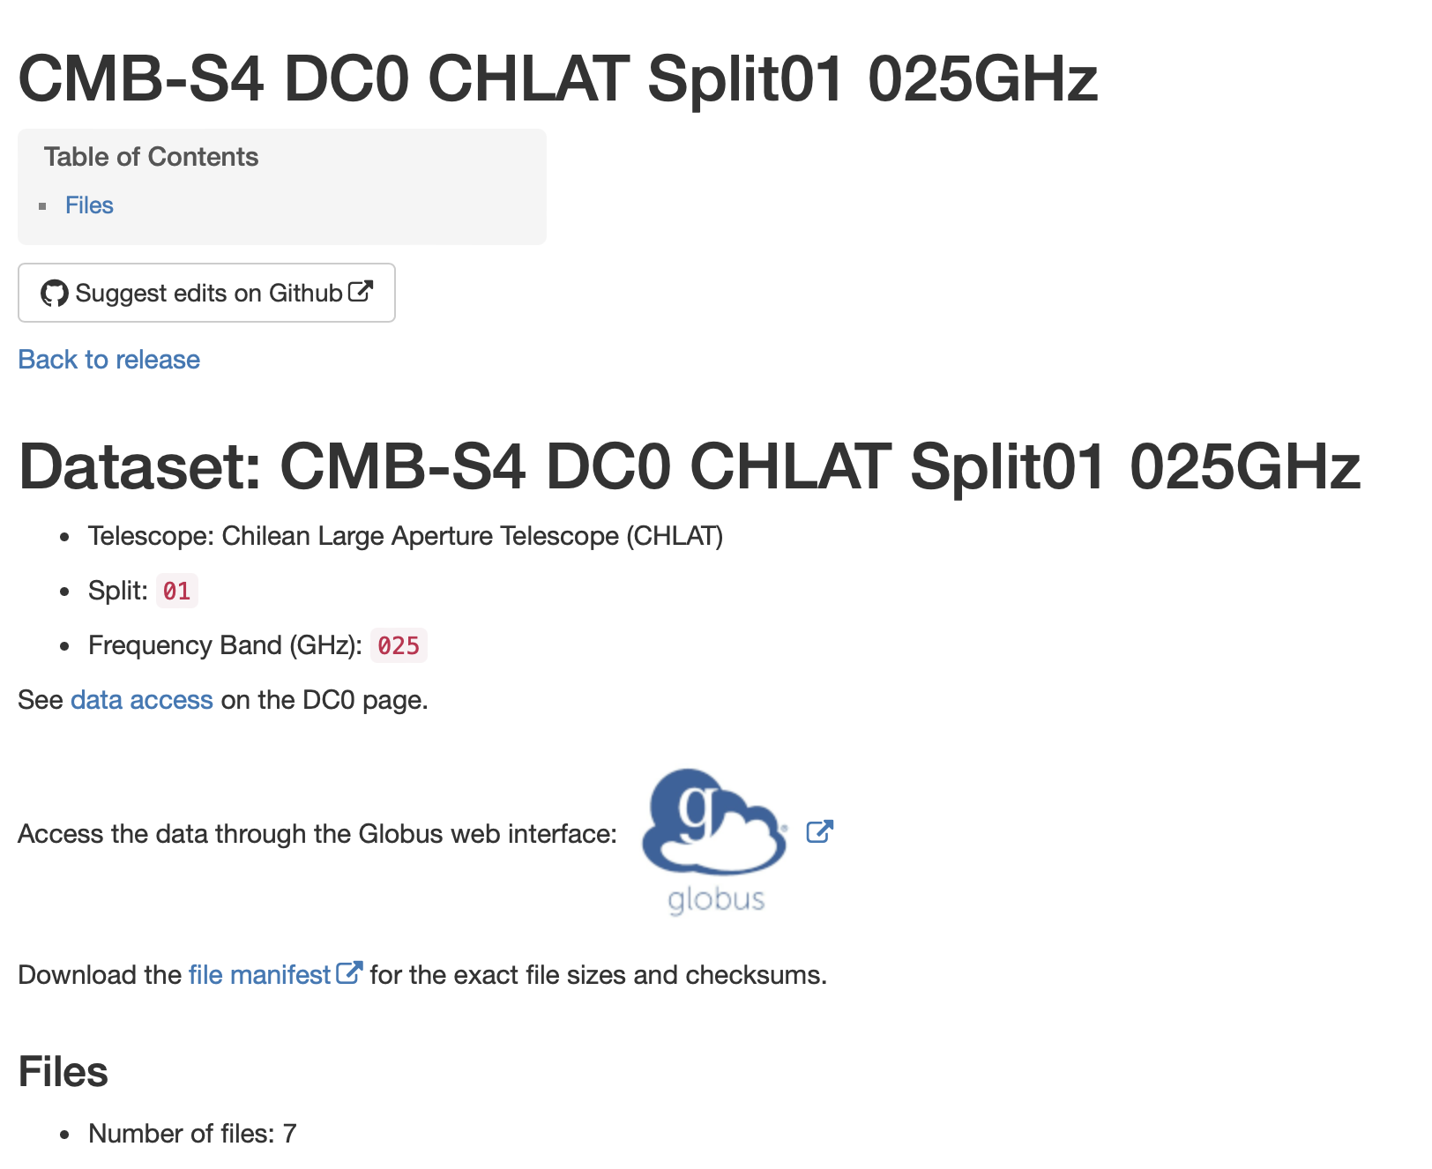

SRDR Components
Policies: permissions, retention, metadata standards
Catalog: GitHub Pages site with dataset landing pages and lists of all datasets
site
generator

Slide 10









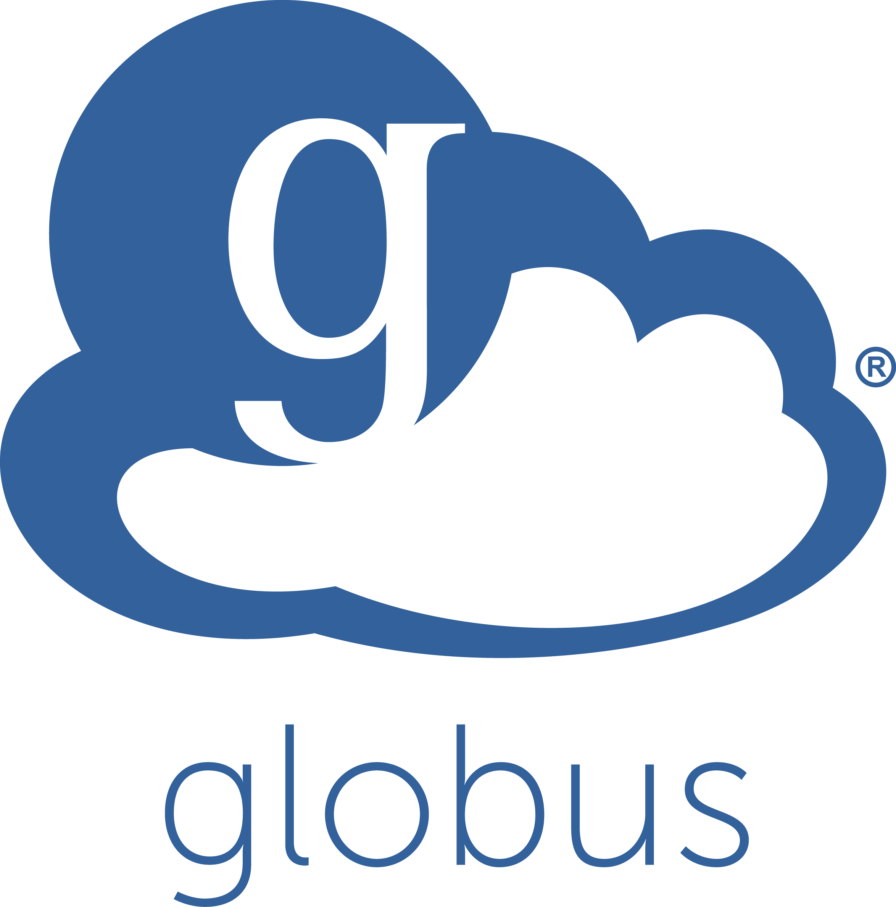
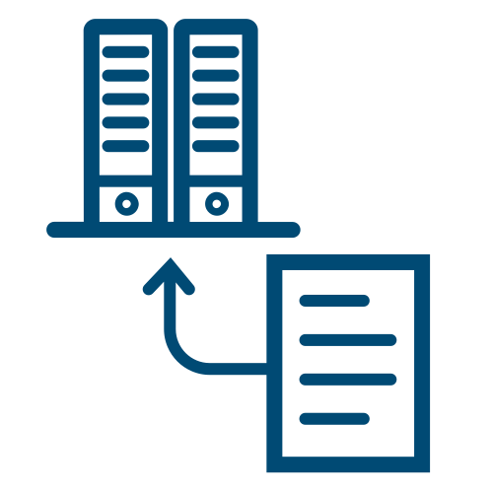





This is you!
site
generator
data
discovery
catalog
markdown
researcher
data steward
data
access
groups
collection
globus connect
permissions
datasets
https
Notes:
This is what you’ll build today

Slide 11
Defining “Cheap”
Minimizing project costs
”Serverless”--no systems maintenance
Catalog hosted on GitHub pages for free
Dataset storage allocated or cost scale by usage
Globus Guest Collection covered by institutional subscription
Over 200 institutional subscribers
70% of R1 universities
Model can be applied to other systems beyond Globus

Slide 12
Being FAIR
Findable
Human & machine-readable metadata
Datasets listed in catalog
Unique dataset identifiers
Interoperable
Metadata based on Schema.org & DataCite
Metadata in JSON-LD
Accessible
Data & landing pages via HTTPS
Access control using OAuth/OIDC
Persistent landing pages
Reusable
Data files in widely-used formats
Usage guidelines defined

Slide 13
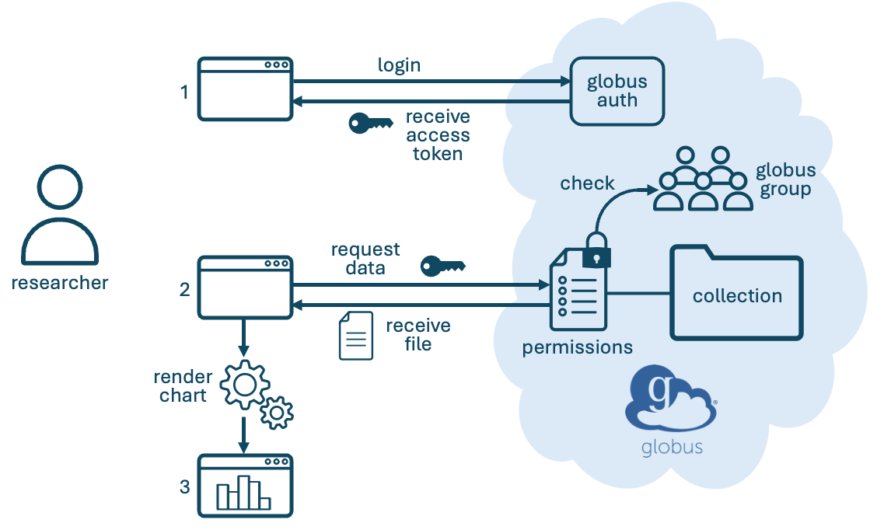
From Repository to Interactive Portal
HTTPS enables in-browser data access
Interactive: plot, subset, analyze, etc.
Both public and restricted data
Can also call APIs to drive workflows

Slide 14
Did you Complete the Setup Steps?
Yes
No

Slide 15
Let’s Get Started!
Link to the JupyterHub instance below
Will clone the tutorial repository into your environment
Look in chat
https://bit.ly/srdr-24
Hit the yes when you’re logged in
Send the no if something goes wrong

