Slide 1
Multihreading in c

Slide 2
Introduction
• Multithreading is a conceptual programming paradigm where a program (process) is divided into two or more subprograms (process), which can be implemented at the same time in parallel.
• For example, one subprogram can display an animation on the screen while another may build the next animation to be displayed.
• A program that contains multiple flow of control is known as multithreaded program.
• ‘threads running in parallel’ does not really mean that they actually run at the same time.

Slide 3
Motivation
Improving Application Responsiveness:
Any program in which many activities are not dependent upon each other can be redesigned so that each activity is defined as a thread. For example, the user of a multithreaded GUI does not have to wait for one activity to complete before starting another.
Using Multiprocessors Efficiently:
Typically, applications that express concurrency requirements with threads need not take into account the number of available processors. The performance of the application improves transparently with additional processors. Numerical algorithms and applications with a high degree of parallelism, such as matrix multiplications, can run much faster when implemented with threads on a multiprocessor.
Improving Program Structure:
Many programs are more efficiently structured as multiple independent or semi- independent units of execution instead of as a single, monolithic thread. Multithreaded programs can be more adaptive to variations in user demands than single-threaded programs.

Slide 4
Project Goal
•Understand the multithreading in C with use of test programmes.
•Understand how to write a multithreaded code: To run multiple codes/functions simultaneously using threading
•Run single threaded and multithreaded code in C-language

Slide 5
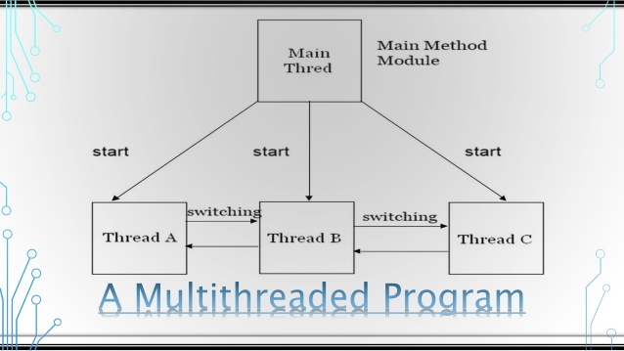
Design Architecture

Slide 6
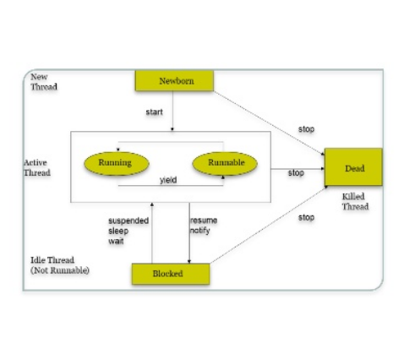
THREAD LIFE CYCLE
• During the life time of a thread, there are 5 states it can enter.
They include:
• 1. Newborn state
• 2. Runnable State
• 3. Running State
• 4.Blocked State
• 5. Dead State

Slide 7
Design architecture CNTD
1.Newborn State:
When we create a thread object, the thread is born and is said to be in newborn state. The thread is not yet scheduled for running. At this state, we can do only one of the following with it: Schedule it for running using start() method. Kill it using stop() method If scheduled, it moves to the runnable state. If we attempt to use any other method at this stage, an exception will be thrown.
2. Runnable state (start()):
The runnable state means that the thread is ready for execution and is waiting for the availability of the processor. That is, the thread has joined the queue of threads that are waiting for execution. If all threads have equal priority, then they are given time slots for execution in round robin fashion. i.e. first-come, first-serve manner.

Slide 8
3. Running State:
• Running means that the processor has given its time to the thread for its execution.
• The thread runs until it relinquishes control on its own or it is preempted by a higher priority thread.
• A running thread may relinquish its control in one of the following situations: A. Sleeping B. Waiting C. Suspended
4.Blocked State
1. A thread is said to be blocked when it is prevented form entering into the runnable state and subsequently the running state.
2. This happens when the thread is suspended, sleeping, or waiting in order to satisfy certain requirements.
3. A blocked thread is considered “ not runnable” but not dead and therefore fully qualified to run again.
5. Dead State
• A running thread ends its life when is has completed executing its run() method. It is a natural death.
• However, we can kill it by sending the stop message to it at any state thus causing a premature death to it.
• A thread can be killed as soon it is born, or while it is running, or even when it is in “not runnable” (blocked) condition

Slide 9
Outcome
•Succefully implemented multithreaded programmes without any errors.
•Learnt about various OS libraries and threading.
Also added programs to actually test these multithreaded codes and those programs are
bigmat.txt
default.c
mat.txt
test2.c
test3.c
test4.c
test.c
verybigmat.txt
Multithread code worked successfully on these test files without any errors.

Slide 10
-Ppt by
Name: Abhishek Jadhavar
MIS: 111708025
Batch: TYIT-WST1

