Slide 1
Iptables and Ebtables
SW3

Slide 2
OUTLINE
Linux process introduction
Concept
Details in process (running states. and so on )
Ways for Linux IPCs
Signal
Pipe/FIFO
Socket(ignore)
Message queue
Semaphore
Shared memory
Thread synchronization
Socket
System V IPC

Slide 3
Linux process introduction
Concept
Program: image for machine code and data which is stored in disks and can be executed,
it is a passive static entity.
Process: a program which is executing under CPU,
can apply and own the system resource.
contain the program and info of current activity.
it is a dynamic entity.
CPU
Control/state info
Code/date
code/date
program
process
Notes:
程序是存放在磁盘上的包括一系列机器代码指令和数据的可执行的映像，因此，是一个被动的实体。
进程是一个具有独立功能的程序关于某个数据集合的一次运行活动。它可以申请和拥有系统资源，是一个动态的概念，是一个活动的实体。它不只是程序的代码，还包括当前的活动，通过程序计数器的值和处理寄存器的内容来表示。
区别：
程序是指令的有序集合，其本身没有任何运行的含义，是一个静态的概念。而进程是程序在处理机上的一次执行过程，它是一个动态的概念。
程序可以作为一种软件资料长期存在，而进程是有一定生命期的。程序是永久的，进程是暂时的。
进程更能真实地描述并发，而程序不能；
进程是由进程控制块、程序段、数据段三部分组成;
进程具有创建其他进程的功能，而程序没有。
同一程序同时运行于若干个数据集合上，它将属于若干个不同的进程。也就是说同一程序可以对应多个进程。
在传统的操作系统中，程序并不能独立运行，作为资源分配和独立运行的基本单元都是进程。

Slide 4
Linux process introduction
Details in process：
Character for executing :
Dynamic : begin and finish dynamic
concurrence : execute together with other process
Independence: a base unit which execute independently, also as the independence unit assigned and scheduled by system.
Asynchronism: advance forward in his own independence and unpredictable speed
Character for frame:
PCB
Program field
Date field
Running module( ready, running, block)
running
block
ready
Notes:
程序是存放在磁盘上的包括一系列机器代码指令和数据的可执行的映像，因此，是一个被动的实体。
进程是一个具有独立功能的程序关于某个数据集合的一次运行活动。它可以申请和拥有系统资源，是一个动态的概念，是一个活动的实体。它不只是程序的代码，还包括当前的活动，通过程序计数器的值和处理寄存器的内容来表示。 进程是由进程控制块、程序段、数据段三部分组成
进程可以划分为运行、阻塞、就绪三种状态，并随一定条件而相互转化：就绪--运行，运行--阻塞，阻塞--就绪。
进程的特征
动态性：进程的实质是程序的一次执行过程，进程是动态产生，动态消亡的。
并发性：任何进程都可以同其他进程一起并发执行
独立性：进程是一个能独立运行的基本单位，同时也是系统分配资源和调度的独立单位；
异步性：由于进程间的相互制约，使进程具有执行的间断性，即进程按各自独立的、不可预知的速度向前推进
结构特征：进程由程序、数据和进程控制块三部分组成。
进程的概念主要有两点：第一，进程是一个实体。每一个进程都有它自己的地址空间，一般情况下，包括文本区域（text region）、数据区域（data region）和堆栈（stack region）。文本区域存储处理器执行的代码；数据区域存储变量和进程执行期间使用的动态分配的内存；堆栈区域存储着活动过程调用的指令和本地变量。第二，进程是一个“执行中的程序”。程序是一个没有生命的实体，只有处理器赋予程序生命时，它才能成为一个活动的实体，我们称其为进程。

Slide 5
Linux process introduction
Details in process：
task_struct: kernel manage process and task with this struct. It has several parts:
State
Scheduling Information
Identifiers
Inter-Process Communication
Links
Times and Timers
File system
Virtual memory
Processor Specific Context
Running Waiting Stopped Zombie
Choose which step into running state
User/group ID,limit the rights of access for file/device
Mechanism for IPC
Relationship between processes(father/child)
CPU time cost and left
file info which is visited
Virtual to physical address
Summary of the state

Slide 6
Linux process introduction
Details in process：
Related APIs
fork(); allocate pid,PCB,copy parent PCB,increase parent reference count,ready state,return pid.Child and parent execute from the same point, write-copy
pid_t fork(void);
pid_t wait(int *statloc);
pid_t waitpid(pid_t pid ,int *statloc,int options);/*particular,nonblock*/
exec(…) cluster;
int system(const char *cmdstring);/*fork+exec+waitpid*/
void _exit(int status);

Slide 7
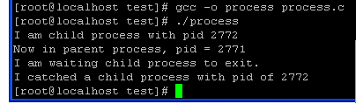
Linux process introduction
#include <sys/types.h>
#include <sys/wait.h>
#include <unistd.h>
#include <stdlib.h>
#include <stdio.h>
#include <errno.h>
int main()
{
pid_t pc, pr;
pc = fork();
if ( pc < 0 ) /* 如果出错 */
{
printf("create child prcocess error: %s\n", strerror(errno));
exit(1);
}
else if ( pc == 0) /* 如果是子进程 */
{
printf("I am child process with pid %d \n", getpid());
sleep(3);/* 睡眠3秒钟 */
exit(0);
}
else /* 如果是父进程 */
{
printf("Now in parent process, pid = %d\n", getpid());
printf("I am waiting child process to exit.\n");
pr = wait(NULL); /* 在这里等待子进程结束 */
if ( pr > 0 ) /*子进程正常返回*/
{
printf("I catched a child process with pid of %d\n", pr);
}
else /*出错*/
{
printf("error: %s\n.\n", strerror(errno));
}
}
exit(0);
}

Slide 8
Ways for Linux IPCs
Signal
Pipe/FIFO
Socket
System V IPCs
Message queue
Semaphore
Shared memory

Slide 9
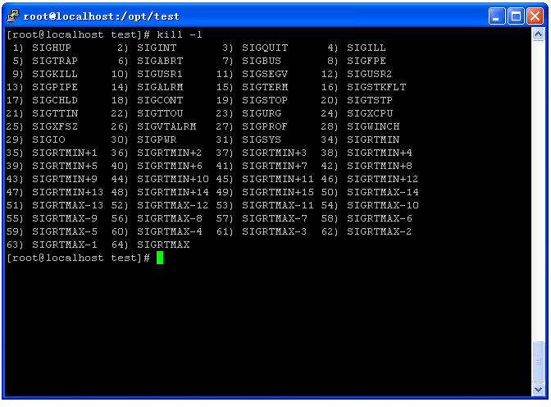
Ways for Linux IPCs
Signal
An IPC with the interrupt mechanism.
Category of the signal number
standard signals
Will be merged when the signal is send to the process which already have that signal pending.
Referred to the original defined signal numbers (0~31).
All original signals has been well defined for specific purpose.
real-time signals
Will be queued when the signal is send to the process which already have that signal pending.
Referred to the signal numbers which are greater than SIGRTMIN(32) and less than SIGRTMAX(63).
Entire set of real-time signals can be used for application-defined purpose by assigning signal number is SIGRTMIN + n due to the variance of the range across Unix system.
If the signal is sent using sigqueue(), an accompanying value can be sent with the signal.
Real-time signals are delivered in a guarantee order.
multiple signals of the same type are delivered in the order they were sent to a process.
multiple signals of different type are delivered starting with the lowest numbered signal

Slide 10
Signal
Related basic APIs
sighandler_t signal(int signum, sighandler_t handler)
int sigaction(int signum, const struct sigaction* act, struct sigaction* oldact)
int kill(pid_t pid, int sig)
int sigqueue(pid_t pid, int sig, const union sigval value)

Slide 11
Signal
sighandler_t signal(int signum, sighandler_t handler)
Description
Install a new signal handler for the signal with number signum. But not for SIGKILL and SIGSTOP
Parameter
signum – the signal number.
Handler – the address of the installed signal handler corresponding to the signal number.
SIG_IGN: ignore the signal. But not for SIGKILL and SIGSTOP.
SIG_DFL: deal with the signal by default action.
Return value
Return the previous value (address) of the signal handler.

Slide 12
Signal
int sigaction(int signum, const struct sigaction* act, struct sigaction* oldact)
Description
Install or query an action for the signal with number signum. But not for SIGKILL and SIGSTOP
Parameter
signum – signal number
act – the installed new action for the signal, if not NULL, the new action will be installed.
oldact – the previous action for the signal, if not NULL, the previous action is saved in oldact.
Return value
If success return 0, otherwise return -1.

Slide 13
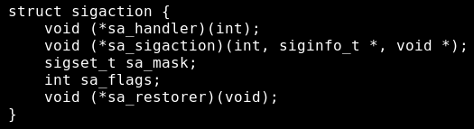
Signal structure if sigaction and siginfo_t
sa_handler and sa_sigaction
cannot assign both in an installation. If the SA_SIGINFO is specified in sa_flags, only sa_sigaction is used to pointer a signal handler function.
Can be set to SIG_IGN and SIG_DFL
sa_handler – the pointer to the signal handler function with the signal number as its only argument.
sa_sigaction – the pointer to the signal handler function with a accompany value if the SA_SIGINFO is set in sa_flags.
sa _mask
The signal number set which will be blocked during the procesing of signal handler.

Slide 14
Signal structure if sigaction
sa_flags
SA_RESETHAND(SA_ONESHOT)
Restore the signal action to default state once the signal handler has been called.
SA_RESTART
Compatible with BSD signal semantics by making certain system calls restartable across signal.
SA_NODEFER(SA_NOMASK)
If set, then the signal which cause the signal handler to be executed will not be added in the blocked signal list. It means it will directly interrupt the signal handler again. Notice that the sa_mask take precedence over SA_NODEFER.
SA_SIGINFO
The signal handler takes three arguments, not one. As the result, sa_sigaction should be used instead of sa_handler.

Slide 15
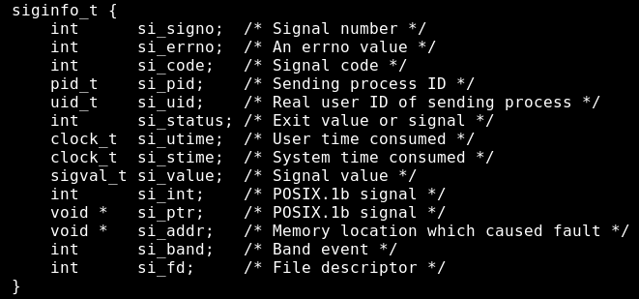

Signal Structure of siginfo_t and sigval

Slide 16
Comparison of signal and sigaction
sigaction provide more powerful installation of signal handler.
allowing to send signal with an accompany value.
Allowing to reset the action of signal handler with sa_flags and sa_mask.
Restore the previous action of signal handler.
Backward compatible with signal().
Both signal() and sigaction() can install standard and real-time signals.
The signal handler installed by sigaction() may not function normally with signal().

Slide 17
Signal int kill(pid_t pid, int sig)
Description
Send a signal to the destination process.
Parameter
pid – the process Id of the destination.
>0: sent to the process with pid.
=0: sent to processes of the same group.
<0 & != -1: sent to the process with | pid | of the same group.
= -1: sent to all process with pid >1 except the sending process.
sig – the sent signal number
Return value
if success return 0(at least one signal was sent), otherwise return -1.

Slide 18

Signal int sigqueue(pid_t pid, int sig, const union sigval value)
Description
Send signal to the destination process.
Parameter
pid – the process Id of the destination.
sig – the sent signal number.
value – if SA_SIGINFO is specified in sa_flags of sigaction.
sival_int: an integer
sival_ptr: a pointer
Return value
If success return 0, otherwise return -1.

Slide 19
Comparison of kill and sigqueue
sigqueue is capable of sending signal with an accompany value.
The standard signals and real-time signals are able to be sent by kill() and siqueue()
Sending standard signals does not cause the multiple signals of the same number to be queued.
sigqueue() does not return error when sent a standard signal to a process the buffer of which is full.
sigqueue()can only send the signal to a single process. kill() is capable of sending signals to a group processes.
Kill() is allowing to send a signal when the signal buffer of destination process is full.

Slide 20
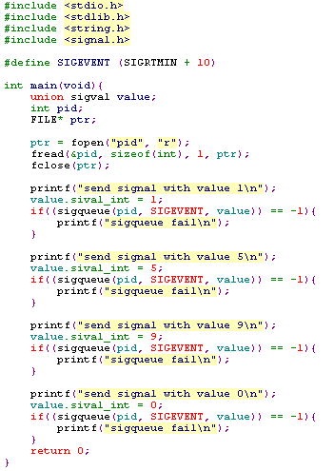

client
Sending multiple signals of the same number

Slide 21
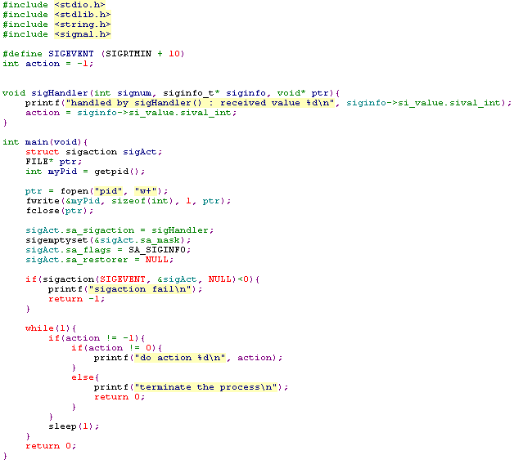
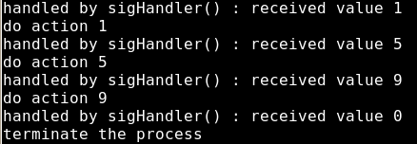
server
The action in signal handler is only moving the received value into local buffer
The installation of signal handler
The processing after the signal hadler

Slide 22
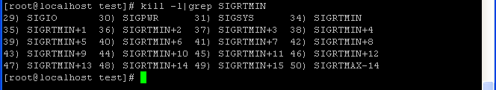
Pipe/FIFO
Pipe: communication among processes in relationship ( father/child or brothers)
as a shared date page among processes
Character:
Semiduplex: date flow one way,
Only be used among process in relationships
An independent file system, only exist in the memory.
Write at the end and Read at the head.
Shell: kill –l | grep SIGRTMIN : create a temporary pipe
Process 1
Father/brother
Process 2
Father/brother
write
read
Pipe
temporary

Slide 23
pipe
Related APIs:
int pipe(int fd[2]);
Fd[0]: used only for read
Fd[1]: used only for write
Read();
write();
Close();
Common File I/O APIs

Slide 24
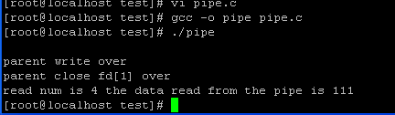
Pipe
#include <unistd.h>
#include <sys/types.h>
#include <errno.h>
main()
{
int pipe_fd[2];
pid_t pid;
char r_buf[100];
char w_buf[4];
char* p_wbuf;
int r_num;
int cmd;
memset(r_buf,0,sizeof(r_buf));
memset(w_buf,0,sizeof(r_buf));
p_wbuf=w_buf;
if(pipe(pipe_fd)<0)
{
printf("pipe create error\n");
return -1;
}
if((pid=fork())==0)
{
printf("\n");
close(pipe_fd[1]);
sleep(3);//确保父进程关闭写端
r_num=read(pipe_fd[0],r_buf,100);
printf("read num is %d the data read from the pipe is %d\n",r_num,atoi(r_buf));
close(pipe_fd[0]);
exit();
}
else if(pid>0)
{
close(pipe_fd[0]);//read
strcpy(w_buf,"111");
if(write(pipe_fd[1],w_buf,4)!=-1)
printf("parent write over\n");
close(pipe_fd[1]);//write
printf("parent close fd[1] over\n");
sleep(10);
}
}

Slide 25
FIFO
Named pipe: own a pathname and exist in the file system(FIFO type)
Processes, even with no relationship ,can communication each other through the FIFO pathname by FIFO.
When use the FIFO ,you should create a FIFO by mkfifo();
Also ,write at the end and read at the head(FIFO)

Slide 26
FIFO
Ralated APIs:
int mkfifo(const char * pathname, mode_t mode)
Pathname: the name of the FIFO.
Mode: the same as the general file mode(when use open()).
If the FIFO has exist ,return EEXIST error.
open ();
If this operation is used for read, it will return success while the write operation has been done,else the process may be blocked(set the block ) or just return (set no block ).
If it is used for write,and the read has been done,it will return success,else it will be block(set the block) or return ENXIO error(set no bolck)
Read()
Write()
Close()

Slide 27
FIFO write
#include <sys/types.h>
#include <sys/stat.h>
#include <errno.h>
#include <fcntl.h>
#define FIFO_SERVER "/tmp/fifoserver"
main(int argc,char** argv)
//参数为即将写入的字节数
{
int fd;
char w_buf[4096*2];
int real_wnum;
memset(w_buf,0,4096*2);
if((mkfifo(FIFO_SERVER,O_CREAT|O_EXCL)<0)&&(errno!=EEXIST))
printf("cannot create fifoserver\n");
if(fd==-1)
if(errno==ENXIO)
printf("open error; no reading process\n");
fd=open(FIFO_SERVER,O_WRONLY|O_NONBLOCK,0);
//设置非阻塞标志
//fd=open(FIFO_SERVER,O_WRONLY,0);
//设置阻塞标志
real_wnum=write(fd,w_buf,2048);
if(real_wnum==-1)
{
if(errno==EAGAIN)
printf("write to fifo error; try later\n");
}
else
printf("real write num is %d\n",real_wnum);
real_wnum=write(fd,w_buf,5000);
//5000用于测试写入字节大于4096时的非原子性
//real_wnum=write(fd,w_buf,4096);
//4096用于测试写入字节不大于4096时的原子性
if(real_wnum==-1)
if(errno==EAGAIN)
printf("try later\n");
}

Slide 28
FIFO read
#include <sys/types.h>
#include <sys/stat.h>
#include <errno.h>
#include <fcntl.h>
#define FIFO_SERVER "/tmp/fifoserver"
main(int argc,char** argv)
{
char r_buf[4096*2];
int fd;
int r_size;
int ret_size;
r_size=atoi(argv[1]);
printf("requred real read bytes %d\n",r_size);
memset(r_buf,0,sizeof(r_buf));
fd=open(FIFO_SERVER,O_RDONLY|O_NONBLOCK,0);
//fd=open(FIFO_SERVER,O_RDONLY,0);
//在此处可以把读程序编译成两个不同版本：阻塞版本及非阻塞版本
if(fd==-1)
{
printf("open %s for read error\n");
exit();
}
while(1)
{
memset(r_buf,0,sizeof(r_buf));
ret_size=read(fd,r_buf,r_size);
if(ret_size==-1)
if(errno==EAGAIN)
printf("no data avlaible\n");
printf("real read bytes %d\n",ret_size);
sleep(1);
}
pause();
unlink(FIFO_SERVER);
}

Slide 29
Pipe/FIFO
Summary:
For pipe, used for shell,and the processes communication who are relatived.
For FIFO: increase function of pipe, no_ relative_processes can communicate with each other.
All use the mechanism of FIFO(first in first out).

Slide 30
System V IPCs
System V IPC
IPC KEY and permission
Message queue
Shared memory
Semaphore

Slide 31
IPC KEY and permission
KEY
The user must have a key to acquire all system V IPCs.
The way of generation and management of keys is not strictly defined in system V IPC.
Well defined public keys
Generated by ftok(char* filepath, char proj)
Use IPC_PRIVATE

Slide 32
KEY generation and management
Well defined public keys
Define a well known keys for any process accessing the IPC object.
#define KEY 1234

Slide 33
KEY generation and management
ftok(char* filepath, char proj)
filepath – the full file path of the created file, which must be exist, otherwise return key value with -1.
proj – a tunable 8 bits value for a specific created file.
different keys will be generated by given different proj for a constant file path.
Notice that IPC still function normally even the KEY is -1, but fail to the requirements of unique when multiple IPC objects is created.
key_t key = ftok(“/tmp/sysvipc”, 1)

Slide 34
KEY generation and management
IPC_PRIVATE
It is equivalent to use 0 as the key.
A guarantee of an unique key generated automatically by kernel but cannot be maintained by the user.
For the scenario of multiple separated processes accessing the same IPC object , it is unwise to use IPC_PRIVATE as the KEY due to the incapability of passing the key to another process.
It is recommended to use between the process which are parent and children due to the inheritance of the address space of the parent process.

Slide 35
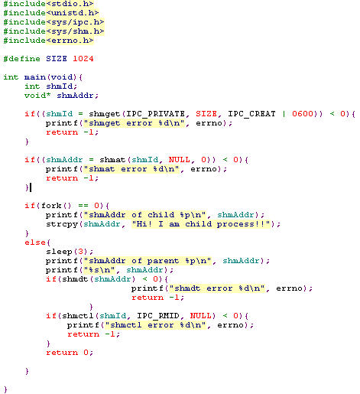

Example of IPC_PRIVATE
directly write the share memory without attach
child
parents

Slide 36
IPC KEY and permission
Permission
System V IPCs are able to be set permission for different users, which is operated with bitwise OR the defined constants in <sys/msg.h>, <sys/shm.h>, <sys/sem.h>.
The octal permission values.
The leading 0 which indicates the integer is octal value cannot be eliminated
Access permission | Octal value
Write by owner | 0200
Read by owner | 0400
R / W by owner | 0600
Write by group | 0020
Read by group | 0040
R / W by group | 0060
Write by others | 0002
Read by others | 0004
R / W by others | 0006

Slide 37
Linux IPCs
System V IPC
IPC KEY and permission
Message queue
Shared memory
Semaphore (next target)
Signal
Socket (next target)
Pipe (next target)

Slide 38
Message queue
A priority based queue of messages.
Transmit a short block of memory holding application-defined messages
Message can be queued and retrieved by multiple process
Where the letter is input message, and the number is priority.
ex. 7A means input message A with priority level 7
input messages with priority
msgsnd()
1J | 7H | 7G | 3F | 7E | 1D | 3C | 1B | 7A
highest priority
1
1B | 1D | 1J
higher priority
msgrcv()
3
3C | 3F
lowest priority
7
7A | 7E | 7G | 7H

Slide 39
Message queue
Related APIs
int msgget(key_t key, int msgflg)
int msgsnd(int msqid, struct msgbuf* msgp, int msgsz, int msgflg)
int msgrcv(int msqid, struct msgbuf* msgp, int msgsz, long msgtyp, int msgflg)
int msgctl(int msqid, int cmd, struct msqid_ds* buf)

Slide 40
Message queue int msgget(key_t key, int msgflg)
Description
Get or create a message associated with a specific key
parameter
key: as the aforementioned discussion.
msgflg: setting access permission and the optional action with bitwise OR operation.
IPC_CREAT: create a new message queue with a associated key, if the queue is existed, IPC_CREAT will be ignored.
IPC_EXCL: if message queue is existed, return -1 if msgflg & IPC_CREAT & IPC_EXCL is true.
Permission bits: as the aforementioned discussion.

Slide 41
Message queue int msgget(key_t key, int msgflg)
Return value
If success, return msqid, otherwise return -1

Slide 42

Message queue int msgsnd(int msqid, struct msgbuf* msgp, int msgsz, long msgtyp, int msgflg)
Description
Send a message to the message queue with id, msqid.
Parameter
msqid – destination message queue id.
msgp – the transmission buffer can be any structure but containing a long integer as the first element.
Where the mtype indicates the priority of this message, which must be positive value.
The mtext can be any type of data structure.

Slide 43
Message queue int msgsnd(int msqid, struct msgbuf* msgp, int msgsz, int msgflg)
Parameter
msgsz – message size of the transmission data excluding mtype.
msgflg
0: if the destination queue is full, the process will be blocked by msgsnd() until the queue is available or return -1 when receiving signal.
IPC_NOWAIT: if the destination queue is full, return -1 with errno is EAGAIN.
Return value
If success, return 0, otherwise return -1

Slide 44
Message queue int msgrcv(int msqid, struct msgbuf* msgp, int msgsz, long msgtyp, int msgflg)
Description
Receiving a message from a message queue with id, msqid.
Parameter
msqid – receiving message queue id.
msgp – the same definition as msgsnd() without assigning mtype.
msgsz – receiving message size excluding mtype.

Slide 45
Message queue int msgrcv(int msqid, struct msgbuf* msgp, int msgsz, long msgtyp, int msgflg)
Parameter
msgtyp – indicates which priority of message will be received.
0: receive the first message in the queue regardless of priority.
> 0: receiving the first message with the mtype equal to given msgtyp.
< 0: receiving the first message with the mtype equal to or less than |msgtyp|.

Slide 46
Message queue int msgrcv(int msqid, struct msgbuf* msgp, int msgsz, long msgtyp, int msgflg)
Parameter
msgflg
0 : if there is no message in the receiving queue, the process will be blocked until a message arrives or return -1 when receiving a signal.
IPC_NOWAIT: if there is no message in the receiving queue, then return -1 with errno, EAGAIN.
IPC_NOERROR: if this bit is turned on, any received message with size greater than msgsz will be truncated.
Return value
If success, return 0, otherwise return -1.

Slide 47
Message queue int msgctl(int msqid, int cmd, struct msqid_ds* buf)
Description
Control the operation of the created message queue
Parameter
msqid – the id of the message queue

Slide 48
Message queue int msgctl(int msqid, int cmd, struct msqid_ds* buf)
Parameter
cmd
IPC_STAT: copy the information from the kernel data structure associated with msqid into the msqid_ds structure pointed to by buf.
IPC_SET: set the value of following structure into the kernel date structure associated with this message queue.
msg_qbytes: only modifiable for root user.
msg_perm.uid: only modifiable for root user or the user with matched uid and cuid.
msg_perm.gid: the same as msg_perm.uid.
msg_perm.mode: the same as msg_perm.uid. Notice that only the least significant 9-bits is modifiable
msg_ctime will be updated.

Slide 49
Message queue int msgctl(int msqid, int cmd, struct msqid_ds* buf)
Parameter
cmd
IPC_RMID: remove the message queue
IPC_INFO: return information about the system-wide message queue limits and parameter.
Linux specific (if the _GNU_SOURCE feature test macro is defined)
An additional structure msginfo is needed. It means a cast of the returned buf with msqid_ds structure is necessary.
buf
The returned structure of msqid_ds, set to NULL when IPC_RMID is used.

Slide 50
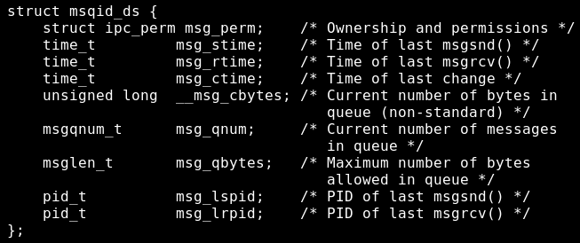
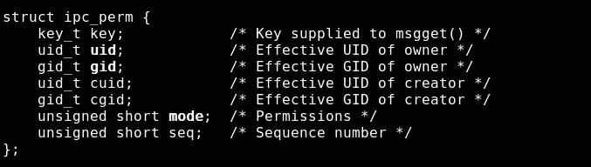
Message queue Structure of msqid_ds and ipc_perm
Only the root user or the users with the matched uid or cuid with msg_perm.uid or msg_perm.cuid can modified the structure of ipc_perm;
To raise the msg_qbytes is only modifiable by the root user.

Slide 51
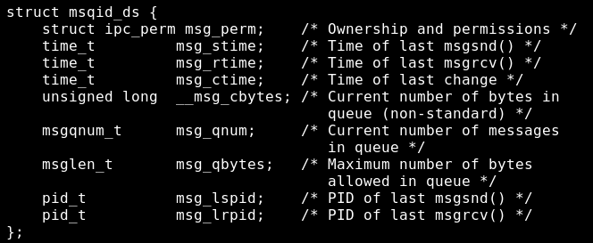
Message queue Structure of msginfo
The msgmni, msgmax, and msgmnb settings can be changed via /proc/sys/kernel files of the same name;

Slide 52
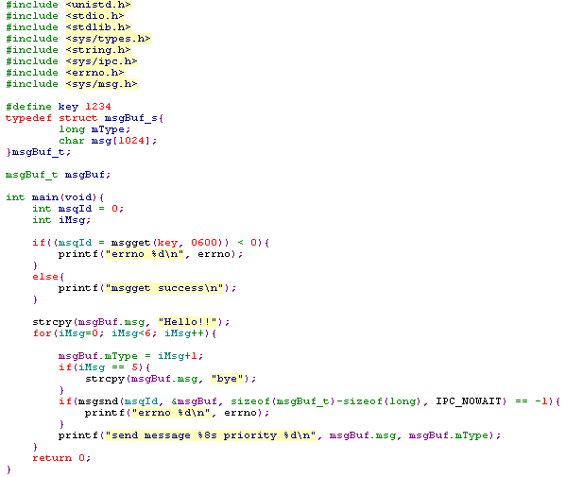

client
get msqid but without IPC_CREAT
The size is excluding the first long integer
send msgs with priority 1~6

Slide 53
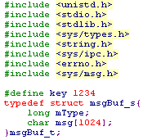
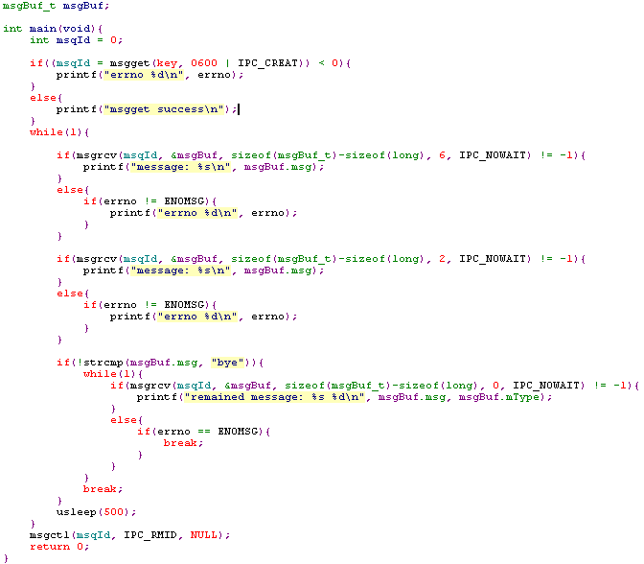

server
get msqid
receive msg with priority 6
The size is excluding the first long integer
receive msg with priority 2
receive msg regardless of priority until queue is empty
remove queue

Slide 54
Linux IPCs
System V IPC
IPC KEY and permission
Message queue
Shared memory
Semaphore (next target)
Signal
Socket (next target)
Pipe (next target)

Slide 55
Shared memory
Create a memory which can be accessed by multiple processes.
Each process is able to access the share table by attaching which into their own memory space
attach
shared table
attach
Process memory
attach

Slide 56
Shared memory
Related APIs
int shmget(key_t key, size_t size, int shmflg)
void* shmat(int shmid, const void* shmaddr, int shmflg)
int shmdt(const void* shmaddr)
int shmctl(int shmid, int cmd, struct shmid_ds* buf)

Slide 57
Shared memory int shmget(key_t key, size_t size, int shmflg)
Description
get or create a shared memory associated with a specific key and with a give size.
Parameter
Key – as aforementioned.
size – the given size of user for the shared memory, which must be greater than SHMMIN and less than SHMMAX.
shmflg - setting access permission and the optional action with bitwise OR operation.
IPC_CREAT: create a new shared memory with a associated key, if the shared memory is existed, IPC_CREAT will be ignored.
IPC_EXCL: if shared memory is existed, return -1 if msgflg & IPC_CREAT & IPC_EXCL is true.
Permission bits: as the aforementioned discussion.

Slide 58
Shared memory int shmget(key_t key, size_t size, int shmflg)
Return value
If success, return shmid, otherwise return -1.

Slide 59
Shared memory void* shmat(int shmid, const void* shmaddr, int shmflg)
Description
Attach the shared memory associated with the shmid to the memory address space of the process.
Notice that the segment may be attached at different addresses in different processes.
Parameter
shmid – the id of the attached share memory.
shmaddr
NULL: the system choose a unused address at which to attach the segment.
isn’t NULL: if the SHM_RND is specified in shmflg, the attach occurs at the address equal to shmaddr rounded down to the nearest multiple of SHMLBA. Otherwise, shmaddr must be a paged-aligned address at which the attach occurs.

Slide 60
Shared memory void* shmat(int shmid, const void* shmaddr, int shmflg)
Parameter
shmflg
SHM_RND: round the given shmaddr to the multiple of the SHMLBA.
SHM_RDONLY: the segment is attached for reading, and the process must have the read permission for the segment..
SHMLBA
Segment low boundary address multiple. Must be page aligned.
Current implementation is PAGE_SIZE.
Return value
If success, return the attached address, otherwise return NULL.
Note
After a fork(), the child inherits the attached shared segmen

Slide 61
Shared memory int shmdt(const void* shmaddr)
Description
Detach the shared memory from the memory address space of the process.
Parameter
shmaddr – the address at which the segment is located in the address space of the calling process.
Return value
If success return 0, otherwise return -1.
Note
After an exec(), all attached shared memory segments are detached from the process.
Upon exit(), all attached shared memory segments are detached from the process.

Slide 62
Shared memory int shmctl(int shmid, int cmd, struct shmid_ds* buf)
Description
Control the operation of the created shared memory.
Parameter
shmid – the id of the attached share memory.

Slide 63
Shared memory int shmctl(int shmid, int cmd, struct shmid_ds* buf)
Parameter
cmd
IPC_STAT: copy the information from the kernel data structure associated with shmid into the shmid_ds structure pointed to by buf.
IPC_SET: set the value of following structure into the kernel date structure associated with the shared memory.
shm_perm.uid: only modifiable for root user or the user with matched uid and cuid.
shm_perm.gid: the same as shm_perm.uid.
shm_perm.mode: the same as shm_perm.uid. Notice that only the least significant 9-bits is modifiable
shm_ctime will be updated.

Slide 64
Shared memory int shmctl(int shmid, int cmd, struct shmid_ds* buf)
Parameter
cmd
IPC_RMID: remove the shared memory.
Marked the segment to be destroyed and the SHM_DEST falg of shm_perm.mode will be set.
The segments will be only actually destroyed after the last process detached it.
Linux allow a process to attach a segment marked for deleting. But this feature is not available for others unix system.
IPC_INFO: return information about the system-wide shared memory limits and parameter.
Linux specific (if the _GNU_SOURCE feature test macro is defined)
An additional structure shminfo is needed. It means a cast of the returned buf with shmid_ds structure is necessary.

Slide 65
Shared memory int shmctl(int shmid, int cmd, struct shmid_ds* buf)
Parameter
cmd
SHM_LOCK: prevent swapping of the shared memory segment.
Linux specific.
After performing, the SHM_LOCKED of shm_perm,mode will be set.
SHM_UNLOCK: allow swapping of the shared memory segment.
Linux specific.
Note : only a privileged process can employ SHM_LOCK and SHM_UNLOCK in kernels 2.6.10. since kernel 2.6.10, an unprivileged user can employ these two cmd if its UID match the owner or the creator uid of the share memory
buf
The returned structure of shmid_ds, set to NULL when IPC_RMID is used.

Slide 66
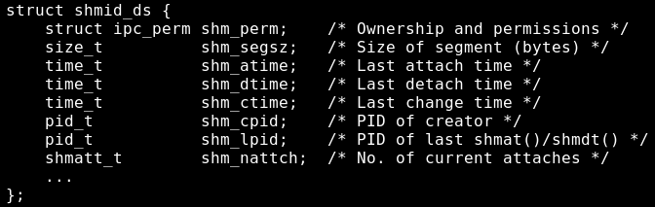
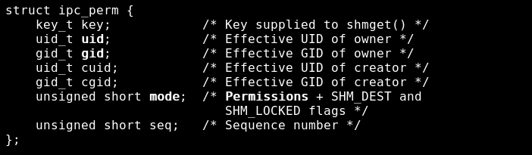
Shared memory Structure of msqid_ds and ipc_perm

Slide 67
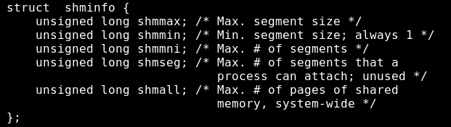
Shared memory Structure of shminfo
The shmmni, shmmax, and shmall settings can be changed via /proc/sys/kernel files of the same name;

Slide 68
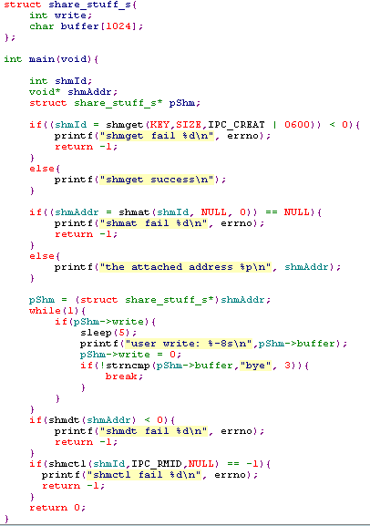
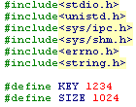
server
create a
shared memory
attach the
share memory
Process the data in the share memory
The prevention of race condition is necessary
detach and remove the share memory

Slide 69
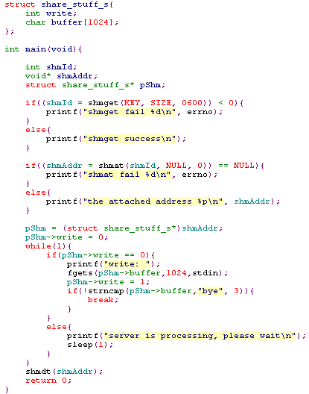
client
get a shared memory
attach the
share memory
write the data in the share memory
The prevention of race condition is necessary
wait for the completion of server processing

Slide 70
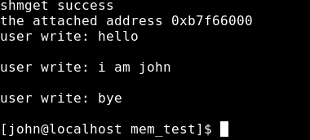
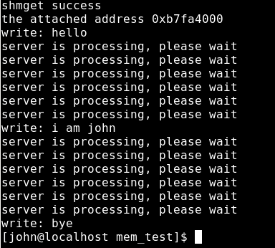
server
client

Slide 71
Semaphore
Not like the others，mainly as a control mechanism for accessing the shared resource among processes
Two types:
Two value semaphore(0/1),like a mutex lock
Counter semaphore(may >1)

Slide 72
APIs
#include <sys/types.h>
#include <sys/ipc.h>
#include <sys/sem.h>
key_t ftok (char*pathname, char proj)
Return a key which is relative to pathname
int semget(key_t key, int nsems, int semflg)
int semop(int semid, struct sembuf *sops, unsigned nsops);
int semctl(int semid，int semnum，int cmd，union semun arg)

Slide 73
Semaphore int semget(key_t key, int nsems, int semflg)
Key:value returned by ftok(), a unique ID for semaphore;
Nsems: the number of the semaphore .
Semflg:a mark bit field.
Fail return -1,then return the semaphore ID
Notes:
1）int semget(key_t key, int nsems, int semflg) 参数key是一个键值，由ftok获得，唯一标识一个信号灯集，用法与msgget()中的key相同；参数nsems指定打开或者新创建的信号灯集中将包含信号灯的数目；semflg参数是一些标志位。参数key和semflg的取值，以及何时打开已有信号灯集或者创建一个新的信号灯集与msgget()中的对应部分相同，不再祥述。 该调用返回与健值key相对应的信号灯集描述字。 调用返回：成功返回信号灯集描述字，否则返回-1。 注：如果key所代表的信号灯已经存在，且semget指定了IPC_CREAT|IPC_EXCL标志，那么即使参数nsems与原来信号灯的数目不等，返回的也是EEXIST错误；如果semget只指定了IPC_CREAT标志，那么参数nsems必须与原来的值一致，在后面程序实例中还要进一步说明。

Slide 74
Semaphore int semop(int semid, struct sembuf *sops, unsigned nsops);
Semid: sempahore ID
Sops: operation in the special semaphore.
Nsops: size of sops sembuf struct：
struct sembuf {
unsigned short sem_num; /* semaphore index in array */
short sem_op; /* semaphore operation */
short sem_flg; /* operation flags */
};
Notes:
2）int semop(int semid, struct sembuf *sops, unsigned nsops); semid是信号灯集ID，sops指向数组的每一个sembuf结构都刻画一个在特定信号灯上的操作。nsops为sops指向数组的大小。 sembuf结构如下：
struct sembuf { unsigned short sem_num; /* semaphore index in array */ short sem_op; /* semaphore operation */ short sem_flg; /* operation flags */}; sem_num对应信号集中的信号灯，0对应第一个信号灯。sem_flg可取IPC_NOWAIT以及SEM_UNDO两个标志。如果设置了SEM_UNDO标志，那么在进程结束时，相应的操作将被取消，这是比较重要的一个标志位。如果设置了该标志位，那么在进程没有释放共享资源就退出时，内核将代为释放。如果为一个信号灯设置了该标志，内核都要分配一个sem_undo结构来记录它，为的是确保以后资源能够安全释放。事实上，如果进程退出了，那么它所占用就释放了，但信号灯值却没有改变，此时，信号灯值反映的已经不是资源占有的实际情况，在这种情况下，问题的解决就靠内核来完成。这有点像僵尸进程，进程虽然退出了，资源也都释放了，但内核进程表中仍然有它的记录，此时就需要父进程调用waitpid来解决问题了。 sem_op的值大于0，等于0以及小于0确定了对sem_num指定的信号灯进行的三种操作。具体请参考linux相应手册页。 这里需要强调的是semop同时操作多个信号灯，在实际应用中，对应多种资源的申请或释放。semop保证操作的原子性，这一点尤为重要。尤其对于多种资源的申请来说，要么一次性获得所有资源，要么放弃申请，要么在不占有任何资源情况下继续等待，这样，一方面避免了资源的浪费；另一方面，避免了进程之间由于申请共享资源造成死锁。 也许从实际含义上更好理解这些操作：信号灯的当前值记录相应资源目前可用数目；sem_op>0对应相应进程要释放sem_op数目的共享资源；sem_op=0可以用于对共享资源是否已用完的测试；sem_op<0相当于进程要申请-sem_op个共享资源。再联想操作的原子性，更不难理解该系统调用何时正常返回，何时睡眠等待。 调用返回：成功返回0，否则返回-1。

Slide 75
Semaphore int semctl(int semid，int semnum，int cmd，union semun arg)
Semid:semaphore ID
Cmd:operation types
Semnum:operation for which semaphore. Meaningful for few special cmd.
Arg:set or return the info of semaphore
Notes:
) int semctl(int semid，int semnum，int cmd，union semun arg) 该系统调用实现对信号灯的各种控制操作，参数semid指定信号灯集，参数cmd指定具体的操作类型；参数semnum指定对哪个信号灯操作，只对几个特殊的cmd操作有意义；arg用于设置或返回信号灯信息。 该系统调用详细信息请参见其手册页，这里只给出参数cmd所能指定的操作。
IPC_STAT获取信号灯信息，信息由arg.buf返回；IPC_SET设置信号灯信息，待设置信息保存在arg.buf中（在manpage中给出了可以设置哪些信息）；GETALL返回所有信号灯的值，结果保存在arg.array中，参数sennum被忽略；GETNCNT返回等待semnum所代表信号灯的值增加的进程数，相当于目前有多少进程在等待semnum代表的信号灯所代表的共享资源；GETPID返回最后一个对semnum所代表信号灯执行semop操作的进程ID；GETVAL返回semnum所代表信号灯的值；GETZCNT返回等待semnum所代表信号灯的值变成0的进程数；SETALL通过arg.array更新所有信号灯的值；同时，更新与本信号集相关的semid_ds结构的sem_ctime成员；SETVAL设置semnum所代表信号灯的值为arg.val；调用返回：调用失败返回-1，成功返回与cmd相关：
Cmdreturn valueGETNCNTSemncntGETPIDSempidGETVALSemvalGETZCNTSemzcnt

Slide 76
Semaphore
#include <linux/sem.h>
#include <stdio.h>
#include <errno.h>
#define SEM_PATH "/unix/my_sem"
#define max_tries 3
int semid;
main()
{
int flag1,flag2,key,i,init_ok,tmperrno;
struct semid_ds sem_info;
struct seminfo sem_info2;
union semun arg; //union semun： 请参考附录2
struct sembuf askfor_res, free_res;
flag1=IPC_CREAT|IPC_EXCL|00666;
flag2=IPC_CREAT|00666;
key=ftok(SEM_PATH,'a');

Slide 77
Semaphore
//error handling for ftok here;
init_ok=0;
semid=semget(key,1,flag1);//create a semaphore set that only includes one semphore.
if(semid<0)
{
tmperrno=errno;
perror("semget");
if(tmperrno==EEXIST)
//errno is undefined after a successful library call( including perror call) so it is saved //in tmperrno.
{
semid=semget(key,1,flag2);
//flag2 只包含了IPC_CREAT标志, 参数nsems(这里为1)必须与原来的信号灯数目一致
arg.buf=&sem_info;
for(i=0; i<max_tries; i++)
{
if(semctl(semid, 0, IPC_STAT, arg)==-1)
{ perror("semctl error"); i=max_tries;}
else
{
if(arg.buf->sem_otime!=0){ i=max_tries; init_ok=1;}
else sleep(1);
}
}

Slide 78
Semaphore
if(!init_ok)
// do some initializing, here we assume that the first process that creates the sem will
// finish initialize the sem and run semop in max_tries*1 seconds. else it will not run
// semop any more.
{
arg.val=1;
if(semctl(semid,0,SETVAL,arg)==-1) perror("semctl setval error");
}
}
else
{perror("semget error, process exit"); exit(); }
}
else //semid>=0; do some initializing
{
arg.val=1;
if(semctl(semid,0,SETVAL,arg)==-1)
perror("semctl setval error");
}

Slide 79
//get some information about the semaphore and the limit of semaphore in redhat8.0
arg.buf=&sem_info;
if(semctl(semid, 0, IPC_STAT, arg)==-1)
perror("semctl IPC STAT");
printf("owner's uid is %d\n", arg.buf->sem_perm.uid);
printf("owner's gid is %d\n", arg.buf->sem_perm.gid);
printf("creater's uid is %d\n", arg.buf->sem_perm.cuid);
printf("creater's gid is %d\n", arg.buf->sem_perm.cgid);
arg.__buf=&sem_info2;
if(semctl(semid,0,IPC_INFO,arg)==-1)
perror("semctl IPC_INFO");
printf("the number of entries in semaphore map is %d \n", arg.__buf->semmap);
printf("max number of semaphore identifiers is %d \n", arg.__buf->semmni);
printf("mas number of semaphores in system is %d \n", arg.__buf->semmns);
printf("the number of undo structures system wide is %d \n",
arg.__buf->semmnu);
printf("max number of semaphores per semid is %d \n", arg.__buf->semmsl);
printf("max number of ops per semop call is %d \n", arg.__buf->semopm);
printf("max number of undo entries per process is %d \n", arg.__buf->semume);
printf("the sizeof of struct sem_undo is %d \n", arg.__buf->semusz);
printf("the maximum semaphore value is %d \n",

Slide 80
Semaphore
//now ask for available resource:
askfor_res.sem_num=0;
askfor_res.sem_op=-1;
askfor_res.sem_flg=SEM_UNDO;
if(semop(semid,&askfor_res,1)==-1)//ask for resource
perror("semop error");
sleep(3); //do some handling on the sharing //resource here, just sleep on it 3 seconds
printf("now free the resource\n");

Slide 81
Semaphore
//now free resource
free_res.sem_num=0;
free_res.sem_op=1;
free_res.sem_flg=SEM_UNDO;
if(semop(semid,&free_res,1)==-1)//free the resource.
if(errno==EIDRM)
printf("the semaphore set was removed\n");
//you can comment out the codes below to compile a different //version:
if(semctl(semid, 0, IPC_RMID)==-1)
perror("semctl IPC_RMID");
else printf("remove sem ok\n");
}

Slide 82
Semaphore Test result:
owner's uid is 0
owner's gid is 0
creater's uid is 0
creater's gid is 0
the number of entries in semaphore map is 32000
max number of semaphore identifiers is 128
mas number of semaphores in system is 32000
the number of undo structures system wide is 32000
max number of semaphores per semid is 250
max number of ops per semop call is 32
max number of undo entries per process is 32
the sizeof of struct sem_undo is 20
the maximum semaphore value is 32767
now free the resource
remove sem ok

Slide 83
Semaphore Summary：
Not same as other communication ways.
Use for the synchronization among the processes.
Every semaphore has a value which can show the available number of the shared resources.
If there’re no enough resource and a request sent by a process,then the process may sleep or return immediately.

Slide 84
Thread
Thread concepts
Execute stat,thread context,stack,local variable,share resource
Advantage
Create
Terminate
Switch
Communication,don’t need intervene with kernel

Slide 85
Thread synchronization(POSIX)
Mutexes
int pthread_mutex_init(pthread_mutex_t *restrict mutex, const pthread_mutexattr_t *restrict attr);
int pthread_mutex_destroy(pthread_mutex_t *mutex);
int pthread_mutex_lock(pthread_mutex_t *mutex);
int pthread_mutex_trylock(pthread_mutex_t *mutex);
int pthread_mutex_unlock(pthread_mutex_t *mutex);
Notes:
Readwriter lock:如果没有线程持有某个给定读写锁用于写，则任意的线程可以持有该读写锁进行读；
仅当没有线程持有该锁进行读或写，才能分配该读写锁进行写。

Slide 86
Readerwriter locks
Applicability
Only one thread at a time can hold a readerwriter lock in write mode
Multiple threads can hold a readerwriter lock in read mode at the same time
Suit for situations in which data structures are read more often than they are modified
Also called sharedexclusive locks
Related functions
int pthread_rwlock_rdlock(pthread_rwlock_t *rwlock);
int pthread_rwlock_wrlock(pthread_rwlock_t *rwlock);
int pthread_rwlock_unlock(pthread_rwlock_t *rwlock);

Slide 87
Conditional variable
Features
Provide a place for threads to rendezvous(wait)
When used with mutexes,condition variables allow threads to wait for conditions to occur
Related functions
int pthread_cond_wait(pthread_cond_t *cond,
pthread_mutex_t *mutex);
int pthread_cond_signal(pthread_cond_t *cond);
mutex_enter(&m)
while (some_condition) {
critical area
}
mutex_exit(&m)

Slide 88
Spinlocks
Applicability
Spinlocks may be used in code that can not sleep,such as interrupt handlers(device driver compete with device interrupt)
Intend for use on multiprocessor systems or a uniprocessor workstation running a preemptive kernel behaves like SMP
Core rule:while holding a spinlock,be atomic,cannot sleep;spinlocks must always be held for the minimum time possible
Require disabling interrupts while the spinlocks is held to avoid deadlock
Related functions
void spin_lock_init(spinlock_t *lock);
void spin_lock(spinlock_t *lock);
void spin_unlock(spinlock_t *lock);

Slide 89
Deadlock
Deadlock concepts
A group of process permanence blocked because compete critical resource or intercommunication
Why deadlock exist
Mutual exclusion
Hold and wait
No preemption
Circular wait

Slide 90
Deadlock prevention
Avoid one of necessary condition
Avoid the adequate condition

Slide 91
Socket
Create a channel on different machines or same machine.
Bidirectional communication between applications.
Function model
int socket (int domain, int type, int protocol);
Notes:
Normally only a single protocol exists to support a particular socket type within a given protocol family, in which case protocol can be specified as 0. However, it is possible that many protocols may exist, in which case a particular protocol must be specified in this manner.

Slide 92
Socket domains
Each socket exists in a domain
Domain determines
Method of identifying socket
nature of communication

Slide 93
Commom Socket domains
UNIX domain (AF_UNIX)
Communication on single host
Address: file system pathname
IPv4 domain (AF_INET)
Communication on IPv4 network
Address: 32 bit + port number
IPv6 domain (AF_INET6)
Communication on IPv6 network
Address: 128 bit + port number

Slide 94
Socket type
Determines semantics of communication
Two main types:
Stream (SOCK_STREAM)
Datagram (SOCK_DGRAM)

Slide 95
Stream socket API
Notes:
Passive socket:
bind(): assign address to socket
listen(): specify size of incoming connection queue
accept(): accept connection off incoming queue
Active socket:
connect(): connect to passive socket
I/O:
write(), read(), close()
send(), recv(): socket specific flags

Slide 96
Stream sockets
Reliable
Byte-stream
Intact:
In order
Unduplicated
Internet domain: TCP protocol

Slide 97
Datagram socket API
Notes:
bind(): assign address to socket
sendto(): send datagram to an address
recvfrom(): receive datagram and address od sender
close()

Slide 98
Datagram sockets
Connection-less
Unreliable
Duplicated
Out of order
Lost data
Internet domain : UDP protocol

Slide 99
Noteworthy points
UDP socket allow broadcast/multicast of datagrams
Internet domain(IPv4 and IPv6 domian) sockets are only method for network communication

Slide 100
Exercise
SW3

Slide 101
Choose a IPC method to write a example of IPC
Complier this program in the linux and capture the result to write a document

