Slide 1
Week 08
planning, painting, cache misses

Slide 2
UI Mokups

Slide 3
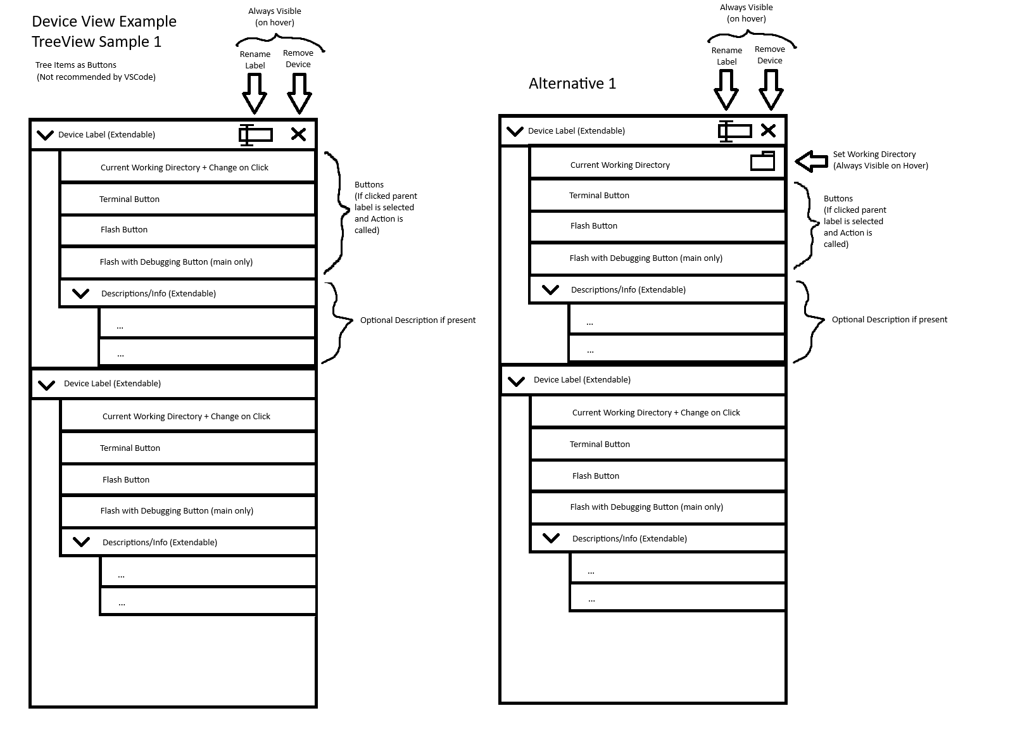

Slide 4
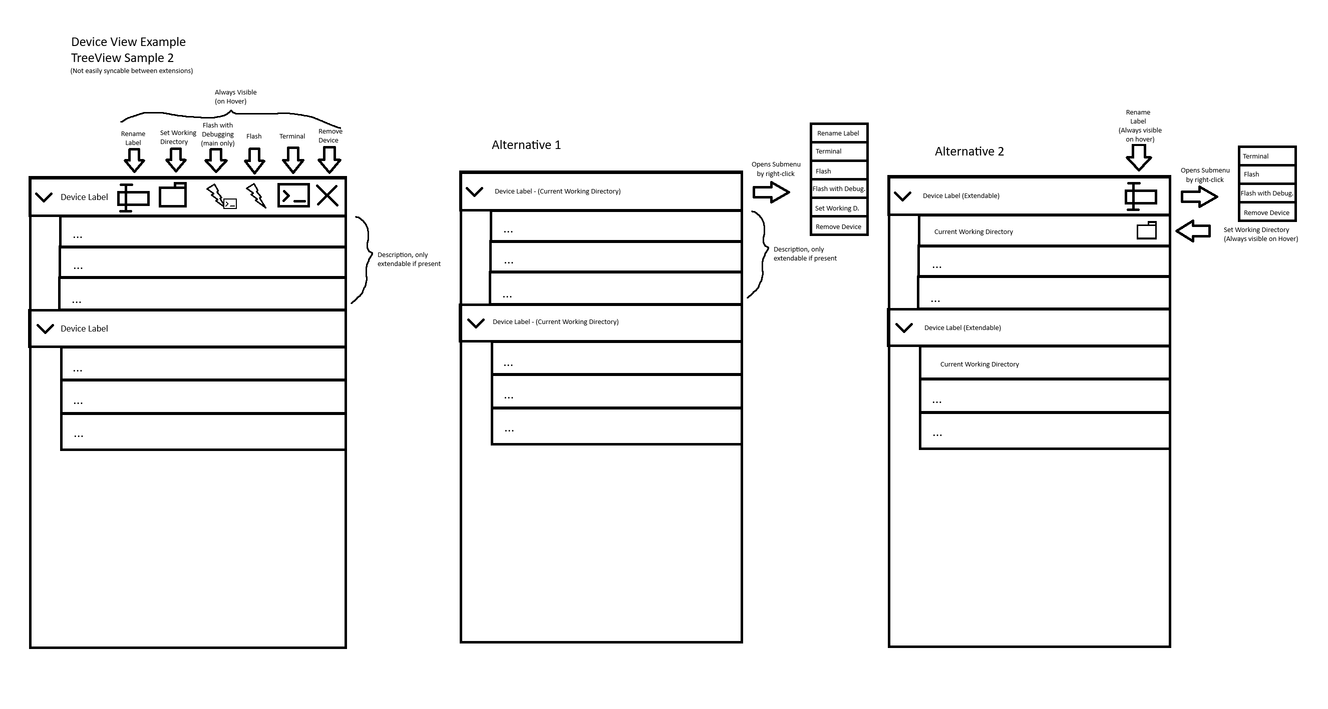

Slide 5
Shell Proxy / Wrapper

Slide 6
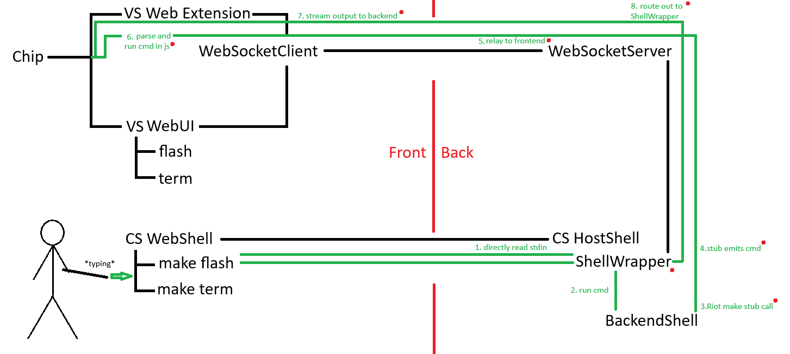

Slide 7
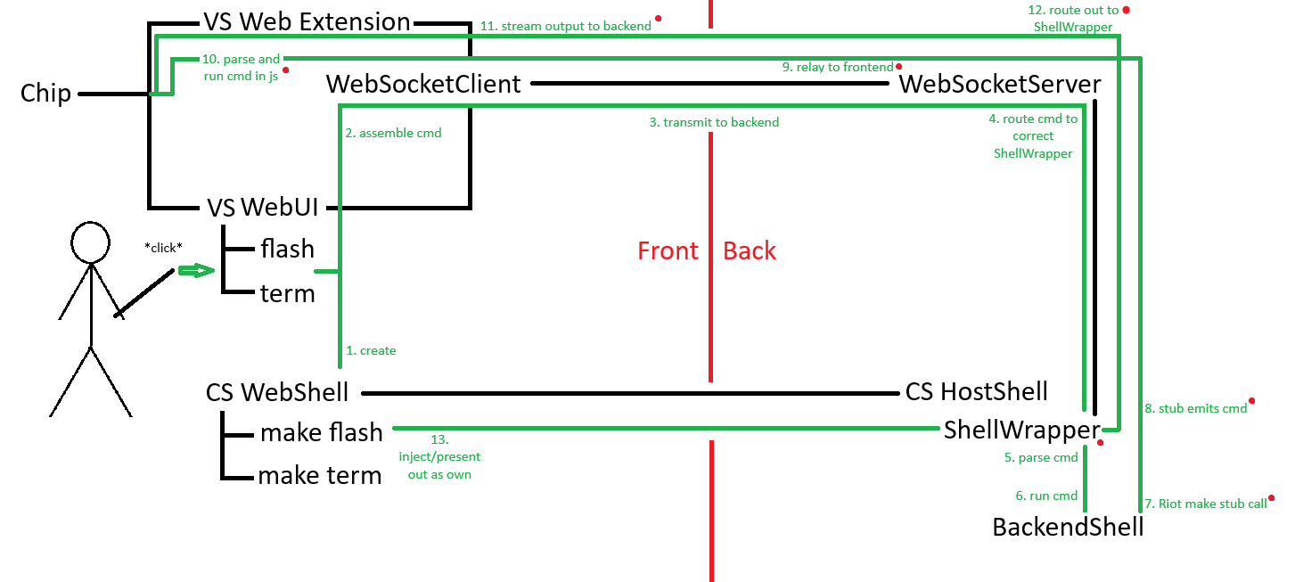

Slide 8
Issues / Features
ShellWrapper can be set as default -> SHELL=/path/to/wrapper
limit to one Shell Wrapper?
  pro: no IDs / routing
  cons: still has to manage one owned slot, time out, mutex,...
reuse existing ShellWrapper?
  by port / device
  by project
  always open new one

