Slide 1
Week 10
Mission Impossible: GHOST Protocol

Slide 2
Protocol

Slide 3
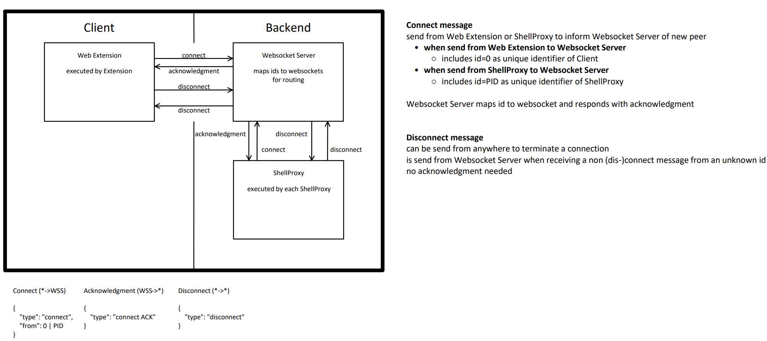
Connect & Disconnect

Slide 4
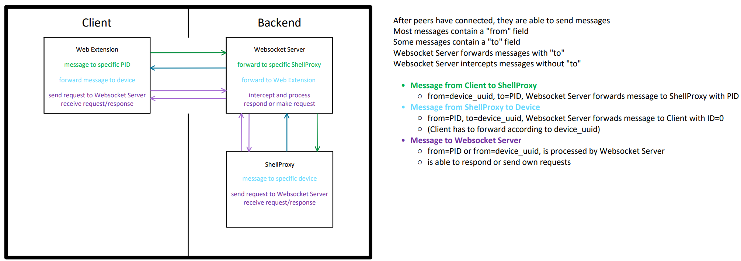
Websocket Server routing

Slide 5
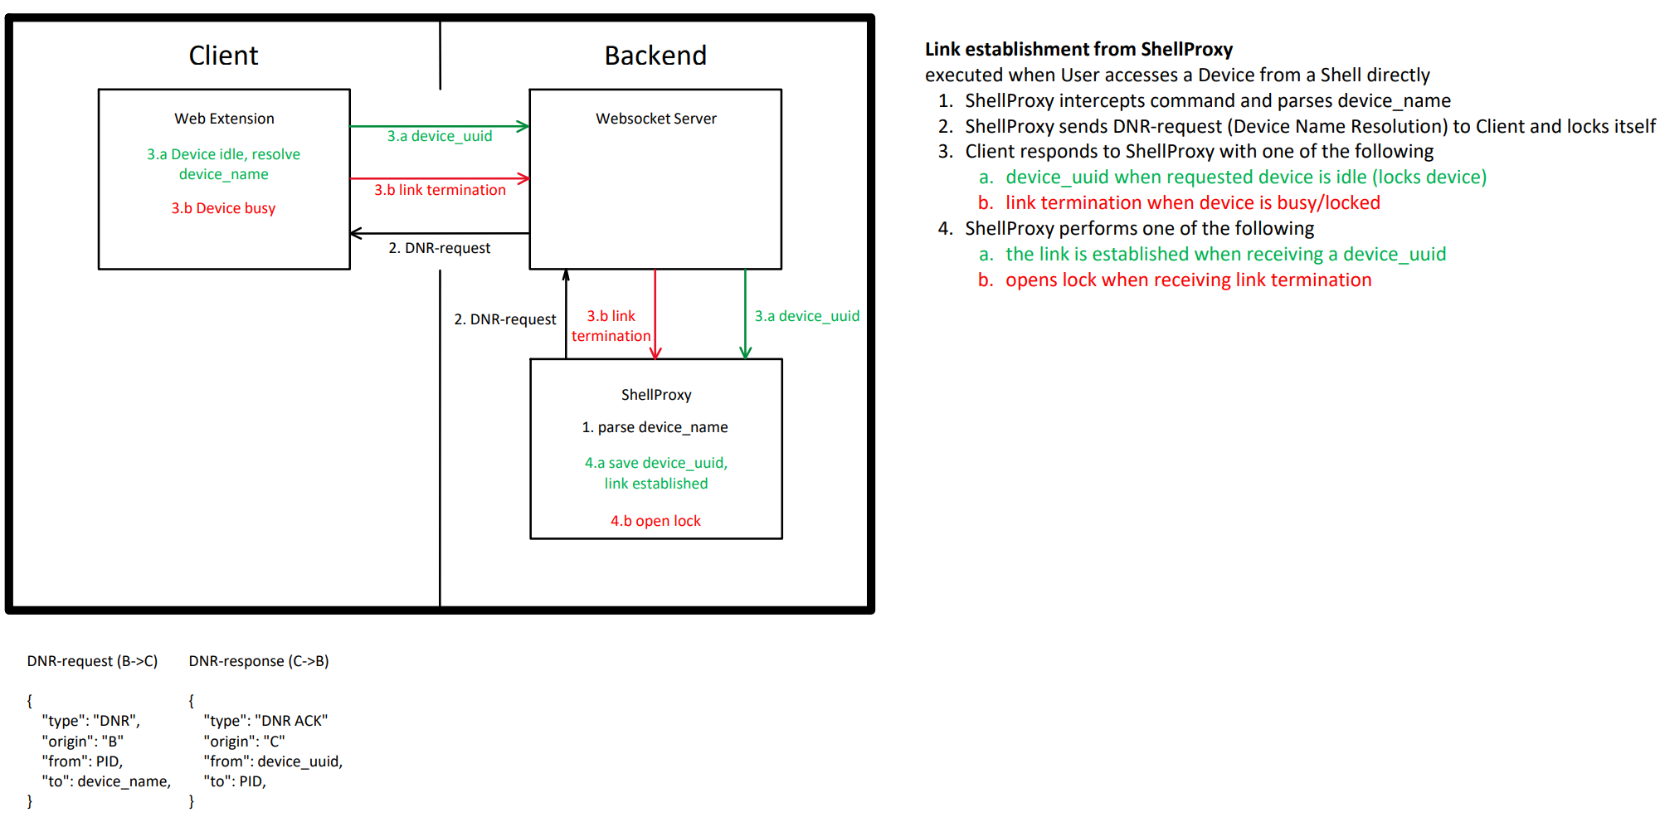
Link Establishment from ShellProxy

Slide 6
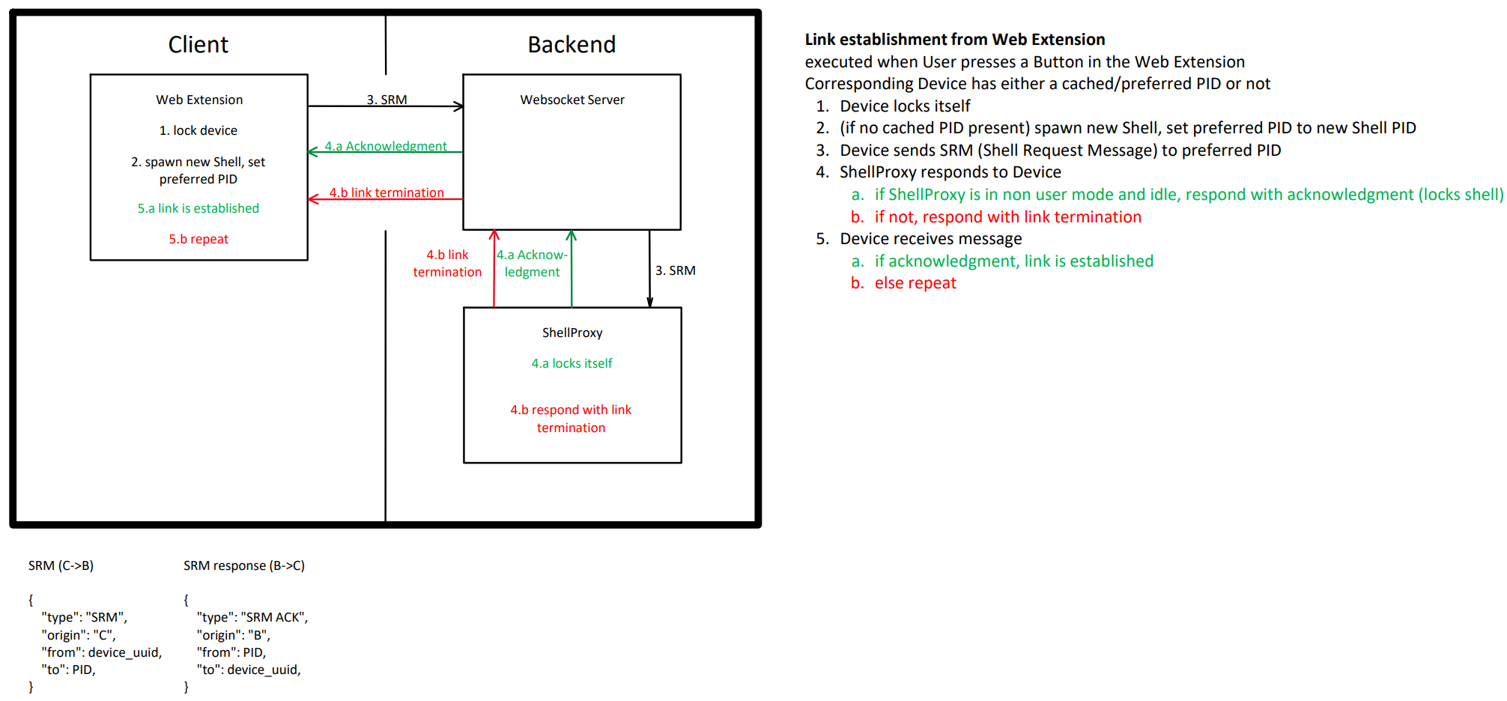
Link Establishment from Web Extension

Slide 7
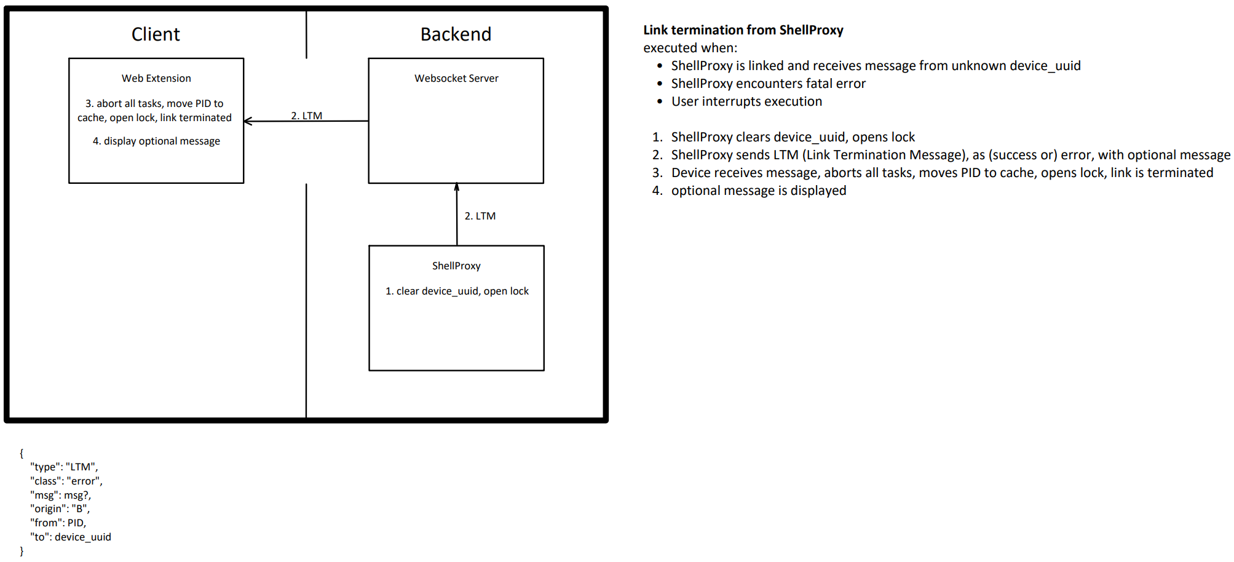
Link Termination from ShellProxy

Slide 8
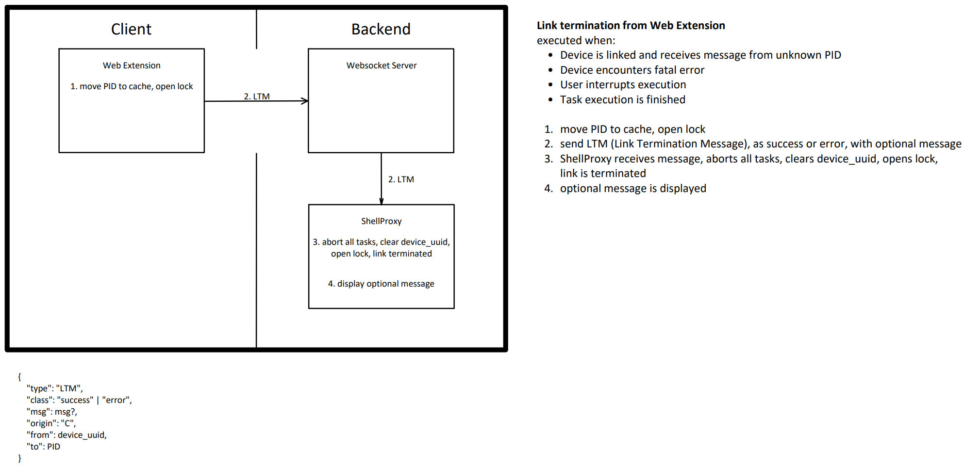
Link Termination from Web Extension

Slide 9
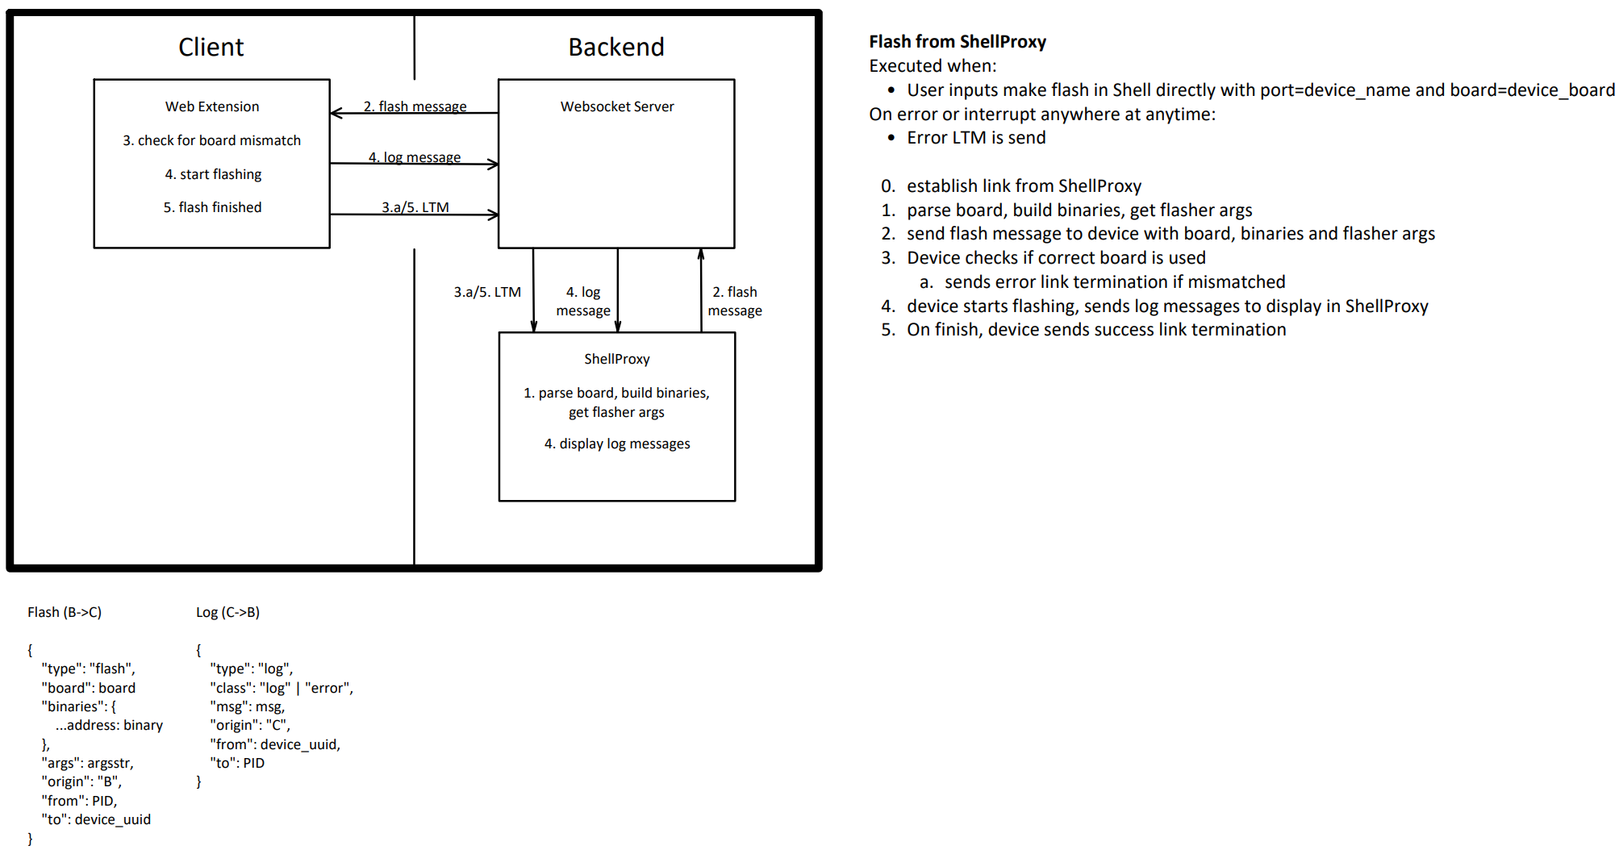
Flash from ShellProxy

Slide 10
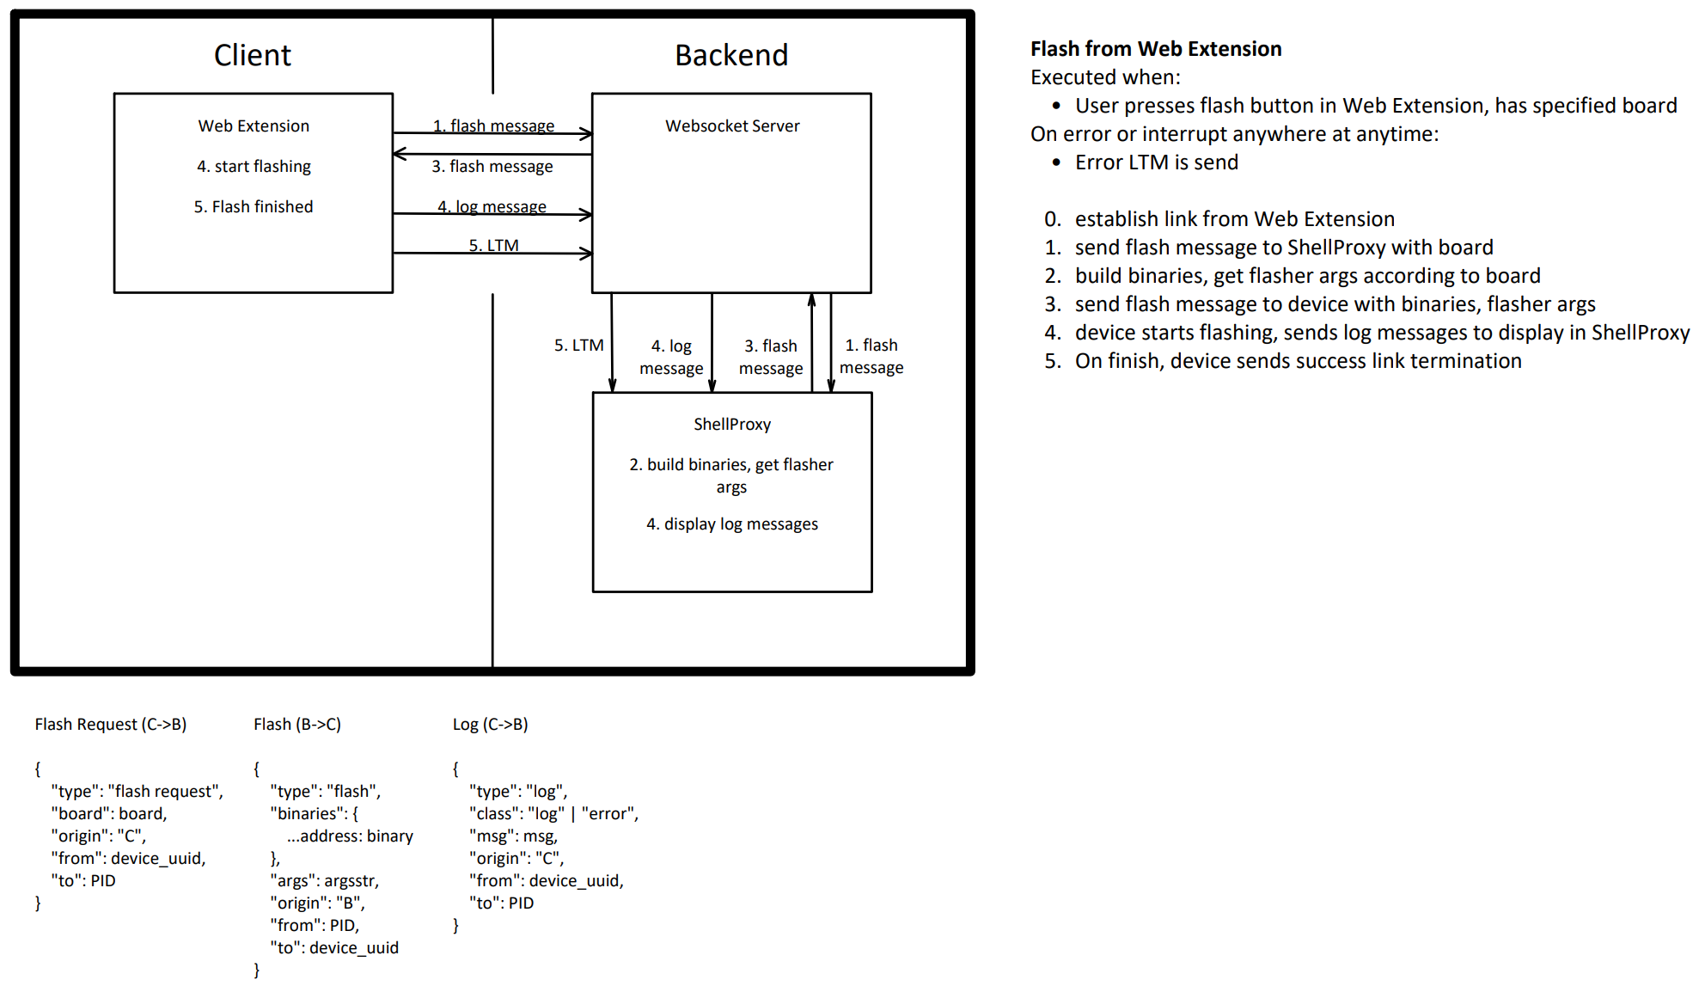
Flash from Web Extension

Slide 11
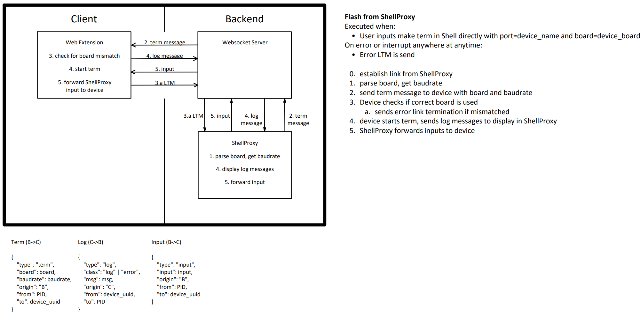
Term from ShellProxy

Slide 12
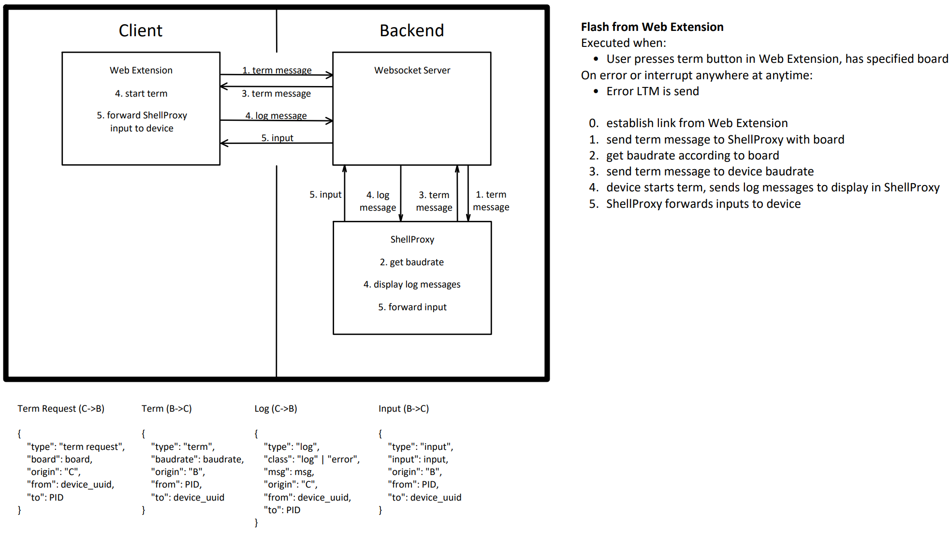
Term from Web Extension

Slide 13
WebSockets

Slide 14
Websocket
advantages:
most compatible across browsers
disadvantages:
no backpressure support (the ability to signal a high load to stall data transfer)

Slide 15
WebsocketStream
advantages:
supports backpressure (uses streams)
disadvantages:
slightly less compatible across browsers
not standard, only supported in one rendering engine (don’t ask, no clue)
requires stream support by server

Slide 16
WebTransport
advantages:
supports backpressure
supports transfer of multiple data types simultanously (different channels, one connection)
supports reliable and unreliable data transfer simultanously (different channels, one connection)
less resource intensive due to QUIC (compared to TCP)
more secruity capabilities
QUIC fixes Head-of-line Blocking (queue of packets is stalled by first packet, due to e.g. out of order delivery)
disadvantages:
least compatible across browsers (still more compatible than WebSerial and WebUSB)
requires either HTTP2 (fallback) or QUIC/HTTP3 Support (and possibly stream support) by server - more complex to use

Slide 17
Other Stuff

Slide 18
Frontend
Websocket Manager (handles connect / disconnect)
bidirectional message channel to
Device Manager (handles DNRs)
calls Device functions (dispatch messages)
Device answers on a shared channel to Device Manager
Device Manager could be merged Websocket Manager

Slide 19
Shell Proxy
started abstractions (maintainance)
completely broken now – yay
python prompt_toolkit
allows for bash input parsing
third party maintained (no effort for RIOT)
place between stdI/O and pty in the MainProcess

Slide 20
Shell Proxy Cases – worst to worse
make flash // caught, np
./flash_my_device.sh // parsable with ttp libs
#!bash: return make flash PORT=/null // special case
log = $(make flash PORT=smth)
make flash PORT=smth 1> log.txt 2> err.txt
./flash_my_dev.py
os.run("make flash") // invoke default shell -> Shell Proxy -> np
worst case: fork, invoke your own shell, pty, run (active jailbreak)

Slide 21
Adafruit Feather
notes on adafruit feather web flash:
different feathers use different chips (Esp32, Arm Cortex MX, nrfX)
our one uses nrf
it has a bootloader -> NativeUSB/WebUSB
dapjs (CMSIS-DAP locally) -> ToDo: look into that
WebUSB flasher tool for ARM based systems (NativeUSB)

Slide 22
TODO
rework protocol?
implement
creation, parsing, handling in ShellProxy
parsing + routing in WS relay
creation, parsing, handling in the Frontend
WebTransport
Feather: dapjs, further investigation

