Slide 1
Week 12
snakes make me crazy

Slide 2
Minor Protocol rework
Messages are lists now (fields by index + cbor friendly)
Address: [AddressType, int]
AddressType{Client, Device, Shell}
added project path to term and flash

Slide 3
Flasher research
DAP.js (ARM Cortex) => needs DAPLink on target device, based on CMSIS-DAP
RNode Flasher (NRF) => port of adafruit-nrfutil in javascript, there is another version directly from Nordic Semiconductor (but archived, possibly outdated)
J-Link WebUSB by Segger (NRF, ARM CORTEX, STM32, ESP) => has no official repo (only a template website), supported boards are a guess based on non WebUSB version
WebSerial ESPTool (ESP) => alternative to currently used esptool.js
Web STM Flasher (STM8 & STM32) => only tested on 3 boards
Arduino Web Uploader (AVR, ATMEGA) => explicitly for Arduino, maybe limited compatibility
Honorable Mention:
Meshtastic Flasher => not relevant for RIOT, but uses ESP, NRF, Pico UF2 flasher, has a Bluetooth port

Slide 4
Demo
hopefully

Slide 5
Hear me out
more work for me, yay

Slide 6
This is horrible
make flash // caught, np
./flash_my_device.sh // parsable with ttp libs
#!bash: return make flash PORT=/null // special case
log = $(make flash PORT=smth)
make flash PORT=smth 1> log.txt 2> err.txt
./flash_my_dev.py
os.run("make flash") // invoke default shell -> Shell Proxy -> np
worst case: fork, invoke your own shell, pty, run (active jailbreak)

Slide 7
ShellProxy + Stub
relay
keeps exactly one connection to the frontend
routes protocol messages between shell – device
connection stateful
rejects unknown with LTM
link unaware

Slide 8
ShellProxy + Stub
terminal
provides shell access to VSCode Extension
UI triggered make flash / term
unique shell identification
unified with regular user shell
Connect, ShellRequest

Slide 9
ShellProxy + Stub
stub
intercepts make flash / term calls
handles the flash / term:
constructs messages, provides make system info
displays device logs (flash / term)
takes input (term)

Slide 10
Stub – ShellProxy Communication
stub stdio
connected to ShellProxy through pty
regular IO → interactive shell experience
start / stop sequence (bytes) to mark communication
transmits final cbor binary to ShellProxy
ShellProxy hands it off to the Socket

Slide 11
TODO
Backend pty: Messaging
cleanup / move message logic to a separate stub
flash with binaries (Front / Back)
more flashers (feather: nrf)
docker setup (change base img + adjustments)

Slide 12
Protocol

Slide 13
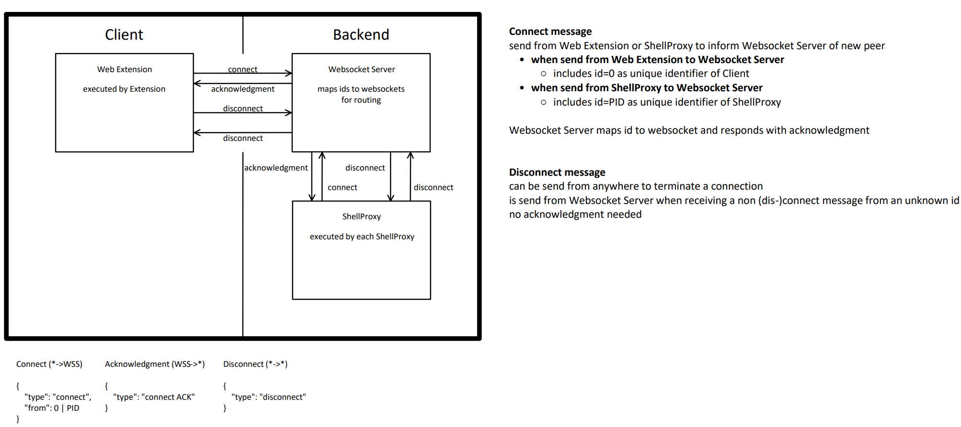
Connect & Disconnect

Slide 14
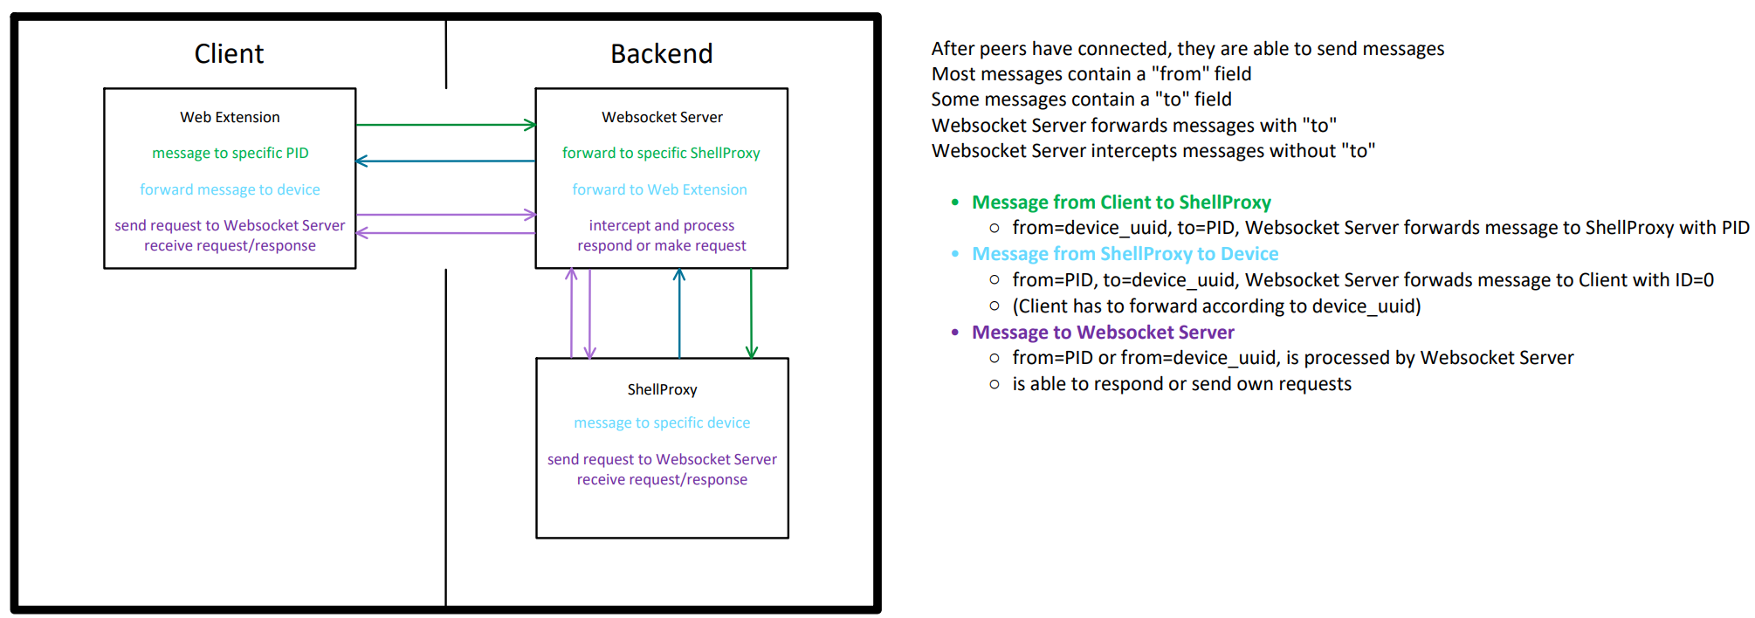
Websocket Server routing

Slide 15
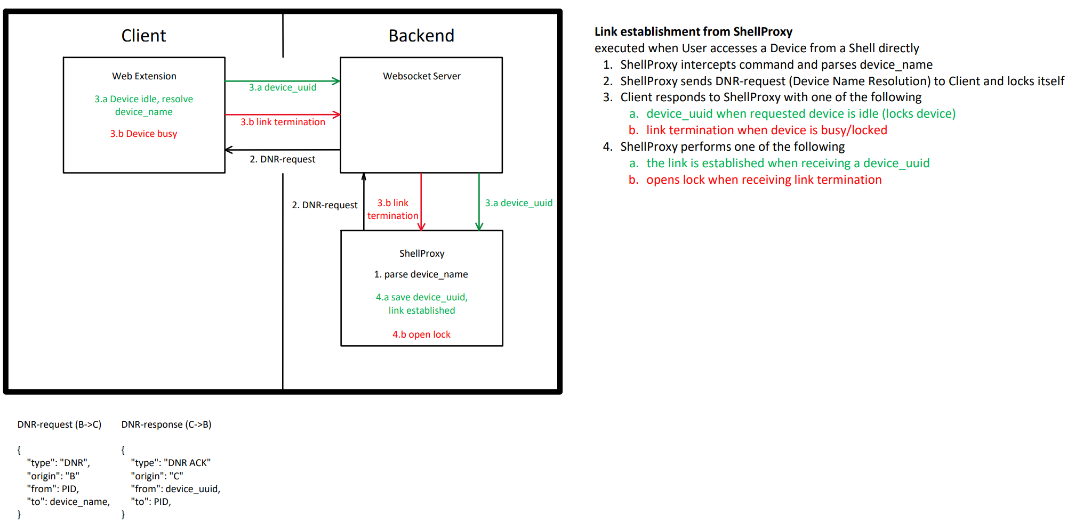
Link Establishment from ShellProxy

Slide 16
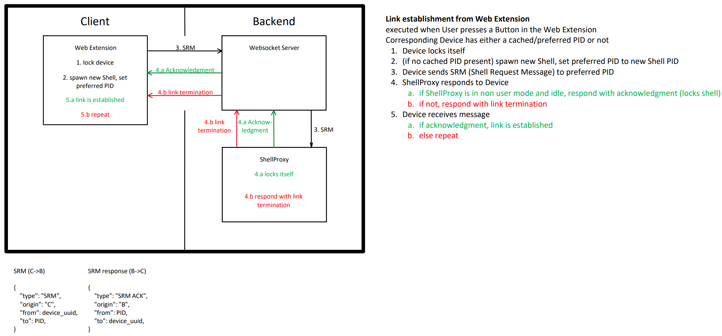
Link Establishment from Web Extension

Slide 17
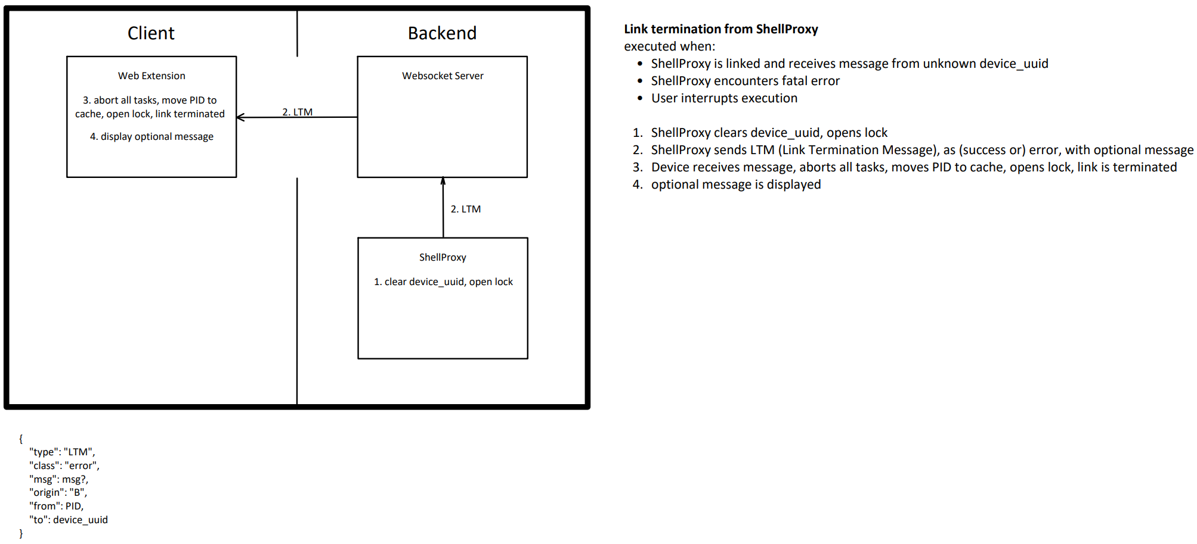
Link Termination from ShellProxy

Slide 18
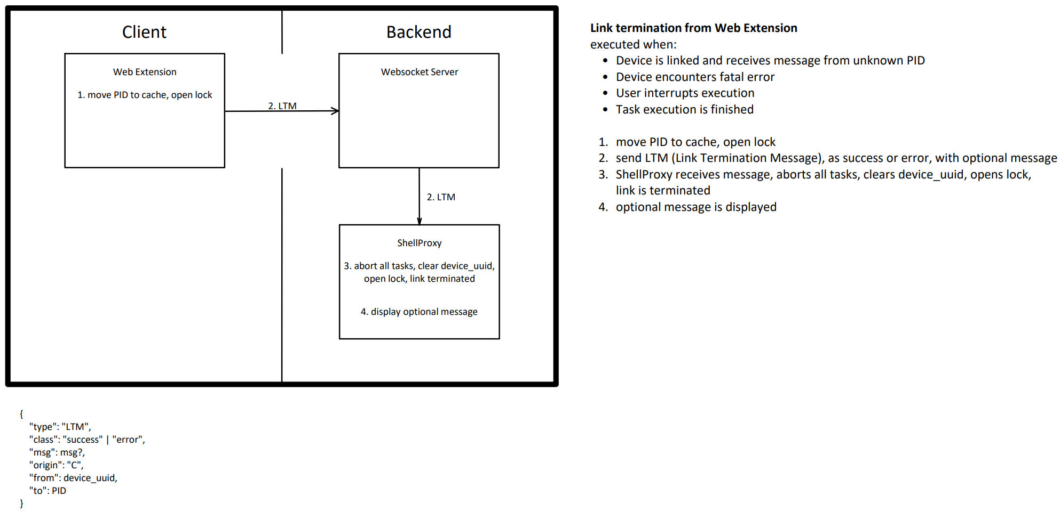
Link Termination from Web Extension

Slide 19
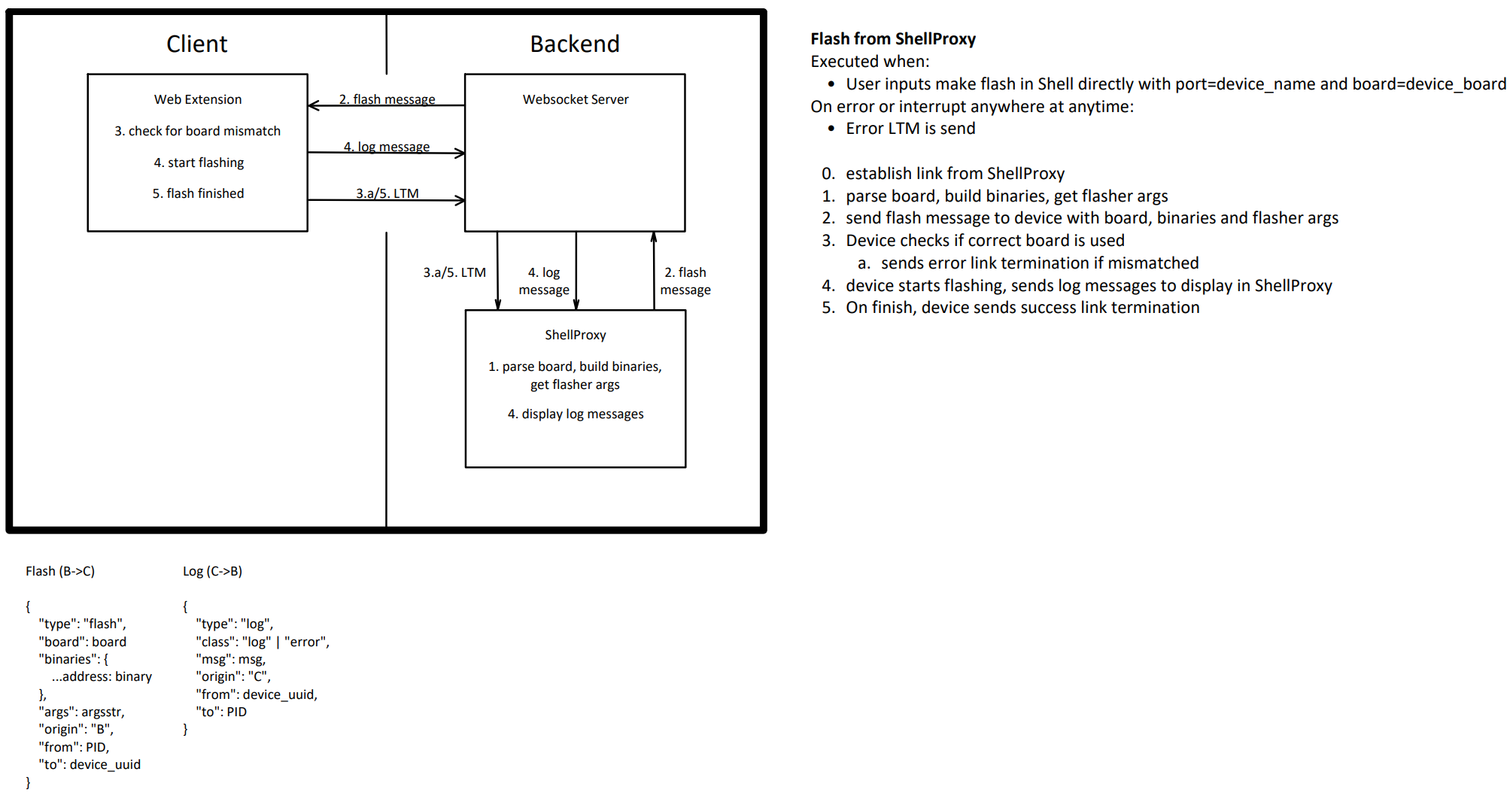
Flash from ShellProxy

Slide 20
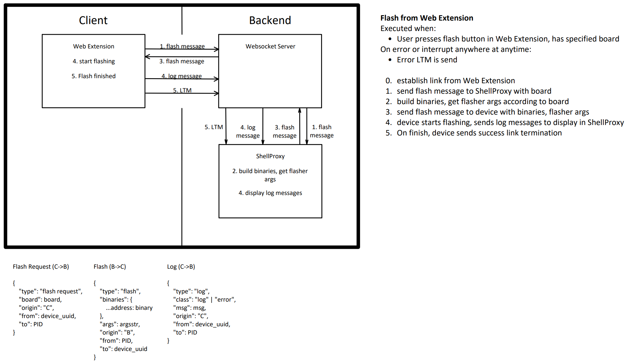
Flash from Web Extension

Slide 21
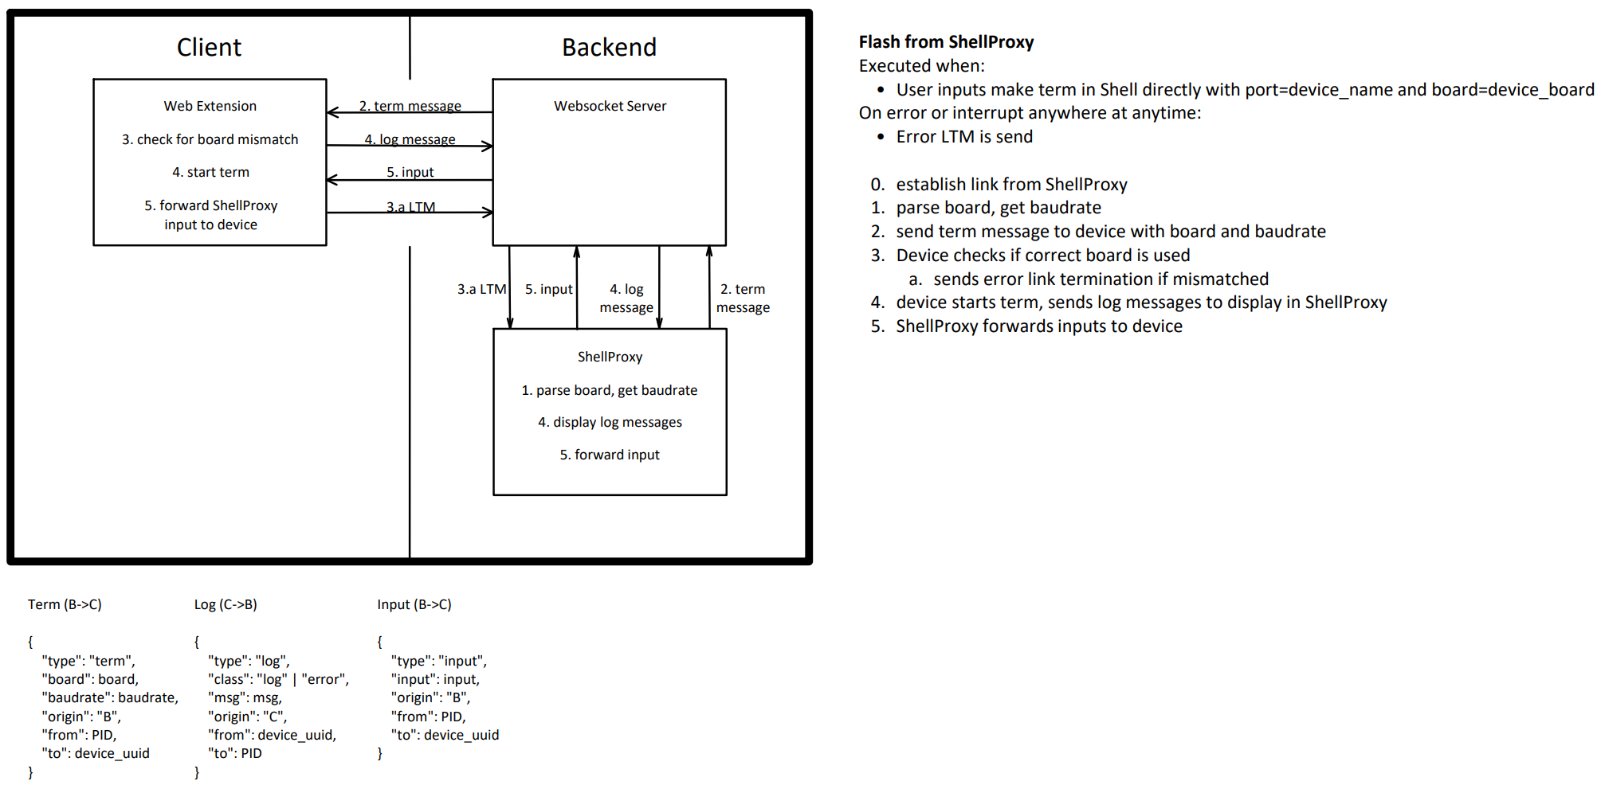
Term from ShellProxy

Slide 22
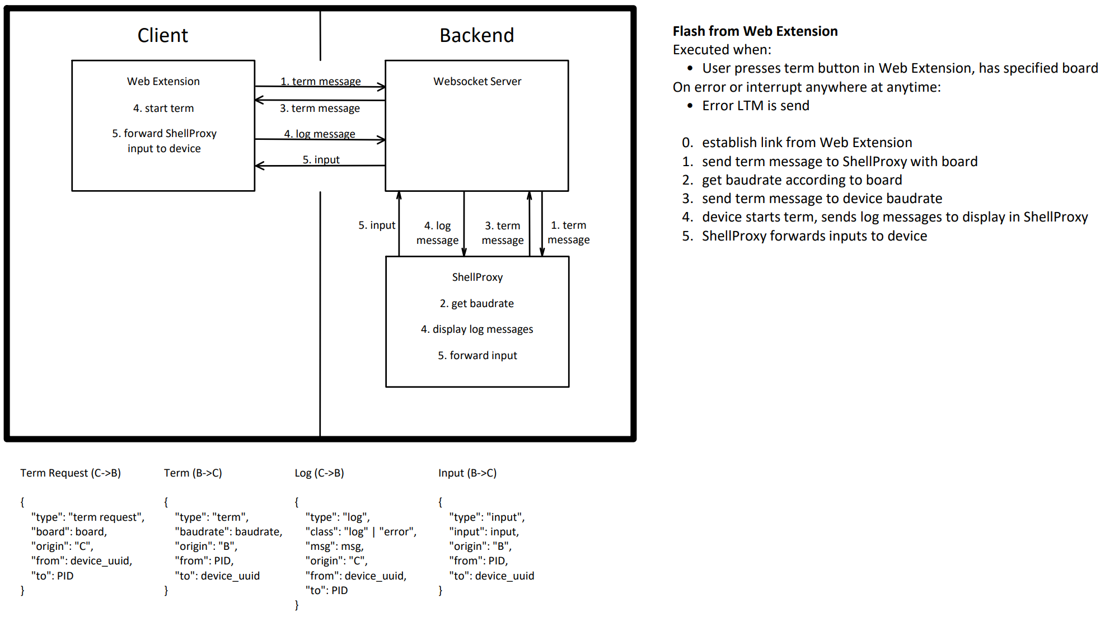
Term from Web Extension

