Slide 1
Week 09
RCE is back baby

Slide 2
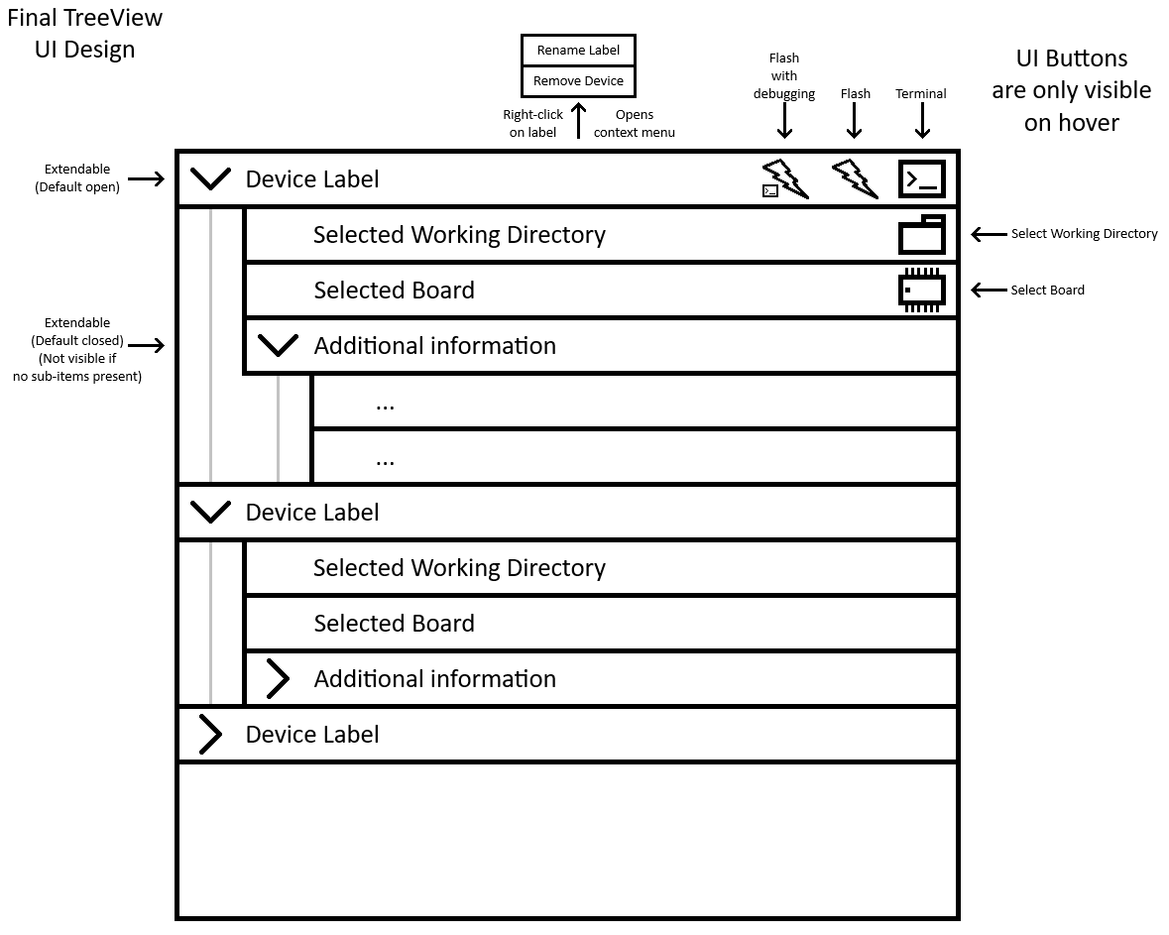
UI implentation
mokups were implemented into the frontend

Slide 3
Demo
maybe

Slide 4
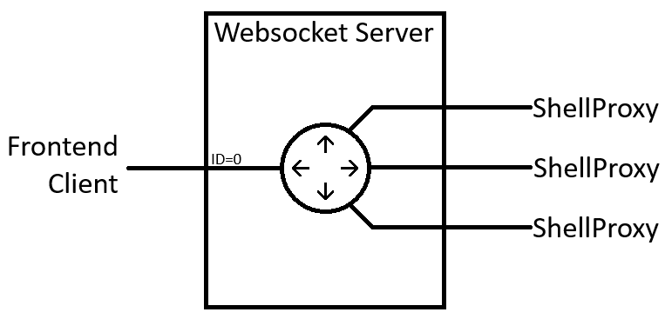
WebSocket relay
added primitive ID system
clients announce themself with their ID (just the first message)
forwarding all msg to ID=0

Slide 5
ShellProxy
shell(bash) in second thread
front shell connected via pty
added websocket
executes all messages from ws as cmds
fixed „exit“ and Ctrl-C to properly shutdown all components

Slide 6
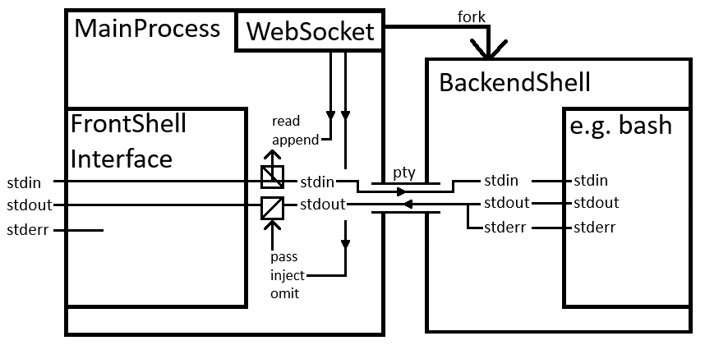
ShellProxy Architecture
stdin read – ws (trigger flash/term)
stdout omit (background tasks?)

Slide 7
Communication

Slide 8
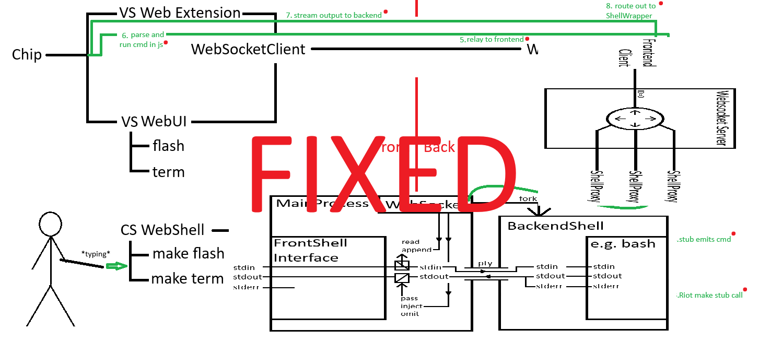
Fixed the Communication Diagram

Slide 9
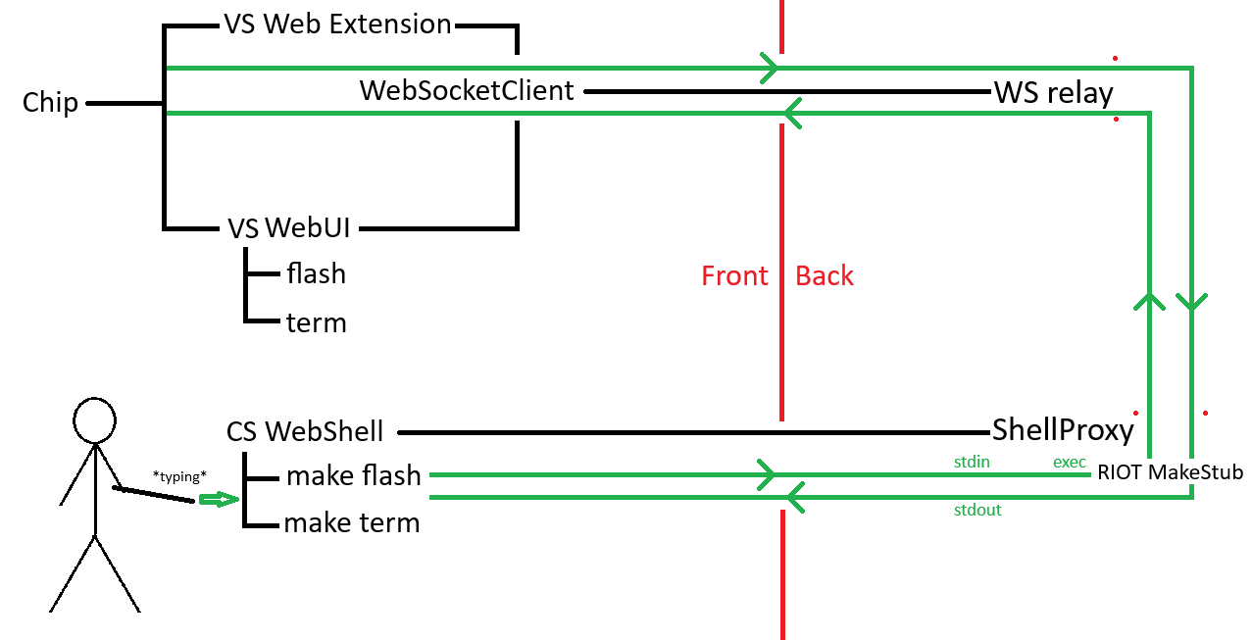
Communication Scheme

Slide 10
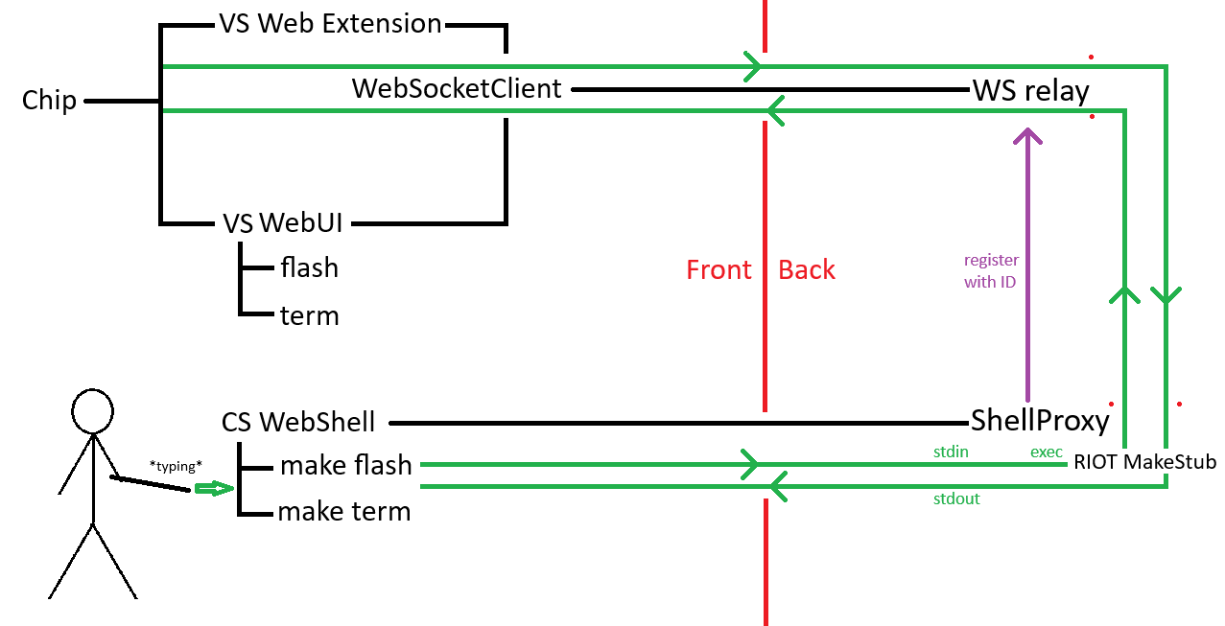
Communication Scheme

Slide 11
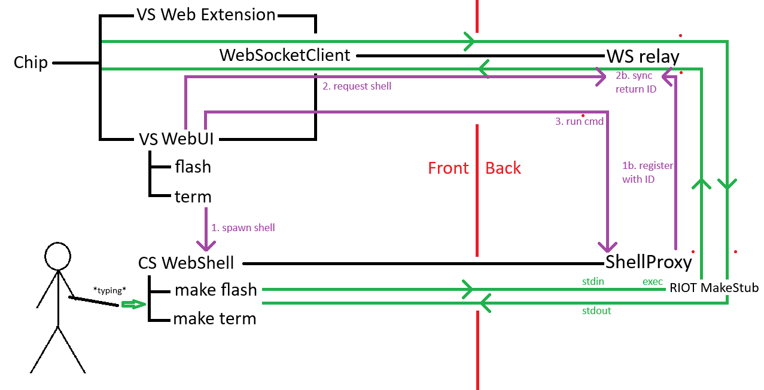
Communication Scheme

Slide 12
Future Considerations
RIOT Flash Stub?
command interception(hard, but clean)
stub – some additional connection (convoluted)
make target PORT=device_name
is that ok? – best idea so far
use instead of WebSocket -> incr. reliability?
WebSocketStream
WebTransport

Slide 13
TODO
create ws protocol
implement
creation, parsing, handling in ShellProxy
parsing + routing in WS relay
creation, parsing, handling in the Frontend
WebTransport?

