Slide 1
Week 06
every day is just a little worse

Slide 2
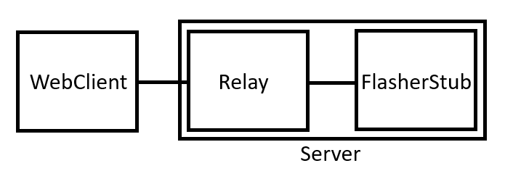
WebSockets are horrible
Client opens WebSocket at PageLoad
build+flash script calls are async – no permanent listener
  hybrid Extension? – no dual ExtensionHosts (not even code-server)
    btw horrible news – later more on that
  some other permanently running WebSocket Server needed
    acts as relay between flash call(script) and frontend WebSocket
    websocketd? – simple websocket deamon, converts everthing to stdin and stdout
How?

Slide 3
Horrible news
all vscode instances run only ONE ExtensionHost
„main“ always takes presidence over „browser“
  can‘t easily merge local and web VSCode Extensions
    yes it seemed to work originally – it doesn‘t
BUT not too bad – the Web version should never be published without the Docker Environment, as its directly dependend

Slide 4
RIOT-FLASH-EXTENSION news
Device Tree View
  enumerated devices
  info section as drop down
added Baudrate as configurable input
more UI prettyfication

Slide 5
USE_PROGRAMMER_WRAPPER_SCRIPT
useless – just directly calls the Flasher with args
  both provided in programmer.py <flasher> <args>
  yes, it also does it in a backround proc, which we dont need
RIOT_FLASH_WEB doesn‘t look so bad
  we have to put an entrypoint somewhere
  lets keep it where someone can actually find it
  fixed export call – now directly takes BOARD, PROGRAMMER, FFLAGS
    no redundant make calls

Slide 6
TODO
Whatever WebSocket solution we chose just now
Extension frontend systems

