Slide 1
A smart meter MCU emulation, introducing ACAE: An ARM cycle accounting emulator
Großer Beleg by Jakob Fregin, Chair of Privacy and Security, Dresden, 25.08.2026
Notes:
MCU emulation
for smart meters
called it ACAE

Slide 2
Motivation
Notes:
Why?

Slide 3
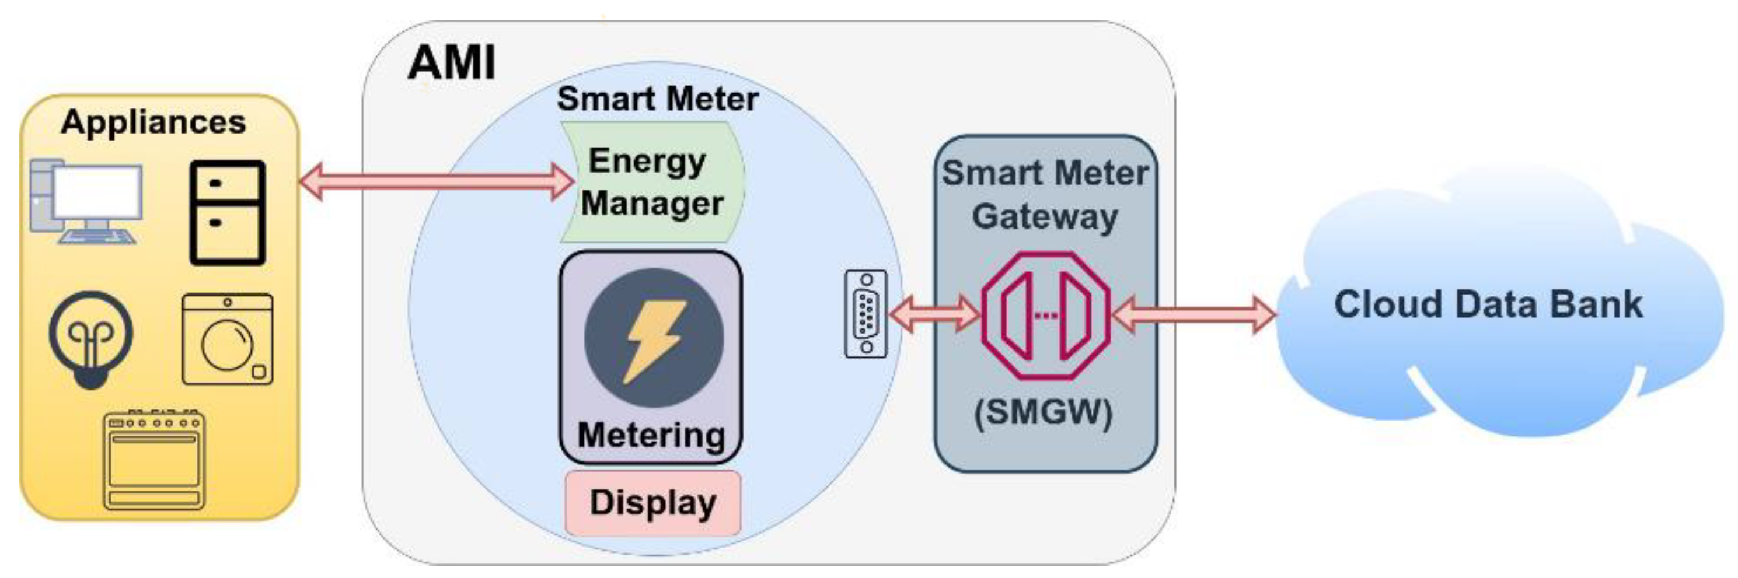
Motivation – SMs as edge-computing devices
currently smart meters (SMs) are measurement and reporting devices
SMs have their own Microcontroller (MCU)
could be used for:
  anomaly detection
  privacy-preserving processing
  local analytics
Figure 1. Advanced Metering Infrastructure
Source: Zakaret et al. [1]
Notes:
Currently measurement + reporting devices
limited resources but:
have MCU
sits right where the data is measured
so we want to know
what else could they do?
anomaly detection
privacy preserving preprocessing
local analytics
local aggregation
cryptography

Slide 4
Research question and contributions
How can we evaluate SM software before deployment on proprietary hardware?
representative SM MCU model
execution platform, that is
  reproducible
  hardware independent
  performance resolving
  → simulation

Slide 5
System Setup

Slide 6
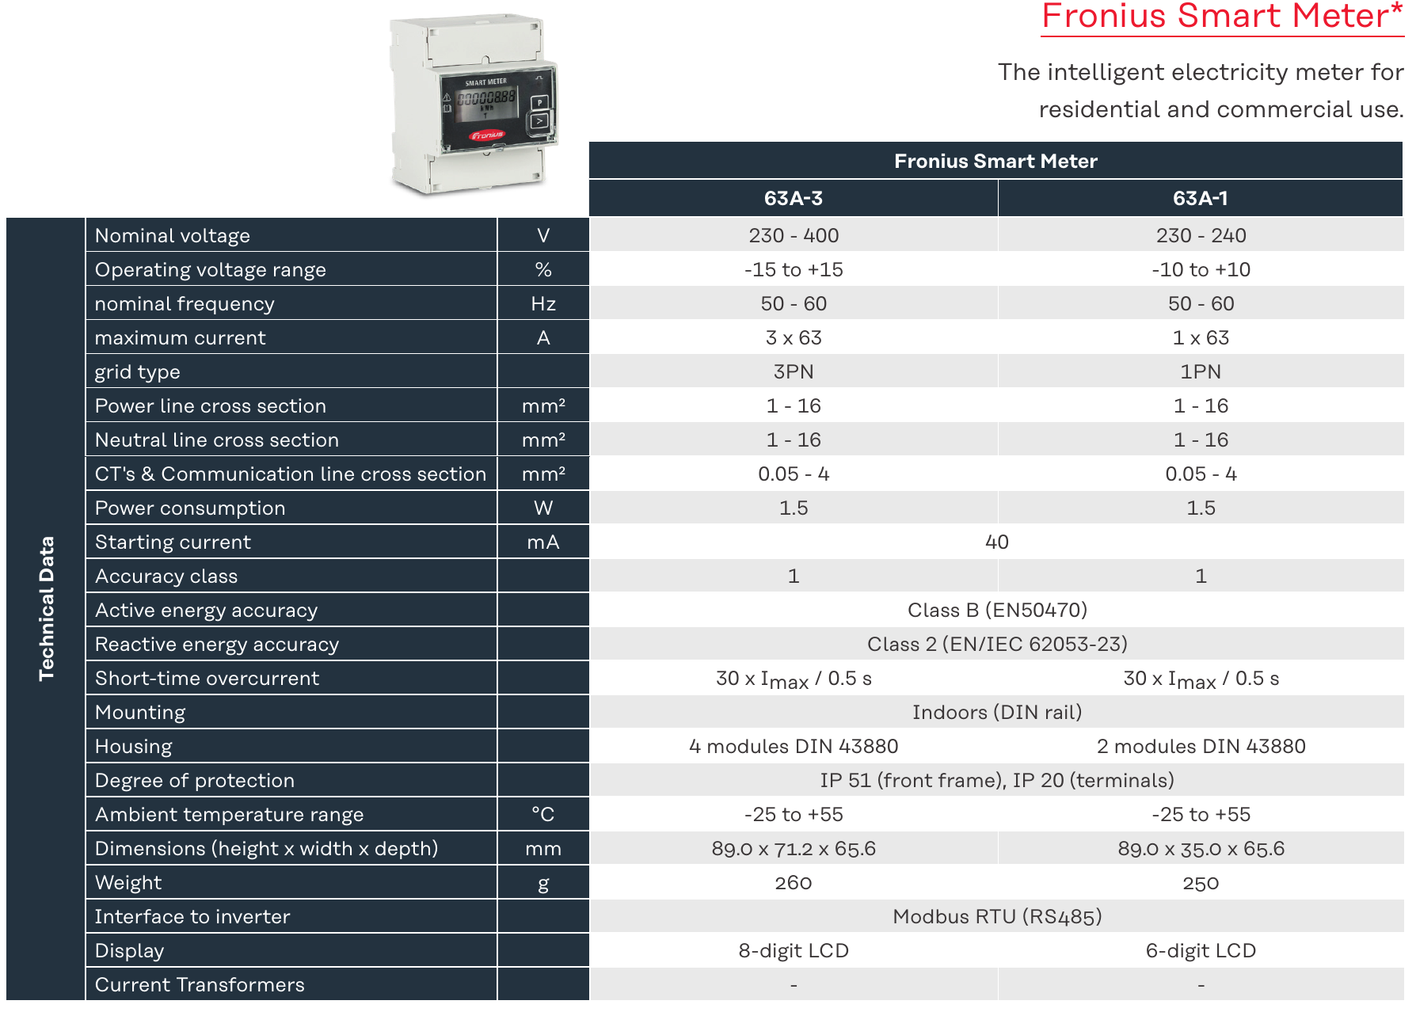
SM Hardware Internals
limited documentation
datasheets focus on external attributes
MCU datasheets intended for metering applications
MCU vendor reference designs
Figure 2. Smart Meter Datasheet
Source: Fronius International [2]

Slide 7
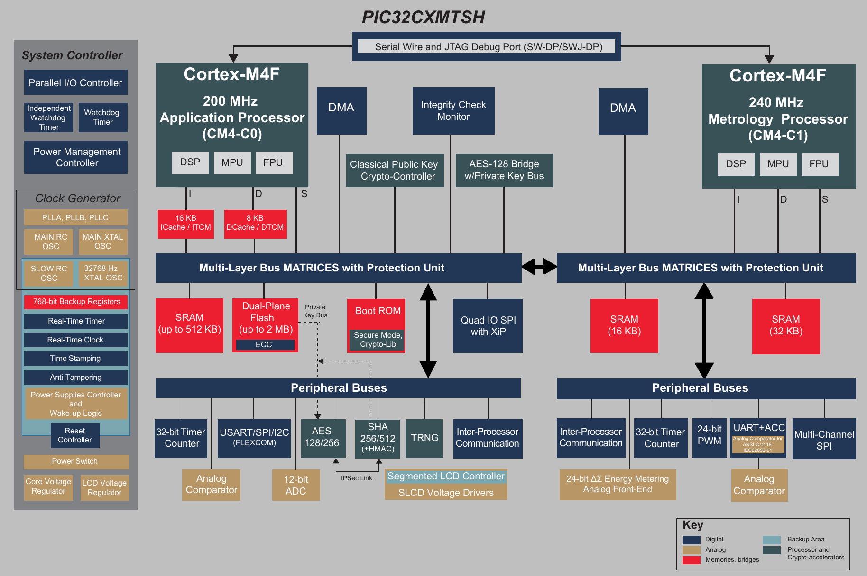
What does a smart meter MCU look like?
dual core processor
  metrology core
  compute / communication core
SRAM
flash
ADC
FPU
Figure 3. Microchip Datasheet
Source: Microchip Technology Inc. [3]

Slide 8
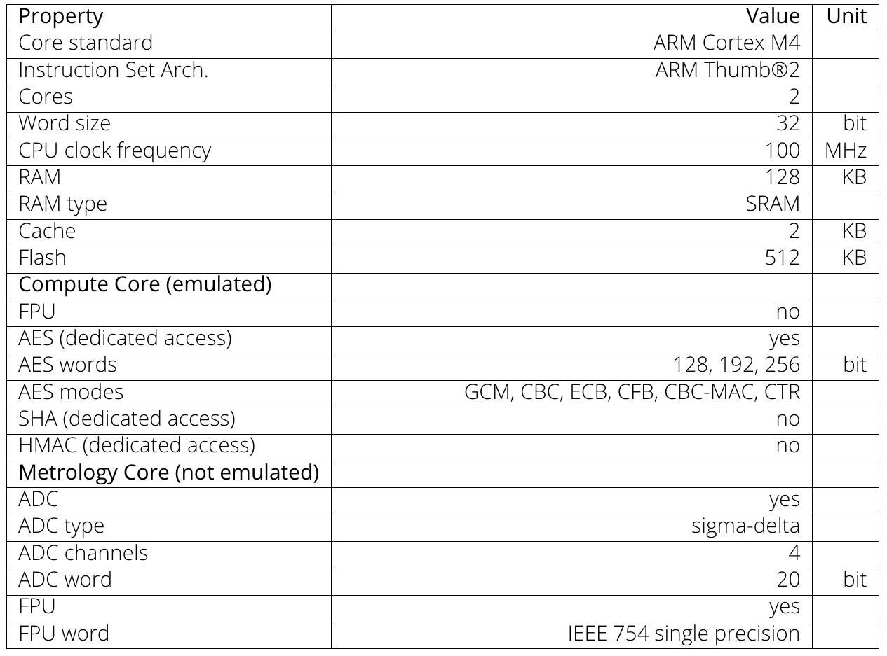
The representative SM MCU model
19 datasheets and 1 reference design
extracted common architectural characteristics
selected representative values
presented to a regulatory institute
it is not a statistically proven average
Table 1. Specifications of the representative SM MCU Model

Slide 9
Simulation of the model
cycle-accurate simulation
accurately resolves time
reproduces microarchitectural characteristics
longer host execution time
requires detailed microarchitectural models
→ ideal, but slow and unavailable
functional simulation
reproduces functional behavior
resolves instructions, not time
shorter host execution time
sufficiently specified by our model
→ feasible, but requires timing model

Slide 10
ACAE
the best of both worlds

Slide 11
ACAE – How it works
QEMU simulates a single modified ARM Cortex-M4 core
  functional simulation → emulation
  instrumentation interface
  added cycle count register
cycle-accounting model
  instrument instructions
  account clock cycles for executed instructions
  provide accumulated clock cycles in the register

Slide 12
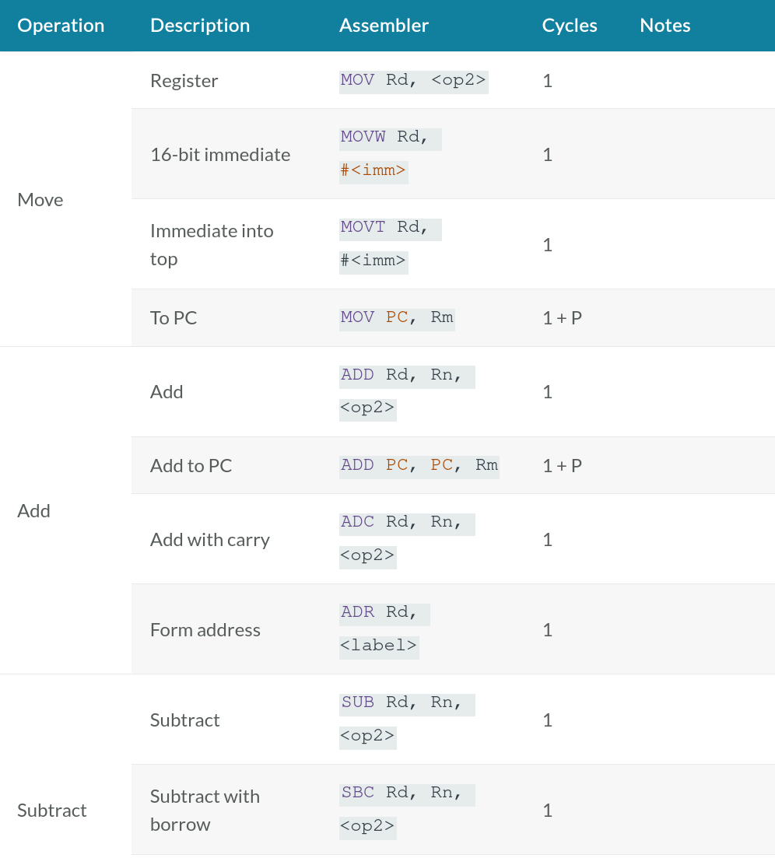
ACAE – The Cycle Model
based on the ARM Technical Reference Manual
simplified proof-of-concept model
estimated cycles:
  default instruction: 1 cycle
  load/store: 2 cycles
  flash memory access: +1 cycle
omitted: division, branches and pipeline effects
→ lower-bound cycle estimate
Table 2. Processor instruction cycles
Source: ARM Limited [4]

Slide 13
Validation

Slide 14
Validation Approach
compare performance of ACAE to physical hardware
benchmark using Dhrystone and CoreMark
baremetal → reproducibility, accuracy
identical source, compiler and configuration
measure performance (3 repetitions)
calculate relative performance deviation

Slide 15
Benchmarks
Dhrystone
integer workload
widely used on embedded systems
compiler sensitive
CoreMark
list, matrix, and string operations
designed for embedded systems
more modern

Slide 16
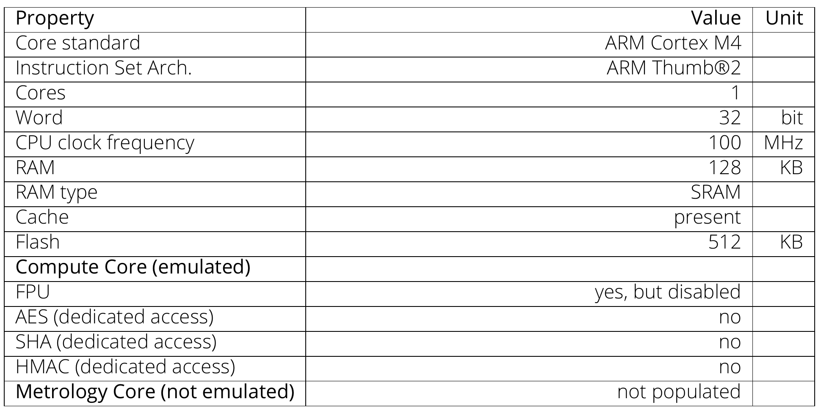
Native HW - The physical reference platform
ARM Cortex-M4 Blackpill board
  STM32F411x
matches compute-core characteristics of our model
Table 3. Specifications of the native HW

Slide 17
Results

Slide 18
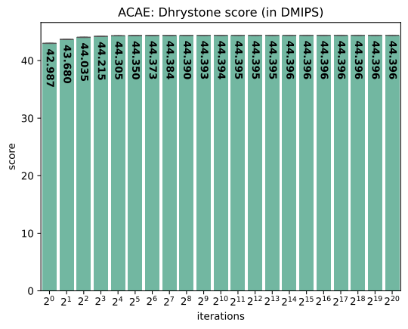
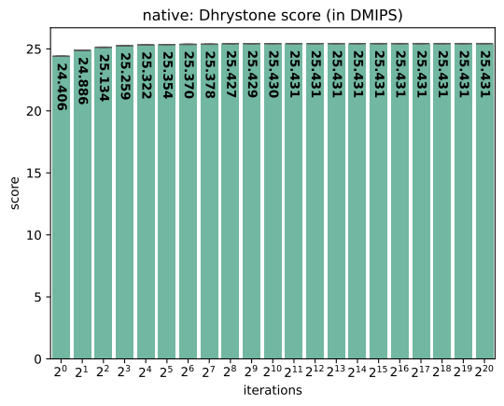
Results: Dhrystone

Slide 19
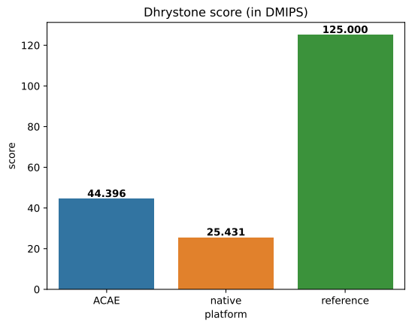
Results: Dhrystone
at highest iteration count
ACAE overestimates performance by 74.6%
vendor reference deviates drastically

Slide 20
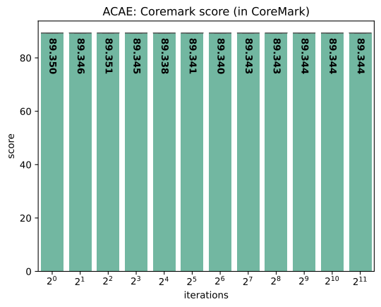
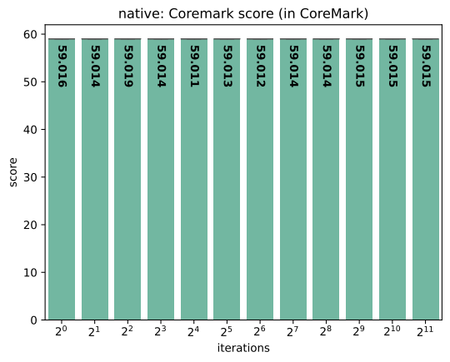
Results: CoreMark

Slide 21
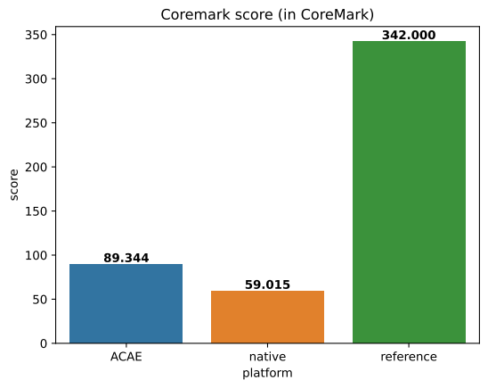
Results: CoreMark
at highest iteration count
ACAE overestimates performance by 51.4%
vendor reference deviates drastically

Slide 22
Assessment
Feasibility
Instrumentation
Reproducibility
Performance trends
Accuracy

Slide 23
Limitations
SM MCU model validity
timing accuracy
workload representation
reference hardware

Slide 24
Future work
expand validation methodology
refine cycle model
allow optimized binaries
extend emulation environment

Slide 25
Conclusion
ACAE is feasible
ACAE reproduces behavior, not yet absolute timing
The cycle model is the main refinement target

Slide 26
Sources
[1]: Zakaret, C., Peladarinos, N., Cheimaras, V., Tserepas, E., Papageorgas, P., Aillerie, M., Piromalis, D., & Agavanakis, K. (2022). Blockchain and Secure Element, a Hybrid Approach for Secure Energy Smart Meter Gateways. Sensors, 22(24), 9664. https://doi.org/10.3390/s22249664
[2]:https://www.fronius.com/en/~/downloads/Solar%20Energy/Datasheets/SE_DS_Fronius_SmartMeter_EN.pdf
[3]:https://ww1.microchip.com/downloads/en/DeviceDoc/PIC32CXMTSH-Data-Sheet-DS60001770A.pdf
[4]:https://support.arm.com/documentation/100166/0001/Programmers-Model/Instruction-set-summary/Table-of-processor-instructions

Slide 27
QnA

