Slide 1
Comparison of benchmarks on a smart meter prototype
Analyse eines Forschungsthemas by Jakob Fregin,
Chair of Privacy and Security, Dresden, 01.09.2026
Notes:
MCU emulation
for smart meters
called it ACAE

Slide 2
Background / Recap
Notes:
Why?

Slide 3
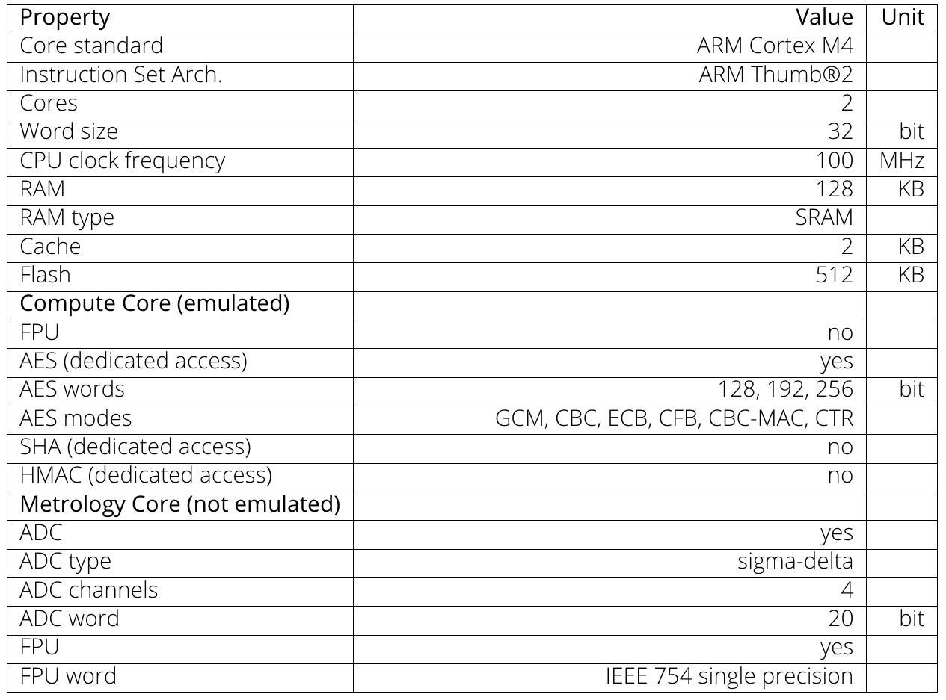
The representative SM MCU model
19 datasheets and 1 reference design
extracted common architectural characteristics
selected representative values
presented to a regulatory institute
it is not a statistically proven average
Table 1. Specifications of the representative SM MCU Model

Slide 4
ACAE – an ARM Cycle Accounting Emulator
QEMU simulates a single modified ARM Cortex-M4 core
  functional simulation → emulation
  instrumentation interface
  added cycle count register
cycle-accounting model
  instrument instructions
  account clock cycles for executed instructions
  provide accumulated clock cycles in the register

Slide 5
Status quo
Representative smart-meter MCU model
QEMU-based functional emulation
Instruction-level cycle accounting
Validation with Dhrystone and CoreMark
Relative performance behavior reproduced
Absolute timing systematically inaccurate

Slide 6
Status quo
Representative smart-meter MCU model
QEMU-based functional emulation
Instruction-level cycle accounting
Validation with Dhrystone and CoreMark
Relative performance behavior reproduced
Absolute timing systematically inaccurate

Slide 7
Extending ACAE’s Validation Methodology

Slide 8
Validation Approach (adjusted)
compare performance of ACAE to physical hardware
benchmark using Dhrystone, CoreMark, and the Embench suite
baremetal → reproducibility, accuracy
identical source, compiler and configuration
measure performance (3 repetitions)
calculate relative performance deviation

Slide 9
Embench™ 1.0
open source benchmark suite
19 Benchmarks
built for embedded systems
aggregates realistic embedded workloads from previous works
Source: Embench-iot [1]

Slide 10
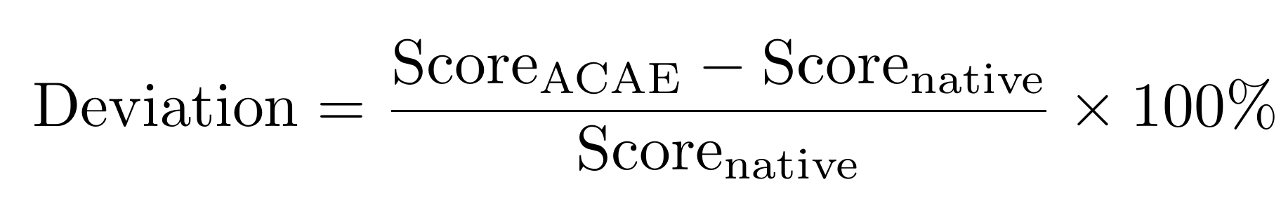
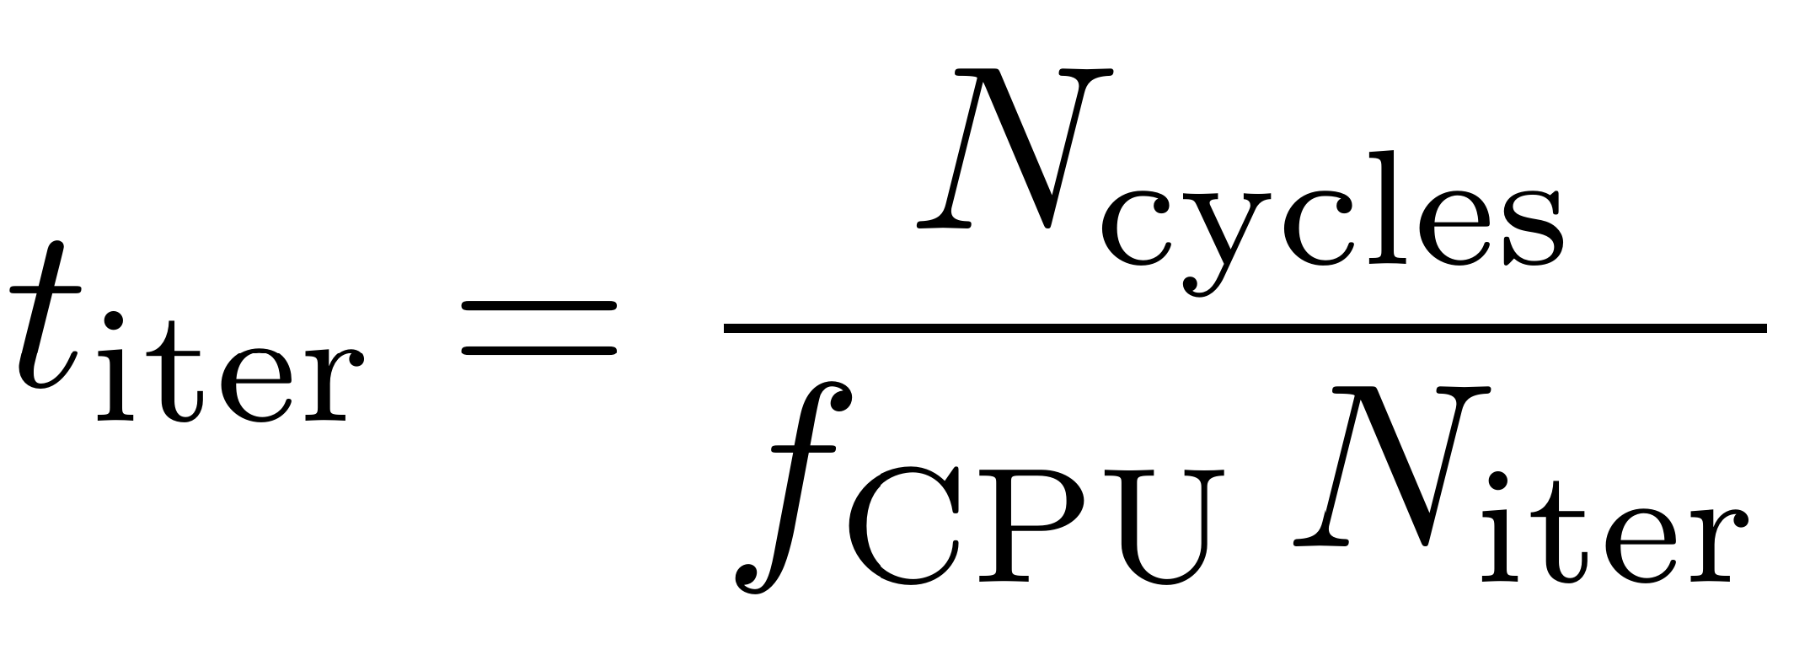
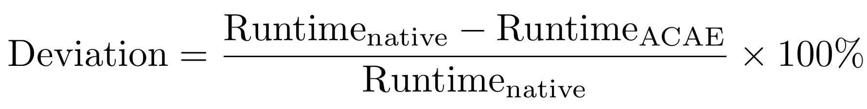
Measurement Methodology
integrated timing and reporting into Embench
2 cache-warm-up iterations
2⁰ to 2¹² iterations

Slide 11
Results

Slide 12
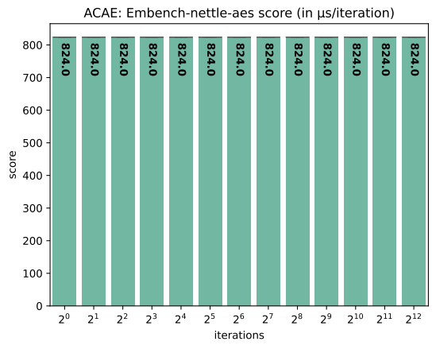
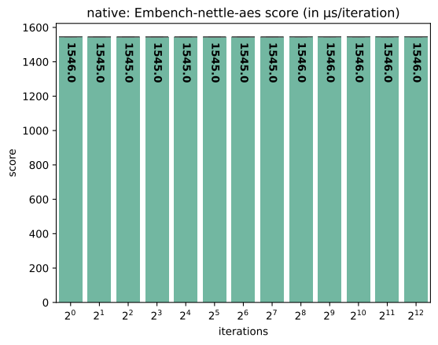
Embench: nettle-aes

Slide 13
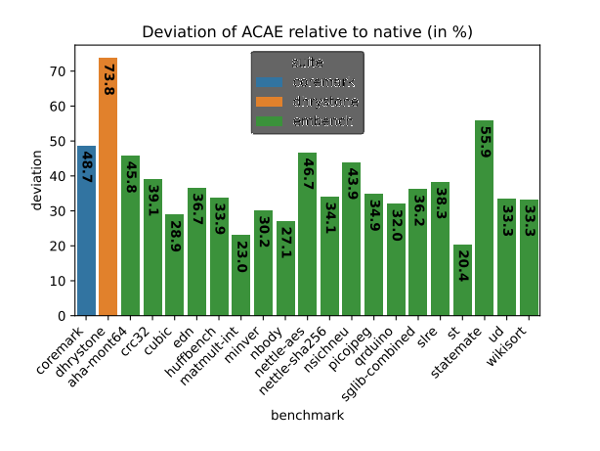
Overall Benchmark Results
Dhrystone: 73.8%
CoreMark: 48.7%
Embench:
  Minimum: 20.4% by st
  Maximum: 55.9% by statemate
  Mean: 35.5%
  Standard deviation: 8.5%

Slide 14
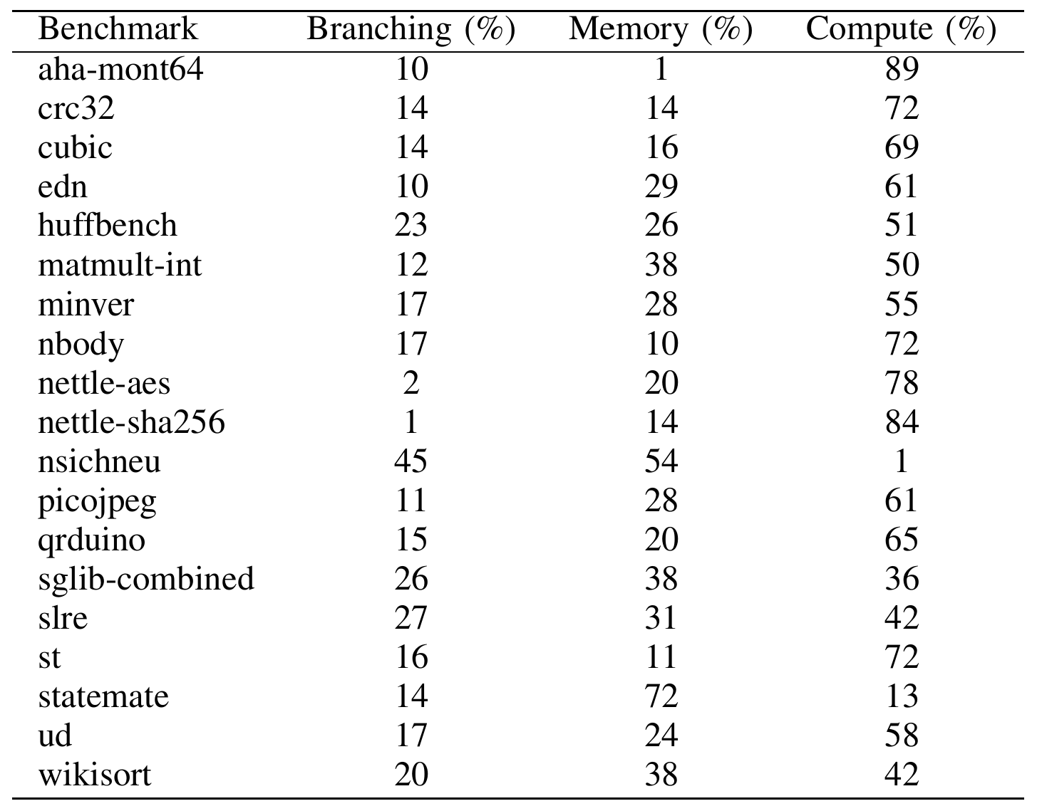
Workload Characterization
Embench’s workload distribution from a published dynamic instruction analysis
on a RISC-V architecture
different workload compositions
Table 2. Workload distribution of Embench benchmarks on RISC-V
Source: Adapted from David Patterson et al. [1]

Slide 15
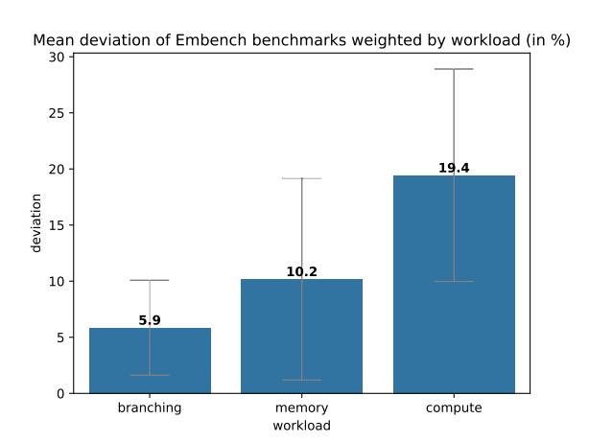
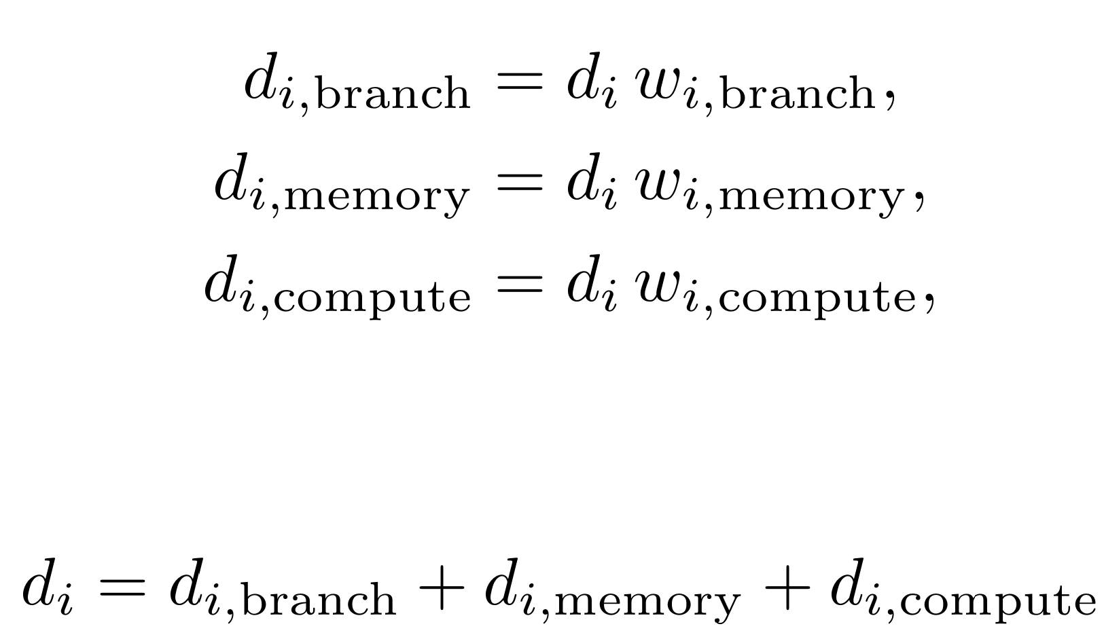
Workload-Weighted Analysis
total mean deviation: 35.5%
mean deviation, sd by workload:
  branching: 5.9%, 4.2%
  memory: 10.2%, 9.0%
  compute: 19.4%, 9.5%

Slide 16
Assessment
established:
timing deviation varies across workloads
all evaluated workloads show systematic performance overestimation
compute shows the largest weighted contribution
not established:
a specific instruction class or microarchitectural mechanism is responsible
the RISC-V workload distribution exactly matches ARM execution

Slide 17
Limitations
workload representation
reference hardware
timing accuracy
workload characterization data

Slide 18
Future work
Instruction tracing
Processor-level measurements
Cycle-model refinement
Revalidation

Slide 19
Conclusion
ACAE shows systematic performance overestimation
The magnitude is workload-dependent
The cycle model is the main refinement target

Slide 20
Sources
[1]: https://github.com/embench/embench-iot
[2]: David Patterson et al. “Embench IOT 2.0 and DSP 1.0: Modern Embedded Computing Benchmarks”. In: Computer 58.5 (2025), pp. 37–47. DOI : 10.1109/MC. 2024.3511352.

Slide 21
QnA

Slide 22
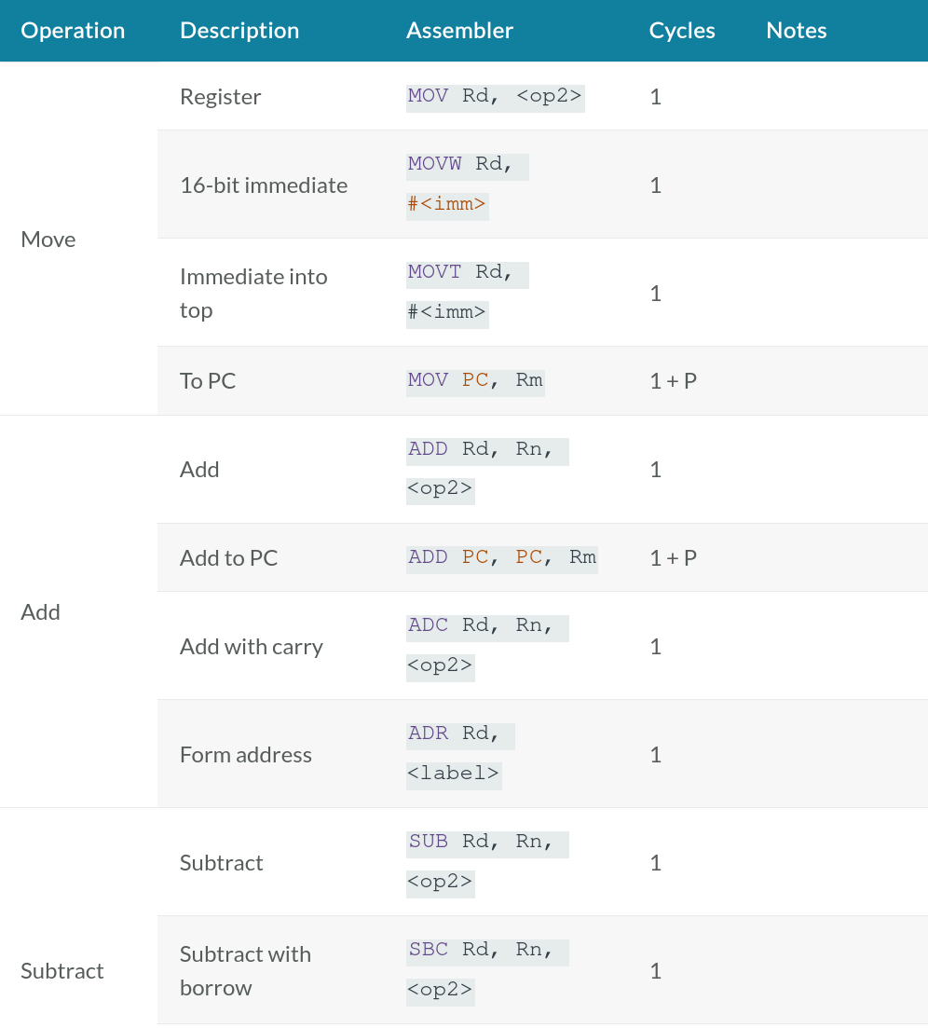
ACAE – The Cycle Model
based on the ARM Technical Reference Manual
simplified proof-of-concept model
estimated cycles:
  default instruction: 1 cycle
  load/store: 2 cycles
  flash memory access: +1 cycle
omitted: division, branches and pipeline effects
→ lower-bound cycle estimate
Table 2. Processor instruction cycles
Source: ARM Limited [4]

Slide 23
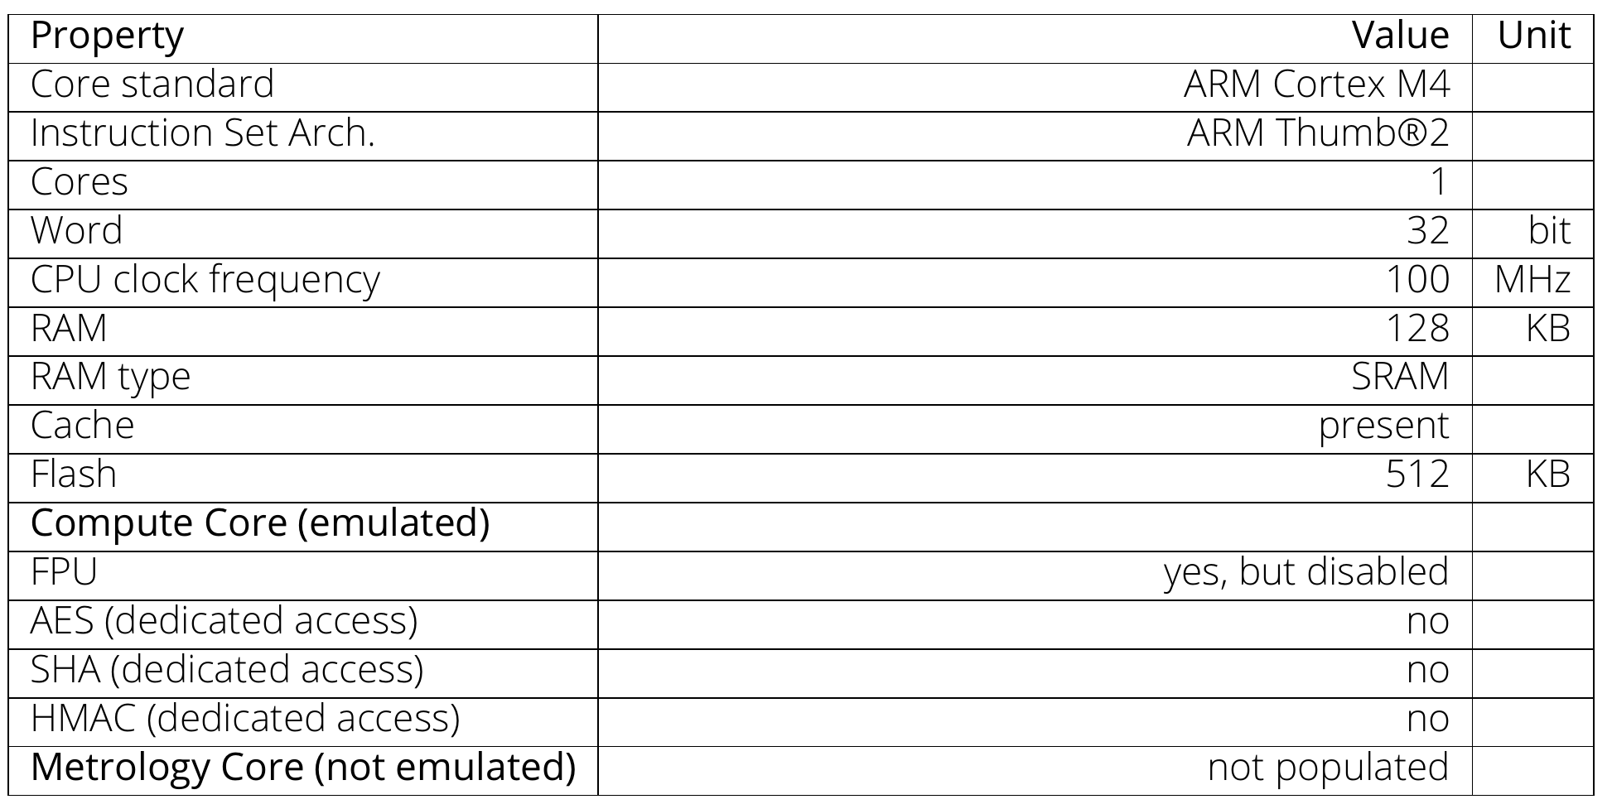
Native HW - The physical reference platform
ARM Cortex-M4 Blackpill board
  STM32F411x
matches compute-core characteristics of our model
Table 3. Specifications of the native HW

Slide 24
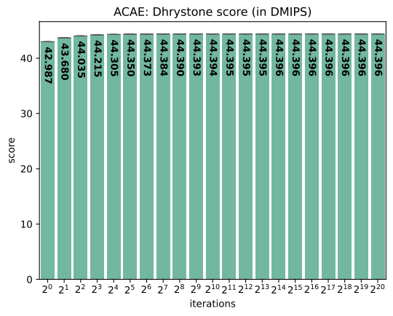
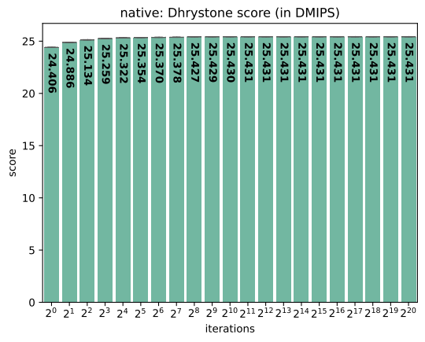
Results: Dhrystone

Slide 25
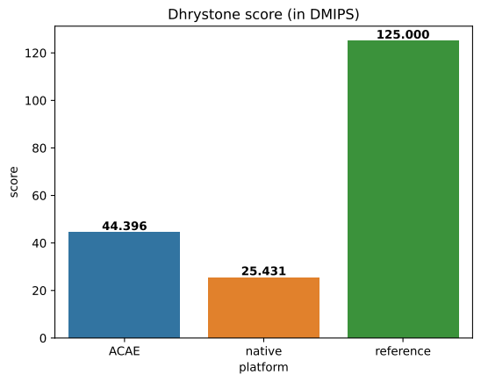
Results: Dhrystone
at highest iteration count
ACAE overestimates performance by 74.6%
vendor reference deviates drastically

Slide 26
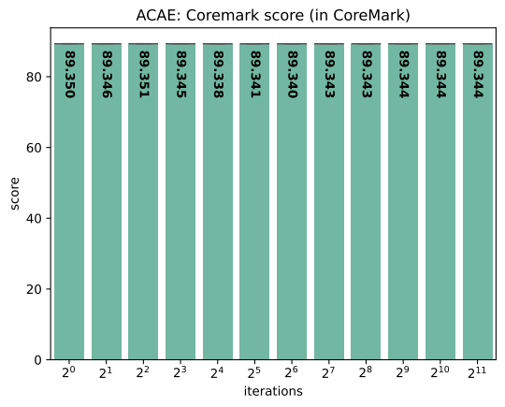
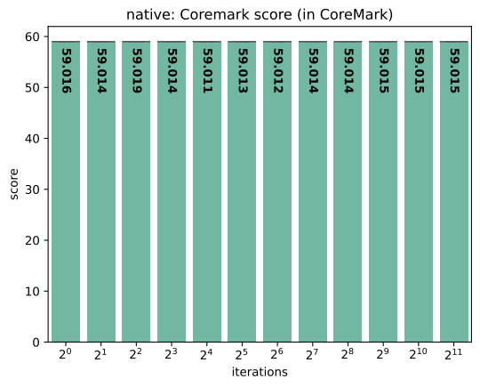
Results: CoreMark

Slide 27
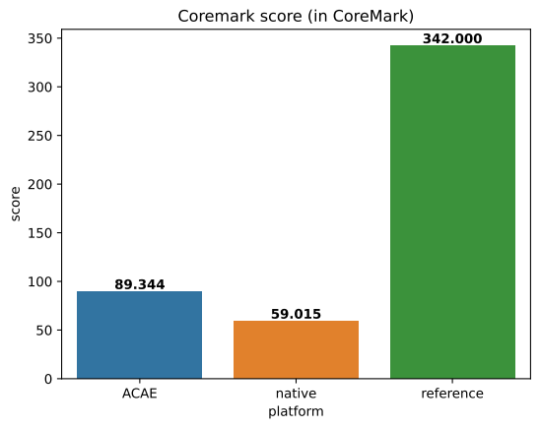
Results: CoreMark
at highest iteration count
ACAE overestimates performance by 51.4%
vendor reference deviates drastically

