Slide 1
Conway’s “Game of Life”
Made by:
Tokarev M.K.
Kuchenkov S.A.
Kozlovskaya K.V.

Slide 2
About the Project and Features
Introduction to the Game:
We are implementing John Conway's classic "Game of Life," a fascinating example of a cellular automaton where simple rules lead to complex emergent behavior.
Main Goal:
Our primary objective is to create a fully functional and interactive system that allows users to simulate the Game of Life.
Features:
Toroidal field: The game field wraps around.
Customizable rules: Users can change the rules for cell birth (born) and survival (survive).
Dynamic changes: Ability to change the state of field cells at any point during simulation.
Interactivity: Control via keyboard commands, output of messages and errors to the terminal.

Slide 3

Key Components and Technologies
Processor: CdM-16 based on von Neumann architecture.
Tools: Logisim (for hardware) and cdm-devkit (for software).
Input/Output: Keyboard for commands, terminal for display.
Logic and Display: Videobuffer for calculations, display (32x32) for visualization.

Slide 4
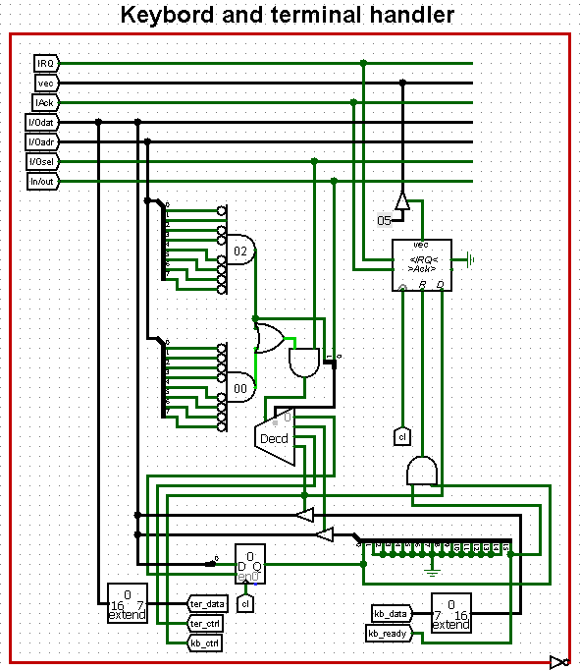
Hardware Part: Input/Output
Keyboard: Generates a character code upon key press. Signals kb_data (character) and kb_ready (ready) are sent to the handler.
Terminal: Displays entered characters and system messages.
Handler: Receives keyboard signals, manages interrupts (IRQ, vector 5), sends data to the I/Odat bus and the terminal.

Slide 5
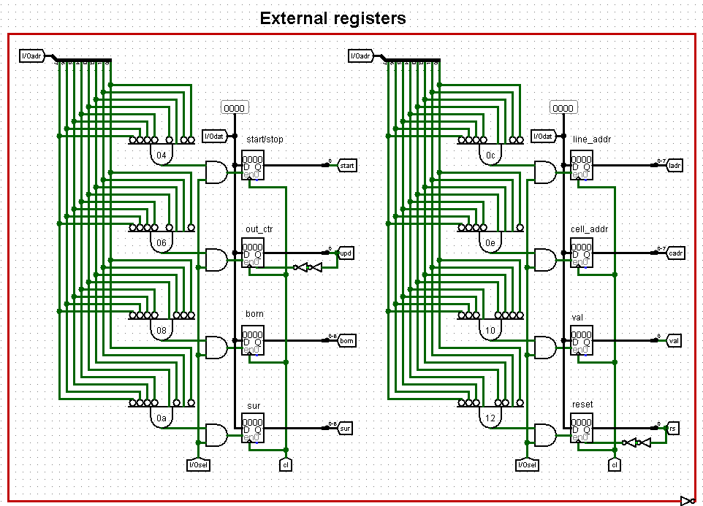
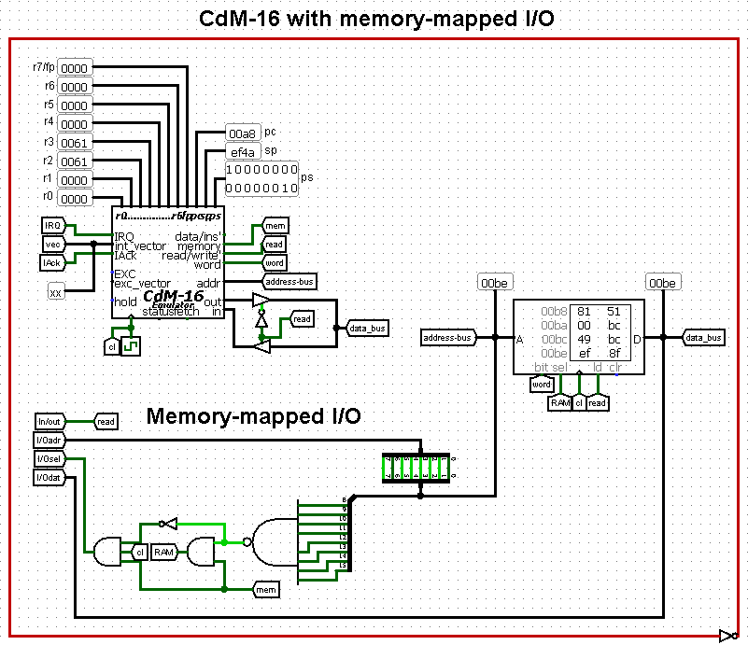
Hardware Part: Processing and Control
CdM-16 Processor: Manages data flow between the keyboard, terminal, and videobuffer via memory-mapped I/O.
External registers: Special memory addresses (0x04-0x12) for game control (start/stop, rules, cell updates, reset).
Videobuffer: Stores the current field state (32x32), calculates the next generation, and sends data to the display. Controlled by signals from external registers.

Slide 6
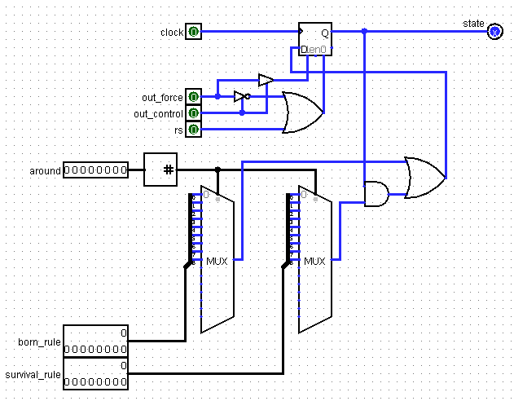
Hardware Part: Videobuffer and Cell Structure
"Line" Structure: The videobuffer consists of 32 "line" sub-circuits, each responsible for a field row. They exchange neighbor data (up/down).
"Cell" Structure: Each "line" contains 32 "cell" sub-circuits.
State Calculation: A "cell" determines its next state based on: Birth (born) and survival (survive) rules.

Slide 7
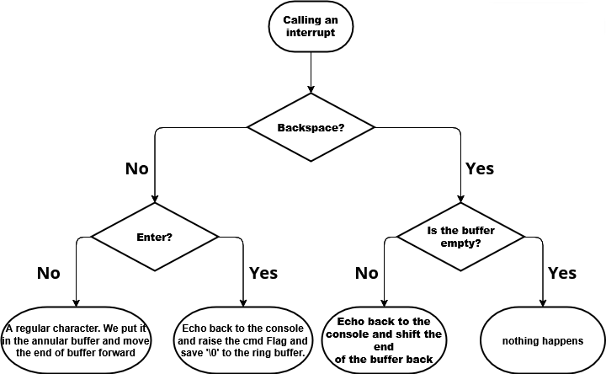
Software Part: Basics
KB_ISR scheme
Entry point (_start): Initializes the stack, enables keyboard interrupts (ISTATE flag), outputs the "> " prompt, and starts the main loop.
Main loop (_main): Constantly checks the cmdFlag. If the flag is set (command entered), calls the command parser.
Interrupt handler (_kb_isr): Activated on key press. Reads the character, handles Backspace and Enter, places characters in a circular buffer. Sets cmdFlag when Enter is pressed.

Slide 8
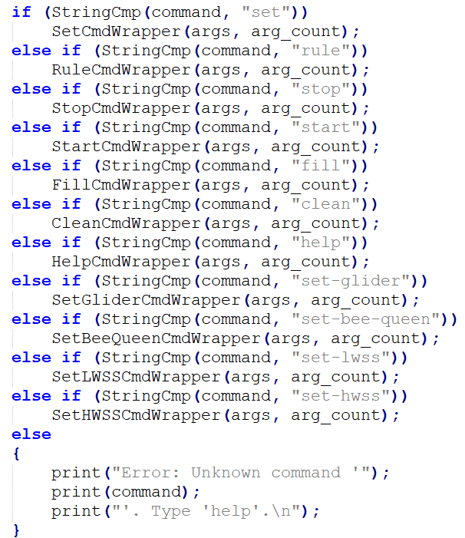
Software Part: Command Processing
Parsing (parser.c -> parse()): Reads the string from the circular buffer, extracts the command name and arguments.
Argument Parsing (parseArgs()): Splits the string into individual arguments by spaces.
Function Call: The command name is compared against a list of known commands. The corresponding handler function (Wrapper) is called.
Handlers: Check the correctness of the number and type of arguments (using my_atoi_safe), interact with the hardware via registers (memory-mapped I/O) to change the game state.

Slide 9



Thank You for listening

